Slide 1






EMPLOYEE DATA ANALYSIS PROJECT
Presentation by Rima Nandy

Slide 2





SYNOPSIS
Introduction
Problem Statement
Analysis
Dashboard
Conclusion

Slide 3

INTRODUCTION
The
Employee Data Analysis project conducted during
my Data Analysis Internship involved the utilization of various
tools such as Excel and PowerBI The project
aimed to analyze and interpret the company's employee data
to gain valuable insights and make informed business
decisions Through the analysis of employee demographics,
performance metrics, and Employee rates, the project sought
to identify patterns and trends that could enhance workforce
management strategies The data analysis techniques
employed provided comprehensive visualizations and
actionable recommendations for improving employee
productivity, engagement, and Performance This project also
showcases my proficiency in utilizing key data analysis tools
and demonstrates my ability to derive meaningful insights
from complex datasets to drive informed decision making in
an organizational context

Slide 4
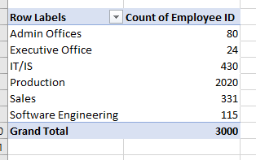

1. Can you create a pivot table to summarize the total number of employees in each
department?

Slide 5
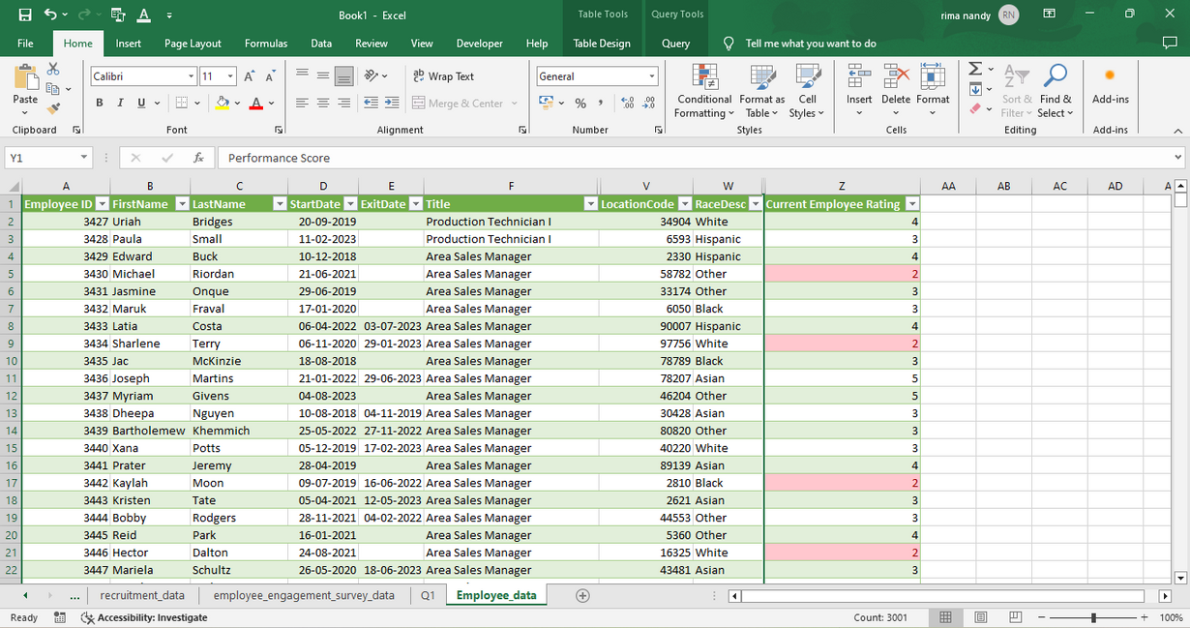
2. Apply conditional formatting to highlight employees with a "Performance Score"
below 3 in red?

Slide 6

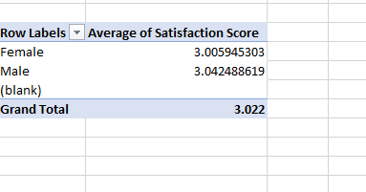
3. Calculate the average "Satisfaction Score" for male and female employees
separately using a pivot table.

Slide 7
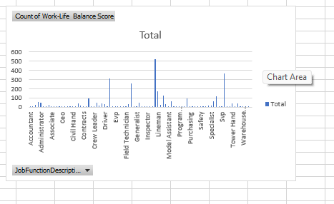

. 4.Create a chart to visualize the distribution of "Work Life Balance Score" for
different job functions.

Slide 8

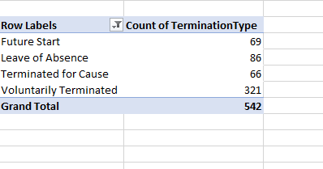
5. Filter the data to display only terminated employees and find out the most common "Termination Type."
The most common termination type is Voluntarily Terminated.

Slide 9

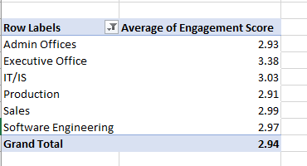
6. Calculate the average "Engagement Score" for each department using a pivot table.

Slide 10
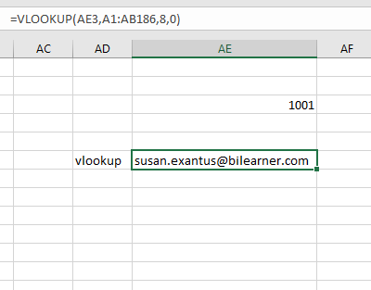
7. Use VLOOKUP to find the supervisor's email address for a specific employee.
The supervisor email address for employee 1001 was found tusing VLOOKUP.

Slide 11
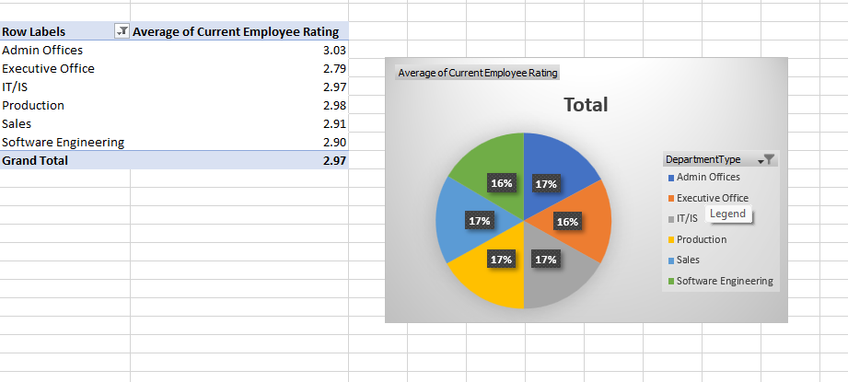
8. Can you identify the department with the highest average "Employee Rating?"
The admin department has the highest Employee Rating.

Slide 12
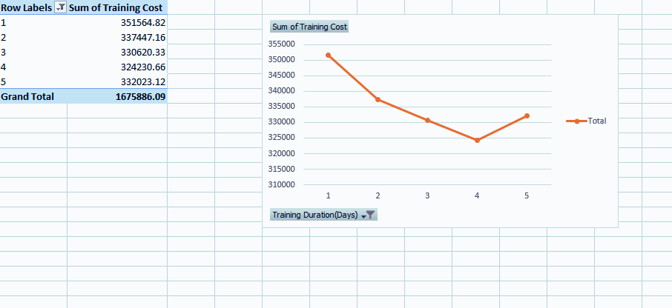
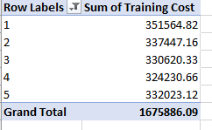
9. Create a scatter plot to explore the relationship between "Training Duration
(Days)" and "Training Cost."

Slide 13

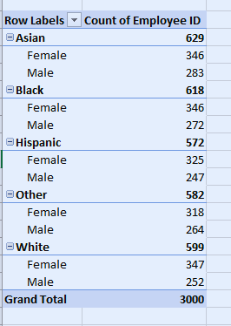
10. Build a pivot table that shows the count of employees by "RaceDesc" and
"GenderCode."

Slide 14

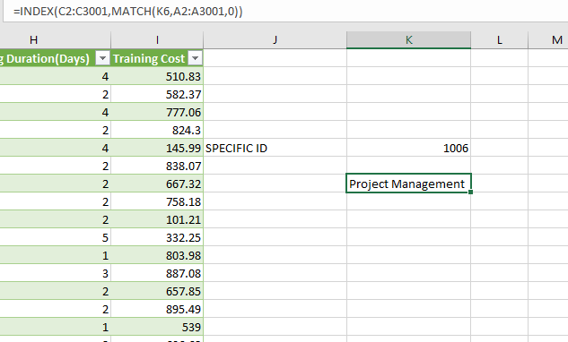
11. Use INDEX and MATCH functions to find the "Training Program Name" for an
employee with a specific ID.
The index and match function was used to find the Training program name of employee ID 1006.

Slide 15
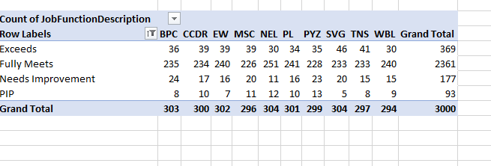
12. Create a multi-level pivot table to analyze the "Performance Score" by "BusinessUnit" and "JobFunctionDescription."

Slide 16
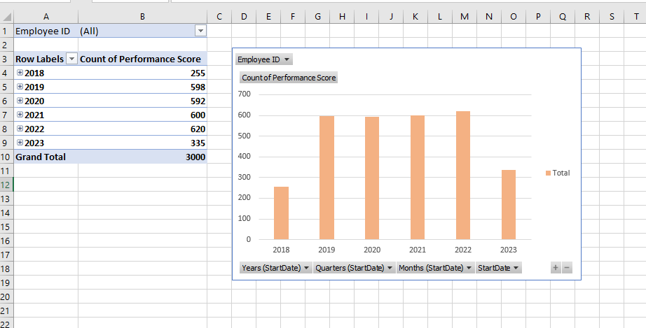
13. Design a dynamic chart that allows users to select and visualize the performance of
any employee over time.

Slide 17
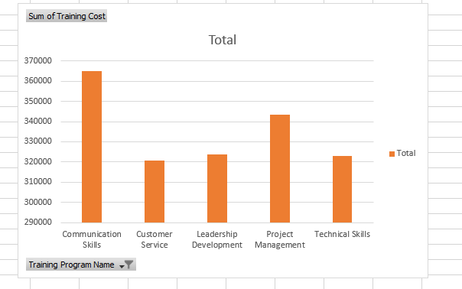
14. Calculate the total training cost for each "Training Program Name" and display it in
a bar chart

Slide 18
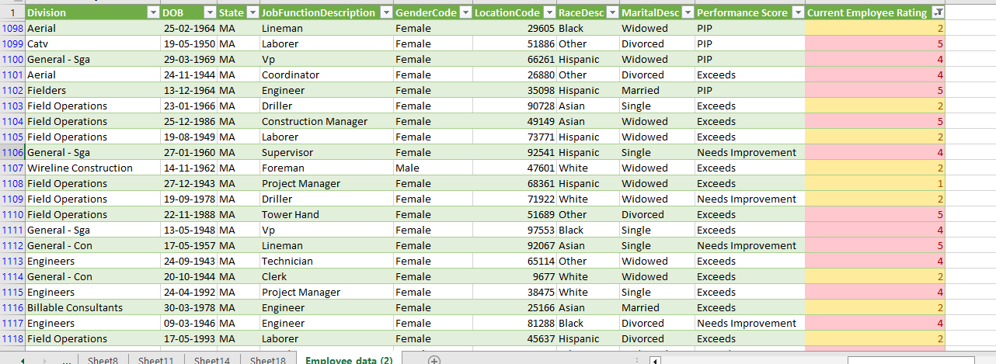
15. Apply advanced conditional formatting to highlight the top 10% and bottom 10%
of employees based on "Current Employee Rating."

Slide 19
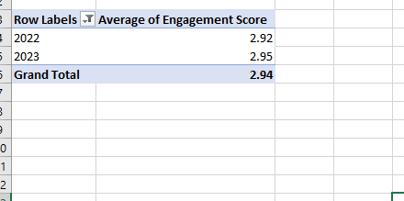
16. Use a calculated field in a pivot table to determine the average "Engagement
Score" per year.

Slide 20
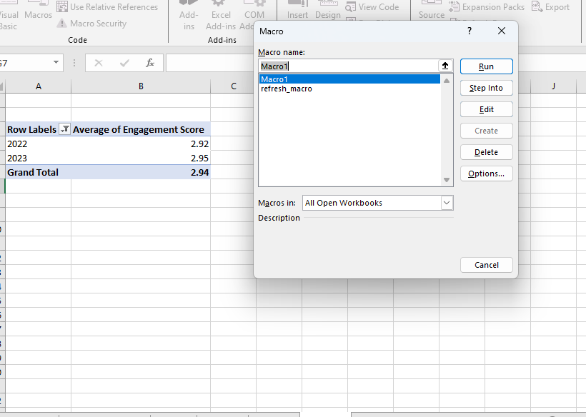
17. Can you build a macro that automates the process of updating and refreshing all pivot tables in the workbook?

Slide 21
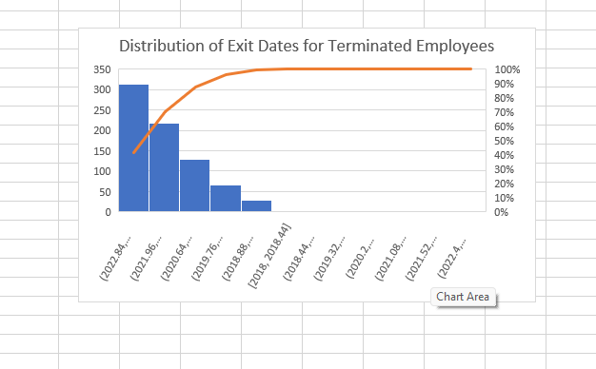
18. Create a histogram to understand the distribution of "ExitDate" for terminated employees.

Slide 22
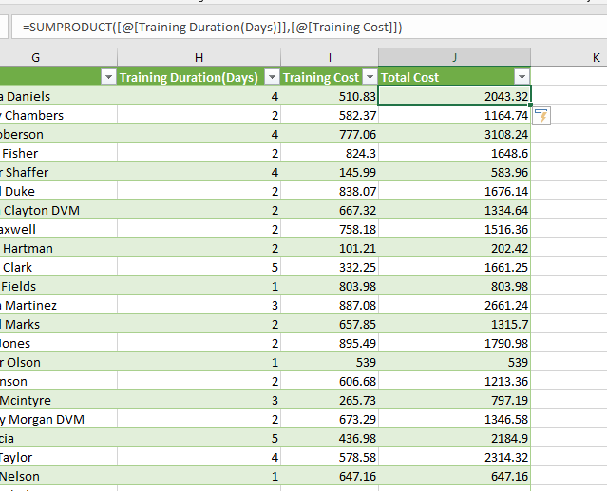
19. Utilize the SUMPRODUCT function to calculate the total training cost for
employees in a specific location.

Slide 23
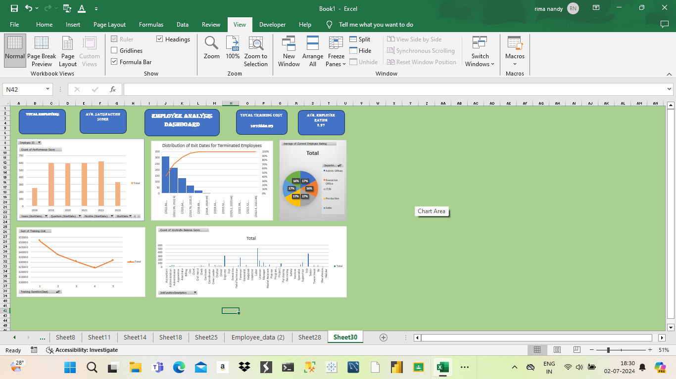
20. Develop a dashboard that provides an overview of key HR metrics, including headcount, performance, and training costs, using charts and pivot tables.

Slide 24
THANK YOU

