Slide 1










DIABETES PREDICTION ANALYSIS PROJECT
BY RIMA NANDY

Slide 2

INTRODUCTION
As
a data analyst intern in Psyliq, I worked on
a project that aimed to analyze the Diabetes
Database using SQL. The goal was to
create a report that could provide insights into the
data and help identify patterns and correlation
between Diabetes and other health conditions. The
project report provides a detailed analysis of the
data and the methodology used to create the report. Overall,
the project was successful in creating an
interpretable report that provides valuable insides
into the data.

Slide 3
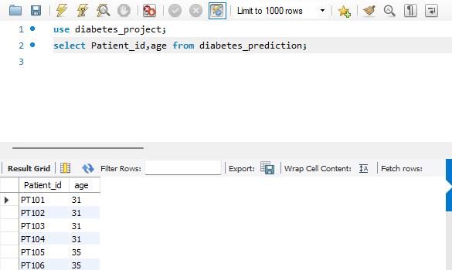
Q1. Retrieve the Patient_id and ages of all patients.

Slide 4


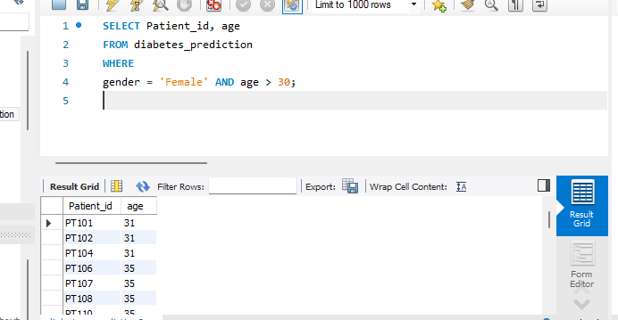
Q2. Select all female patients who are older than 30.

Slide 5


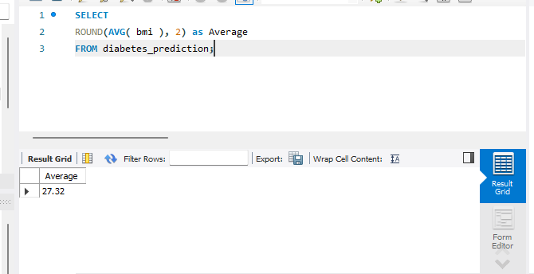
Q3. Calculate the average BMI of patients.

Slide 6
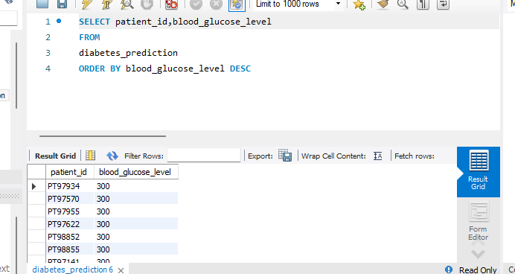


Q4. List patients in descending order of blood glucose levels.

Slide 7

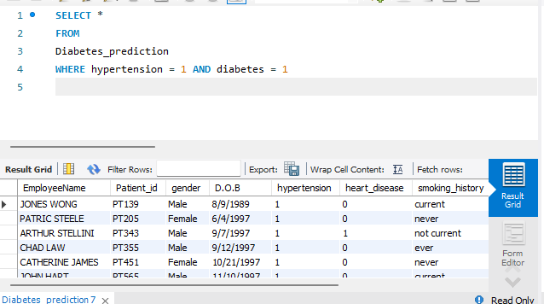
Q5. Find patients who have hypertension and diabetes

Slide 8

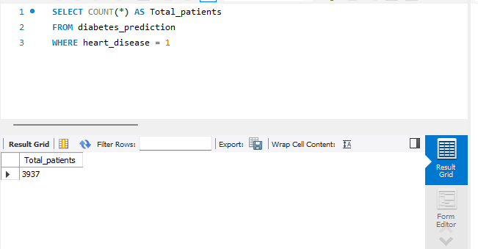

Q6. Determine the number of patients with heart disease.

Slide 9
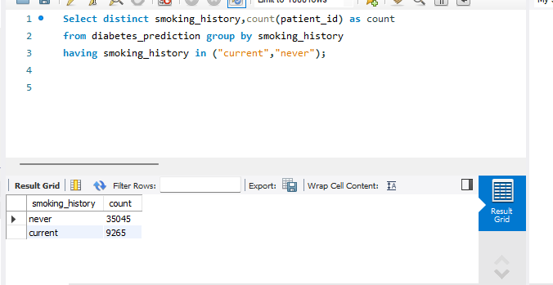

Q7. Group patients by smoking history and count how many smokers and non- smokers there are.

Slide 10

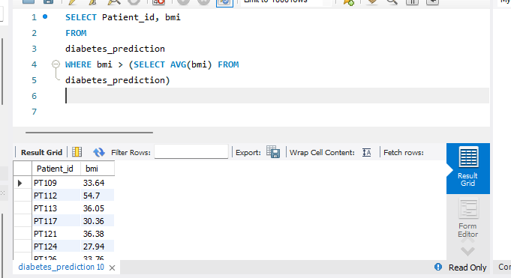

Q8. Retrieve the Patient_id of patients who have a BMI greater than the average BMI.

Slide 11

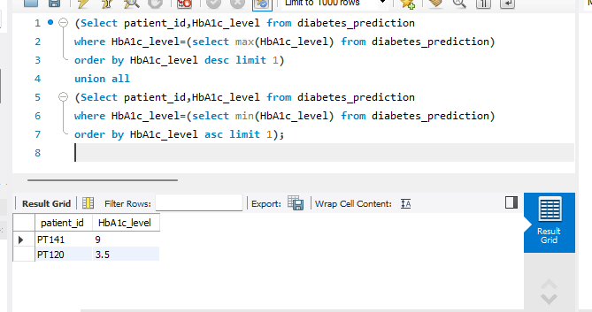
Q9. Find the patient with the highest HbA1c level and the patient with the lowest HbA1clevel.

Slide 12
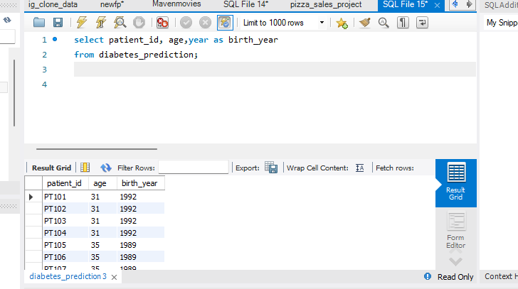
Q10. Calculate the age of patients in years (assuming the current date as of now)

Slide 13

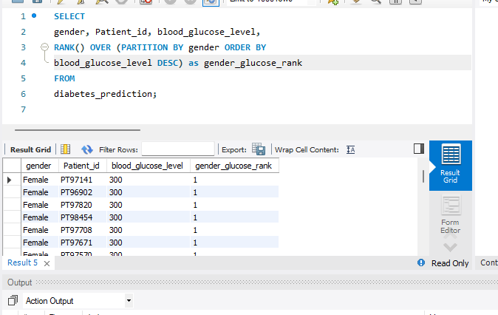


Q11. Rank patients by blood glucose level within each gender group.

Slide 14

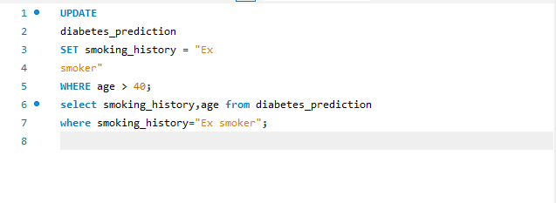

Q12. Update the smoking history of patients who are older than 40 to "Ex-smoker."

Slide 15
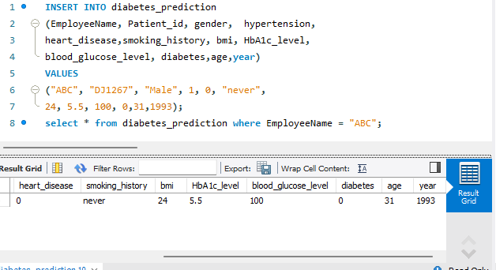
Q13. Insert a new patient into the database with sample data.

Slide 16
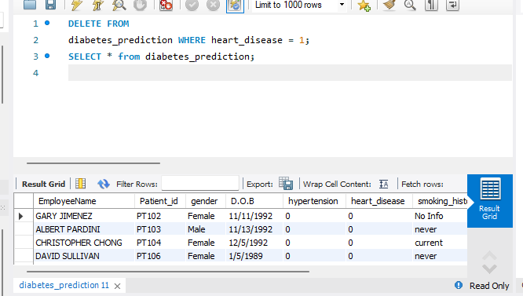
Q14. Delete all patients with heart disease from the database.

Slide 17
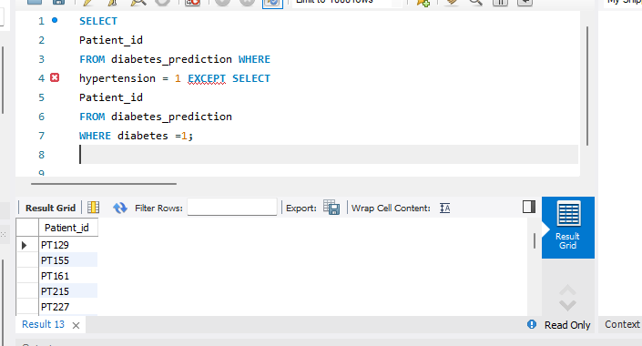
Q15. Find patients who have hypertension but not diabetes using the EXCEPT operator

Slide 18
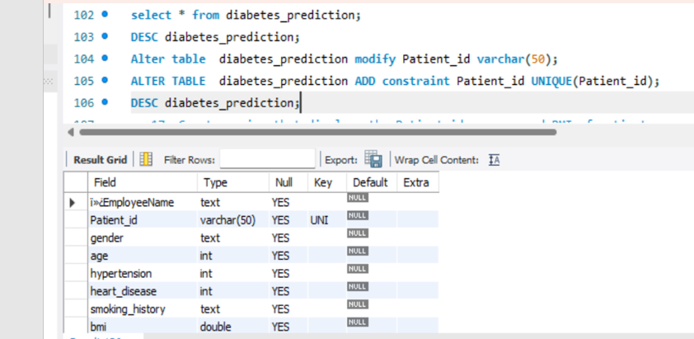
Q16. Define a unique constraint on the "patient_id" column to ensure its values are unique.

Slide 19
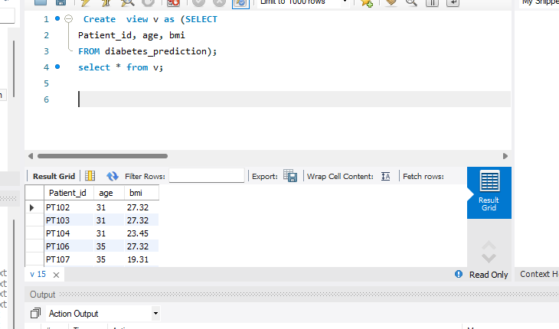
Q17. Create a view that displays the Patient_ids, ages, and BMI of patients.

Slide 20
Q18. Suggest improvements in the database schema to reduce data redundancy and improve data integrity.
To reduce data redundancy and improve data integrity in a database schema, we can consider the following best practices:
Normalization:
Apply normalization techniques to eliminate redundancy and dependency issues. This involves breaking down tables into smaller, related tables to reduce data duplication.Ensure data is stored at the most granular level possible and relationships between entities are properly represented.
Use Primary and Foreign Keys:
Define primary keys for each table to uniquely identify each record.
Establish foreign key relationships between tables to ensure referential integrity.
Data Types:
Choose appropriate data types for each column. This not only improves data integrity but also saves storage space.
Ensure Constraints:
Implement constraints such as NOT NULL, UNIQUE, and CHECK constraints to maintain data integrity.
Use triggers or stored procedures to enforce complex business rules
Indexes:
Use indexes wisely to improve query performance. However, avoid creating too many indexes, as they can impact write performance.

Slide 21
Q19. Explain how you can optimize the performance of SQL queries on this dataset.
Use Indexing:
Proper indexing can significantly improve query performance. Identify columns frequently used in WHERE clauses, JOIN conditions, and ORDER BY clauses, and create indexes on those columns. However, avoid over-indexing, as it can impact write performance.
Optimize JOIN Operations:
Use appropriate JOIN types (INNER JOIN, LEFT JOIN, etc.) based on the relationships between tables. Ensure that join columns are indexed. Consider denormalization for read-heavy queries if normalization causes performance issues.
Write Efficient Queries:
Use aggregate functions judiciously and consider using the GROUP BY clause only when necessary.
Limit the Result Set:
Use the LIMIT clause to restrict the number of rows returned, especially for large datasets.
Use pagination techniques to retrieve a subset of data at a time.
Avoid SELECT DISTINCT:
Use SELECT DISTINCT sparingly, as it can be resource-intensive. Consider if there are alternative ways to achieve the desired results without using DISTINCT.
Write queries that retrieve only the necessary columns and rows. Avoid using SELECT * if you don't need all columns

Slide 22
THANK YOU!

