Slide 1



HR DATA ANALYSIS PROJECT
Presentation by Rima Nandy

Slide 2

INTRODUCTION
In this project, we aim to analyze and gain insights from a comprehensive dataset encompassing various aspects of employee demographics, job roles, satisfaction levels, and performance metrics. By leveraging tools like Power BI and Excel, we seek to uncover patterns, trends, and correlations within the data to inform strategic decision-making and optimize organizational effectiveness. From examining factors influencing employee attrition to understanding the impact of salary adjustments on income, our analysis endeavors to provide actionable insights that drive workforce management, improve employee satisfaction, and enhance overall business performance. Through thorough examination of the dataset and application of advanced analytical techniques, we aim to deliver valuable insights that empower stakeholders to make informed decisions and foster a thriving work environment.

Slide 3
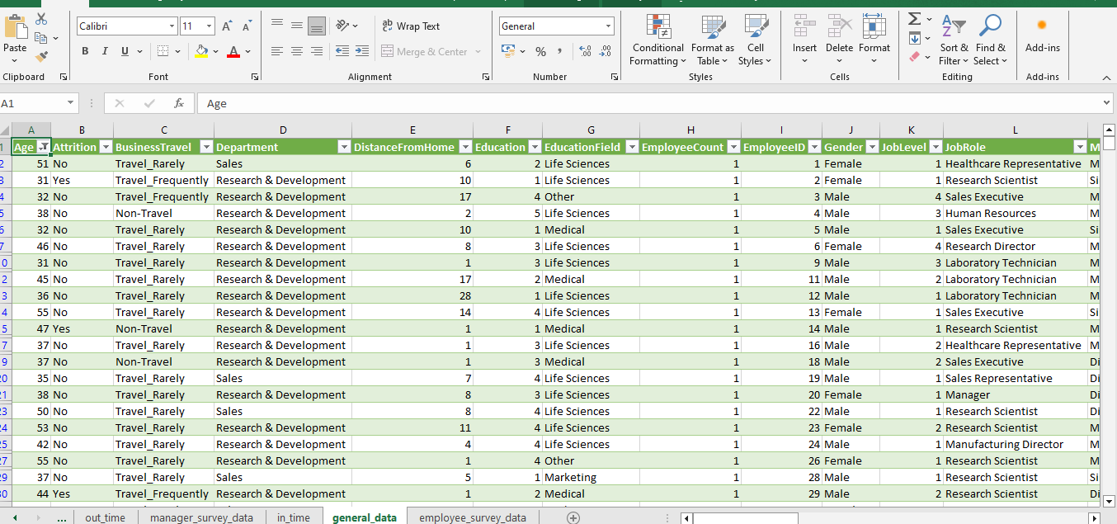
1. Using Excel, how would you filter the dataset to only show employees aged 30 and above?

Slide 4

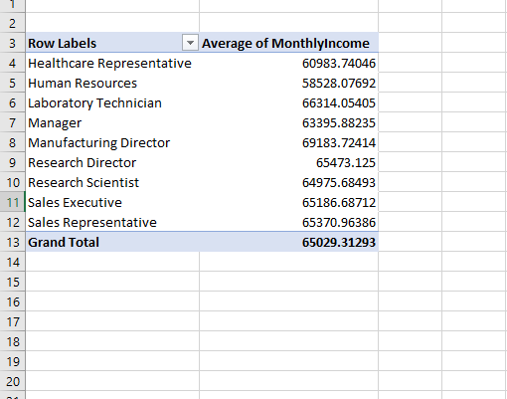
2. Create a pivot table to summarize the average Monthly Income by Job Role.

Slide 5

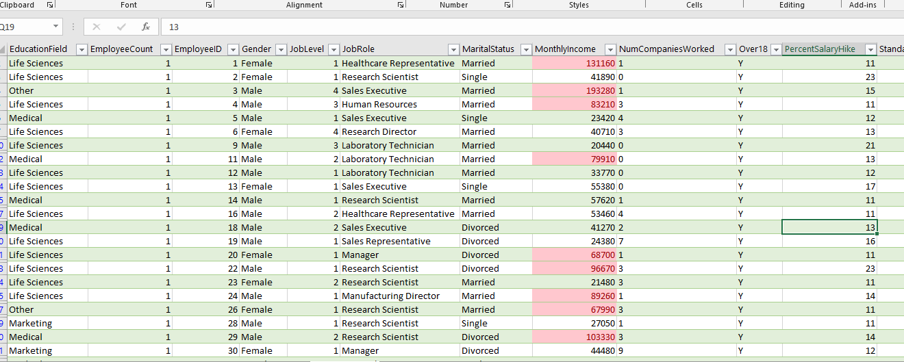
3. Apply conditional formatting to highlight employees with Monthly Income above the company's average income.

Slide 6

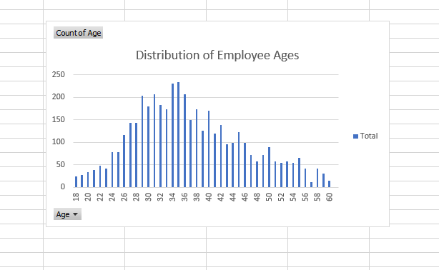
4. Create a bar chart in Excel to visualize the distribution of employee ages.

Slide 7
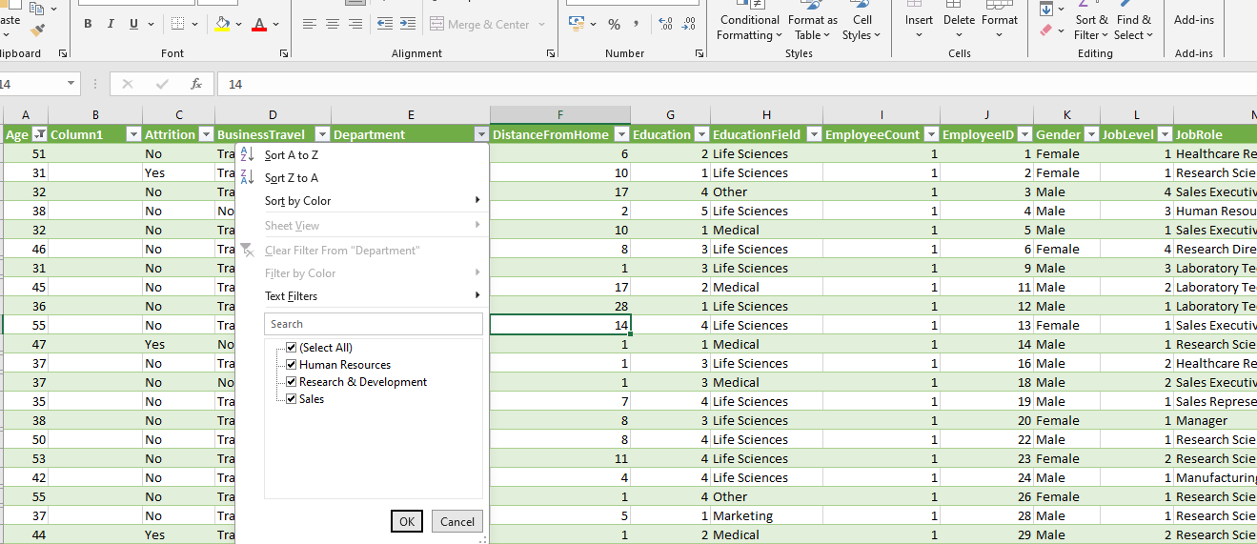

5.Identify and clean any missing or inconsistent data in the "Department" column
No missing data was found in the department column.

Slide 8
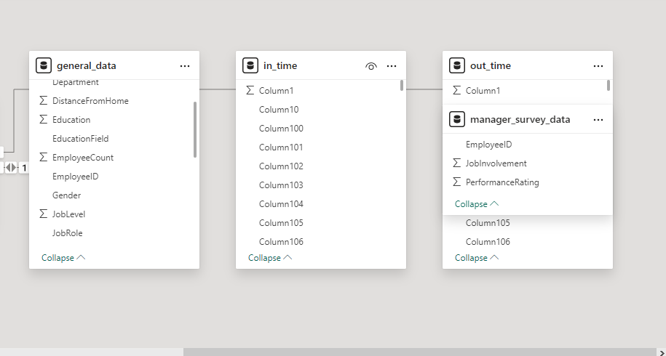

6. In Power BI, establish a relationship between the "EmployeeID" in the employee data and the "EmployeeID" in the time tracking data.

Slide 9
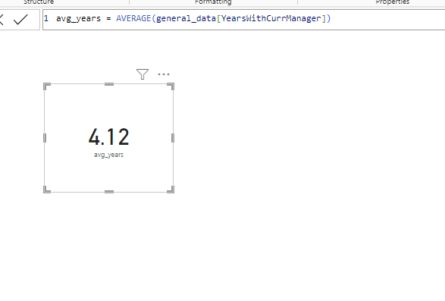

7. Using DAX, create a calculated column that calculates the average years an employee has spent with their current manager.

Slide 10
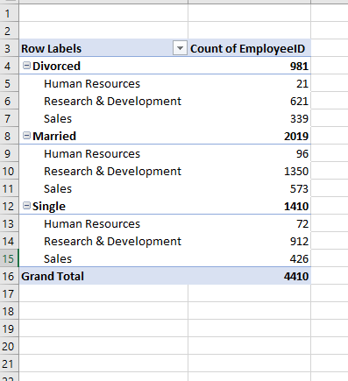
8. USING EXCEL, CREATE A PIVOT TABLE THAT DISPLAYS THE COUNT OF EMPLOYEES IN EACH MARITAL STATUS CATEGORY, SEGMENTED BY DEPARTMENT.

Slide 11

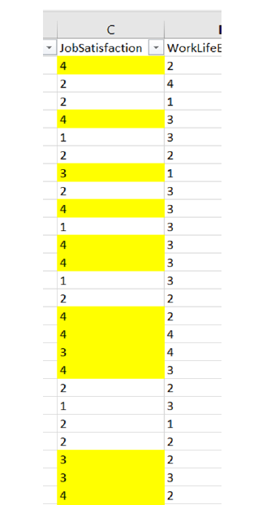
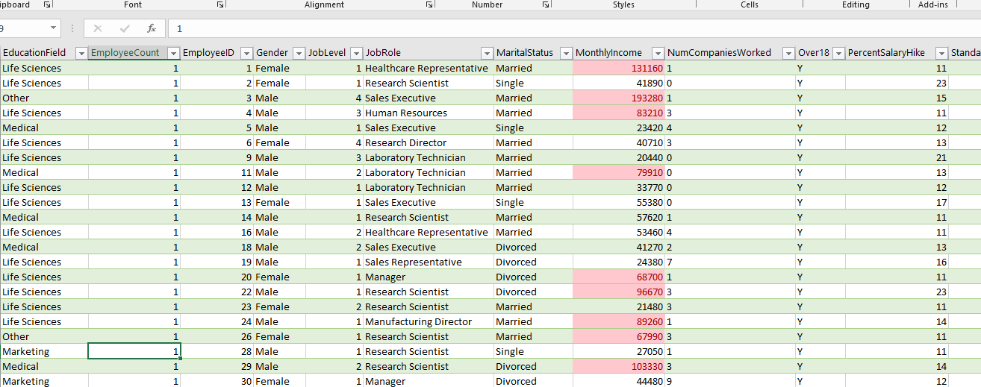
9. APPLY CONDITIONAL FORMATTING TO HIGHLIGHT EMPLOYEES WITH BOTH ABOVE-AVERAGE MONTHLY INCOME AND ABOVE-AVERAGE JOB SATISFACTION.

Slide 12
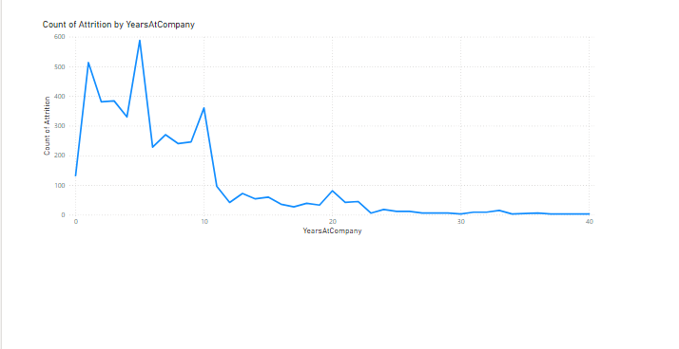
10. In Power BI, create a line chart that visualizes the trend of Employee Attrition over the years.

Slide 13
11. Describe how you would create a star schema for this dataset, explaining the benefits of doing so.
•
Scalability: Star schemas are scalable and flexible, allowing for the addition of new dimensions or facts without disrupting the existing structure
•
Normalized Data: While fact tables contain numerical data for analysis, dimension tables can be normalized to reduce data redundancy. This normalization ensures consistency and reduces the risk of data anomalies.
The star schema offers several benefits for organizing and querying data in a data warehouse or relational database:
•
Simplified Querying: Star schemas simplify the querying process by reducing the number of joins required.
•
Enhanced Performance: The structure of a star schema often leads to improved query performance. The database engine can efficiently process queries involving the fact table and its related dimensions due to the clear and optimized relationships.
•
Improved Readability: Users can easily understand the relationships between the central fact table and dimension tables, making it more accessible for analysts and report developers.

Slide 14
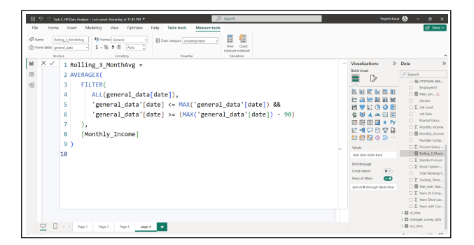
12. Using DAX, calculate the rolling 3-month average of Monthly Income for each employee

Slide 15
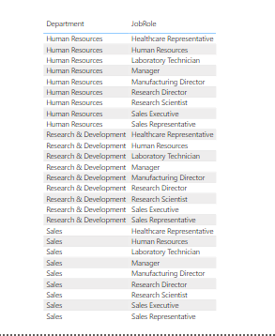
13. Create a hierarchy in Power BI that allows users to drill down from Department to Job Role to further narrow their analysis.

Slide 16
14. How can you set up parameterized queries in Power BI to allow users to filter data based
on the Distance from Home column?
In Power BI, set up parameterized queries by creating a parameter for the Distance from Home column.
Go to "Home" and select "Manage Parameters" to define a new parameter, let's call it "DistanceParameter."
Apply this parameter in the Power Query Editor to replace the hardcoded distance filter with the parameter. For example, in your query, use each [DistanceFromHome] = DistanceParameter.
Now, users can dynamically filter data based on Distance from Home by adjusting the parameter value in the Manage Parameters window, providing a flexible way to interact with the report.

Slide 17
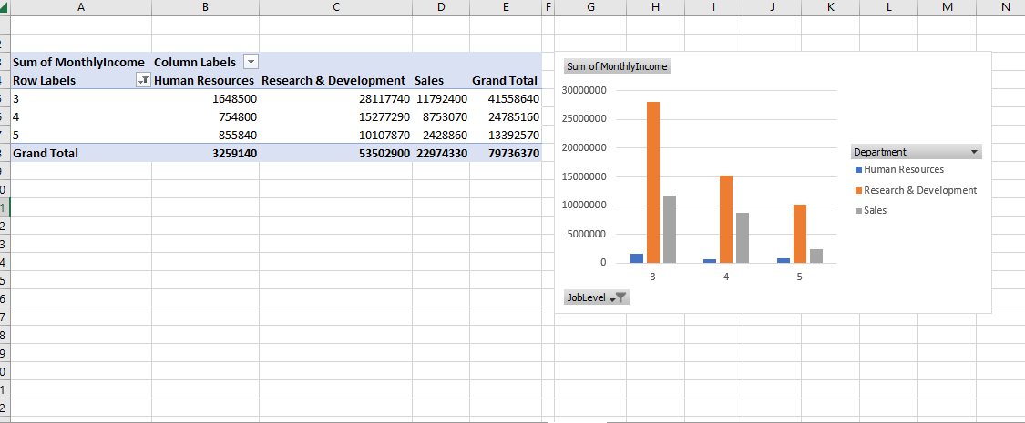
15. In Excel, calculate the total Monthly Income for each Department, considering only the employees with a Job Level greater than or equal to 3.

Slide 18
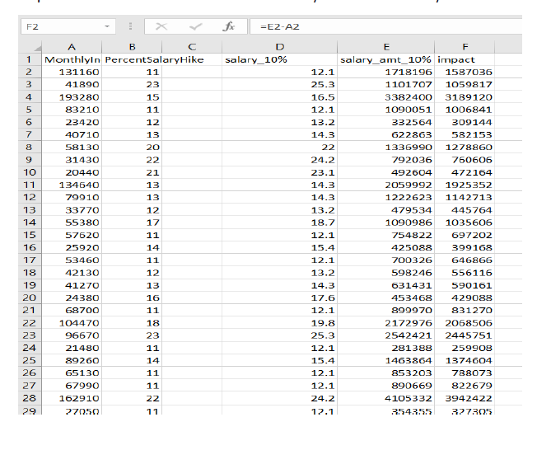
16. Explain how to perform a What-If analysis in Excel to understand the impact of a 10% increase in Percent Salary Hike on Monthly Income.
What-If Analysis is the process of changing the values in cells to see how those changes will affect the outcome of formulas on the worksheet.

Slide 19
17. Verify if the data adheres to a predefined schema. What actions would you take if you find inconsistencies?
•
Review the data to find any fields, values, or formats that deviate from the predefined schema.
•
Document the inconsistencies, noting the specific fields or records that don't adhere to the expected schema.
•
Understand the reasons behind the inconsistencies. It could be data entry errors, system issues, or changes in source systems.
•
Set up validation rules to prevent future inconsistencies. This ensures that new data entering the system conforms to the defined schema.
•
Implement ongoing monitoring processes to catch and rectify inconsistencies early on, maintaining data quality over time.
•
Update documentation to reflect any changes made to the schema or validation rules.
•
Establish a continuous improvement process to regularly review and enhance data quality measures.

Slide 20
THANK YOU!

