Slide 1
DENYING THE DENIAL - SECURING 6LOWPAN AGAINST DOS
1
MITIGATION STRATEGIES TO MINIMIZE VULNERABILITIES IN IOT 802.15.4 PROTOCOL STACK
Abhishek Mishra
2016BSY7508
MSR Project under Dr. Abhishek Dixit

Slide 2
The vulnerable 6LoWPAN
2
6LoWPAN – IPv6 over low power wireless personal area network
Simply understood as Network Layer in IoT proposed by IEEE
Current recommended protocol stack is IEEE 802.15.4 (A ZigBee parallel)
Vulnerabilities and Research challenges:
Lack of IPsec, IKE adoption for Internet of Things
Key sharing mechanisms have not been tested and optimally proven
Time synchronisation, Trusted authority challenges in implementation
Dynamic authentication and absence of suitable lightweight hash algorithms
The nuisance of Mirai botnet attack – Massive DDoS takedown of 2016

Slide 3
DoS – The nightmare bottleneck for IoT
3
Denial of service is a great troublemaker even for the devices running on power and able processors
Currently we have no proper solutions that can be easily adopted to develop systems invulnerable to botnet attacks like Mirai attack.
Some experts claim complete eradication of Denial of service is not possible.
Reasons being the lack of any mechanism for correct identification. IP, MAC, Device IDs are spoof-able, no VPN mechanism for SSL verification.
Hackers are aware of every algorithm, technology-in-use and the accompanying vulnerabilities.
If a company ignores DoS or any other security vulnerability and goes ahead with a billion dollar project, one advertised attack can put the project back to where it came from leaving the company with loss of reputation and money.

Slide 4
Denying the denial, Possible?
4
There have been solutions built by using 25 years+ of security engineering.
None come without sacrificing throughput, power-friendliness or computational efficiencies. (Essentially kicking Internet of Things applicability).
But let’s be adamant about solving it
How much time do we need to reject one packet?
Total delay in rejection = T(receive packet) + T(decrypt the packet) + T(weak identification attempt) + T(delete packet)
Add computation required for each packet and associated power consumed in these operations, even after that we can’t guarantee nothing went in unnoticed.
Performance compromises so high that market keeps on adding insecure IoT applications praying bad things don’t happen to them.

Slide 5
Make a Wish
5
If only we could reject packets really cheap
Total = T(Receive 16 bytes) + T(compare 16 bytes hash) + T(reject and delete the packet)
With a mechanism to reject a packet in just 16 bytes we can do it.
But only if you can answer these questions optimally
What hash algorithm shall we use? Is it..
Lightweight, just 16 bytes and still safe against 1st pre-image, 2nd pre-image, collision attacks
Is ready for implementation, has gone through tests for power-processor-memory needs?
This hash changes every time, updating hash is easy and only privy to legitimate devices
Info from which hash is to created is confidentially shareable while allowing demands of a practical system in needs

Slide 6
Literature Survey
Being optimistic – seeking the answers
6
The conducted literature survey covers –
Have there been any solutions proposed like this already?
Remote similarity exists in a conference paper[1] where 16 bit PRFn pseudo random number used for identification – Not practical and doesn’t satisfy the needs of the system.
The candidates for lightweight hash algorithm – Spongeon, Quark, Photon, Keccak – power-processor-memory test comparisons
Problems solved on own
Secure distribution of secret info for hash algorithm
Easily update-able hash with lesser iterations
Installation, multiple access and mode-wise operation simulation for a Proof-of-concept (Using a minimalist network simulation)

Slide 7
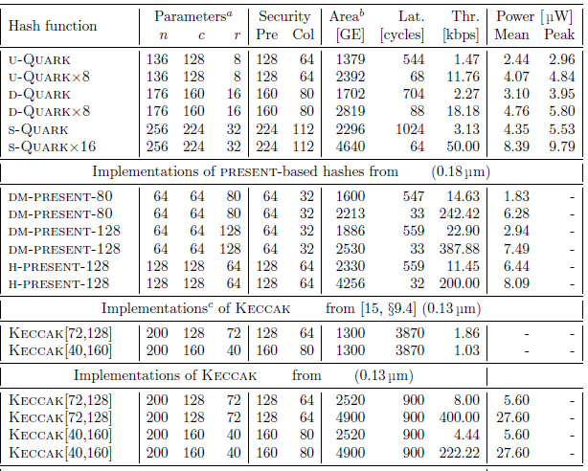
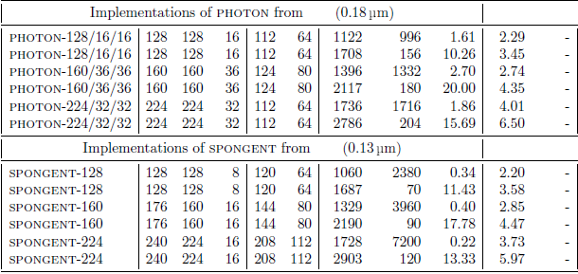
Are your candidates lightweight?
7
Reference of data for Tables [2]
a - For the non-sponge present-based functions, n, c, r are respectively the lengths of a digest, internal state
and message block.
b - For Quark implementations, one GE is the area of a 2-input drive-one NAND gate, i.e., in the target
0.18 µm technology, 9.3744 µm²
c - These implementations use external memory to store the internal state.

Slide 8
Smart-Home Scenario
Testing implementation in a practical model
8
PAN consists of 1 master device and n slave devices
All slave devices send/receive to/from master device only and refuse any other request
Slave’s identity should not be spoof-able. Only trusted devices should be admitted in installation.
Modes of operation
Master: Install (Registration mode), Master mode, Alert mode
Slave: Sleep mode (No packet requested from master), Active mode (Installation / packet sending)
Alert mode – A response mode after Intrusion detection
Install (register mode) – Performs registration at the beginning of each cycle (Polling used)
Master mode – Polls each device sequentially for response, devices not supposed to send packets otherwise

Slide 9
ALGORITHMS FOR REGISTER/MASTER MODE
9
IF MASTER MODE
1. Contacting Device $i
2. Connection successful || Failed to connect, Device $i not in range
3. Receiving Data || Waiting to receive response from device $i
4. Data successfully received || Couldn't receive data from $i, aborting
IF REGISTER MODE
1. Sending beacon, registration cycle started
2. Device has contacted
3. Initiation verification of packet
4. Displaying device info, please authenticate
5. DISPLAY DEVICE INFO

Slide 10
Distribution of hash and secret ID
10
Let F_{H} be the hash algorithm
Packet ----16 bytes 0000 || ECC encrypted packet, encryption key – Public key of master device
For sending a registration request fill 16 bytes space with zeros, any other form of request is immediately rejected. ECC stands for Elliptic curve cryptography
The payload contains slave device info, public key of slave device which the master device verifies over from a trusted authority.
Master device generates F_{H} = H(slave info, sequence = 1, ID allotted by master)
If the device is verified it is sent back a packet 16 bytes 0000 || E_{pub_key_slave} (Info sent by slave|| ID allotted || F_{H})
In master mode, whenever slave device is polled, slave sends
F_{H} || E_{pub_key_master} (payload)
Subsequent F_{H} is updated by adding seq(n) = seq(n-1) + 1 and rotating ID by n bytes, this saves the system from replay attacks and improves first image, second image and collision security in hash.
Master device generates hash for corresponding device and compares, accepts the packet and decrypts only when hash matches else rejects and saves time in decryption and header verification thus saving time in rejection of packet.

Slide 11
Pros / Con Analysis
11
Confident that:
Implementable with currently existing infrastructure
ECC used hence lightweight encryption/decryption instead of AES as proposed in 6LoWPAN
Secured packet replay, fragmentation, overflow and denial of service vulnerabilities
Hash generation done with lightweight hashes and using different input every time gives One-Time pad security.
Rejects packet in much lesser time than former deep packet inspection mechanism. Don’t inspect the packet if you can’t trust it.
To be worked upon:
Claims need to be verified by extensive tests for different classes of power-processor-memory
Currently the system is secure for intra-PAN only and no measures taken for inter-PAN communication.
Models like vehicular IoT where presence of VeriSign authority is not there and response needed in real-time this system doesn’t offer any solution.

Slide 12
References
12
1. Khan, M. A., & Hasan, A. (2008, May). Pseudo random number based authentication to counter denial of service attacks on 802.11. In Wireless and Optical Communications Networks, 2008. WOCN'08. 5th IFIP International Conference on (pp. 1-5). IEEE
2. J.-P. Aumasson, “Quark: A lightweight hash,” International Workshop on Cryptographic Hardware and Embedded Systems.
Toreskaas, Jonas. "ECC vs. RSA." (2015).
Notes:
12

