Slide 1

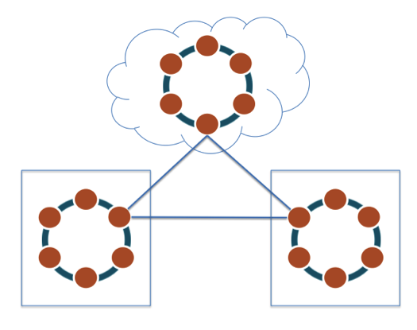
Group - 3
Cassandra
Presented by
Rimi Reza Duity - 21166043
Shovon Paulinus Rozario - 21166036

Slide 2
NoSQL Database
Zero downtime
No single point of failure
Cassandra
Distributed Database
Masterless peer-to-peer mechanism
High throughput

Slide 3
Google - Bigtable
Facebook => Apache
Cassandra
Amazon - Dynamo

Slide 4
A
Cassandra & CAP
MySQL
Cassandra
PostgreSQL
Typically classified as AP system
Can be tuned with replication factor and consistency level to also meet C
Riak
C
P
MongoDB
Redis

Slide 5
What problem does it solve?
Cassandra

Slide 6


Regular Databases
Not dynamically scalable
Requires downtime to spec up
Performance hit with increase in throughput

Slide 7
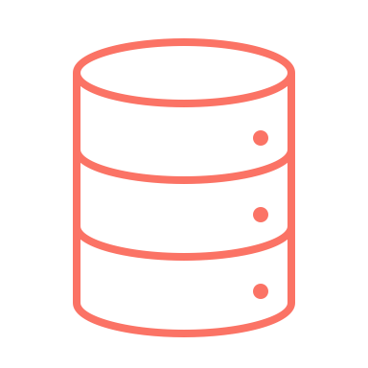
Improve Performance with
Master – Read Replica Setup
Write data into master
Data gets replicated to the read replicas
Read data from one of the replicas
Read Data
Read Data
Write Data
What if there are more writes?
Read Replica
Master
Read Replica
What if the master DB dies?

Slide 8
Cassandra
Dynamically scalable
Nodes are all considered as Master
Better Fault-tolerance

Slide 9
Rack
Replication
Node
Token
Terminologies
Data center
Cassandra
Cluster
Virtual Node
Tunable consistency

Slide 10
Cluster
A collection of nodes that represents a single system
Data center
Contains multiple stacks of servers
Rack
A unit that contains multiple servers stacked together
Node
A single database server
Virtual Node
Virtual instance(s) within a server

Slide 11
Token
A mechanism Cassandra uses to know on where the data resides
A token is a hashed value of the partition key
Each node contains data having token range between 2⁻⁶³ to 2⁶³
A Cassandra cluster is visualised as a ring because
it uses a consistent hashing algorithm to distribute data

Slide 12
Replication Strategies
Data replication strategy can be designed according to needs
Simple Strategy: Data replicated within the same data centre
Network Topology Strategy: Data replicated within
multiple data centres
Replication Factor: Number of replication copies
Replication Factor: 2
Notes:
https://app.pluralsight.com/course-player?clipId=055f072d-f5cb-48eb-b224-dad37ce2f844

Slide 13
Tunable Consistency
By default data in Cassandra become consistent eventually
But the consistency can be tuned to it’s need

Slide 14
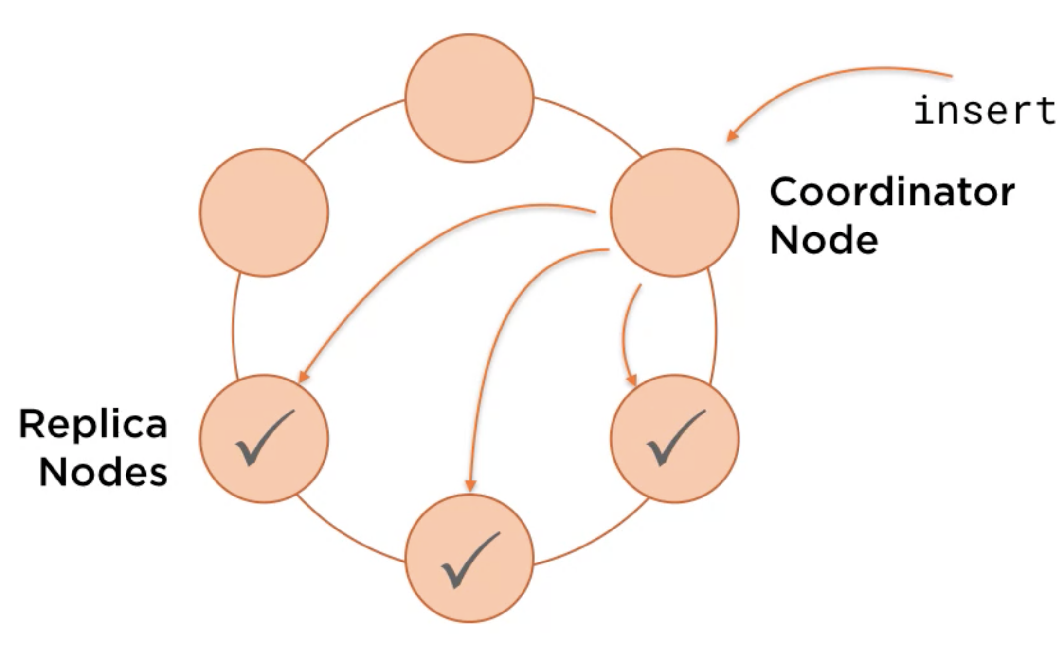
Tunable Consistency for Write
With Replication Factor 3
Number of replication acknowledgement required
before successful response is returned can be set
One: require acknowledgement from 1 node
Two: require acknowledgement from 1 node
.
.
.
Quorum: require acknowledgement from majority nodes
All: : require acknowledgement from all nodes

Slide 15
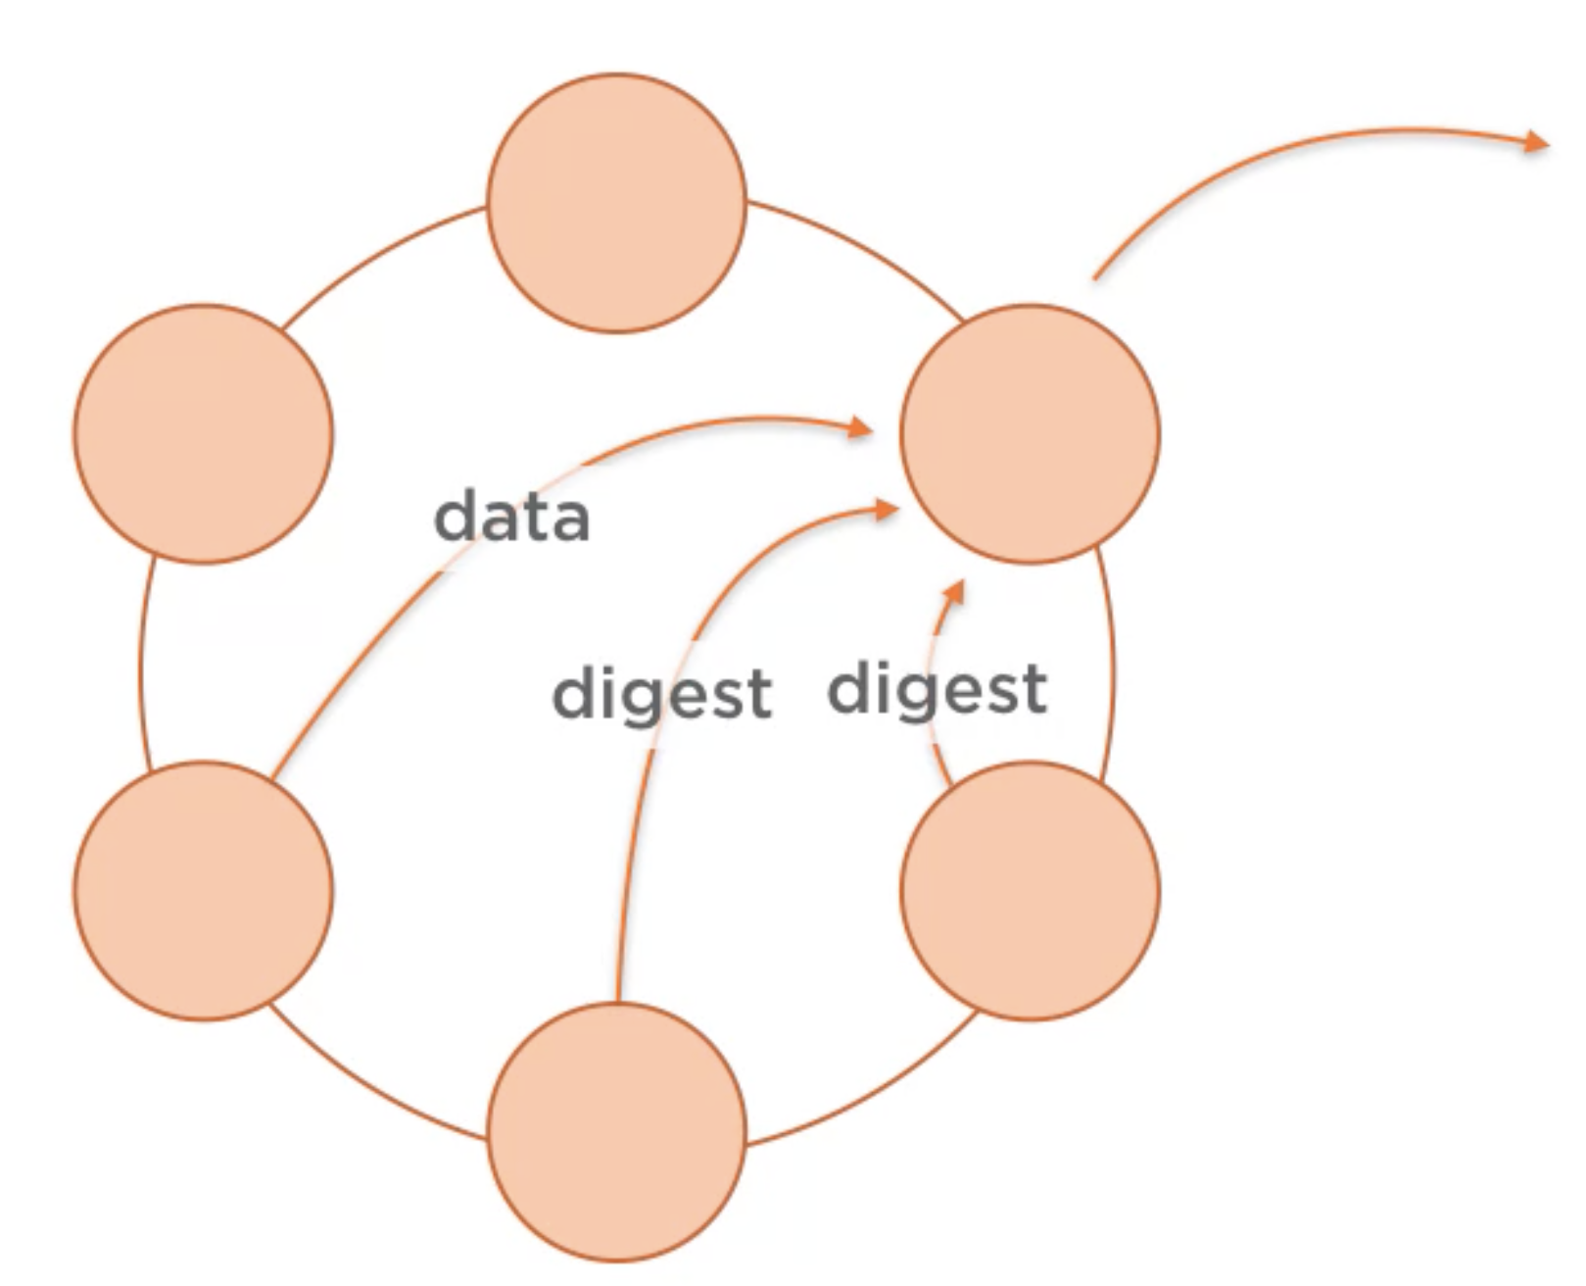
Tunable Consistency for Read
Data fetched from 1 node and digest from others
If digest differs, it then fetches data from all nodes
With Replication Factor 3
Number of data copies to check for consistency
before successful response is returned can be set
One: checks data from 1 node
Two: checks data from 2 nodes
.
.
.
Quorum: checks data from majority nodes
All: : checks data from all nodes

Slide 16
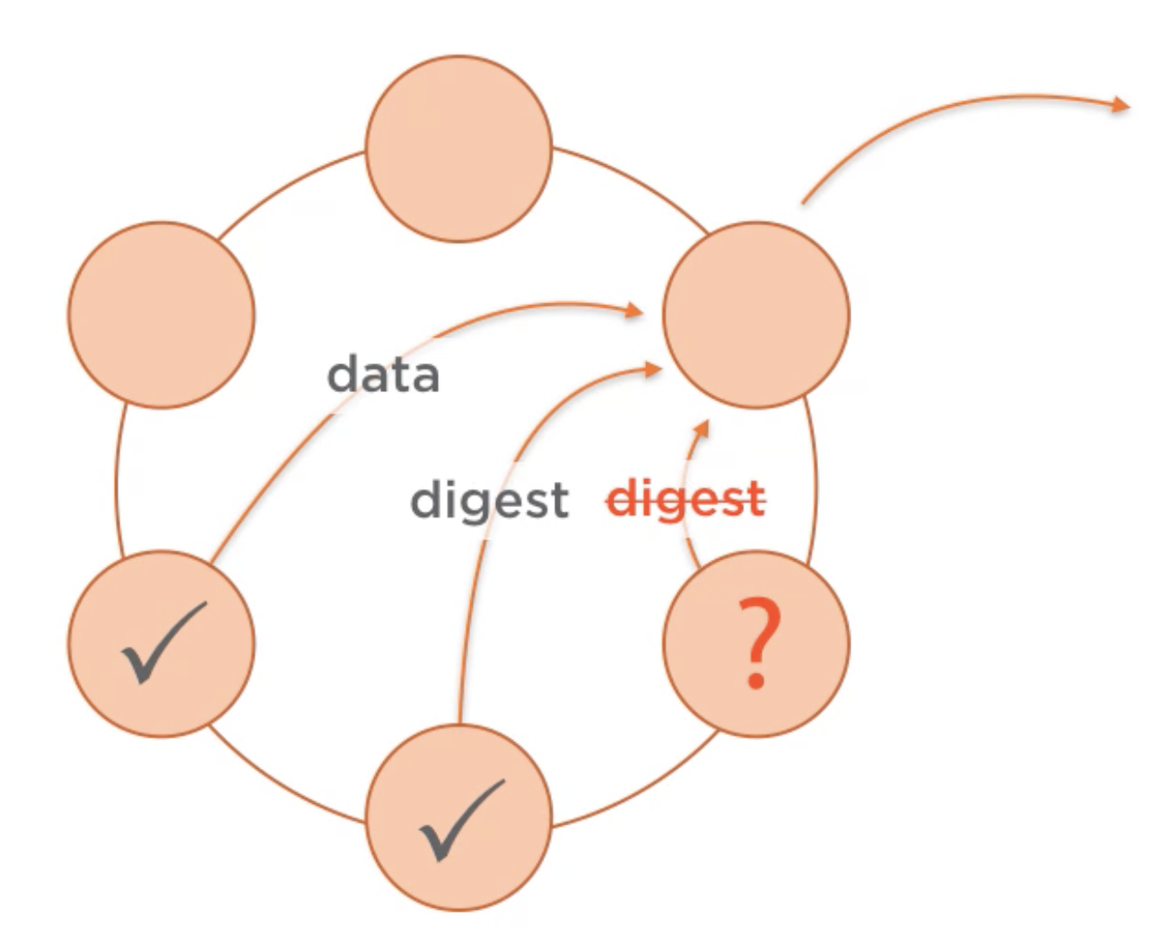
Tunable Consistency for Read
Data fetched from 1 node and digest from others
If digest differs, it then fetches data from all nodes and repairs
the data on the inconsistent node
=> Read Repair

Slide 17
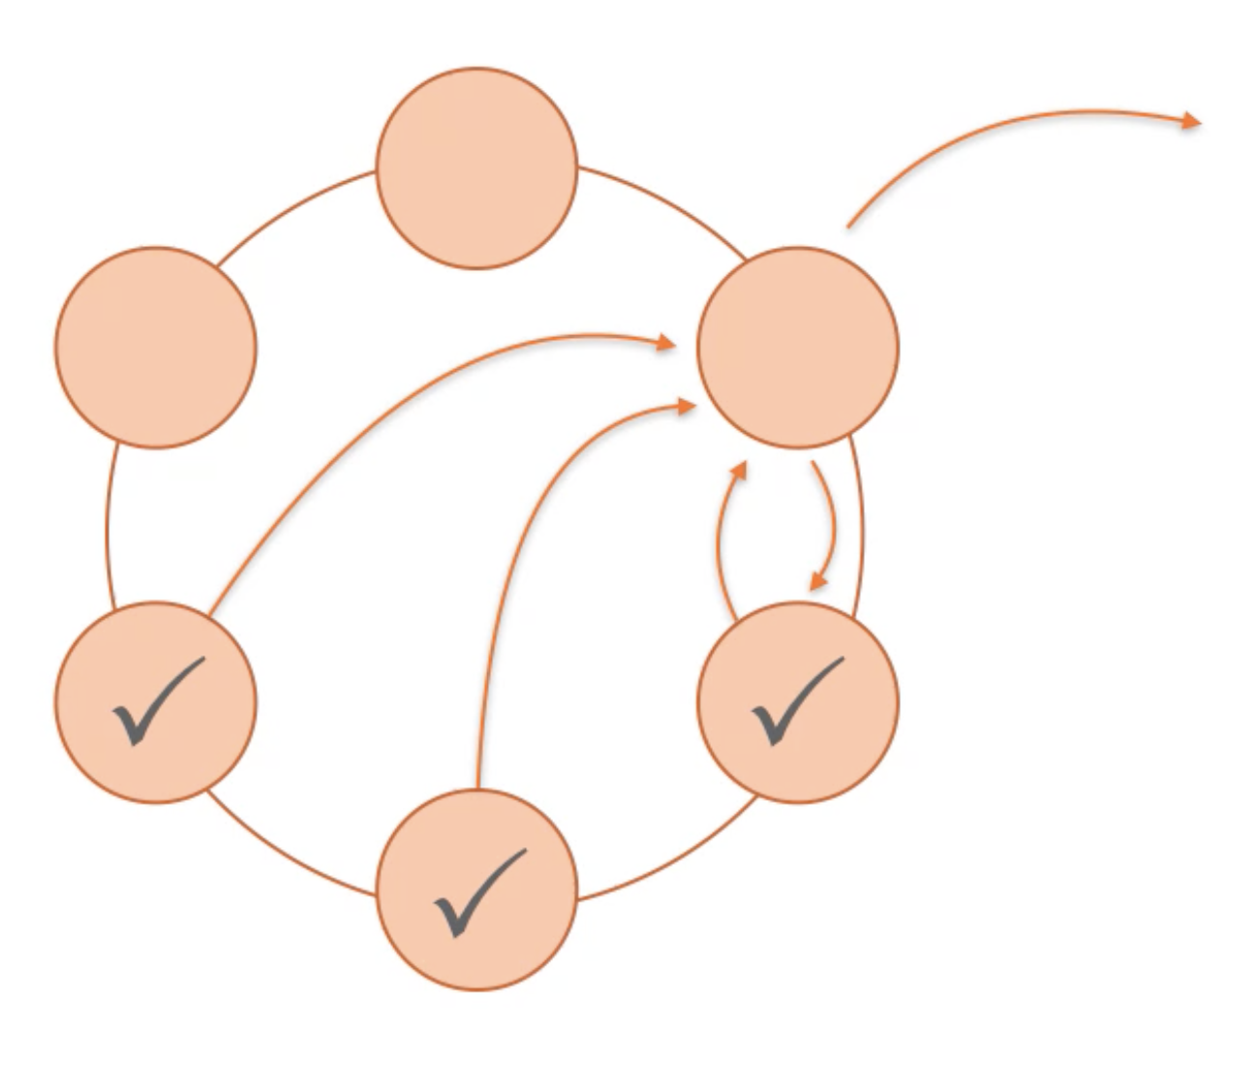
Tunable Consistency for Read
Data fetched from 1 node and digest from others
If digest differs, it then fetches data from all nodes and repairs
the data on the inconsistent node
=> Read Repair

Slide 18
Thank You

