Slide 1



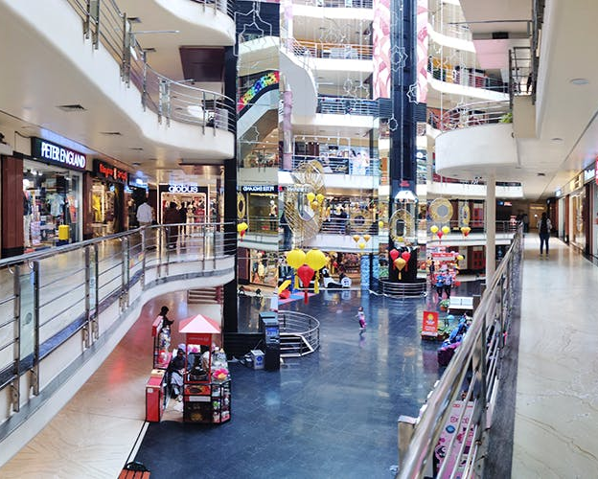

City Centre Mall
Max, Archies, Adidas, Apple Store, Biba, Carbon, Crocodile, Crossword, FabIndia, Metro Shoes, Mufti, Music World and Titan
Presented By:
RIMI SINGHA

Slide 2



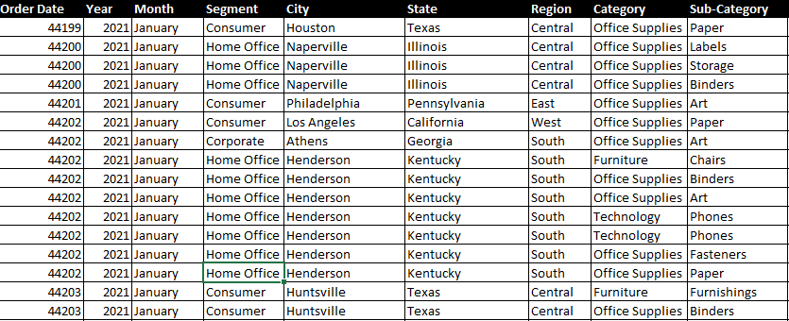


The Problem
In the Mall we can see how many people are coming in mall in a month and how many no.
It shows that which age group of Patients comes to the mall the most.
It shows that which types of things are attracting most.
It shows that which gender of person came most in the mall.

Slide 3

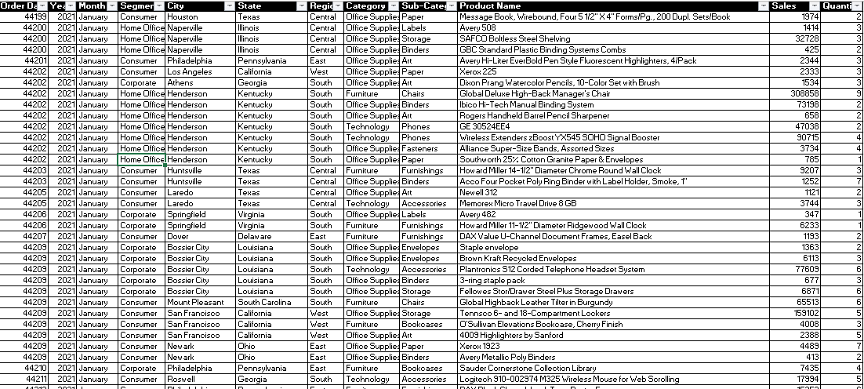
Dataset Snapshot

Slide 4

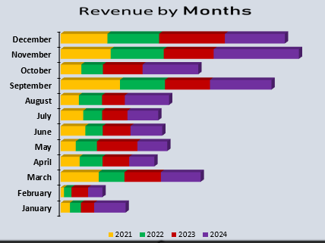
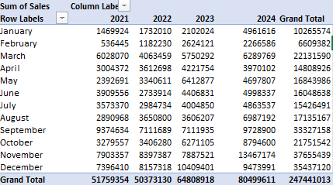
Revenue by Months
The stacked bar chart shows monthly revenue trends for the mall, highlighting consistent growth across departments. Each month displays combined contributions from all categories, allowing clear comparison of peak and low-revenue periods. The visualization effectively presents overall performance, seasonal changes, and category-wise revenue distribution throughout the year.

Slide 5
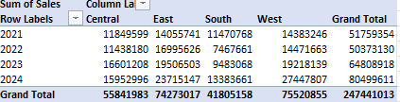
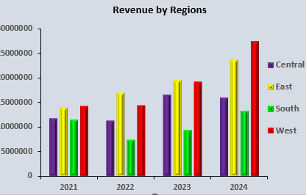
Revenue by Regions
The column bar chart clearly highlights the mall’s revenue distribution across different regions. It shows which areas contribute the highest sales and which perform moderately. This comparison helps identify strong markets, understand customer trends, and focus on regions with growth potential to improve overall mall performance.

Slide 6
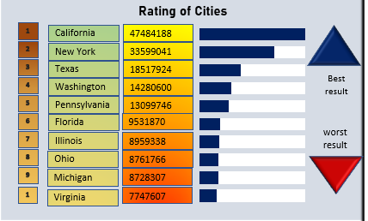


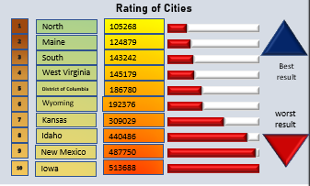
Rating of Cities
Positive: Cities with higher ratings reflect better customer satisfaction, strong service quality, and enjoyable shopping experiences. These locations show efficient management and consistent footfall.
Negative: Lower-rated cities indicate issues in service, limited facilities, or customer dissatisfaction, highlighting areas needing improvement.

Slide 7
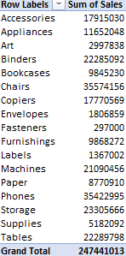
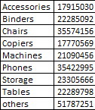


Quantity of Goods
The pie chart illustrates the distribution of goods quantity across four years. The largest share appears in 2023 and 2024, reflecting higher stock movement and customer demand. Meanwhile, 2021 and 2022 contribute smaller portions. This distribution highlights changing inventory needs and growing sales activity within the mall over time.

Slide 8




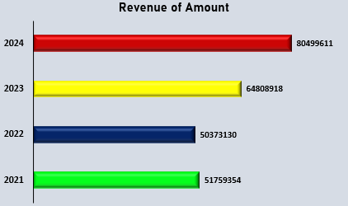
Revenue of Amount
The bar graph highlights the mall’s annual revenue trend from 2021 to 2024. Revenue shows steady growth, rising from 2021 and peaking in 2024. This upward pattern indicates improved customer footfall, better sales strategies, and strong market performance, contributing to a significant overall increase in total revenue

Slide 9
Rating of Cities
Positive: Cities with higher ratings reflect better customer satisfaction, strong service quality, and enjoyable shopping experiences. These locations show efficient management and consistent footfall.
Negative: Lower-rated cities indicate issues in service, limited facilities, or customer dissatisfaction, highlighting areas needing improvement.

Slide 10


Sales by Category and Segment
The bar graphs display sales performance across different categories and segments in the mall. Technology shows the highest sales among categories, while furniture and office supplies follow.
In segments, the first segment leads strongly, with the second and third segments contributing lower values. This comparison highlights key revenue-generating areas.

Slide 11

Roadmap
Q1–Q2
1
2
3
Analyse Yearly Trends Study the quantity of goods across all years to identify rising demand patterns and adjust inventory planning accordingly.
Optimize Stock Management Focus on high-demand years like 2023 and 2024 to ensure sufficient supply and avoid stockouts during peak periods.
Plan Future Growth Strategies Use multi-year data insights to improve purchasing, enhance customer experience, and implement strategies that support continuous mall growth.

Slide 12

Conclusion
In conclusion, the analysis provides clear insights into the mall’s overall performance, highlighting growth in revenue, shifting product demand, and strong category-wise sales contributions. The yearly, segment, and subcategory trends reveal opportunities for strategic improvement. These findings support informed decision-making, optimized inventory planning, and a focused roadmap for future business expansion.

Slide 13
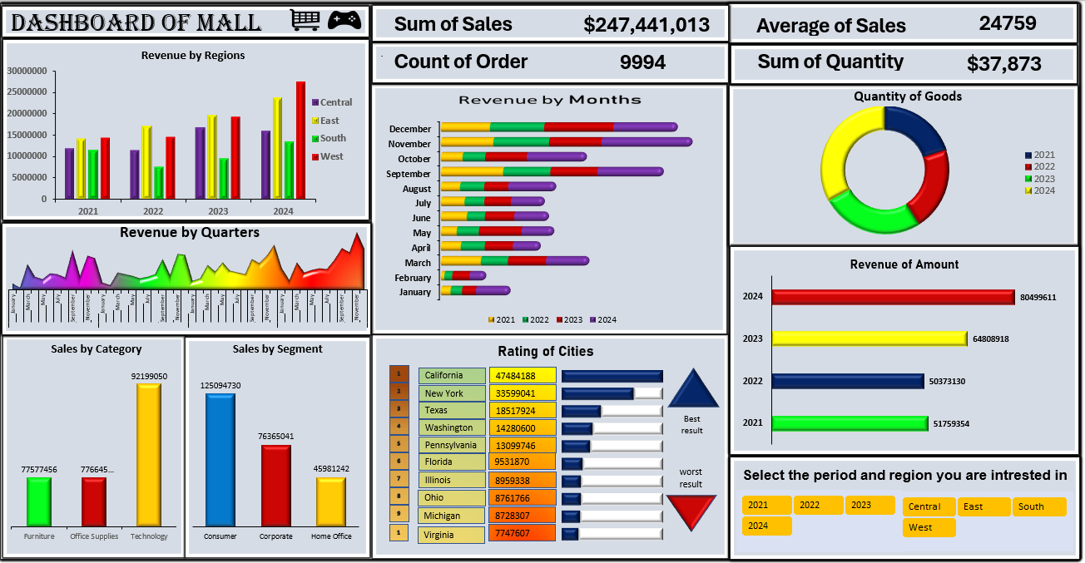
Dashboard
In conclusion, the analysis provides clear insights into the mall’s overall performance, highlighting growth in revenue, shifting product demand, and strong category-wise sales contributions. The yearly, segment, and subcategory trends reveal opportunities for strategic improvement. These findings support informed decision-making, optimized inventory planning, and a focused roadmap for future business expansion.

Slide 14



City Centre Mall
Let’s Build Better Investments
We’re redefining how responsible investment works. Looking for partners who believe that profit and purpose can scale—together.
Thank You
Very Much
www.linkedin.com/in/rimi-singha-3093b532b
Indrapastha, Berhampore

