Slide 1

Netflix Data Analysis
Exploring Content, Genres, Ratings & Trends
Python • Pandas • Matplotlib
Presented by -- Rimi Singha

Slide 2
Table of Contents
01
Project Overview
07
Top Genres
02
Dataset & Columns
08
Yearly Content Trend
03
Key Statistics
09
Movie & TV Show Trends
04
Movies vs TV Shows
10
Key Insights & Findings
05
Top Countries
11
Challenges Faced
06
Rating Distribution
12
Conclusion

Slide 3



Step 1 — Project Overview
Objective
Dataset
Tools Used
Analyze Netflix content library to uncover patterns in movies, TV shows, genres, ratings, and country-wise distribution of content.
Netflix dataset with 7 columns: Title, Type, Genre, Country, Release Year, Rating, and Duration Minutes.
Python for scripting, Pandas for data cleaning & analysis, and Matplotlib for creating visualizations and dashboards.

Slide 4
Step 2 — Dataset & Columns
Your dataset contains 7 key columns used for all analysis:
title
Name of the Movie or TV Show
type
Movie or TV Show
genre
Genre category (Horror, Drama, Comedy...)
country
Country where content was produced
release_year
Year the content was released
rating
Content rating (TV-MA, PG, R...)
duration_minutes
Duration in minutes

Slide 5
Step 3 — Key Statistics
400+
2
7
5+
Total Titles
Content Types
Genres
Ratings
Dataset Quick Summary
Movies make up 47% of all content
Horror is the most popular genre
TV Shows make up 53% of all content
TV-MA is the most common rating
India is the top content-producing country

Slide 6
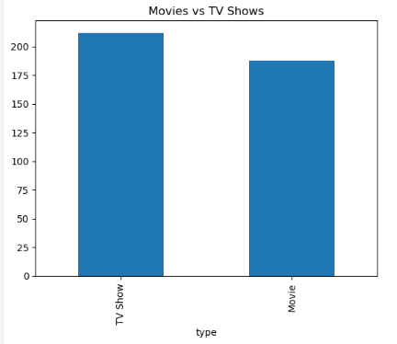
Step 4 — Movies vs TV Shows
Movies vs TV Shows Code
Results
# Count Movies vs TV Shows
type
total_count
type_counts = df["type"].value_counts()
TV Show
210
type_counts.plot(kind="bar")
plt.title("Movies vs TV Shows Count")
190
Movie
plt.xlabel("Type")
plt.ylabel("Count")
plt.show()
TV Shows (53%) slightly outnumber Movies (47%) in this dataset

Slide 7
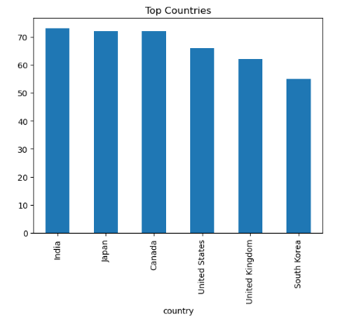
Step 5 — Top Countries Producing Content
Code
Top Countries
# Top countries by content
India
73
df["country"].value_counts()
Japan
72
.head(10).plot(kind="bar")
Canada
71
plt.title("Top Countries")
United States
66
plt.show()
United Kingdom
62
South Korea
55
India is the leading content-producing country in the dataset”

Slide 8
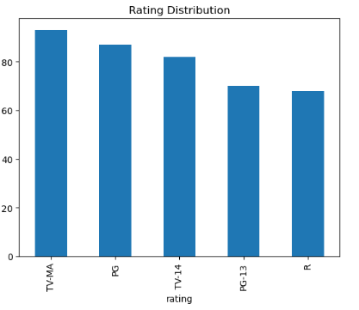
Step 6 — Rating Distribution
Code
Rating Counts
# Rating distribution
TV-MA
92
df["rating"].value_counts()
.plot(kind="bar")
PG
87
plt.title("Rating Distribution")
TV-14
83
plt.show()
PG-13
70
R
68
TV-MA dominates — showing Netflix targets mature adult audiences most

Slide 9
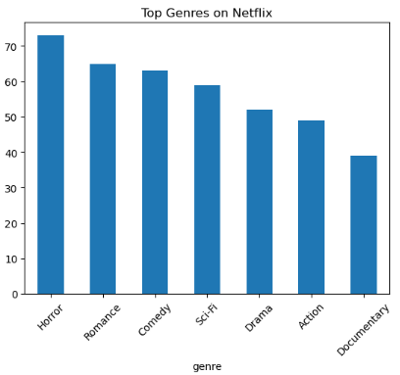
Step 7 — Top Genres on Netflix
Code
Genre Counts
# Top genres
Horror
73
df["genre"].value_counts()
Romance
65
.head(10).plot(kind="bar")
Comedy
63
plt.title("Top Genres on Netflix")
Sci-Fi
59
plt.xticks(rotation=45)
Drama
52
plt.show()
Action
49
Documentary
39
Horror leads

Slide 10
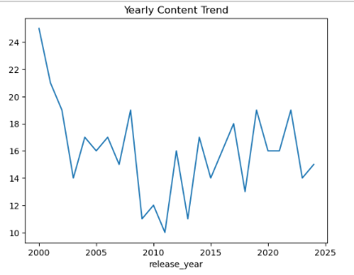
Step 8 — Yearly Content Trend
Yearly Trend Analysis Code
# Yearly content trend
df.groupby("release_year")
.size()
.plot(kind="line")
plt.title("Yearly Content Trend")
plt.show()
# Movie vs TV Show trends
movies = df[df["type"]=="Movie"]
tvshows = df[df["type"]=="TV Show"]
movies["release_year"]
.value_counts().plot(kind="line")
tvshows["release_year"]
.value_counts().plot(kind="line")

Slide 11
Step 9 — Data Exploration & Cleaning
Data Cleaning Code
# Check missing values
df.isnull().sum()
# Fill missing values
for col in df.columns:
if df[col].dtype == "object":
df[col] = df[col].fillna("Unknown")
else:
df[col] = df[col].fillna(0)
# Dataset info
df.info()
df.describe()
# Shape and columns
df.shape # rows x columns
df.columns # column names

Slide 12
Step 10 — Dashboard Code
Create 2x3 Dashboard Grid
fig, axs = plt.subplots(2, 3, figsize=(18, 10))
axs[0,0].bar(type_counts.index, type_counts.values)
axs[0,0].set_title("Movies vs TV Shows")
axs[0,1].bar(country_counts.index, country_counts.values)
axs[0,1].set_title("Top Countries")
axs[0,2].bar(rating_counts.index, rating_counts.values)
axs[0,2].set_title("Rating Distribution")
axs[1,0].bar(genre_counts.index, genre_counts.values)
axs[1,0].set_title("Top Genres")
axs[1,0].tick_params(axis="x", rotation=45)
axs[1,1].plot(year_trend.index, year_trend.values)
axs[1,1].set_title("Yearly Content Trend")
axs[1,2].plot(movie_trend.index, movie_trend.values, label="Movies")
axs[1,2].plot(tv_trend.index, tv_trend.values, label="TV Shows")
axs[1,2].set_title("Movie vs TV Trends")
axs[1,2].legend()
fig.suptitle("Netflix Data Dashboard", fontsize=18)
plt.tight_layout()
plt.savefig("netflix_dashboard.png", bbox_inches="tight", dpi=150)
plt.show()

Slide 13
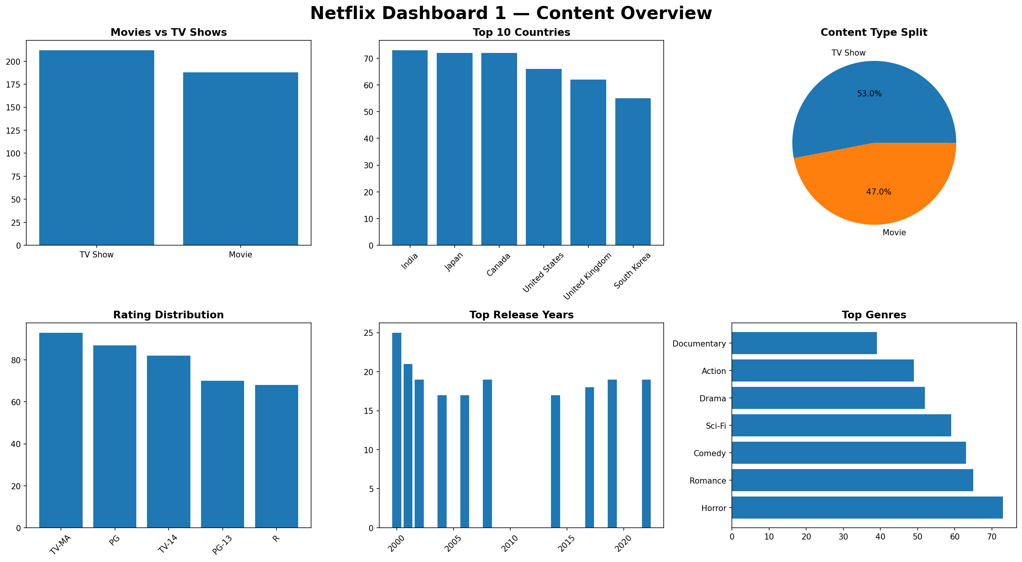
Dashboard - 1

Slide 14
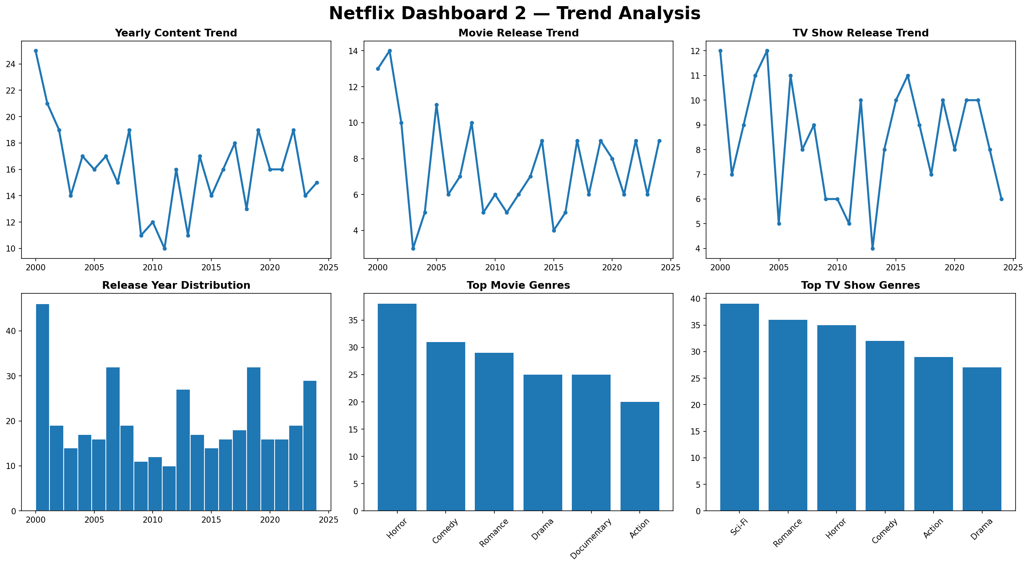
Dashboard - 2

Slide 15

Step 11 — Key Insights & Findings
01
TV Shows Lead
02
India on Top
TV Shows make up 53% vs Movies at 47%.
India produces the most Netflix content.
03
Mature Content
04
Horror #1 Genre
TV-MA is the most common rating.
Horror leads, followed by Romance & Comedy.
05
Consistent Trend
06
90-Min Runtime
Content volume is stable year over year.
Most movies run 90-100 minutes long.

Slide 16
Step 12 — Challenges & Conclusion
Challenges Faced
Conclusion
Column name mismatches (KeyError)
Successfully built 2 professional dashboards
Missing 'director' & 'date_added' columns
Fixed all dataset column errors step by step
fillna() FutureWarning with newer Pandas
Used Pandas & Matplotlib for full analysis
Charts showing 0 Axes when savefig order wrong
Applied value_counts, groupby, and filtering
Replacing listed_in → genre throughout code
Saved dashboards as high-quality PNG files

Slide 17
Thank You!
Netflix Data Analysis Project
Built with Python • Pandas • Matplotlib
6294653977
rimi.singha01@gmail.com
www.linkedin.com/in/rimi-singha-3093b532b
Berhampore ,West Bengal

