Slide 1
Sales Data
Analysis
14 Worksheets
Sales KPI • Profit KPI • Quantity KPI
Sparklines • Region Wise
Monthly by Segment
Tableau Desktop Project
Advanced Features
Interactive dashboards, KPI tracking, state-wise analysis
and dynamic measure switching using Orders+ dataset
LOD Expressions • Parameters
Dynamic Measures • YOY Calc
Color Intelligence
Presented by -- Rimi Singha
Tableau Desktop • Orders+ (Sales Data) • 14 Worksheets • Advanced Calculations & Parameters

Slide 2
Table of Contents
01
Project Overview
07
Avg Sales by State
Objective, tools & dataset
State-wise color classification
02
Data Source & Fields
08
Avg Profit by State
Tables, measures & dimensions
LOD profit comparison
03
Key Statistics
09
Monthly Sales by Segment
KPI snapshot from the data
Consumer, Corporate, Home Office
04
Sales KPI & Sparkline
10
Sales & Profit by States
Current Year vs Prior Year Sales
Geographic analysis
05
Profit KPI & Sparkline
11
Dynamic Measures
YOY profit trends by month
Parameter-driven CASE switching
06
Quantity KPI & Sparkline
12
Key Insights & Findings
Order quantity trends
Top conclusions from the data

Slide 3
Step 1 — Project Overview
Objective
Dataset
Tools Used
Build interactive Tableau dashboards for Sales data
Source: Orders+ (Sales Data)
Tableau Desktop for all visualizations
Track KPIs: Sales, Profit & Quantity (CY vs PY)
Tables: Orders, People, Sheet1 (Hexmap)
LOD Expressions for fixed aggregations
Identify state-wise and segment-wise trends
Fields: Sales, Profit, Quantity, Discount
CASE/IF statements for dynamic calculations
Enable dynamic measure switching via Parameters
Dimensions: State, Segment, Ship Mode, Category
Parameters for user-driven measure switching

Slide 4
Step 2 — Data Source & Fields
Key Fields — Orders Table
Calculated Fields & Parameters
Order Date
Date of order placement
Total CY Sales
IF YEAR([Order Date])={MAX(YEAR(...))} THEN [Sales]
Sales
Revenue per order line
Total PY Sales
Prior year equivalent of CY Sales
Profit
Net profit per order line
YOY Sales
(CY - PY) / PY → Growth %
Quantity
Units ordered
YOY Indicator
▲ if positive, ▼ if negative
Discount
Discount applied (%)
avg Sales state wise
{FIXED [State]: AVG([CY Sales])}
Segment
Consumer / Corporate / Home Office
avg Profit overall
{FIXED: AVG([CY Sales])}
State/Province
Geographic dimension
Sales Avg Color
IF state < overall THEN 'Below Avg'...
Ship Mode
Shipping method
Dynamic Measure
CASE [Parameter] WHEN... THEN...
Category / Sub-Cat
Product classification
Min Max Month/Profit/Qty
Sparkline highlight logic

Slide 5
Step 3 — Key Statistics
$2.3M
$286K
37,873
14
Total CY Sales
Total CY Profit
Total CY Quantity
Worksheets Built
Dataset Quick Summary
Sales data spans multiple years; Current Year (CY) vs Prior Year (PY) comparison built with IF + MAX LOD logic.
Segments tracked: Consumer (highest revenue), Corporate, and Home Office — analyzed monthly by area chart.
State-wise avg sales & profit classified as Above Average / Below Average / Equal to Average using IF/ELSEIF.
Dynamic Measure parameter lets users toggle between Sales, Profit, and Quantity without rebuilding views.
Sparklines use MIN/MAX calculated fields to highlight peak and trough months for each KPI.

Slide 6
Step 4 — Sales KPI & Sparkline
Sales KPI Card
Sales Sparkline — Monthly Trend
$2,297,201
Total CY Sales
Total PY Sales
$2,097,132
YOY Growth
+9.5% ▲
YOY Indicator
▲ Positive Growth
🔴 Peak months highlighted using MIN/MAX calculated field (Min Max Month).
Green ▲ = CY above PY | Red ▼ = CY below PY

Slide 7
Step 5 — Profit KPI & Sparkline
Profit KPI Card
Profit Sparkline — Monthly Trend
$286,397
Total CY Profit
Total PY Profit
$241,162
YOY Growth
+18.8% ▲
Profit Margin
~12.5% of Sales
Min Max Profit calculated field highlights peak and lowest profit months in sparkline view.

Slide 8
Step 6 — Quantity KPI & Sparkline
Quantity KPI Card
Quantity Sparkline — Monthly Trend
37,873
Total CY Quantity
Total PY Quantity
34,506
YOY Growth
+9.8% ▲
Top Segment
Consumer
Min Max Quantity field drives sparkline color encoding to spotlight peak order months.

Slide 9
Step 7 — Avg Sales by State — Color Classification
Above Average
Below Average
Equal to Average
How It Works
Sample State Classification
Step 1
avg Sales state wise =
{FIXED [State/Province]: AVG([Total CY Sales])}
California
$457K
Above Average
New York
$310K
Above Average
Washington
$235K
Step 2
avg Profit overall =
{FIXED : AVG([Total CY Sales])}
Above Average
Texas
$170K
Below Average
Ohio
$138K
Step 3
Sales Avg Color =
IF [state] < [overall] THEN 'Below Average'
ELSEIF [state] > [overall] THEN 'Above Average'
ELSE 'Equal to Average' END
Below Average
Pennsylvania
$116K
Below Average
Illinois
$87K
Below Average

Slide 10
Step 8 — Avg Profit by State
Profit Avg Color Logic
Profit Avg Color field classifies each state's average profit vs the national average:
Below Avg
State profit < Overall avg
Above Avg
State profit > Overall avg
Equal
State profit = Overall avg
LOD calc: {FIXED [State/Province]: AVG([Total CY Sales (copy)])}
Note: Profit KPI uses 'avg profit state wise' vs 'avg Profit overall' for the color dimension.

Slide 11
Step 9 — Monthly Sales by Segment
Segment Insights
Consumer
~52% — Largest revenue driver
Corporate
~31% — Steady growth pattern
Home Office
~17% — Smallest but rising
Peak Month
Nov — Highest sales across all
Chart Type
Area — SUM(Dynamic Measure) on rows
Sheet: Monthly Sales by Segment | Columns: Segment + MONTH(Order Date) | Rows: SUM(Dynamic Measure) | Mark: Area

Slide 12
Step 10 — Sales & Profit by States
Sheet: Sales and Profit by States | Also includes: Region wise Sales & Total Sales by Location Manager worksheets

Slide 13
Step 11 — Dynamic Measures — Parameter Switching
The 'Select Measure' parameter lets users switch KPIs without rebuilding any view.
01
Parameter
'Select Measure'
02
CASE Formula
'Dynamic Measure'
03
Chart Redraws
Instantly
User picks:
• Total CY Sales
• Total CY Profit
• Total CY Quantity
CASE [Select Measure]
WHEN 'Total CY Sales'
THEN [Total CY Sales]
...
END
Rows shelf: SUM(Dynamic Measure)
All segments update automatically
No view rebuild needed
▶
▶
CASE [Parameters].[Select Measure] WHEN 'Total CY Sales' THEN [Total CY Sales] WHEN 'Total CY Profit' THEN [Total CY Profit] WHEN 'Total CY Quantity' THEN [Total CY Quantity] END

Slide 14
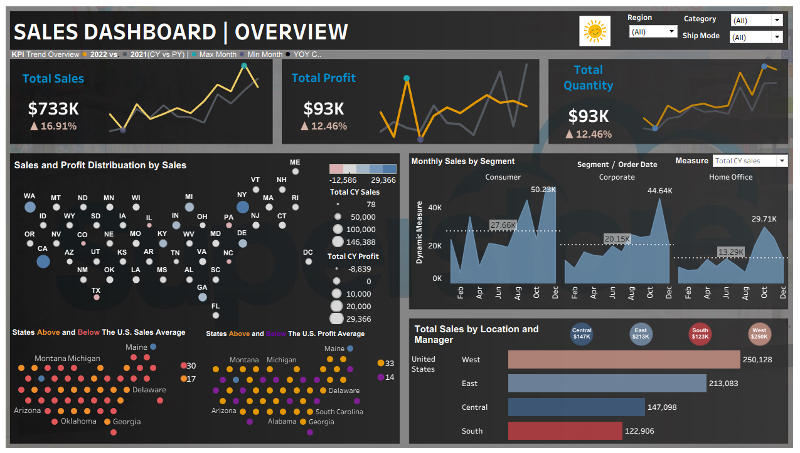
Dashboard - 1

Slide 15
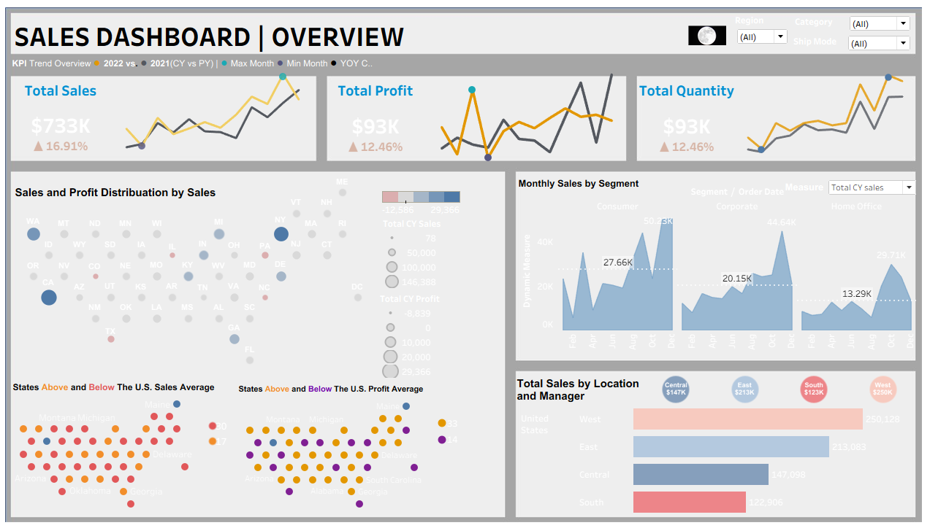
Dashboard - 2

Slide 16
Step 12 — Key Insights & Findings
01
Sales Growth
02
Profit Surge
Total CY Sales reached $2.3M — a +9.5% YOY improvement, with November as the peak month.
CY Profit hit $286K, growing +18.8% YOY. West & East regions are the most profitable.
03
Consumer Leads
04
State Insights
Consumer segment drives ~52% of revenue. Corporate is steady; Home Office is growing.
California & New York are above-average states. Central US states mostly fall below average.
05
Dynamic Power
06
Sparkline Magic
CASE parameter lets stakeholders switch KPIs instantly — no separate sheets needed.
MIN/MAX calculated fields highlight best & worst months per KPI for quick visual scanning.

Slide 17
Thank You!
Sales Data Analysis — Tableau Desktop Project
Built with Tableau Desktop • Orders+ (Sales Data) • LOD • Parameters • Sparklines
6294653977
rimi.singha01@gmail.com
www.linkedin.com/in/rimi-singha-3093b532b
Berhampore ,West Bengal
14
3
6
1
Worksheets
KPI Scorecards
Sparkline Views
Dynamic Parameter
Questions & Discussion | Tableau Sales Data Analysis Project

