Slide 1


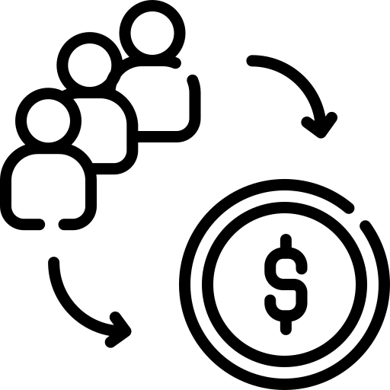
Improving User Retention and Engagement
Analysis of user behavior & anomalies
Focus: driving retention, engagement, and conversions
Based on 5,000 user signups dataset

Slide 2



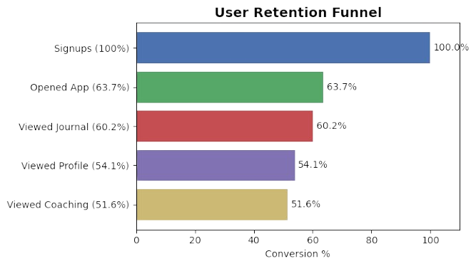
Key Findings & Insights
Retention drop-off: Only 64% of signups open the app
Churned users average 6 sessions, vs 32+ sessions for retained users
Low exploration of deep features (journal, profile, coaching)
Retained users consistently engage more with Sleep, Strain, Recovery features

Slide 3



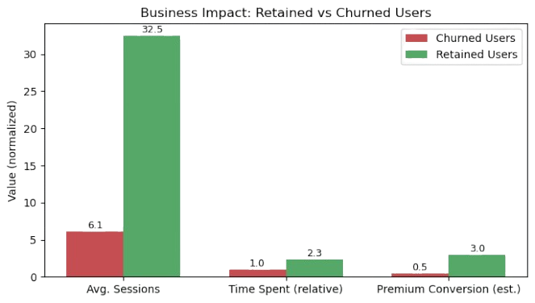
Business Impact
High churn → ~36% users lost after signup
Revenue leakage: churned users unlikely to convert to
Engagement gap: Retained users spend 2.3x more time in app
Missed upsell : coaching & premium features under-used

Slide 4



Recommendations
Onboarding Redesign
- Guide new users to explore journal, profile, and coaching
- Personalized welcome flows
Feature Nudges & Reminders
- Push notifications / in-app prompts for high-value features
- Focus : Sleep, Strain, Recovery
Incentivize Premium Trial
- Offer limited-time free access
- Showcase premium value early

Slide 5

Implementation Considerations
Tech : Notification system, onboarding updates
Data : Track feature adoption & retention by cohort , trial-to-premium conversion
UX : Nudges must be helpful, not spammy

Slide 6
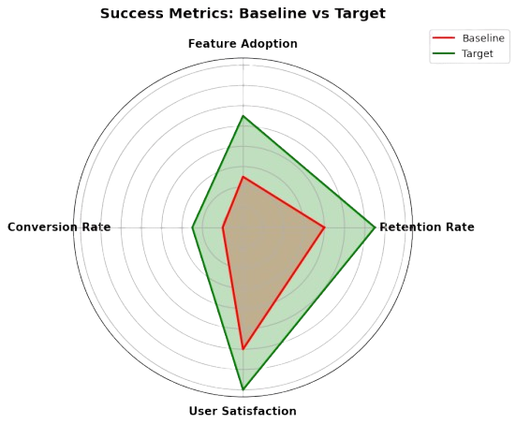
Success Metrics
- Retention Rate: % active after 4+ weeks
- Feature Adoption: Journal, Profile, Coaching engagement
- Conversion : Free → Premium subscriptions
- Satisfaction: NPS , app ratings

Slide 7
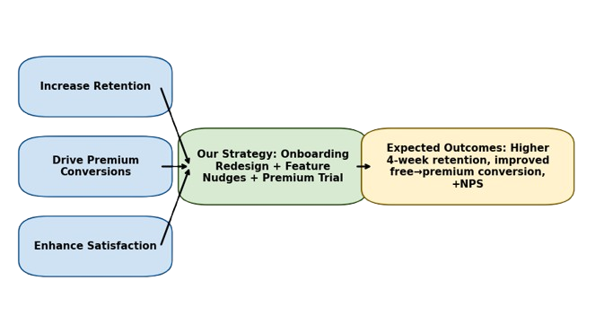
Takeaway
By redesigning onboarding, encouraging feature adoption, and incentivizing premium trials, we drive:
Higher Retention
💲 More Premium Conversions
😊 Improved Satisfaction

