Slide 1



UNIHIVE: A Unified Social Platform for University Communities
Presented By-
Raihan Rimon
ID: 213311004
Md. Abid Hasan
ID: 213311014
Abdullah All Mamun
ID: 213311035
Supervised By-
Salma Akter Lima
Lecturer, Dept. of CSE
Varendra University

Slide 2

1
Outlines
Introduction
Objective
Problem Statement
Workflow
Progress
Tools and technologies
Challenges
UNIHIVE vs Other Platforms
Future work
Conclusion

Slide 3
2
Introduction
A social media platform for university communities.
Aims to connect students, faculty and alumni.
To achieve a focused academic environment.
Encourages academic discussions and student networking.

Slide 4
3
Objective
Interactions between students, faculty and alumni.
Real-time conversations and discussions.
Authentication and verification within the university domain.

Slide 5
4
Problem Statement
Students don’t have a unified campus-specific platform for networking.
Most social media platforms are too generic for academic communication.
Facebook distracts, UNIHIVE keeps it academic and focused.
UNIHIVE fills the gap with a secure, campus-focused platform.

Slide 6

5
Workflow
Frontend
Start
Log In / Sign Up
Username and Password correct?
No
Yes
Home Page
Feeds
Suggested Users
Log Out
Profile
Chat
React/Comment
Follow User
Stop
Update Profile
Search User
View Profile
Followers
Unfollow
Posts
Figure : 01
Album

Slide 7
6
Workflow
Backend
Front End
Middleware
Controller
DB (MongoDB)
Response
Socket.io server (Real Time)
Figure : 02

Slide 8
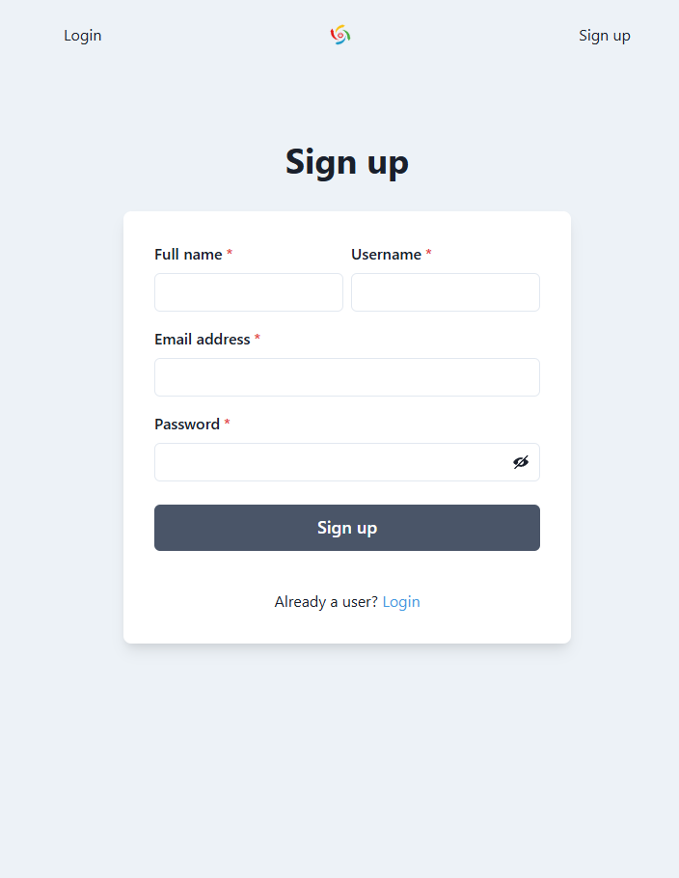
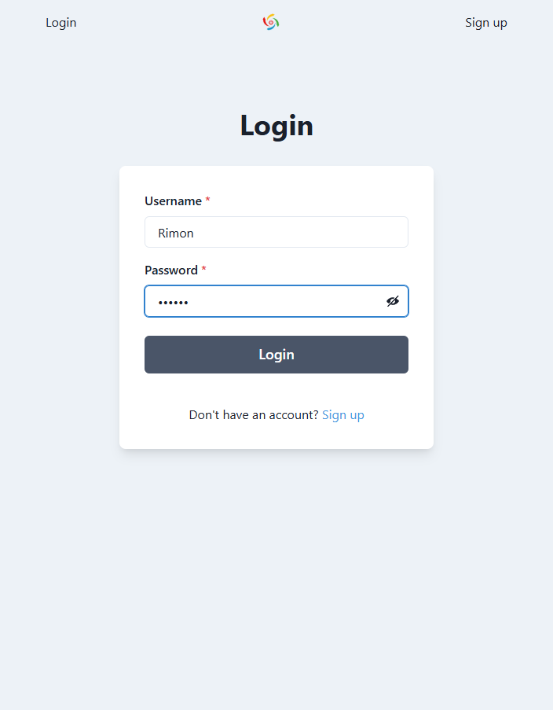
7
Progress
Screenshot 1: Sign Up
Screenshot 2: Login

Slide 9
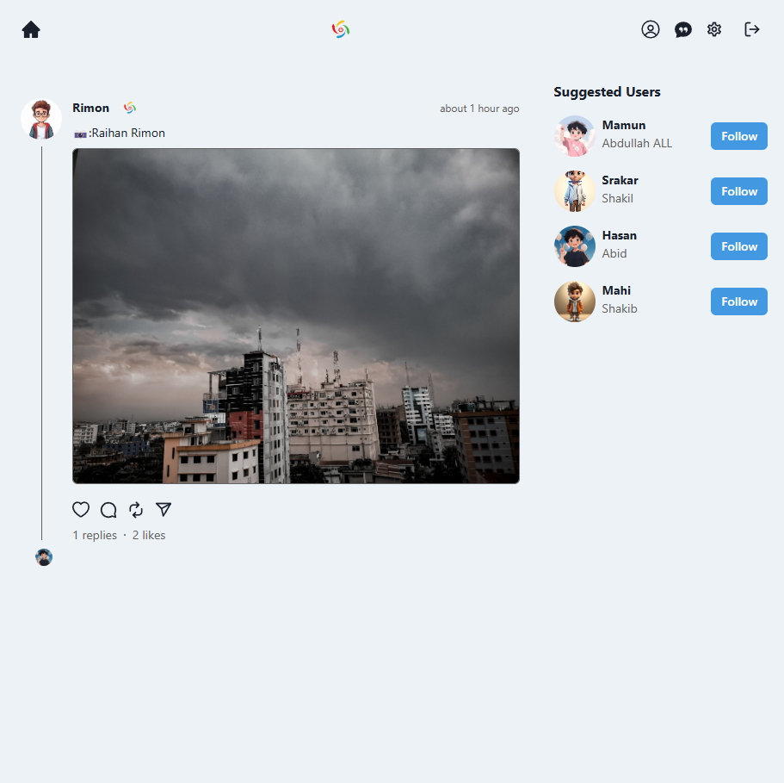
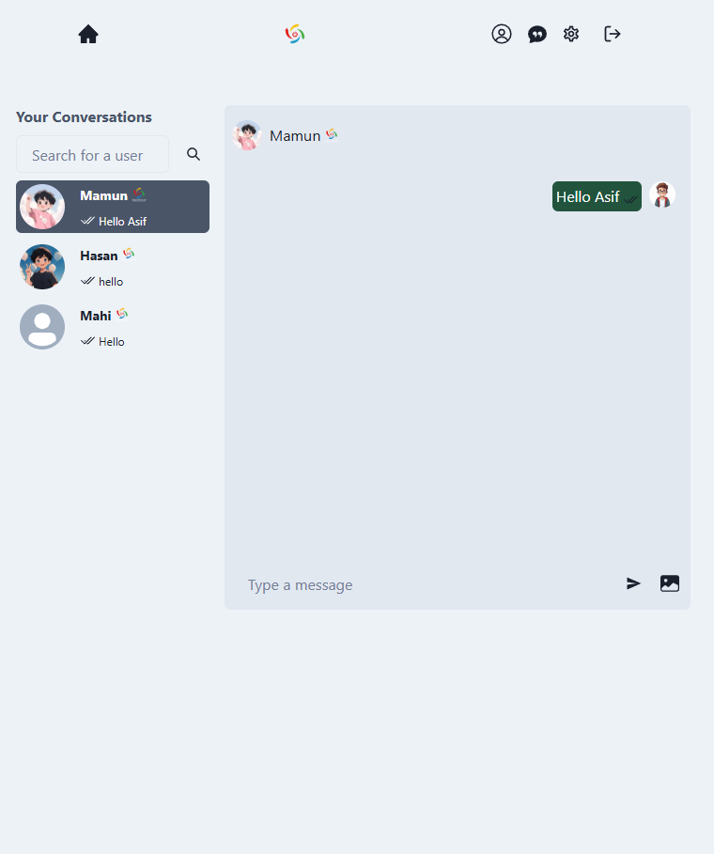
8
Screenshot 3: Homepage
Screenshot 4: Chat

Slide 10
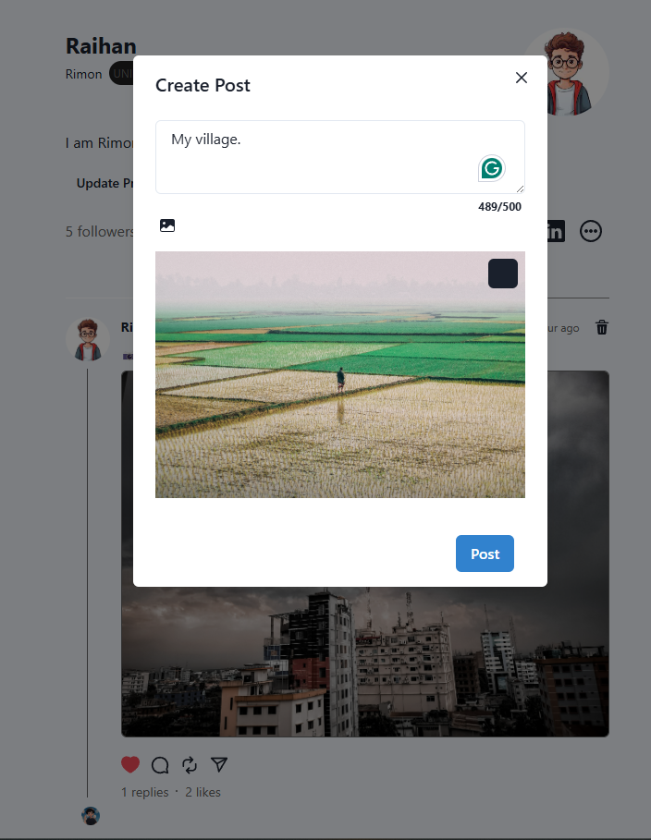
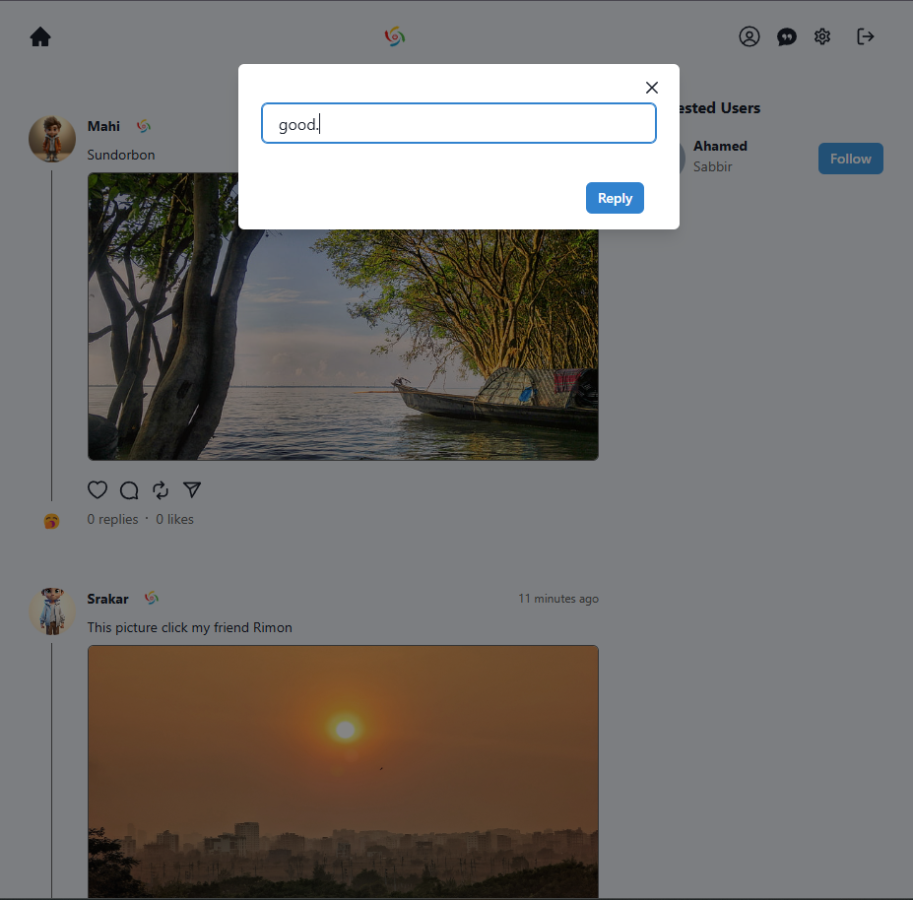
9
Screenshot 5: Create Post
Screenshot 6: Comment

Slide 11
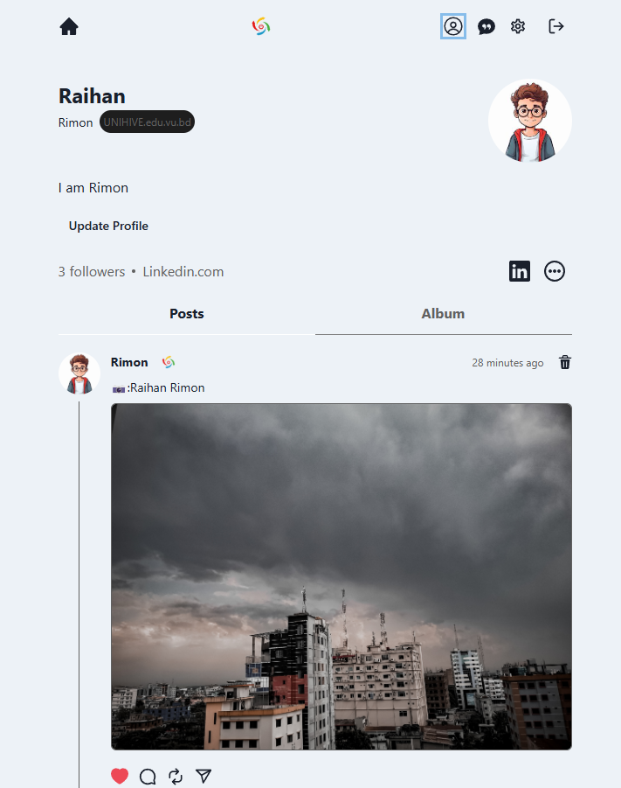
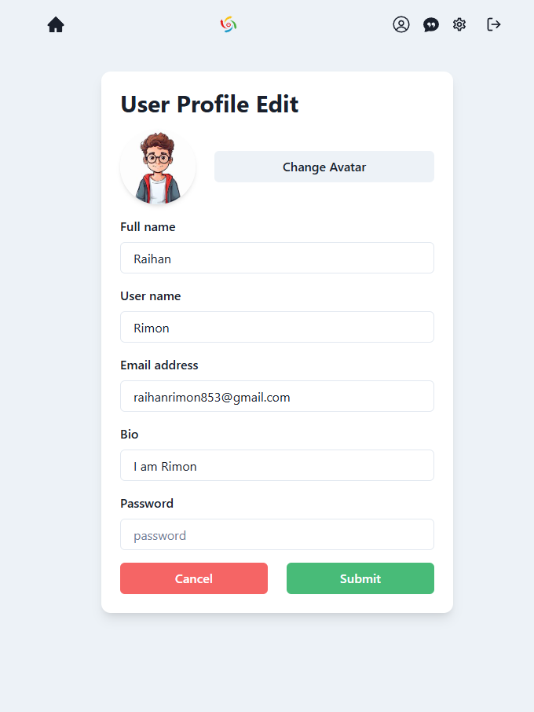
10
Screenshot 7: View Profile
Screenshot 8: Update Profile

Slide 12

11
Tools And Technologies
Frontend: React, JavaScript, Chakra UI.
Backend: Node, Express.
Database: MongoDB.
Real-time Communication: Socket.io.
Editor: VS Code

Slide 13
12
Challenges
Handling user verification logic and protecting routes effectively.
Media uploads and save them across frontend and backend.
Socket events between users in real-time.

Slide 14
13
UNIHIVE VS Other Platforms
Features/Platforms | UNIHIVE | Facebook | Instagram
University Focused | Yes | No | No
Verified Users | For Students/Faculty | Public | Public
Distraction Free | Yes-Mostly academic | Highly distracting | Highly distracting
Group/Class Creation | Yes-Future work | Limited | No
Tools for Universities | Yes-Future work | No | No
Table 1: UNIHIVE vs other Platforms

Slide 15
14
Future Works
Class and group creation.
Academic resource sharing.
Enhance user verification with institutional email login.

Slide 16
15
Conclusion
UNIHIVE offers a focused and secure environment for university users.
It enhances communication and collaboration across campus communities.
It addresses the specific need for academic-based social interaction

Slide 17


Thanks

