Slide 1
Checkpoint intro database

Slide 2
Table of contents
01
02
03
What is NO SQL
What is SQL?
Difference between MongoDB && VS SQL

Slide 3
What is SQL?
-Structured Query Language -SQL lets you access and manipulate databases -SQL became a standard of the American National Standards Institute (ANSI) in 1986, and of the International Organization for Standardization (ISO) in 1987

Slide 4
What is NO SQL?
-NoSQL, also referred to as “not only SQL”, “non-SQL”
-Is an approach to database design that enables the storage and querying of data outside the traditional structures found in relational databases.

Slide 5
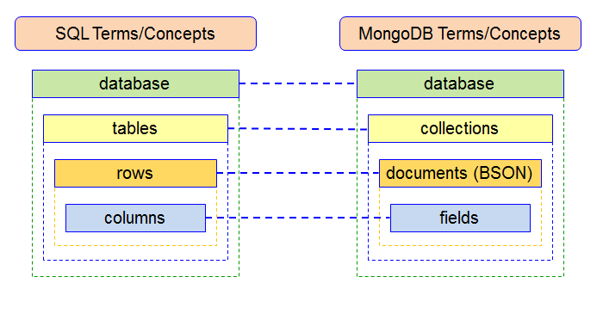
Difference between MongoDB VS SQL

Slide 6
End

