Slide 1
Global Revenue Leakage Dashboard
Analyzing Revenue Loss & Improving Profitability

Slide 2
Problem Statement
• Businesses face revenue leakage due to:
- High discounts
- Product returns
- Cancelled transactions
• Difficult to identify root causes across regions
• Lack of actionable insights for decision-making

Slide 3
Objective
• Identify revenue leakage across regions and categories
• Analyze root causes (discounts, returns, cancellations)
• Enable deep-dive analysis using drill-through
• Simulate profit improvement using what-if analysis

Slide 4
Dashboard Overview
• KPI-driven design for quick insights
• Interactive filters (Date, Month, Analyze By)
• Dynamic visualizations for trend analysis
• Drill-through functionality for detailed investigation

Slide 5
Key KPIs
• Total Sales: 32.15M
• Revenue Leakage: 4.76M
• Leakage %: 14.82%
• Net Profit: 6.11M
• Margin %: 20.23%
• Return Rate: 4.92%

Slide 6
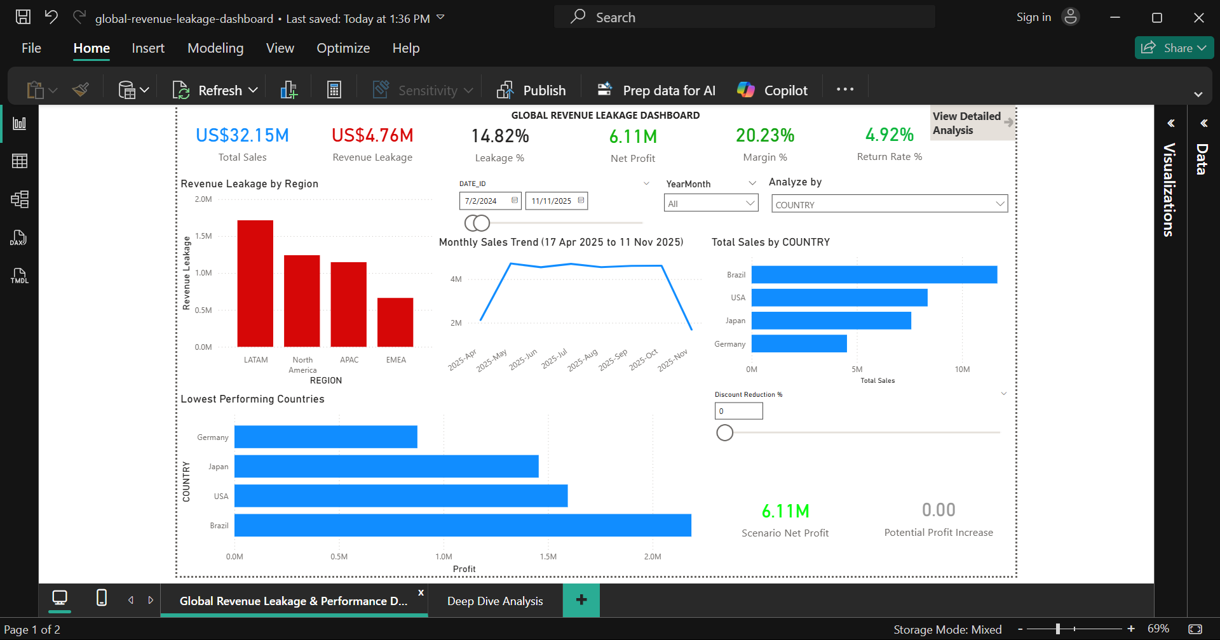
Main Dashboard
• Revenue leakage by region highlights high-risk areas
• Monthly trend shows sales and leakage patterns
• Lowest performing countries identified
• Interactive filtering for deeper analysis

Slide 7
Key Insights
• LATAM region shows highest revenue leakage
• Sales trend declines significantly in later months
• Certain countries consistently underperform
• Discounts contribute significantly to revenue loss

Slide 8
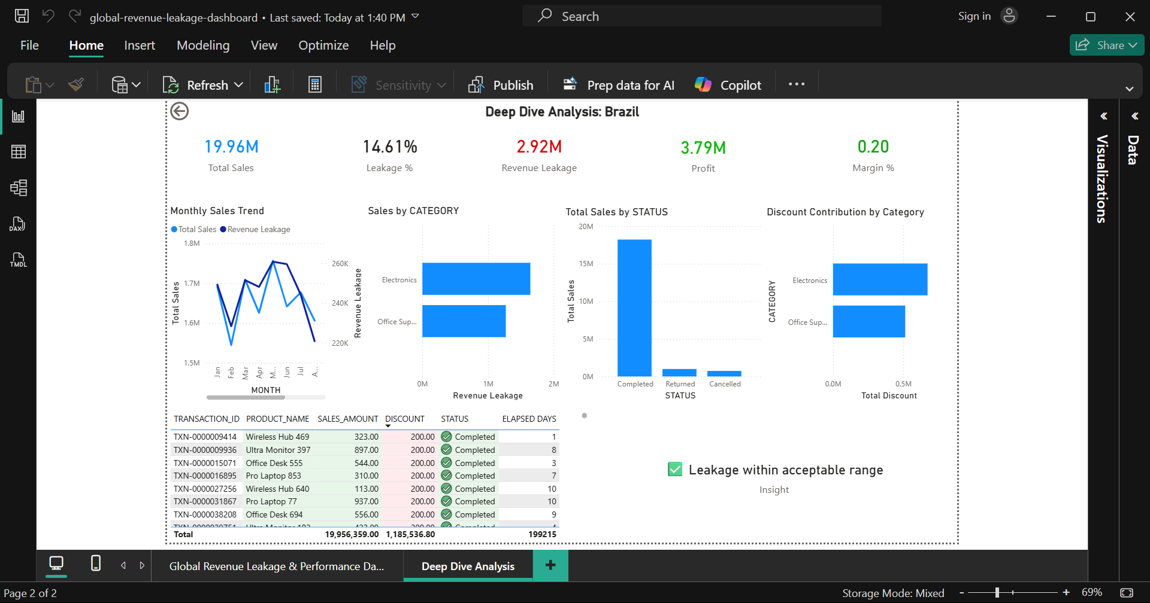
Deep Dive Analysis
• Drill-through enabled for detailed investigation
• Category-level leakage breakdown
• Status analysis (Completed, Returned, Cancelled)
• Transaction-level data for root cause analysis

Slide 9
What-if Analysis
• Discount reduction parameter introduced
• Simulates impact on profit
• Helps evaluate business strategies
Example:
Reducing discount → Increased profit potential

Slide 10
Business Impact
• Identifies high-risk regions and categories
• Reduces unnecessary discounts
• Improves profitability through data-driven decisions
• Enhances visibility into operational inefficiencies

Slide 11
Conclusion
• Transforms raw data into actionable insights
• Combines analysis, interactivity, and simulation
• Supports strategic decision-making
• Moves beyond reporting to a BI solution

