Slide 1

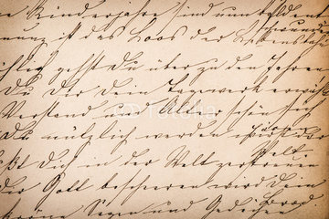




Excalibur, Techspardha ‘16
SCRIBBLE

Slide 2
MOTIVATION
Image Processing+ Machine Learning=Deadly Combination
Rimsha+Aakriti+Ayush=Deadly Combination
Having developed android applications, Team Aakrimya set out to explore the domain of Machine Learning and Image Processing.
This domain is still under exploration and research.

Slide 3
PLATFORM and TOOLS
Prototyping in MATLAB.
User Interface in GUIDE.
Interface Designing in Photoshop.
Executable File (.exe) which will work in all versions of Windows OS.

Slide 4
TARGET AUDIENCE
People searching for Scanned Document to Text Converters.
Students who wish to convert neat, written notes to Editable *.txt format.
People requiring Binarisation of images.
Users with Windows OS.

Slide 5
SCRIBBLE v/s EXISTING
SCRIBBLE is an ICR.
It recognizes Cursive Handwriting unlike the existing OCRs.
SCRIBBLE predicts results using Advanced Techniques like Neural Networks and Image Processing.

Slide 6
COMPATABILITY &
INSTALLATION
The .exe file runs for all versions of Windows OS.
It requires No Internet Connectivity or Installation of any other external module.
It works on simple clicks.
The output text file is a simple and compatible Notepad File.

Slide 7
IMPLEMENTATION
User can upload images of .jpeg format.
Option of cropping and rotating according to user’s requirement is allowed.
A feature of enhancement and image binarisation is available.
Feature of downloading the current state of image is provided.
The handwriting in the selected image is predicted and saved in a text file.

Slide 8
Contd…
The prediction makes use of Artificial Neural Networks with 400 input features for each character.
The ANN is trained with a dataset of 12000 distinct handwritten samples.
The algorithm separates each ‘character’ from each segmented ‘word’ from each extracted ‘line’ of the document and runs prediction on it.

Slide 9
USER
INTERFACE

Slide 10
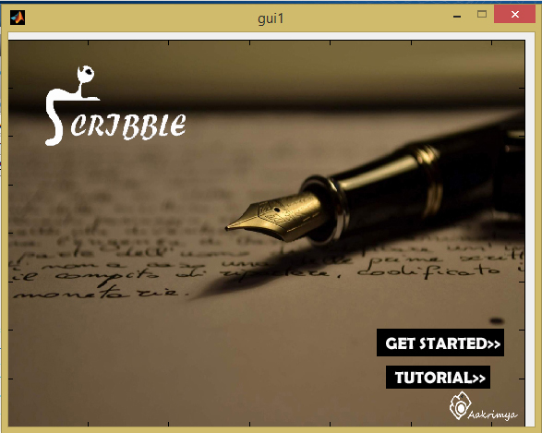

Slide 11
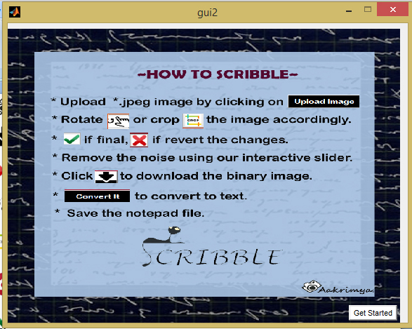

Slide 12
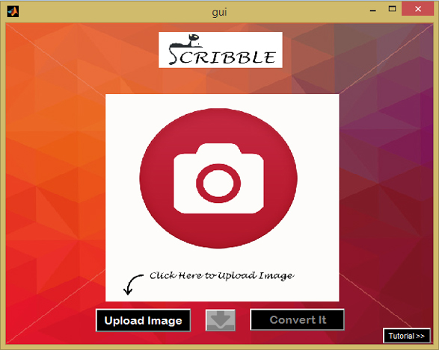

Slide 13
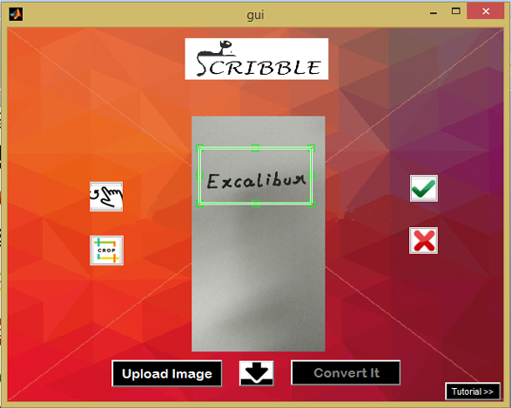

Slide 14
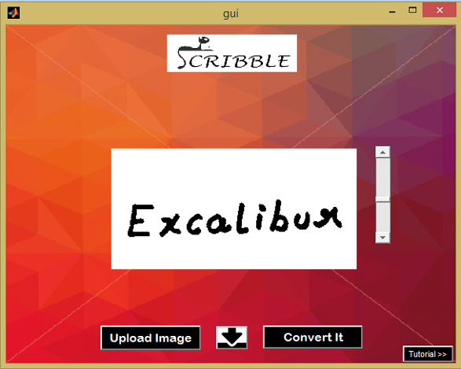

Slide 15
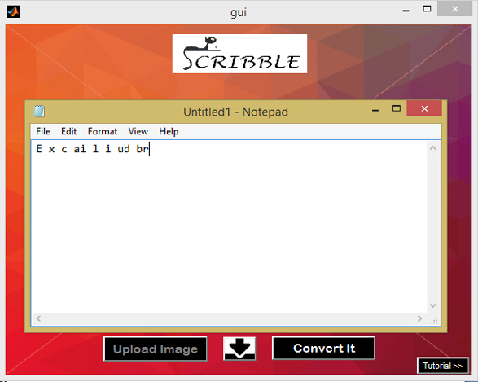

Slide 16
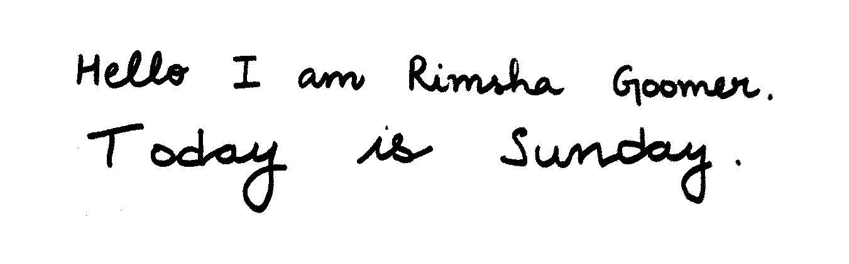
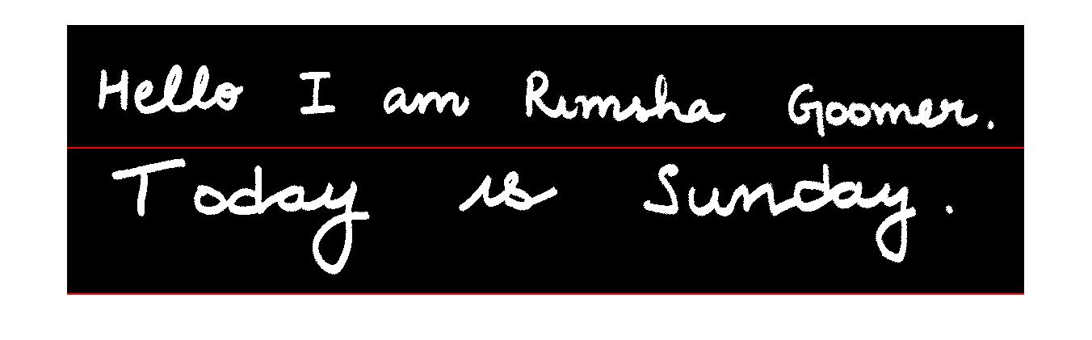
EXTRACTION OF LINES

Slide 17
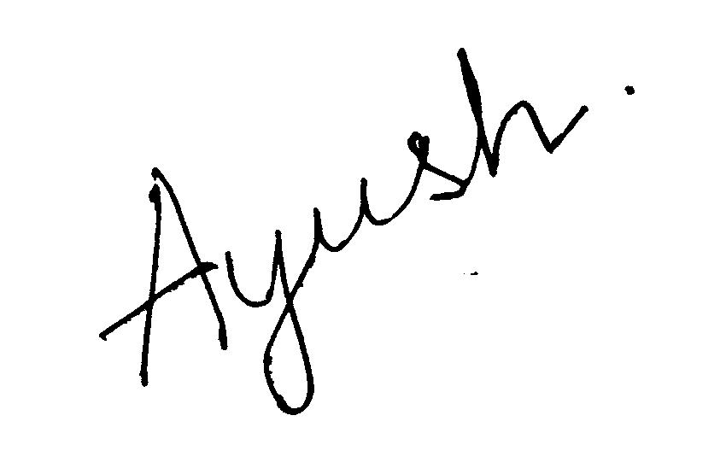
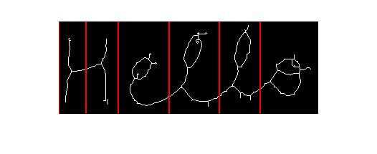
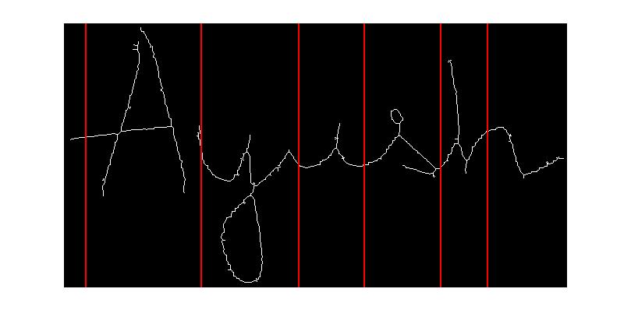
SKEW DETECTION
WORD SGMENTATION

Slide 18
PERKS
Also acts as a light image editing/binarisation software.
Does not require internet connectivity, no use of external modules.
Predicts single characters with 88 % accuracy.

Slide 19
FUTURE SCOPE
The training set can be increased for better prediction results.
This MATLAB prototype can be published as an android application.
Can implement auto-complete dictionary features.
Each user’s test handwriting can be used to train the neural network further.
Output in various formats.

Slide 20
THANK YOU

