Slide 1

Capstone Project Hotel Booking Analysis
BY
RIMSHA HARMAEN
NEHA PANDEY

Slide 2
Work Flow: Work flow is divided into 3 steps as shown below:
Data Cleaning and
Manipulation
Exploratory Data Analysis (EDA)
Data Collection and
understanding

Slide 3
Data Collection and Understanding
First we read the data using pandas library. After collecting the data it’s very important to understand our data. So we had hotel booking analysis data which had 119390 Observations and 32 Attributes. Also we observed there are different types of datatype like integer, float and object.

Slide 4
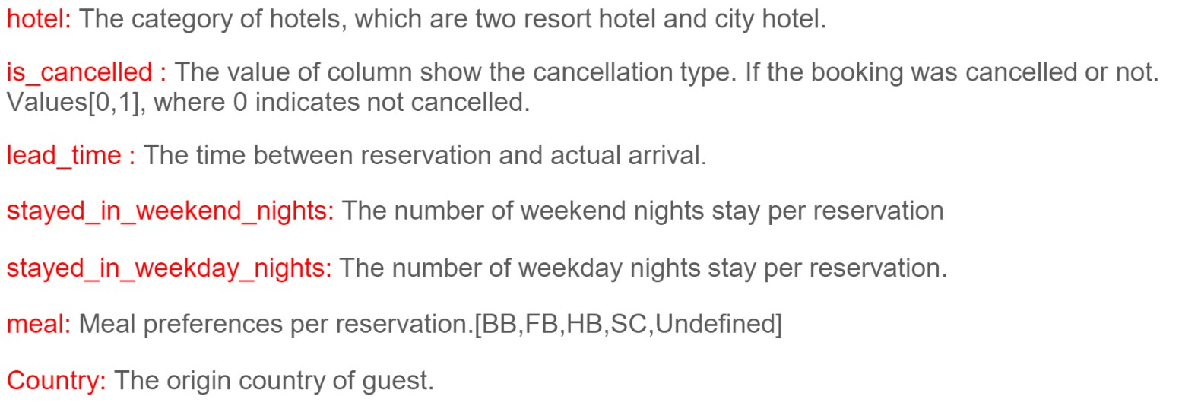
Data Summary
Given data set has different columns of variables crucial for hotel bookings. Some of them are:

Slide 5
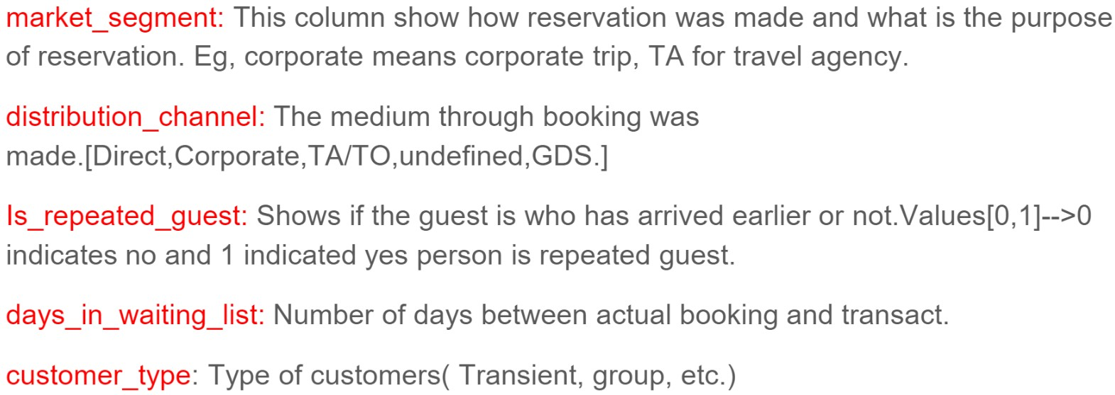
Data Summary(contd..)

Slide 6
Data Cleaning and Manipulation
There were 4 Columns company, agent, country and children with missing values
Then fill the missing value of company with 0,
fill the missing value of country with others,
fill the missing value of children with mean and
fill the missing value of agent with 0.
Handling the Duplicate Data
Data Set had 31994 duplicate values. So we dropped it from the data

Slide 7
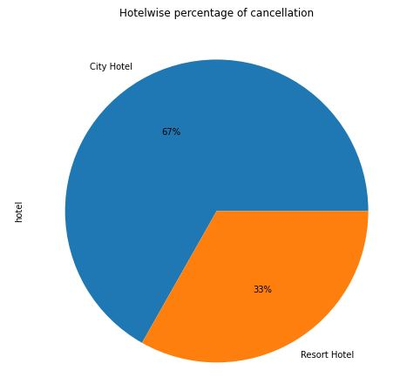
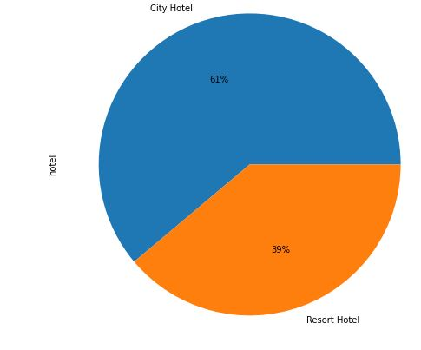
Exploratory Data Analysis (EDA):
Pie Chart showing most preferred hotel
Conclusions:
61% Customers preferred City hotel whereas Resort Hotel was preferred only 39% of customers
Out of the total Cancellations city hotel received 67 % of cancellations and only 33% cancellations was received by Resort Hotel.

Slide 8
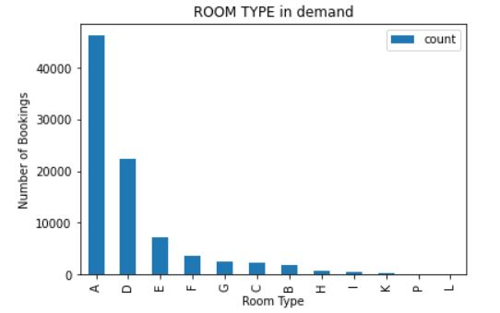
Conclusion: Room type ‘A’ is most preferred, after that room type ‘D’ is most preferred by customers.
Exploratory Data Analysis (EDA):

Slide 9
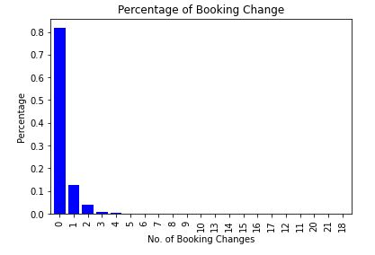
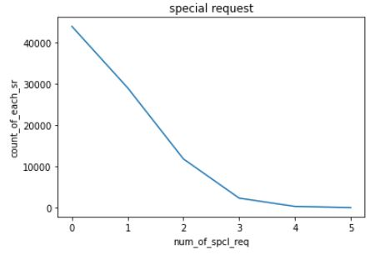
Exploratory Data Analysis (EDA):
Conclusion:
More than 80% customers made no changes in their booking while 10% customers made one change in their booking.
Conclusion:
More than 40000 customers made no special request in their booking while more than 20000 customers made one special request.

Slide 10
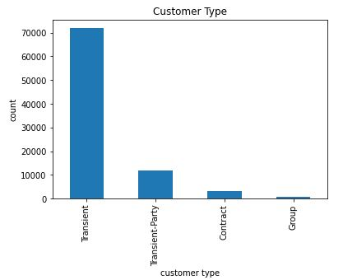
Exploratory Data Analysis (EDA):
Conclusion:
Most of the customers/guests were Transient type.
Contract-when the booking has an allotment or the type of contract associated to it.
Group-when the booking is associated to a group.
Transient-when the booking is not part of a group or contract, and is not associated to other transient booking.
Transient-party-when the booking is transient, but is associated to a least other transient booking.

Slide 11
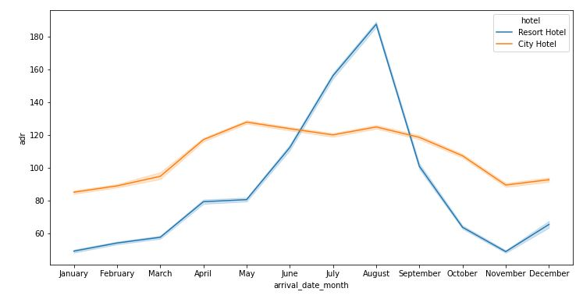
Exploratory Data Analysis (EDA):
Conclusion:
For the month of July and august Resort Hotel has Higher ADR whereas
So in the months of January , February ,
March , April, November and December customers have a chance of getting better ADR.

Slide 12
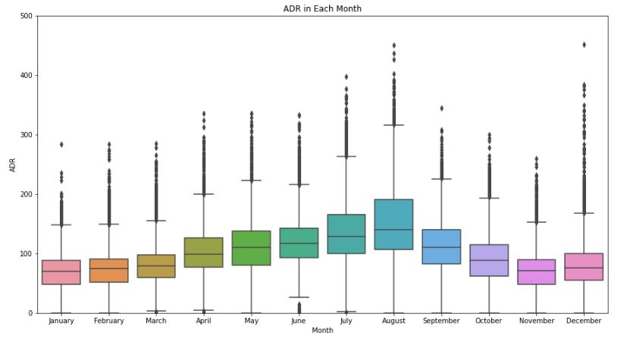
Exploratory Data Analysis (EDA):
Conclusion:
Average ADR rises from January and reaches peak in August and then comes down.

Slide 13
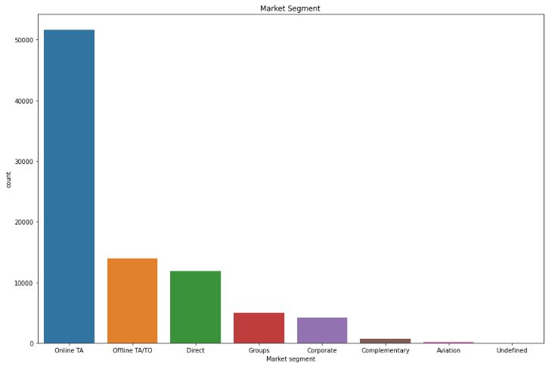
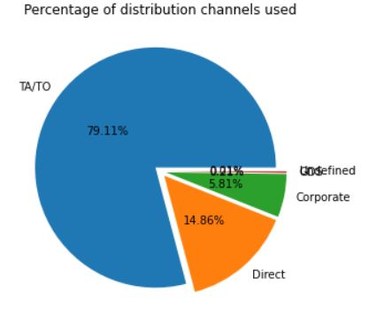
Exploratory Data Analysis (EDA):
Conclusion:
Online TA is most preferred market segment whereas offline TA/TO is the second most preferred market segment.
Conclusion:
TA/TO is most preferred distribution channel with 79.11% share after it customers preferred Direct distribution channel with 14.86% share.

Slide 14
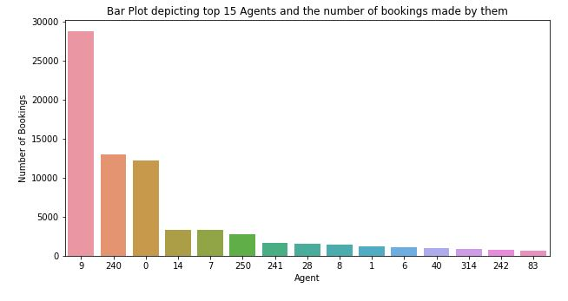
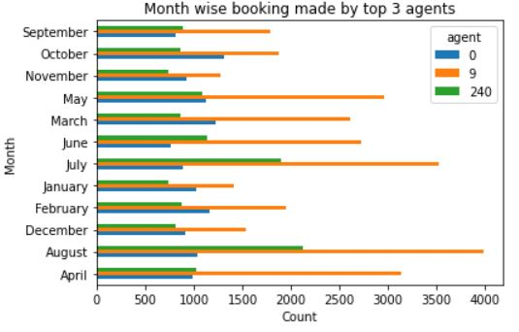
Exploratory Data Analysis (EDA):
Conclusion:
Agent 9 has done most number of bookings. After agent 9 agent 240 has done most number of booking i.e agent 9 is the most efficient agent.
Conclusion:
Agent 9 and 240 has done highest booking in august month which means august is good month for booking through agent.

Slide 15
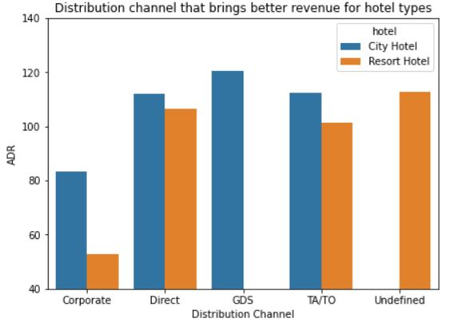
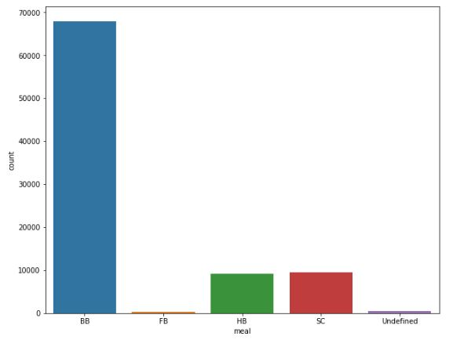
Exploratory Data Analysis (EDA):
Conclusion:
GDS is the most revenue generation distribution channel for City Hotel and undefined is the most revenue generation channel for Resort hotel
Conclusion:
The most preferred type meal by guests is BB(Bread and Breakfast).
After BB, HB (Half Board) and SC (Self Catering) was equally preferred by customers.

Slide 16
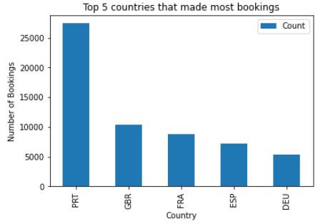
Exploratory Data Analysis (EDA):
Conclusion:
Maximum number of Guests (more than 25000 guests) were from Portugal.
After Portugal Great Britain and France are the countries from which guests visited.

Slide 17
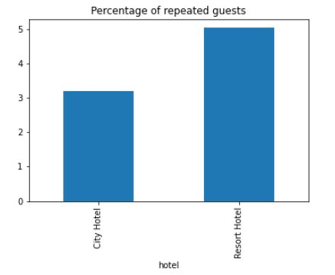
Exploratory Data Analysis (EDA):
Conclusion:
Bar Chart showing number of nights stays in hotels.
Resort hotel received total 5 % of repeated guests out of its total visitors.
City hotel received only 3 % of repeated guests out of its total visitors.

Slide 18
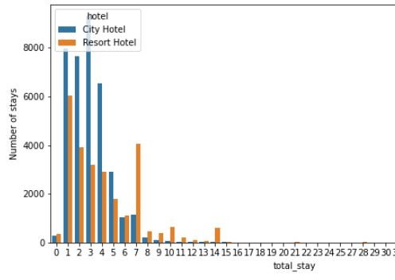
Exploratory Data Analysis (EDA):
Conclusion:
Bar Chart showing number of nights stays in hotels.
3 Night stay is most preferred in City hotel and
1 Night stay is most preferred in Resort Hotel

Slide 19
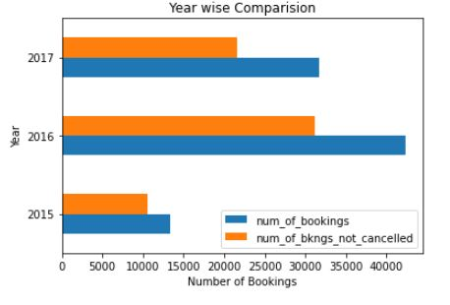
Exploratory Data Analysis (EDA):
Conclusion:
In the Year 2016 Maximum number of bookings was received by both the hotels.

Slide 20
THANK YOU

