Slide 1
Team : 2003A51013 Rimsha Mujeeb 2003A51019 Finza Tazeen Under guidance of T . Sampath Kumar Sir
CAFÉ RECOMMENDATION SYSTEM
Java course project

Slide 2
CONCEPTS:
GUI (swings)
Frames(swings)
Files
Exception Handling
Conditional Statements

Slide 3
Problems Faced:
1.Adjusting the project across many frames.
2.Raising Exceptions in GUI.
3.Searching and showing all the café s names & address that have that menu accurately

Slide 4
How Problems were solved:
1.multiple frames achieved through simple setVisible() command
2.In exceptions we used Textfields.
3.To reset we have set the fields to null.

Slide 5
INTRODUCTION:
The Aim of the project is to create a user-friendly model to identify cafeteria's provide the food items they desire to enjoy thus connecting both customers and café stores effectively.

Slide 6
OBJECTIVE:
The main objective of our project is to create a user-friendly site to assist users to locate places easily based on their cravings.
It provides café owners with an option to update their MENUS at regular interval of time.

Slide 7
FLOW DIAGRAM:
Update Menu
Café Owner
Select Your Cafe
Login
Invalid Login
INPUT
List of Recommended Cafes
Customer
Search Food Item

Slide 8
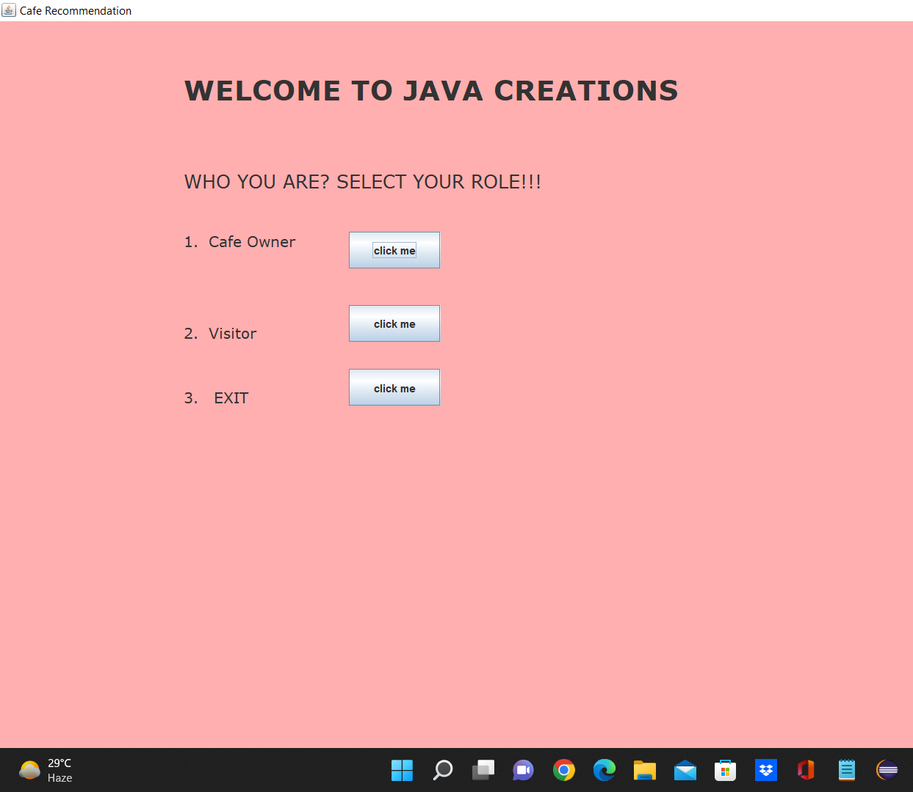
GUI-HOMEPAGE :

Slide 9
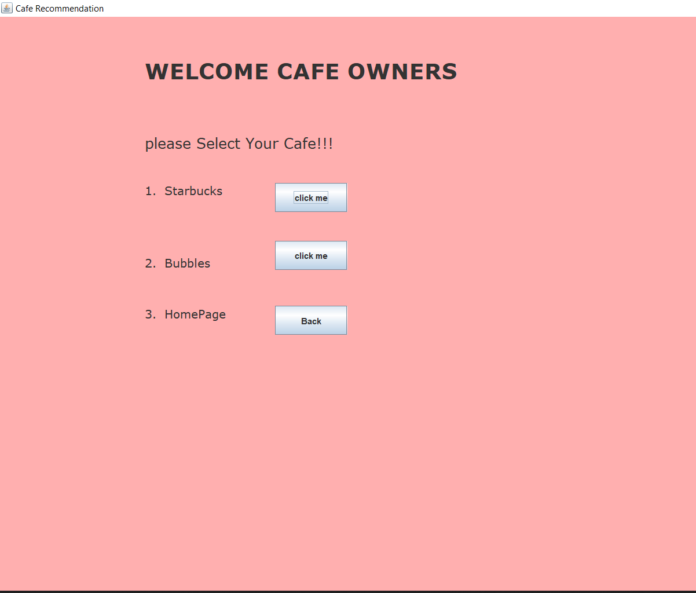
GUI-CAFÉ OWNERS PAGE:

Slide 10
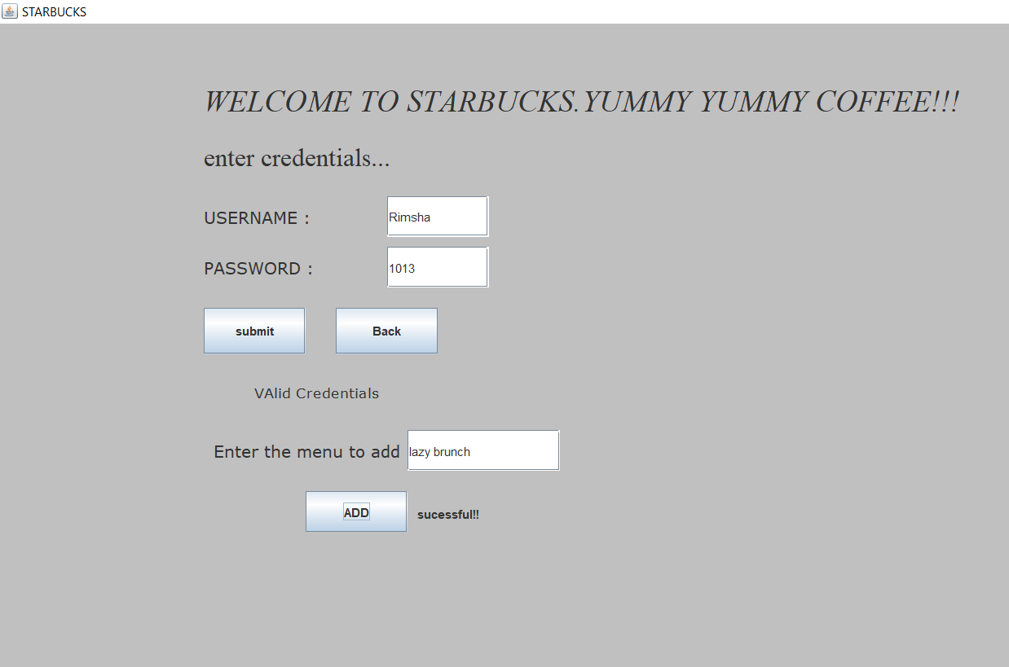
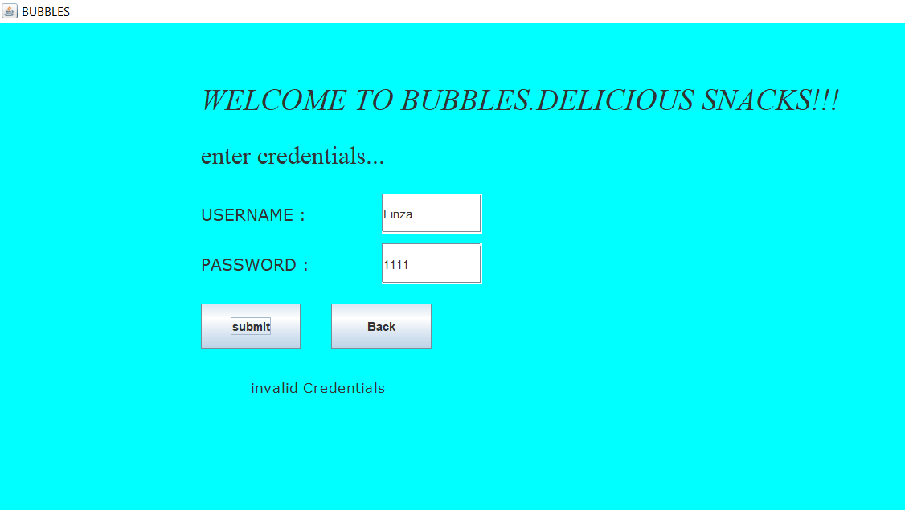
INDIVIDUAL OWNERS PAGE:
STARBUCKS
BUBBLES

Slide 11
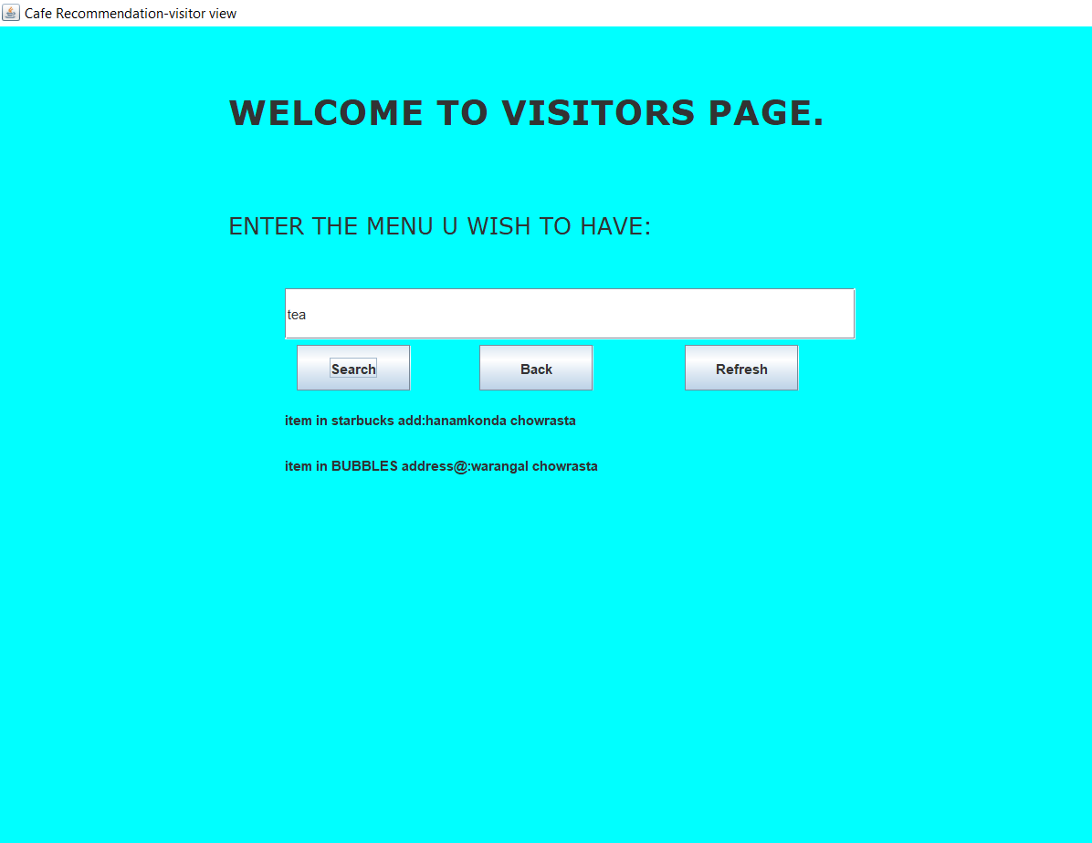
GUI-VISITORS SECTION:

Slide 12
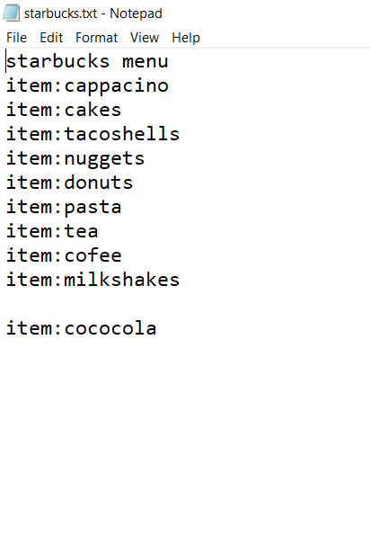
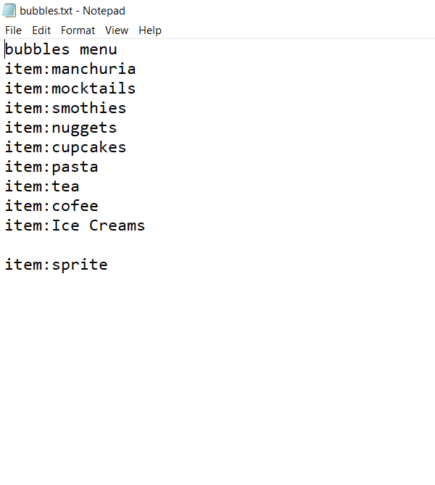
FILES AFTER APPENDING

Slide 13
References:
Java lab Notes
TEXTBOOKS:
Java The Complete Reference (Herbert Schildt , Mc Graw)
Understanding OOPC (T.Budd ,Pearson Education)

Slide 14
THANK YOU ☺

