Slide 1

>>>Python.intro()
Knowledge sharing
DRAFT FOR DISCUSSION

Slide 2
Disclaimer
Zen of Python: https://www.python.org/dev/peps/pep-0020/

Slide 3
Contents Template
Topic # | Topic | Slide #
1 | Python Installation – Navigating Jupyter, Installing Packages | 3
2 | Data Structures | 4
3 | Data Manipulation with Pandas | 5
4 | Analytic toolbox from python + Demo | 6
5 | Codelabs
6
7

Slide 4
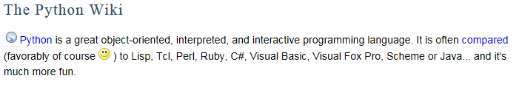
What is Python?
>>> Open source General-purpose programming language
>>> Supports object-oriented programming
object.method(another_object)
Self.find(the_one)
>>>
Want to know the philosophy behind? Read “Zen of Python”: https://www.python.org/dev/peps/pep-0020/

Slide 5
…But why?
>>> Highly extensible with the use of packages
>>> Intended to be highly readable
>>> Open Source
>>> Used in wide array of applications e.g web development (Django), machine learning(scikit, tensorflow), Scientific research etc.
>>> Great documentation and developer community
>>> Easy to learn

Slide 6
How to Install?
While there are a lot of ways to install python we’ll be using package:
ANACONDA
Easy installation
Data Science Packages are already available
Installs Jupyter Notebook – handy for collaborative working
Includes Spyder – Rstudio like environment

Slide 7
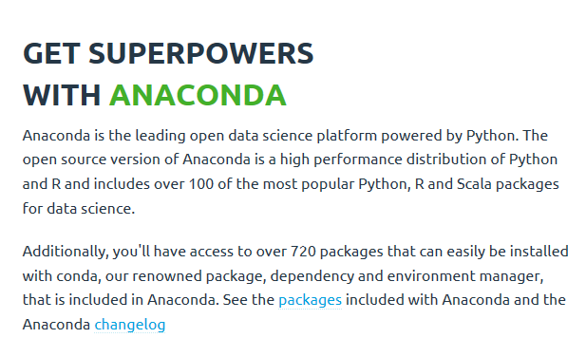

Slide 8
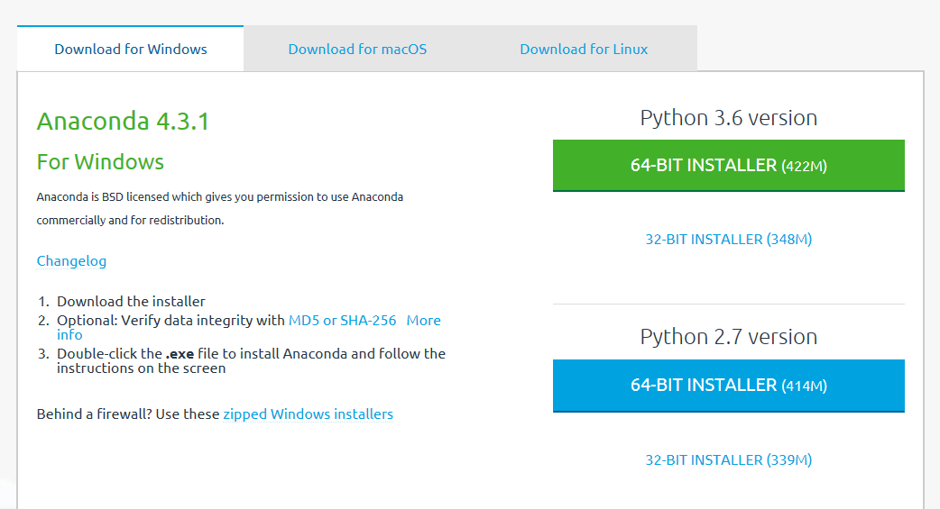
Which version to use?

Slide 9
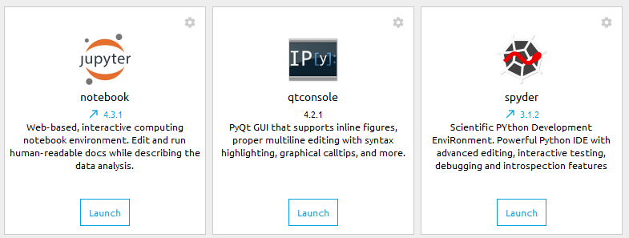
Applications Bundled with Anaconda

Slide 10
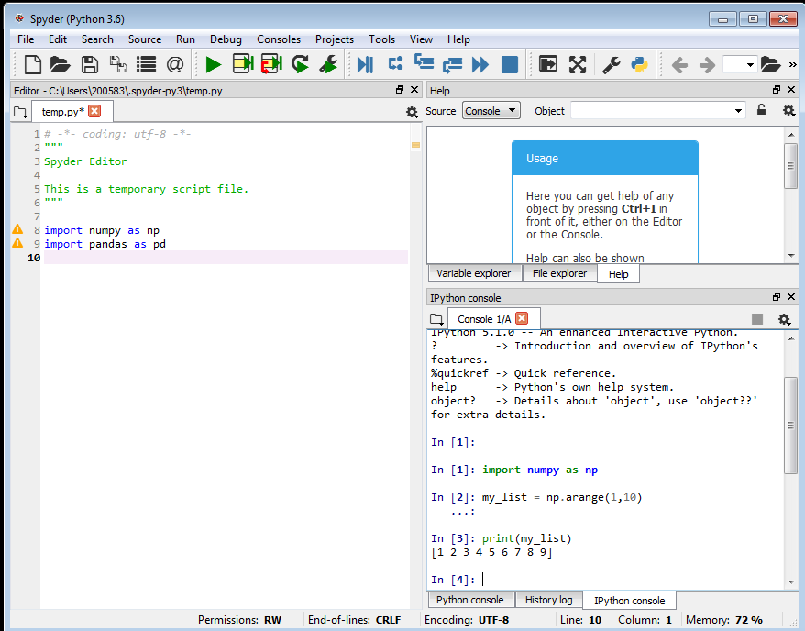
Spyder

Slide 11
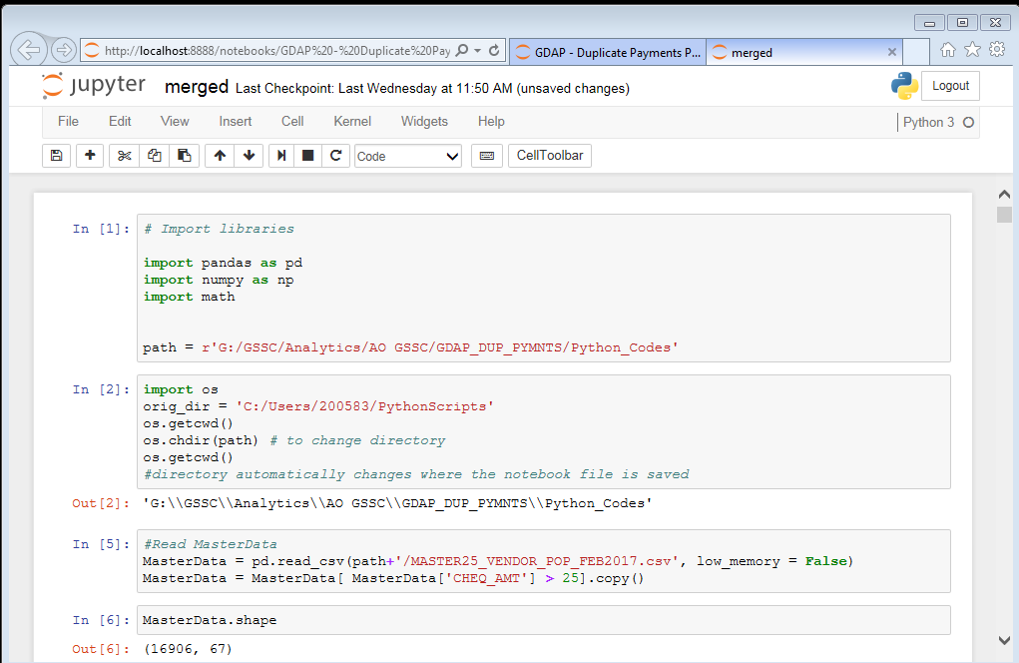
Jupyter Notebook

Slide 12
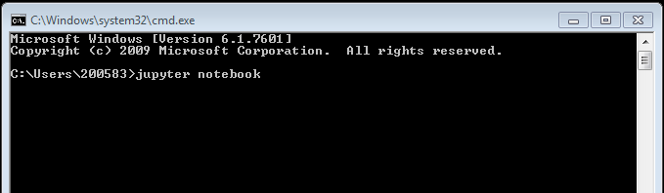
Launching the Jupyter Notebook
If the application cannot be launched from start menu, launch directly from command prompt using the command below:
Alternatively, we can launch via web browser by this address:
http://localhost:8888/tree

Slide 13
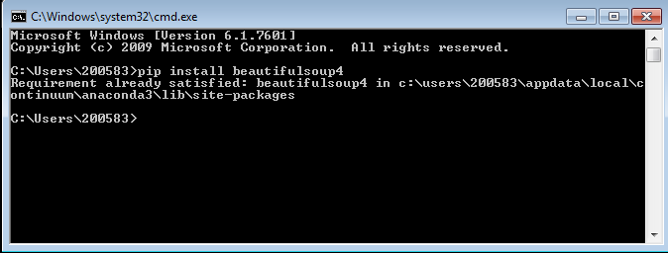
Need some packages?
We can install packages via pip.
For example, $ pip install beautifulsoup4

Slide 14
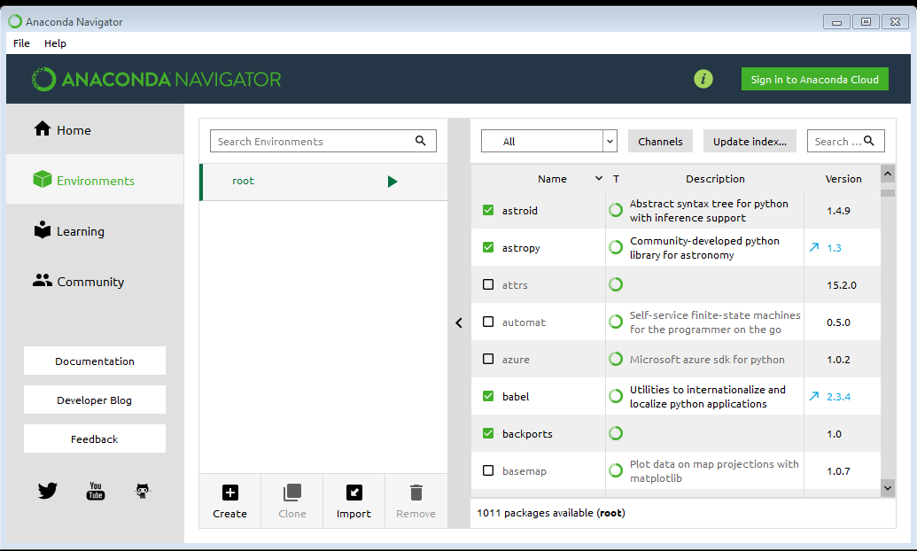
We can also Update/Install packages from Anaconda Navigator

Slide 15
Too Much Talk! I want a demo!

Slide 17
Agenda Template
Day X
Time
Agenda item
Who
Objectives
10:00-10:30 | Introduction | XX
10:30-11:30 | Topic 2 | XX
11:30-12:30 | Topic 3 | XX
12:30-13:30 | Lunch
13:30-14:30 | Topic 4 | XX
14:30-16:30 | Topic 5 | XX
16:30-17:30 | Topic 6 | XX
17:30-18:00 | Topic 7 | XX
19:00+
XXXXX
XXXXX

Slide 18
Four Blocker Template
Section 1
Section 2
Section 3
Section 4

Slide 19
Two-blocker Comparison Template
Section 1
Section 2

Slide 20
Table Template
TITLE |  | TITLE | TITLE | TITLE | TITLE
 |  | Text | Text | Text | Text
Text | Text | Text | Text | Text | Text
Text
Text
Text
Text

Slide 21
Sample Pie Chart
Key Observations

Slide 22
Sample Bar Chart

Slide 23
Questions & answers

Slide 24
Thank you
Contact Person Name
Contact Person Title
telephone +61 2 9123 4567
contact.person@qbe.com
www.qbe.com/lorem
Contact Person Name
Contact Person Title
telephone +61 2 9123 4567
contact.person@qbe.com
www.qbe.com/lorem

Slide 25
Disclaimer

