Slide 1
TEAM TWINPULSE
GlucoTwin
Glucose forecasting with
inspectable reliability
Digital Twin Challenge 2026
Research prototype
Notes:
Team TwinPulse presents GlucoTwin, a research prototype that forecasts glucose from recorded CGM observations. Explain the project as a limited patient-state model. The dashboard processes observations incrementally. It has no live hardware connection and offers no treatment recommendations. The central result is an 11.1% relative reduction in patient-mean 30-minute MAE against persistence. Scoring v2 corrects causal warning emission and censoring. The Reliability Lab adds controlled delivery disruptions and forecast receipts. Team details appear on the closing slide.

Slide 2
THE PROBLEM
Why glucose forecasting?
A reading describes now.
A forecast estimates what comes next.
We want to support earlier review of rising glucose
and make the evidence behind each forecast visible.
Intended benefit: better-informed review. Clinical benefit requires a separate study.
02
Notes:
A sensor reading describes the present. We are investigating whether recent glucose dynamics help estimate the next 30 minutes. The intended user today is a researcher or clinician reviewing recordings. Better health outcomes remain a future question. Diabetes relevance in India motivates the project but does not validate this model for Indian patients. Motivation source: WHO India, https://www.who.int/india/health-topics/diabetes. Project scope: docs/PROTOCOL.md.

Slide 3
THE PROTOTYPE
What GlucoTwin does
60 min
6
30 min
of recent glucose history
future glucose estimates
forecast horizon
Receive a reading. Update the patient state.
Compare the issued forecast when its outcome arrives.
Clinical and activity fusion engines share the same workflow.
03
Notes:
The system receives linked baseline clinical information and dynamic observations. Its patient state records recent glucose, quality and previously issued forecasts. It computes six future estimates. The dashboard can reveal later readings for comparison, but those readings never enter the earlier forecast. The clinical and activity engines implement data fusion. Validation chose the simpler CGM-only model. Sources: core.py, prepare.py, app.py, reports/frozen_config.json.

Slide 4
DATASET
Real clinical and sensor records
45
Source cohort | Participants
Type 2 diabetes | 14
Prediabetes | 16
Without diabetes | 15
linked participant records
Clinical profile
Age, BMI, HbA1c and fasting glucose
Dynamic observations
CGM with available heart rate and activity
US research cohort. Published CGM contains interpolation. Native-sensor replication required.
04
Notes:
CGMacros v1.0.0: https://physionet.org/content/cgmacros/1.0.0/
Local sources: reports/audit_summary.json, reports/data_audit.csv, docs/PROTOCOL.md.
We downloaded 48 numeric CSV members, verified member CRC32 checks, and recorded member SHA256 values. We did not download or verify the complete photo archive. The source contains interpolation. Our fixed five-minute phase reconstruction reduces reuse of interpolated minute values, but cannot establish original sensor timestamps. Keep this caveat visible. Source license: CC BY-NC-SA 4.0.

Slide 5
SYSTEM DESIGN
The patient state and update cycle
01 Clinical profile
02 Dynamic state
Baseline measurements remain linked
to the same participant.
New readings update recent history
and input-quality checks.
03 Forecast
04 Outcome check
Six estimates cover the next
five to thirty minutes.
Later observations measure the error
of previously issued forecasts.
Clinical fusion uses both streams. The validation winner uses CGM history and time features.
05
Notes:
A limited digital twin is a changing patient-specific data representation. It does not estimate physiology such as insulin sensitivity. The state stores the linked profile, thirteen five-minute glucose points spanning an hour, quality information and pending predictions. Each update matures old errors before issuing a new forecast. It requires sufficient uninterrupted glucose history. Optional online bias correction uses matured errors only. Validation selected an update rate of zero, so deployed adaptation is disabled. Sources: core.py; reports/frozen_config.json.

Slide 6
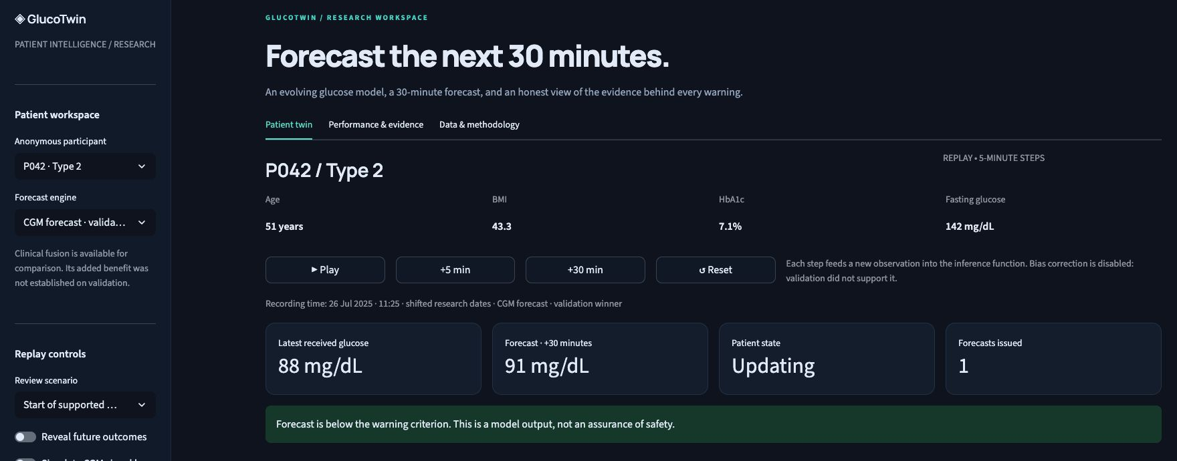
ACTUAL PROTOTYPE SCREENSHOT
The working dashboard
Recorded-data replay with incremental inference. Screen captured from the local application.
06
Notes:
Point to participant and engine selection, the linked clinical profile, controls, current reading and forecast. Each step passes a new observation to TwinState.update. The chart shows observed CGM, the issued forecast and, for the selected model, empirical residual bands. Future outcomes are hidden until explicitly revealed. Screenshot source: local http://127.0.0.1:8502/, captured 19 October 2026. Original screenshot stored in tmp/pptx/assets/dashboard-overview.png. No patient name or identifying original date is shown.

Slide 7
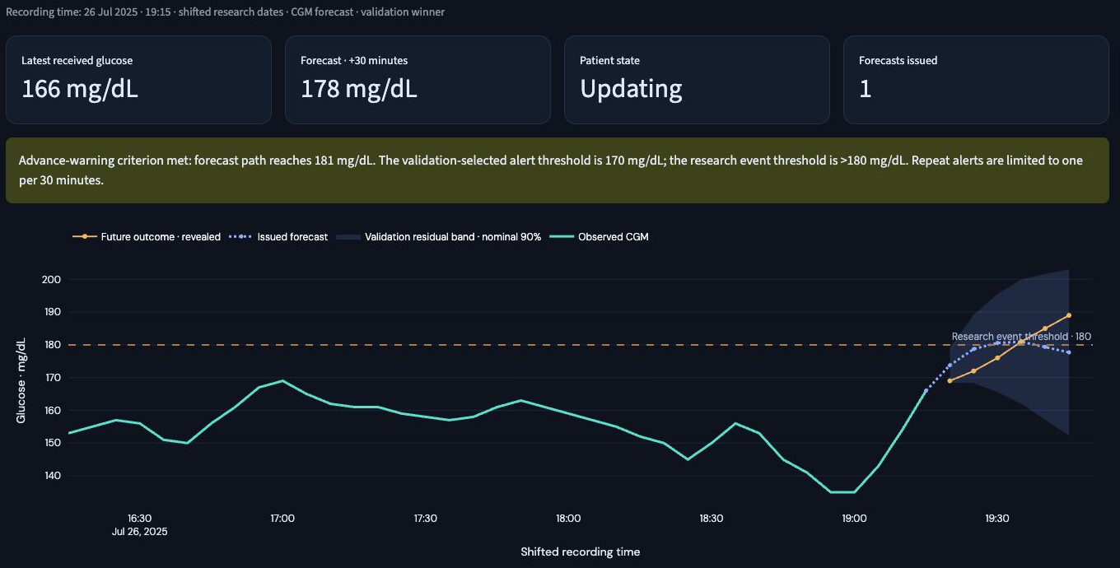
ACTUAL RECORDED EXAMPLE
One forecast, checked against later readings
P042, 26 Jul 2025, 19:15. Shifted research date. Scenario selection uses known outcomes.
07
Notes:
The displayed current value is 166 mg/dL. The issued path peaks near 181 and ends near 178 at +30 minutes. The path satisfies the alert criterion of 170. A sustained research onset begins at 19:35, twenty minutes after this saved qualifying score. Reveal later CGM only for review. Scenario jumps reset local replay state and cooldown, so this is a selected forecast example, not an exact reproduction of every emitted alert. Sources: reports/documentation_event_audit.json; reports/test_results.json; saved artifacts/test_replay.joblib. Screenshot source: local dashboard, tmp/pptx/assets/success-full.png.

Slide 8
EVALUATION DESIGN
We kept participants separate
27
9
9
participants for training
for validation
reserved for testing
8 test participants had scoreable forecasts.
Only 3 had Type 2 diabetes.
Same 18,746 supported test timestamps across forecast comparisons.
08
Notes:
The split is deterministic and cohort-stratified: 27 training, 9 validation, 9 reserved test participants. No participant belongs to multiple partitions. The first 24 hours establish cadence and do not enter scored predictions. One test participant has no supported post-initialization windows under the fixed cadence rule. Eight participants therefore contribute forecast-error metrics, including only three with Type 2 diabetes. All nine remain in monitoring coverage. Model and warning thresholds were selected on validation and frozen before the recorded test. Sources: reports/splits.json; reports/frozen_config.json; reports/test_comparison.csv; docs/PROTOCOL.md.

Slide 9
MAIN RESULT
11.1% lower average forecast error
Eight scoreable test participants. Patient-mean MAE at +30 min, mg/dL. Lower is better.
09
Notes:
Source: local frozen evaluation, 19 Oct 2026. Patient means at +30 minutes, mg/dL.
Boosted CGM was selected on validation, not the test ranking. Persistence MAE 14.2117565142; boosted MAE 12.6384222076. Relative reduction 11.0707%. This is an average error reduction, not an accuracy percentage. Clinical fusion is numerically slightly lower on test but did not win validation. RMSE remains 18.62 for selected boosted CGM, versus 21.14 for persistence. No independent-cohort replication or confidence interval establishes the small fusion difference. Source: reports/test_comparison.csv; reports/validation_forecasts.csv.

Slide 10
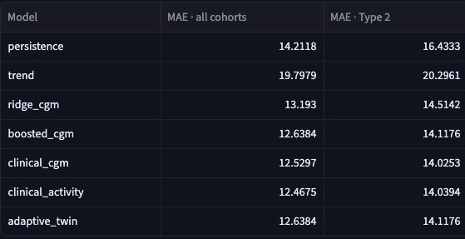
ACTUAL RESULTS SCREENSHOT
Results visible inside the product
Every model uses
the same eligible
test timestamps.
The dashboard exposes
model-level and
participant-level errors.
Crop shows the forecast-error columns. Warning metrics require the audit on slide 12.
10
Notes:
This is a crop of the actual application results table, with model identifiers and all-cohort and Type 2 MAE columns. It is not a rendered mockup or a chart invented for the slides. The adaptive_twin row equals boosted_cgm because validation disabled bias correction. A separate native chart and appendix table provide fully editable values. Screenshot source: local application Performance & evidence tab, 19 October 2026, tmp/pptx/assets/results-full.png.

Slide 11
ABLATION RESULT
Clinical fusion needs more evidence
Model | Validation | Reserved test
Boosted CGM | 10.55 | 12.64
Clinical + CGM | 10.65 | 12.53
Clinical + CGM + activity | 10.62 | 12.47
CGM-only won validation.
Online bias correction also failed to improve validation.
The deployed update rate is zero.
MAE in mg/dL. Model selection uses validation, even when test rankings differ.
11
Notes:
The clinical_cgm engine adds baseline age, BMI, HbA1c and fasting glucose. The clinical_activity engine adds available dynamic activity and coverage indicators. The selected model remains boosted CGM because it had the best validation MAE. The small fusion advantage in test does not establish general improvement. We should retain the frozen winner and repeat matched ablations on independent data. Tested online bias update rates were 0, 0.03 and 0.1. Zero won validation, so adaptation is disabled. Sources: reports/validation_forecasts.csv, reports/test_comparison.csv, reports/frozen_config.json.

Slide 12
SCORING V2
Corrected warning evaluation
162 / 163
What changed
Every emitted warning
advances cooldown.
Incomplete outcomes
remain censored.
eligible onsets credited
268 false warnings
3 warnings with unknown outcomes
Type 2 false-warning burden
0.466 per eligible non-event hour
Frozen models and thresholds. Retrospective research counts, not overall accuracy.
12
Notes:
Scoring v2 emits warnings using current supported scores, advances cooldown for every emission, and matches observed sustained positive onsets despite gaps later in follow-up. Unmatched alerts without 45-minute complete follow-up are censored. Selected model: 162/163 onsets credited, 268 false warnings, 3 censored alerts, 0.231600 false warnings per eligible non-event hour, median credited lead 10 minutes. Type 2: 106/106 credited, 161 false warnings, 1 censored, 0.466441/hour, three participants. Persistence: 139/163 at 0.212588/hour. No retraining or threshold tuning. Thresholds were originally selected with scoring v1. The test cohort is small and inspected. No clinical usefulness claim follows. Sources: reports/scoring_v2_audit.json; reports/test_results.json. Old outputs remain in reports/scoring_v1/.

Slide 13
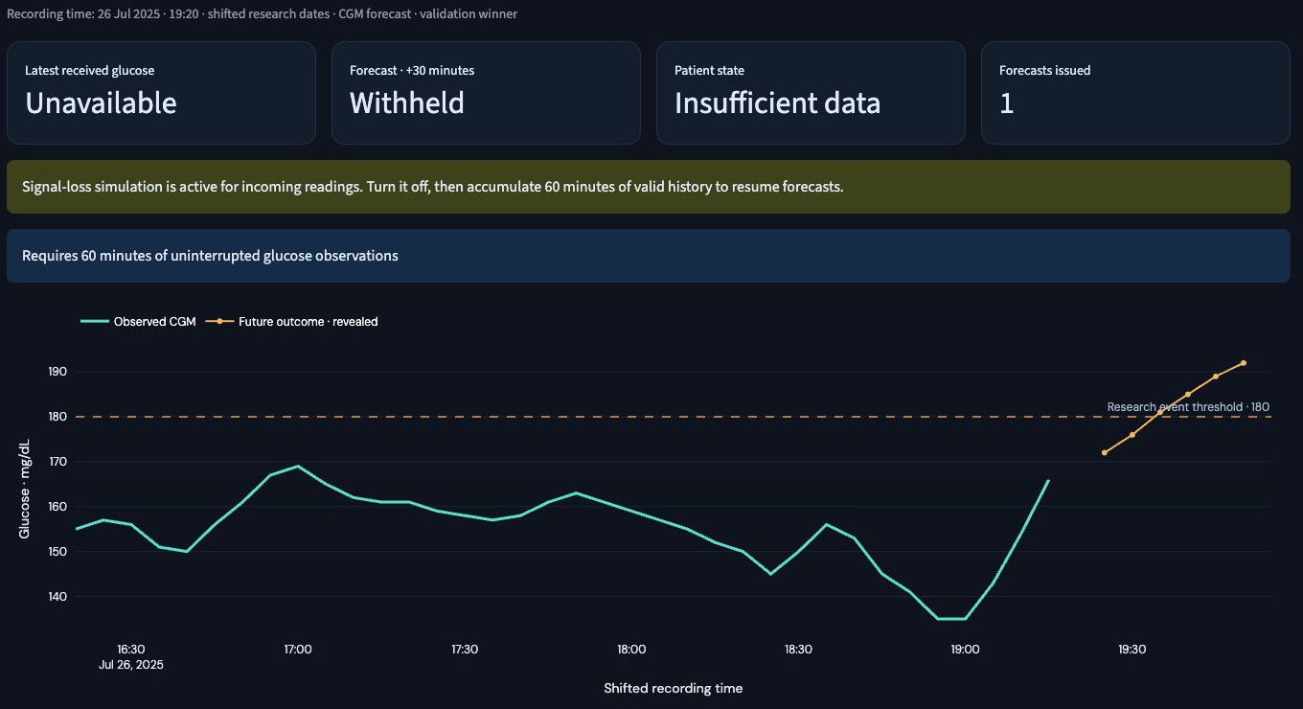
ACTUAL RELIABILITY BEHAVIOR
Missing data produces a withheld forecast
Signal-loss simulation. Forecasting resumes after sufficient uninterrupted history returns.
13
Notes:
We activated loss for incoming CGM, advanced a single five-minute step, and captured the resulting unavailable input, withheld forecast and insufficient-data state. This proves an input-rule behavior rather than clinical reliability. The historic source data can contain interpolation, so raw native sensor missingness still requires validation. The revealed future curve is a review-only outcome and is not available to the inference function. Screenshot source: local app at P042, 19:20 shifted research time, captured 19 October 2026, tmp/pptx/assets/loss-full.png.

Slide 14
OPERATING LIMITS
Uncertainty and monitoring coverage
86.5%
78.8%
observed coverage of
a nominal 90% band
monitoring time with
a supported forecast
The 30-minute error band spans 50.8 mg/dL.
Average forecast improvement still leaves large errors.
Patient-mean test measurements. One unsupported test participant remains in monitoring coverage.
14
Notes:
Residual interval half-widths come from the validation absolute-error 90th quantile at each forecast horizon. Test outcomes fall within the band 86.5% on average across scoreable participants, below its nominal 90% target. The 30-minute width is 50.8 mg/dL. This is an empirical error interval and not an event probability. Forecast monitoring coverage is 78.8% across nine reserved participants including P018 with no supported windows, and 93.7% in the Type 2 subset. Source: reports/test_results.json, reports/frozen_config.json, reports/test_comparison.csv.

Slide 15
FORECAST RELIABILITY LAB
Disruption reduces forecast availability
Retained forecasts equal normal forecasts on the same inputs.
The result measures availability, not better predictive accuracy.
All 9 reserved participants, including one unsupported recording. Controlled delivery faults.
15
Notes:
Frozen-model engineering stress test. Normal patient-mean coverage 78.7997%, repeated 15-minute loss every 6 hours 62.4216%, 10-minute delivery delay for 30 minutes every 6 hours 59.1904%. The latter rejects packets older than five minutes. Gaps require new uninterrupted history, with no carry-forward or backfill. Loss withholds 3909 extra rows. Delay withholds 4680 extra rows and rejects 2213 stale packets. Scenario MAEs use different retained targets; paired normal MAE matches exactly on each retained set. No accuracy improvement is claimed. The mask can reuse saved predictions because retained inputs are unchanged. Tests establish incremental parity of retained windows. This is a controlled transport stress test on inspected test data, not new independent clinical validation. Source: reports/reliability_benchmark.json.

Slide 16
INPUTS AND OUTCOMES
A receipt for an actual issued forecast
Issued at 2025-07-26 11:25:00
Target time | Issued glucose | Later observed
11:30 | 87.1 mg/dL | 85.0 mg/dL
11:35 | 87.2 mg/dL | 81.0 mg/dL
11:40 | 88.7 mg/dL | 80.0 mg/dL
11:45 | 89.9 mg/dL | 81.0 mg/dL
11:50 | 89.7 mg/dL | 85.0 mg/dL
11:55 | 90.7 mg/dL | 91.0 mg/dL
13 received inputs
6 fixed predictions
Later outcomes
Download JSON
from the dashboard
Content hash checks the issued payload. It is not a signature or authenticated medical record.
16
Notes:
Receipt generated from P042 at the first supported timestamp, using the frozen boosted-CGM model and actual incremental updates. The receipt preserves an input snapshot, model-artifact SHA256, issued timestamp and six forecast values. Outcomes append after target readings arrive. The payload hash excludes later outcomes and remains checkable. Clinical profile is retained but not used by the CGM-only model. Recent errors use only observed matured +30-minute targets, with a maximum of 20, and are descriptive overlapping errors. Source: output/evidence/example_forecast_receipt.json; reliability.py; tests/test_reliability.py.

Slide 17
ROADMAP
What we must establish next
Replicate on native CGM observations
Use original device timestamps and a larger
independent Type 2 cohort.
Broaden the delivery stress tests
Test different delays, fault schedules and
real device transport behavior.
Evaluate a real care workflow
Study usability and acceptable warning burden
before clinical-benefit claims.
17
Notes:
The scorer correction and engineering disruption lab are complete. Future work is independent replication on native CGM observations, broader transport fault schedules, and prospective evaluation. Current source interpolation, small cohort and Type 2 false-warning burden remain material limits.

Slide 18
GLUCOTWIN
Team TwinPulse
Rimzim Kumari
Aksh Agrawal
Team Leader
CSE, VIT Bhopal
Team Member
ECE, VIT Vellore
11.1% lower average forecast error.
Next: independent replication.
18
Notes:
Team details supplied by the user: Rimzim Kumari, leader, CSE, VIT Bhopal; Aksh Agrawal, ECE, VIT Vellore. No specific work split or qualifications beyond those details have been inferred. Close with the measured result and the transparent limits. Project proof today is a functioning incremental forecast demo with separate-patient evaluation and a documented scoring weakness.

Slide 19
APPENDIX
Full forecast comparison
Model | Validation | Test | Type 2 test
Unchanged glucose | 11.37 | 14.21 | 16.43
Recent trend | 16.72 | 19.80 | 20.30
Linear CGM | 10.79 | 13.19 | 14.51
Boosted CGM (selected) | 10.55 | 12.64 | 14.12
Clinical + CGM | 10.65 | 12.53 | 14.03
Clinical + CGM + activity | 10.62 | 12.47 | 14.04
30-minute patient-mean MAE, mg/dL. Test: 8 scoreable participants, including 3 with Type 2.
19
Notes:
Source: local frozen evaluation, 19 Oct 2026. Patient means at +30 minutes, mg/dL.
All model values come from reports/test_comparison.csv and reports/validation_forecasts.csv. Adaptive_twin equals boosted_cgm with alpha 0 and is not an independent method improvement. Trend extrapolates 15-minute slope capped at +/-2 mg/dL/minute. Learned models predict deltas from the current glucose. Training balances participant contributions. No confidence interval is reported. Preserve units and cohort denominators when quoting these values.

Slide 20
APPENDIX
Sources and reproducibility
CGMacros v1.0.0
physionet.org/content/cgmacros/1.0.0/
Dataset license: CC BY-NC-SA 4.0
Frozen experiment and audit
reports/test_comparison.csv
reports/frozen_config.json
reports/documentation_event_audit.json
Local demo: python3 glucotwin/run.py
Verification: python3 scripts/check.py (inside glucotwin)
20
Notes:
Data source: CGMacros v1.0.0 https://physionet.org/content/cgmacros/1.0.0/. Motivation: WHO India Diabetes https://www.who.int/india/health-topics/diabetes. Experiment and evidence: reports/frozen_config.json; reports/test_comparison.csv; reports/test_results.json; reports/documentation_event_audit.json; reports/verification.json. Eight existing meaningful checks passed before the warning boundary audit. That audit shows why passing tests does not establish model validity. Reproducing the old evaluator reproduces its flaw. Scoring v2 corrects causal emission and censoring, retaining frozen thresholds. Team and institution details come directly from the user.

