Slide 1
블럭요소와 앨리먼트요소 구분하기
- 마몽드 메인페이지 -

Slide 2
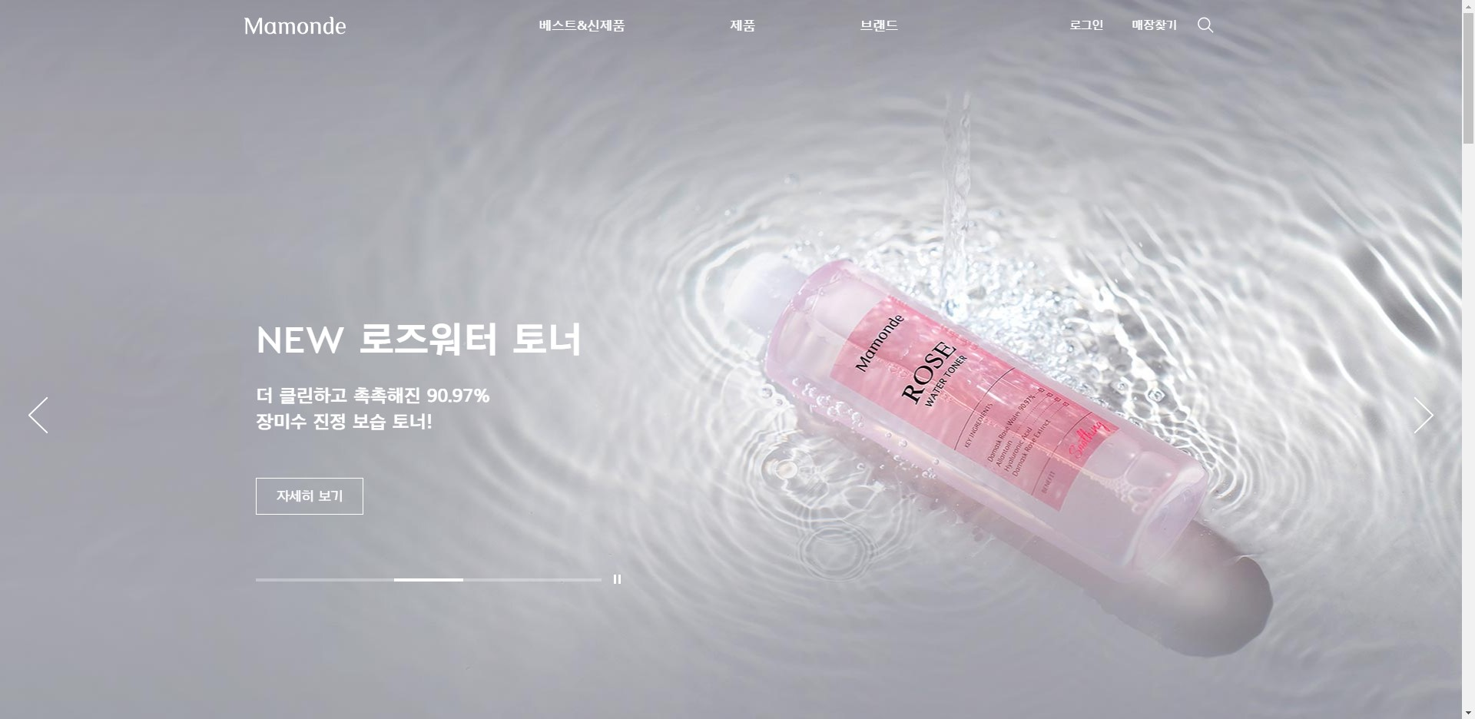
wrapper
Header(fixed)
Logo(h1)
nav
util
Ul > li
main
Common-btn
Common
Arrow-prev
Common
Arrow-next
Common-pagenation

Slide 3
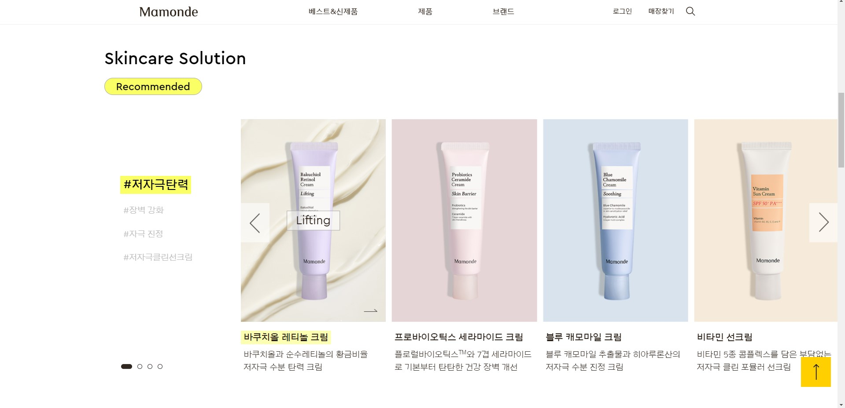
Header(fixed)
Section-header
Title (h2)
Section-body
Common Main-arrow
*여기썸넬 공통으로 하기엔 애매함(메인과다름) 주석으로 미리말씀드리기*
Swiper-wrap
Pagination
section

Slide 4
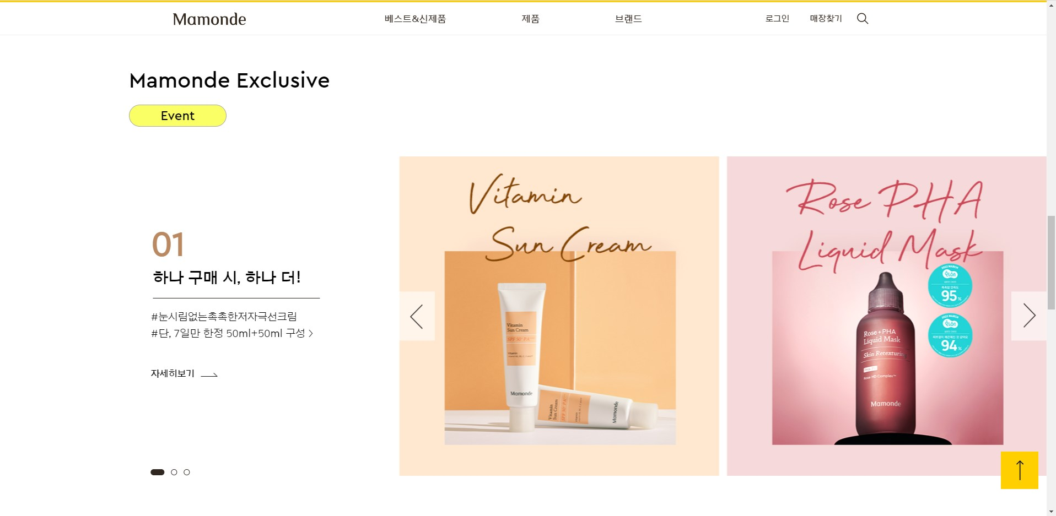
Header(fixed)
Section-header
Title (h2)
Section-body
Swiper-wrap
Pagination
section

Slide 5
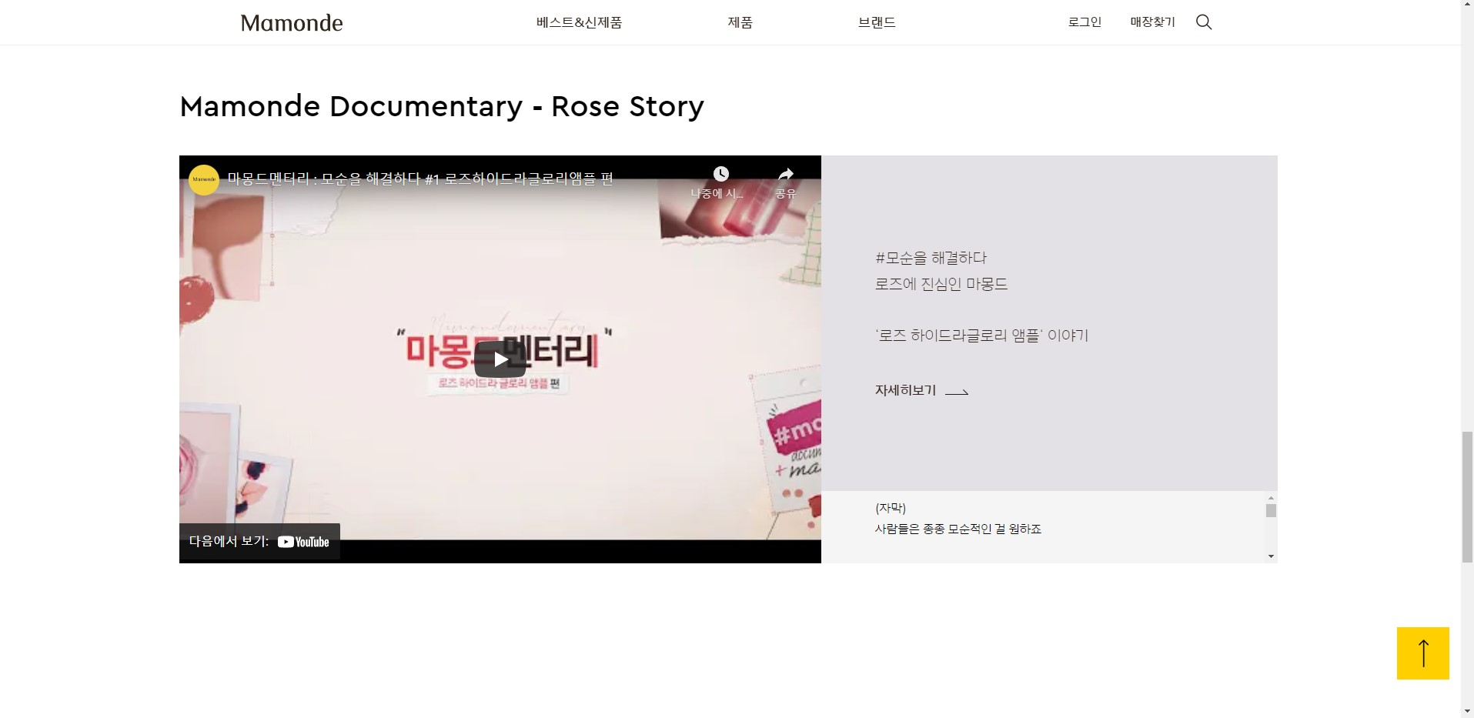
Header(fixed)
Section-header
Section-body
section

Slide 6
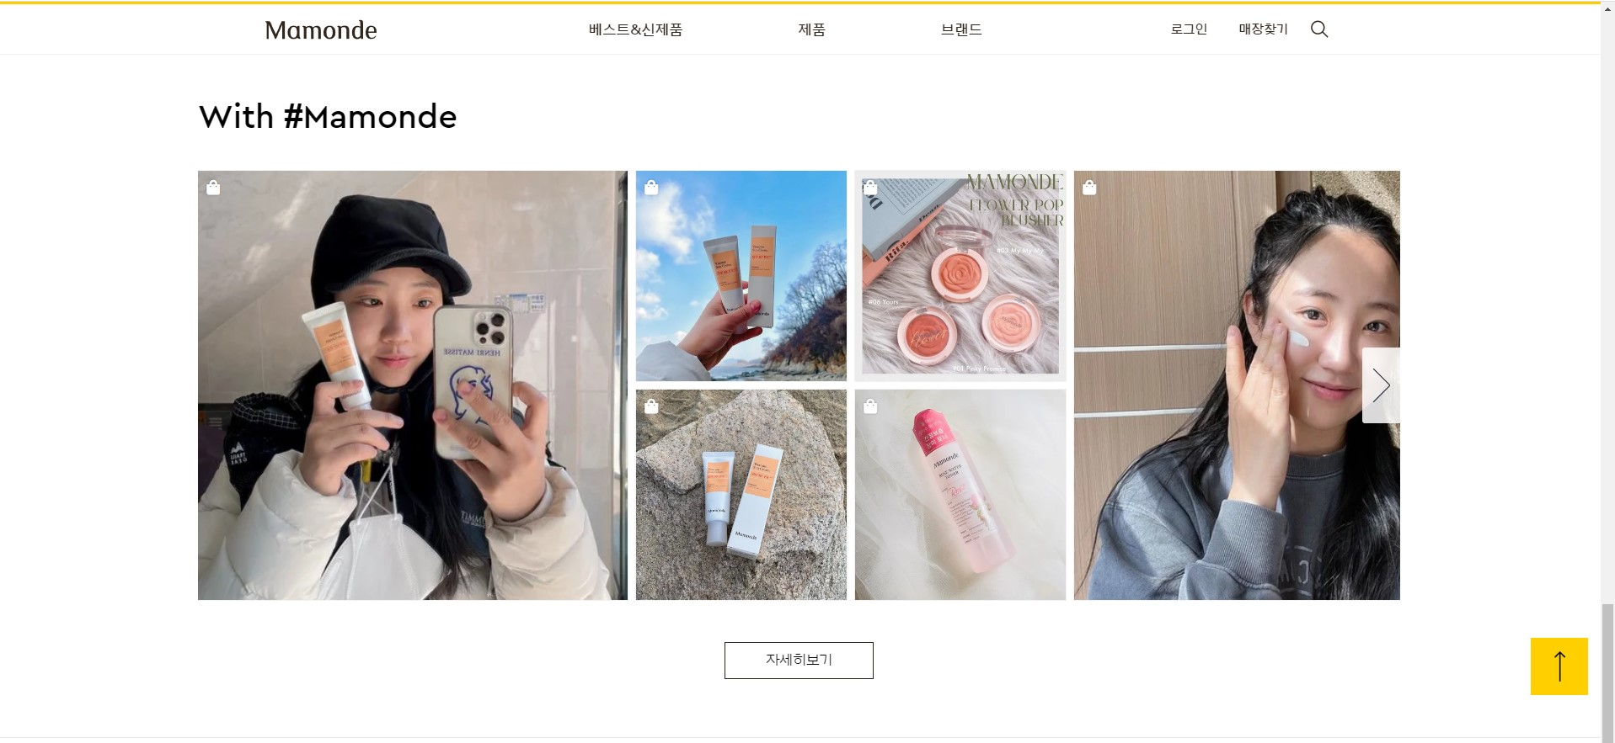
Header(fixed)
Section-header
Common-btn
Section-body
section

Slide 7
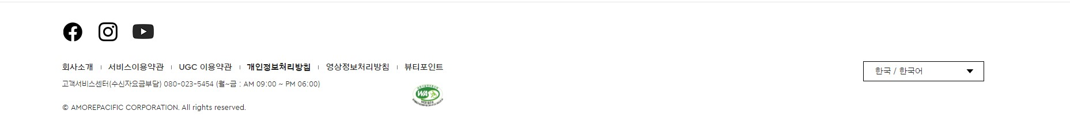
footer
Select or ul li

Slide 8
블럭요소와 앨리먼트요소 구분하기
- 헤라 상품 상세 -

Slide 9
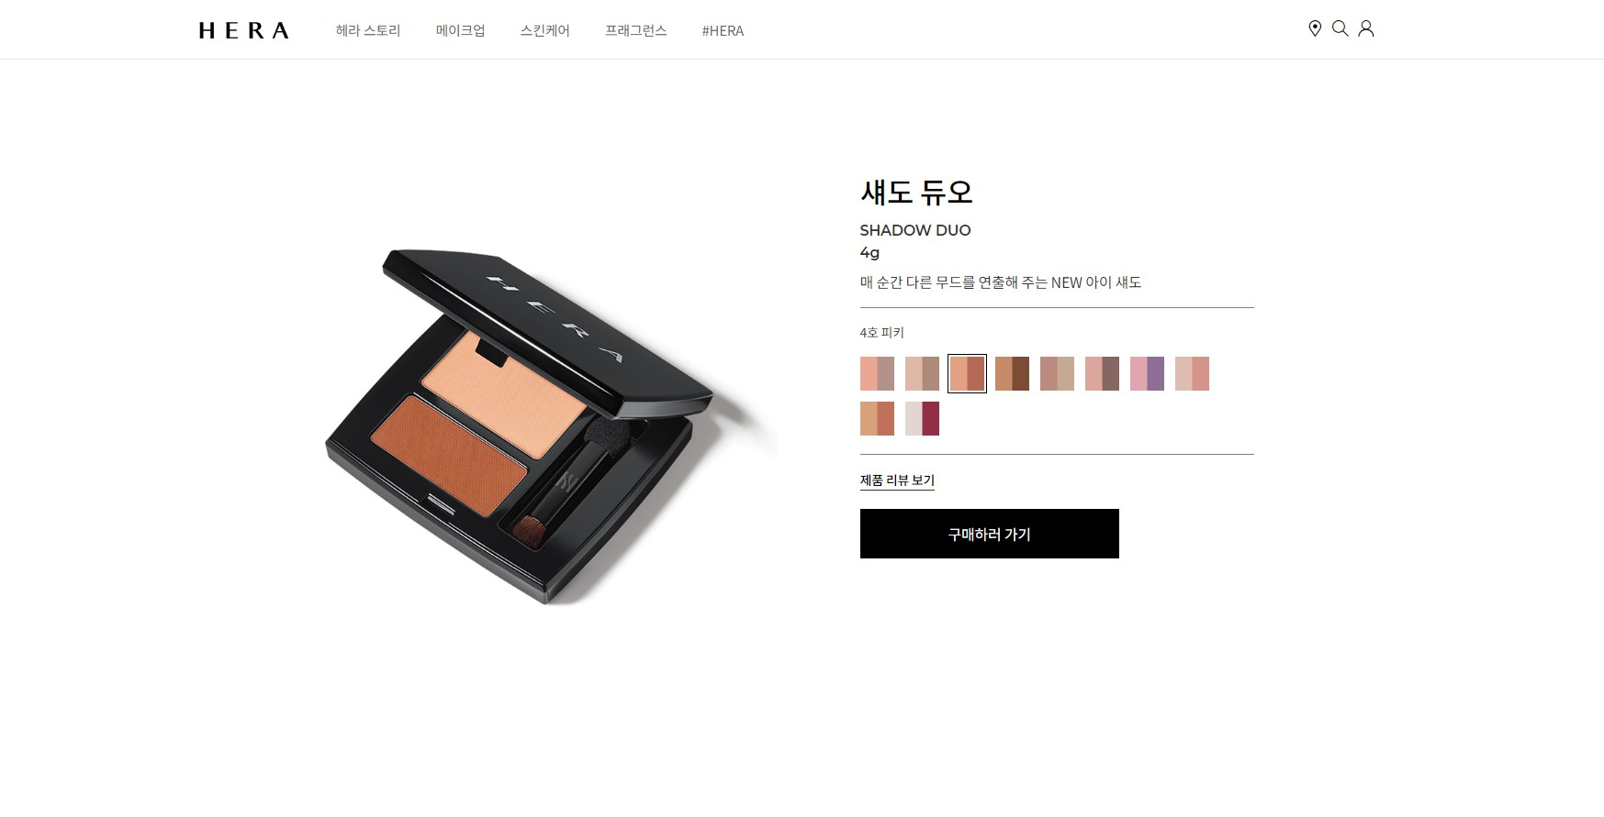
Header(fixed)
Logo(h1)
nav
util
Ul>li
section

Slide 10
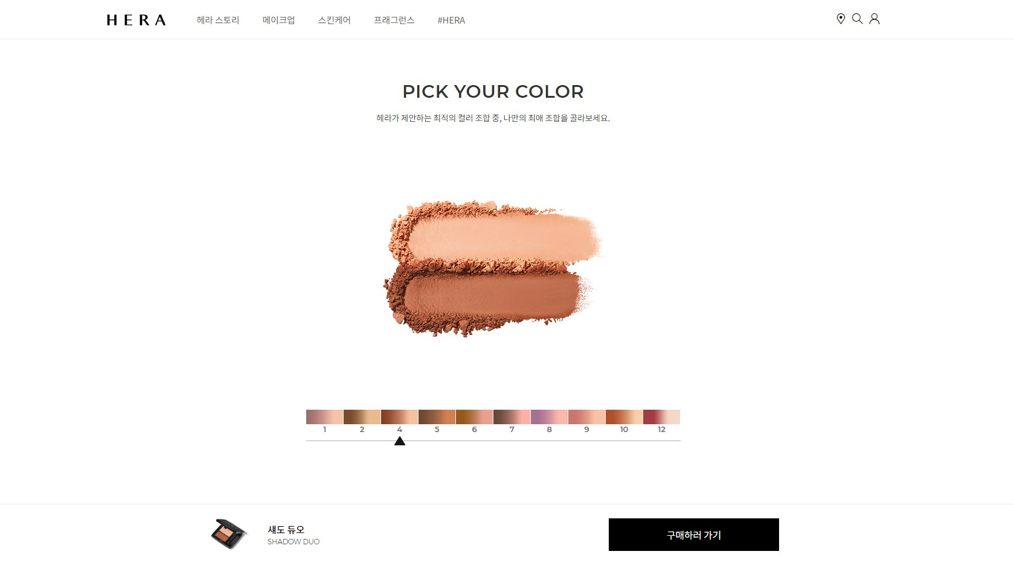
Header(fixed)
section
Section-header
Section-body
fixed

Slide 11
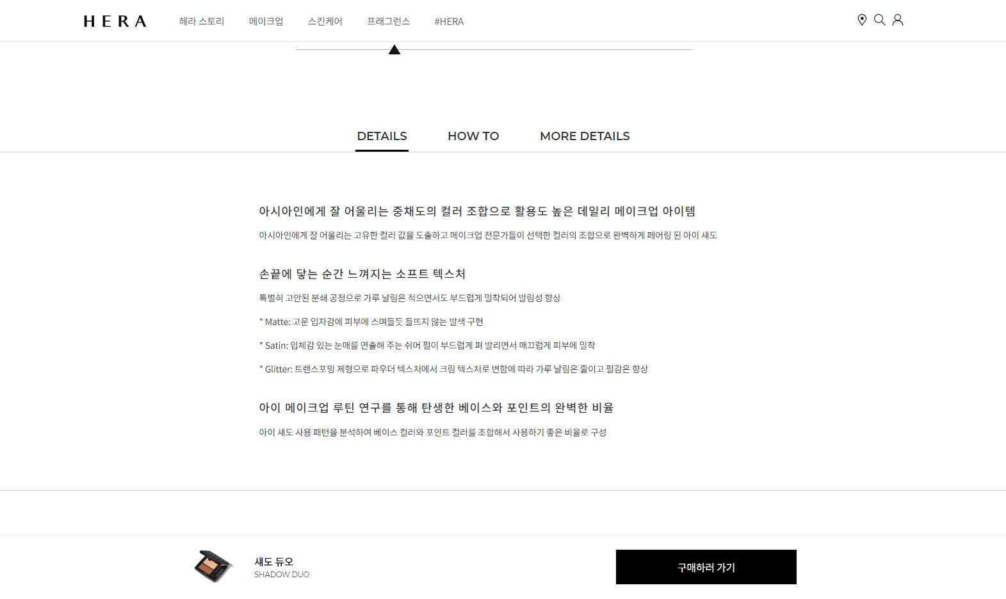
Header(fixed)
section
Section-header
Section-body
fixed

Slide 12
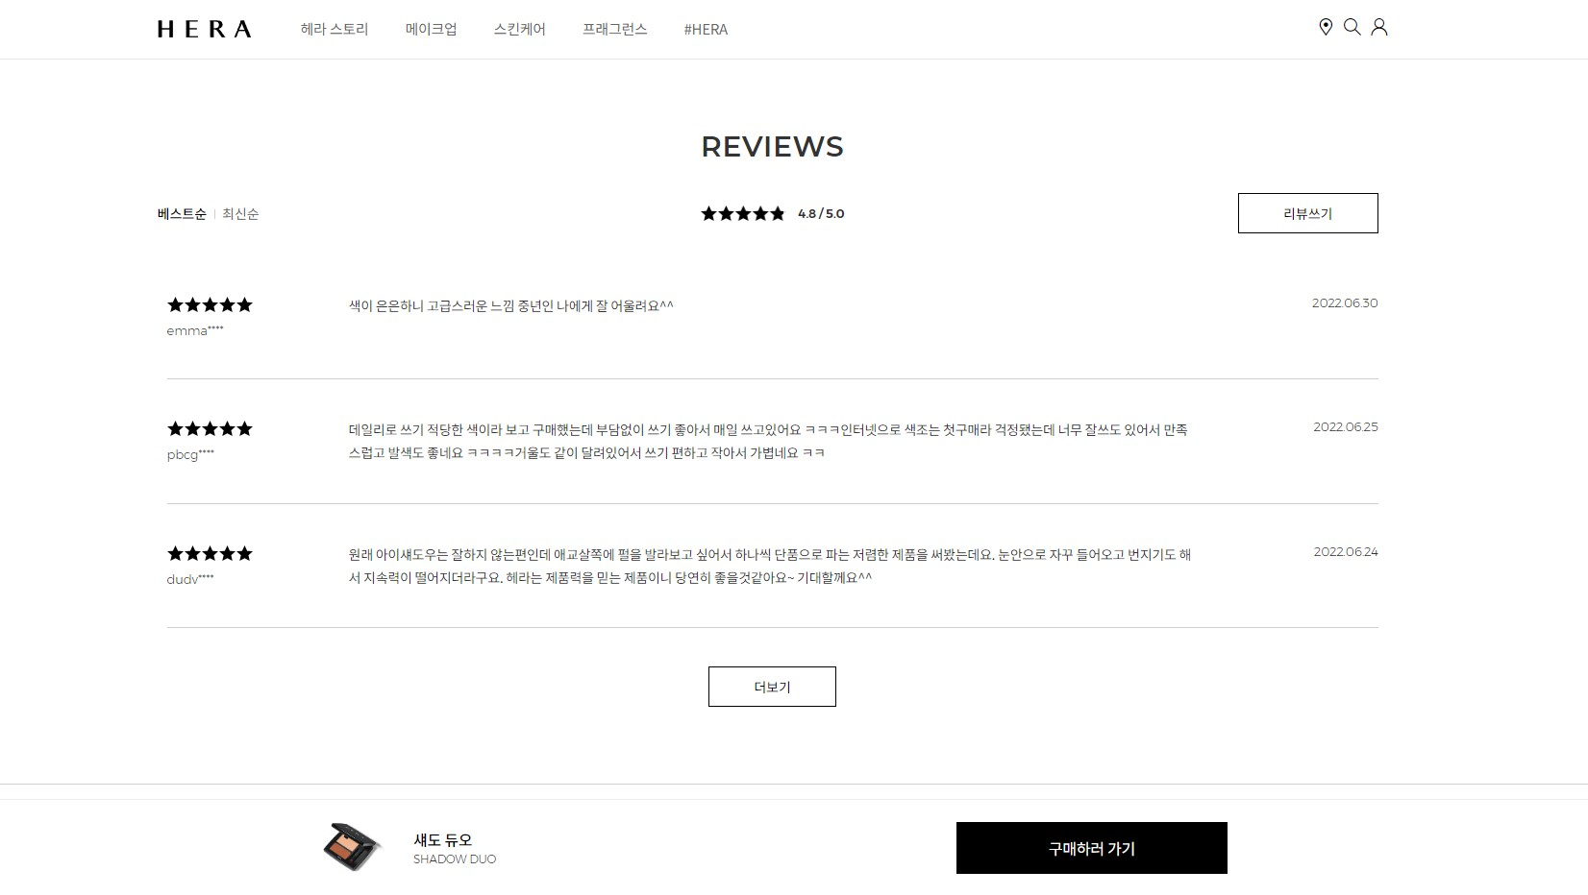
Header(fixed)
section
Section-header
Section-body
fixed

Slide 13
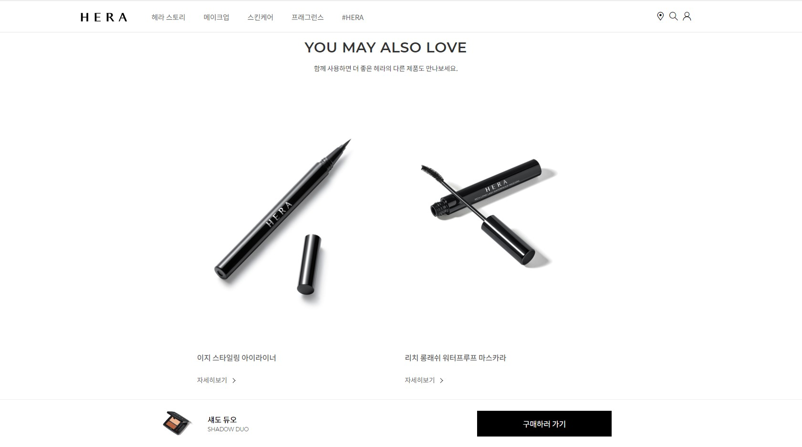
Header(fixed)
section
Section-header
Section-body
fixed

Slide 14
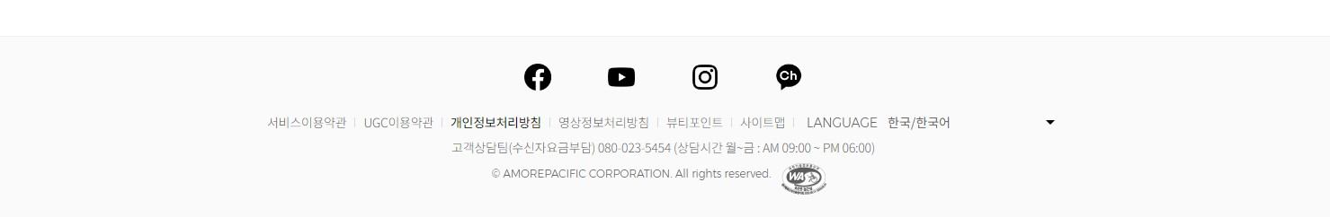
footer

