Slide 1


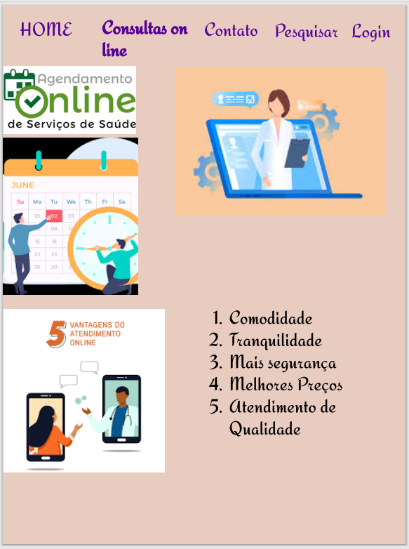
Desktop
Tablet
Mobile

