Slide 1
Slay Diver: Rise of 67
A boss-chase platformer where the only weapon is arithmetic.
Play it now: https://alina-anila.itch.io/slay-diver-rise-of-67

Slide 2
The Hook
Make the score exactly 67 while Boss 67 tries to mathematically ruin you.
• Score starts at 1.00
• Land on exactly 67.00 → you win
• Land on 0.00 → the run fails
• Everything on screen is just another +, -, or x on your score

Slide 3
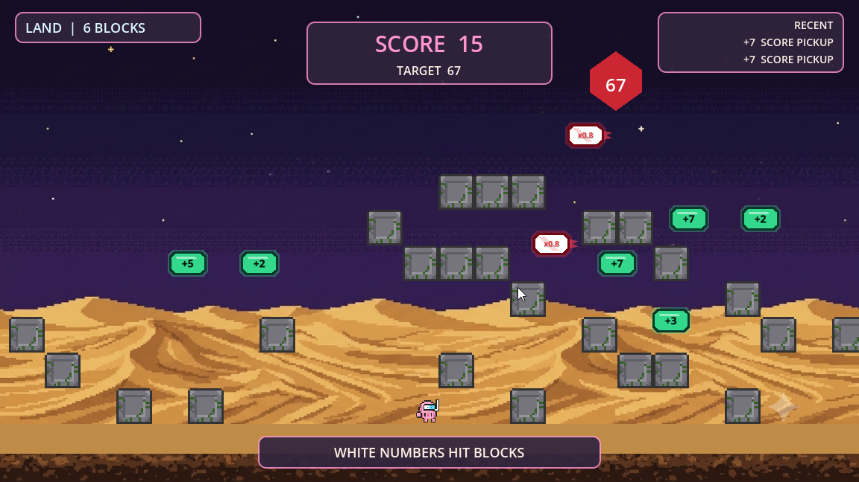
Gameflow: Land Phase
• Walk, jump, and dodge across the authored sand route
• Green pickups add to your score (+1...+7)
• White boss numbers multiply your score (x0, x0.5, x0.8) and are blocked by terrain
• HUD tracks score, target 67, distance in blocks, and recent operations

Slide 4
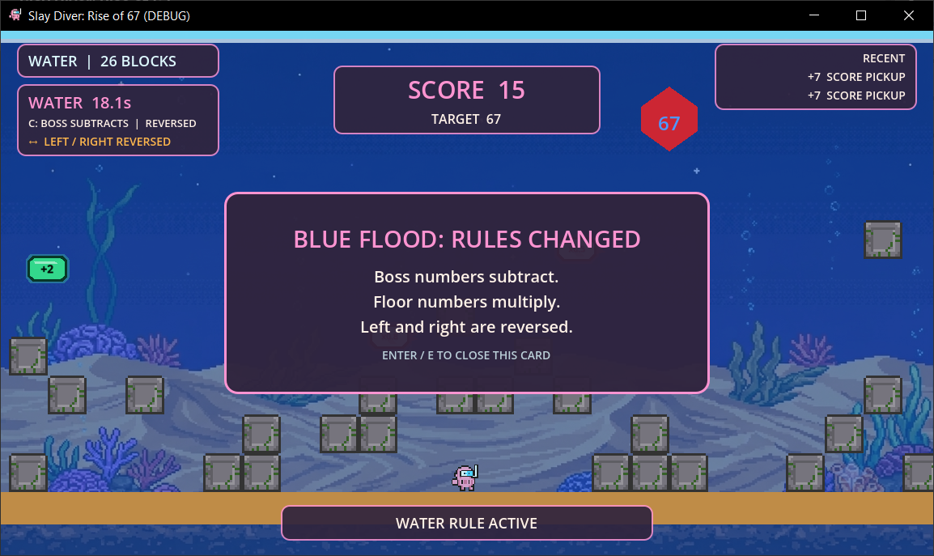
The Blue Flood: Reversed Controls
• At 28 blocks (or when score is divisible by 6/7), the Blue Flood hits
• Water rules swap operations: boss subtracts, floor pickups multiply
• 50/50 complication roll: here, left/right controls are reversed for 20s

Slide 5
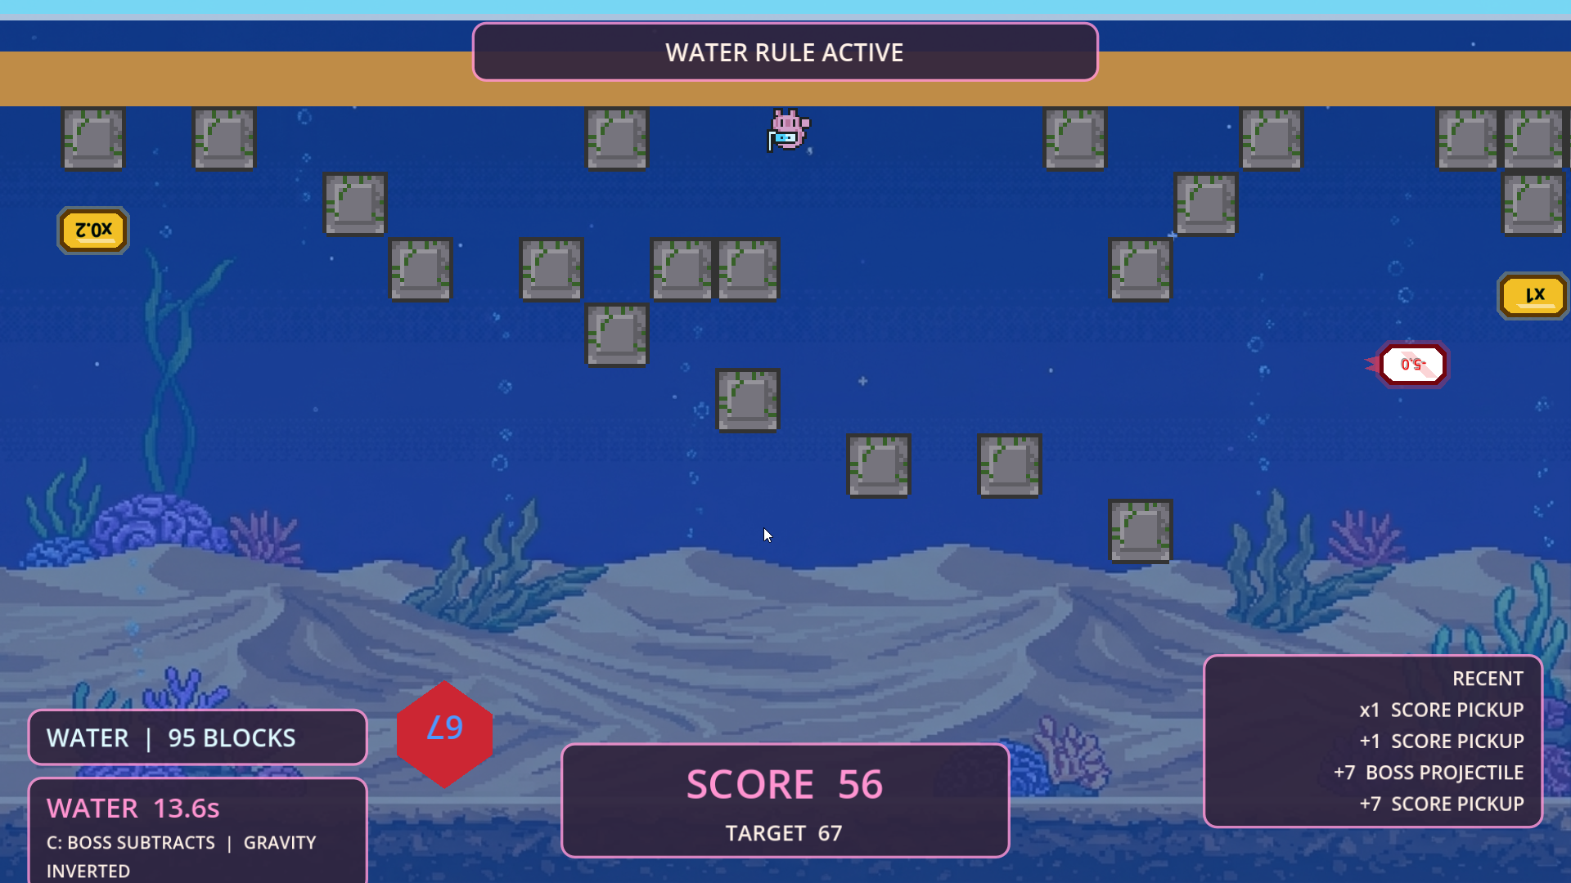
The Blue Flood: Gravity Inverted
• Other 50/50 outcome: the whole world flips 180°
• Camera and player render upside down, sand rises to the top
• HUD panels swap top/bottom so score and rules stay readable
• Physics and operand logic are untouched — purely visual disorientation

Slide 6
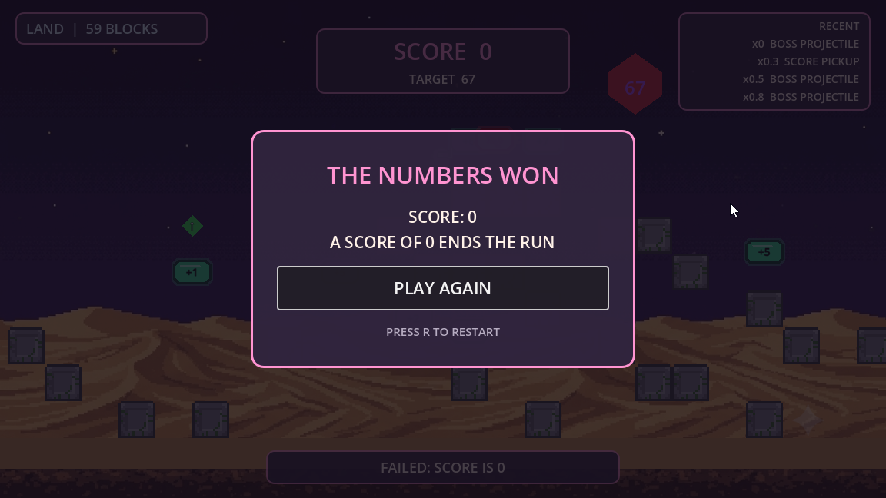
Gameflow: Failure State
• Score hits 0 → "THE NUMBERS WON"
• Recent-operations panel shows exactly which hits caused the fail
• Instant restart with R — no friction between attempts

Slide 7
Architecture Overview
GameState
score, run phase, water state,
win / fail
GameRules
constants & operations
Boss67LevelController
chunks, spawns, distance,
water triggers
HUD
score, rules, water timer,
power-ups
GameEvents
global signal hub
ScoreService
fixed-point score math
Player
platformer movement,
phase visuals
ResultScreen
victory / failure, restart
AudioBus / SceneLoader
sound playback, intro,
restart flow
WaterRuleService
water variant &
complication selection
Boss67
presentation &
projectile spawn anchors
WaterRuleOverlay
water rule announcement card
Contract-first: every cross-owner signal lives in GameEvents and is documented in INTEGRATION_CONTRACT.md. Three ownership zones (Polina / Alina / Rinata) work in parallel without touching each other's scenes directly.

Slide 8
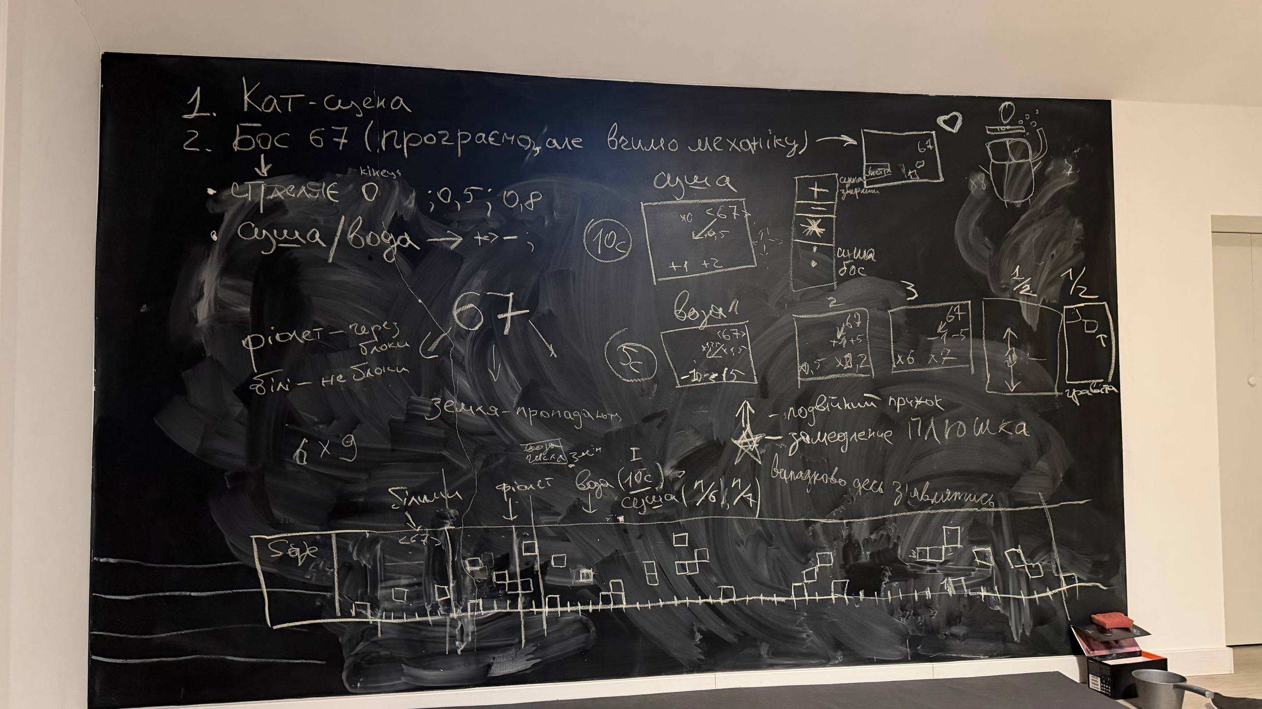
Our Process
• Started with a chalkboard jam session: cutscene plan, Boss 67 mechanics, water variants, operand tables, and the authored level layout
• Locked the numeric rules (x0/x0.5/x0.8, water A/B/C variants, +1..+7 pickups) before writing code
• Split into three ownership zones from day one, integrated continuously via a shared contract doc

Slide 9
Try It
https://alina-anila.itch.io/slay-diver-rise-of-67
Avoid zero. Use your operations. Hit exactly 67.

