Slide 1
Development of Vision-Based Perception and Control Systems Using Monocular RGB Images and 3D Simulation
Technical Report
October 16, 2026

Slide 2
Introduction
The objective of this work is to develop baseline systems for practical applications by integrating position and orientation estimation from monocular RGB images with control techniques.
The following principles were adopted:
1. Monocular RGB Images
Estimate object position and orientation for control.
2. Target-Specific Estimation Methods
Select geometric calculations, PnP, or image matching based on target characteristics.
3. 3D Simulation
Generate training data, train control algorithms, and validate systems.
4. Control Methods
Apply reinforcement learning or PID control depending on the target.
5. Raspberry Pi 5 Validation
Evaluate feasibility under limited computational resources.
These approaches establish reusable baseline systems that can be adapted and extended to meet practical requirements.

Slide 3
Contents
1. Yaw Control
1.1 Overview | Controlling Suspended Payload Yaw from 2D Images
1.2 Reinforcement Learning-Based Yaw Control | From Rotation to Stabilization
1.3 Image Recognition | Separating Detection from Geometric Estimation
1.4 Raspberry Pi 5 | From Image Recognition to Closed-Loop Yaw Control
2. Fine-Tuning
2.1 Overview | 6D Pose Estimation from Monocular RGB Images
2.2 Fine-Tuning | From Synthetic Images to Real-World Environments
2.3 Ground Truth Generation | Fitting 3D Models to Real Images
2.4 GPU vs. Raspberry Pi 5
3. Drone Control
3.1 Overview | Autonomous Delivery of Nine Boxes Using Two Drones
3.2 PID Control
3.3 Image Processing | PnP and Image Matching
3.4 Delivery Planning | Assignment, Sequence, and Timing Using CP-SAT

Slide 4
Implementation Comparison
This page compares the implementation approaches used in three development projects based on 2D image recognition.
Item | Yaw Control | Fine-tuning | Drone Control
Objective | Suspended payload yaw control | 6D object pose estimation | Box pickup and delivery
Input | Monocular RGB | Monocular RGB | Monocular RGB
Training Data | 3D Simulation | 3D Sim + Real Images | 3D Simulation
Image Recognition | Keypoint Detection | Object Detection + Real Images | Object Detection + Keypoint Detection
Position / Orientation Estimation | Geometric Calculation | PnP | PnP + Image Matching
Control | Reinforcement Learning (SAC) | ― | PID
Optimization | ― | ― | CP-SAT
Raspberry Pi 5 | Validated | Validated | Not Validated*
Key Design Principles
1. Image Recognition as a System Component
Combine image recognition with geometric calculations and PnP.
2. Simulation as a Development Platform
Use simulation for data generation, control training, and system validation.
3. Technology Selection Based on Objectives
Select appropriate methods for control and optimization.
* Similar detection models have been tested on Raspberry Pi 5,
but drone system performance remains unverified.

Slide 5
1. Yaw Control
Estimate suspended payload yaw from monocular RGB images and control its orientation using reinforcement learning.
Publications
GitHub Pages：https://rindajones.github.io/payload-yaw-control/en/
Zenn(Japanese)：https://zenn.dev/rindajones/articles/a8b6189171848f

Slide 6
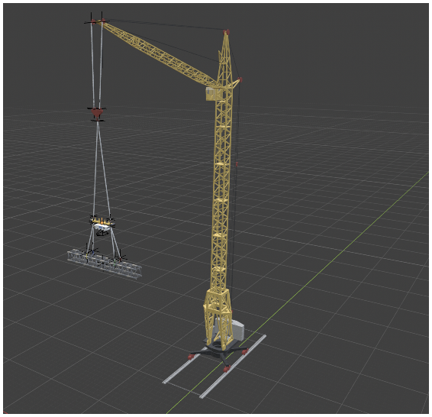
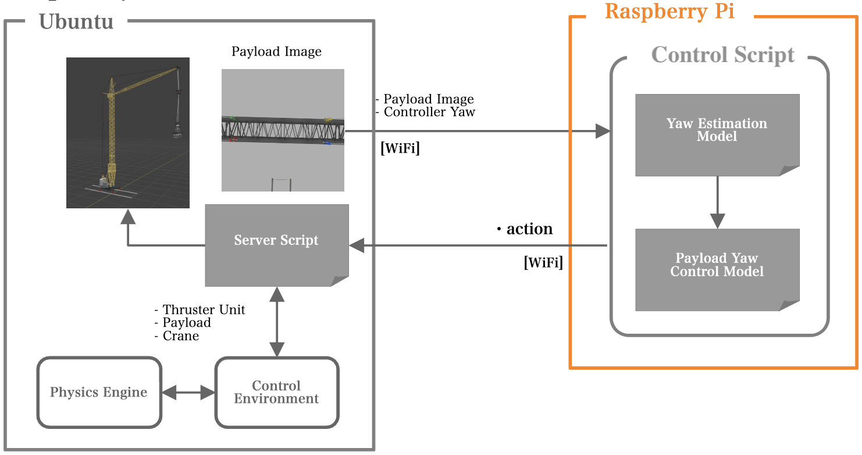
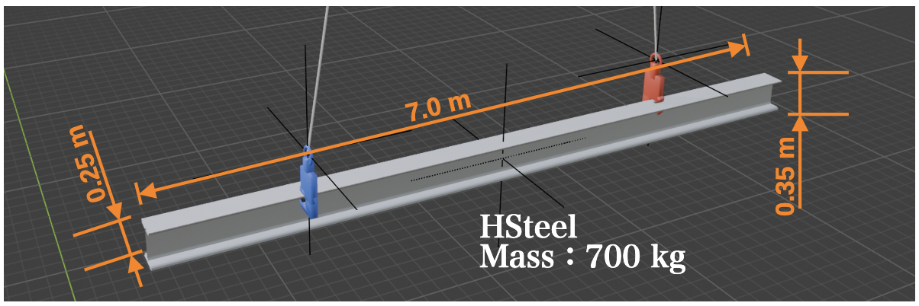
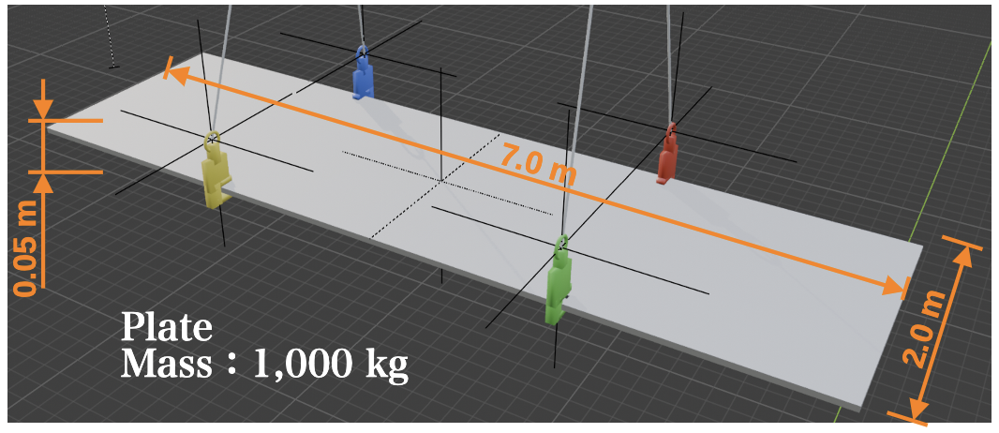
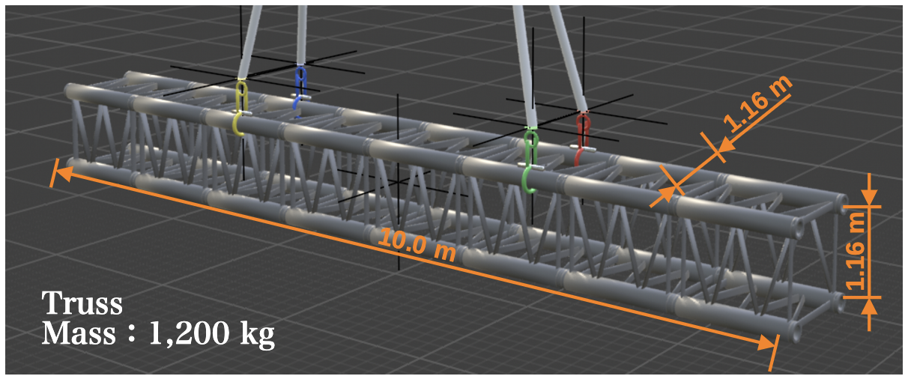
1.1 Overview | Suspended Payload Yaw Control from 2D Images
Physics Simulation × Image Recognition × Reinforcement Learning × Raspberry Pi 5
Target Payloads
Control Pipeline
Camera Image → Yaw Estimation → SAC Control → Four Thrusters

Slide 7
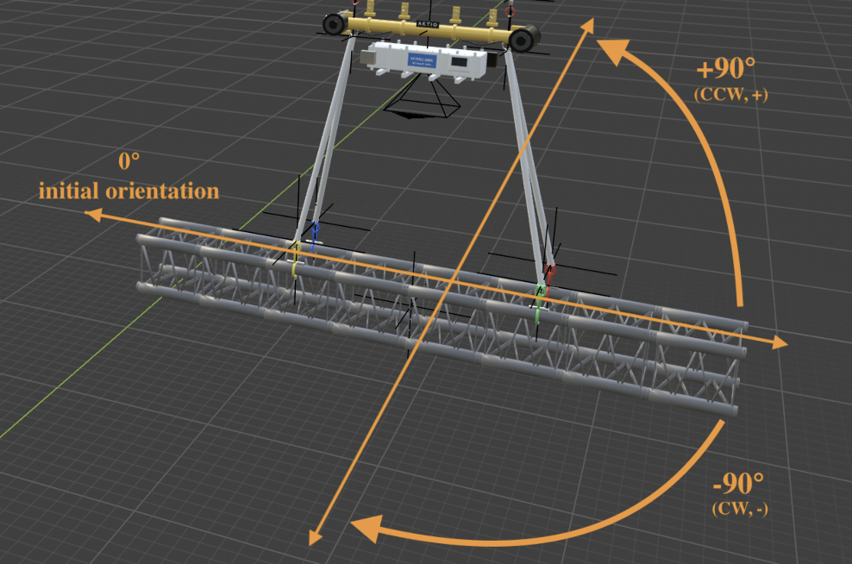
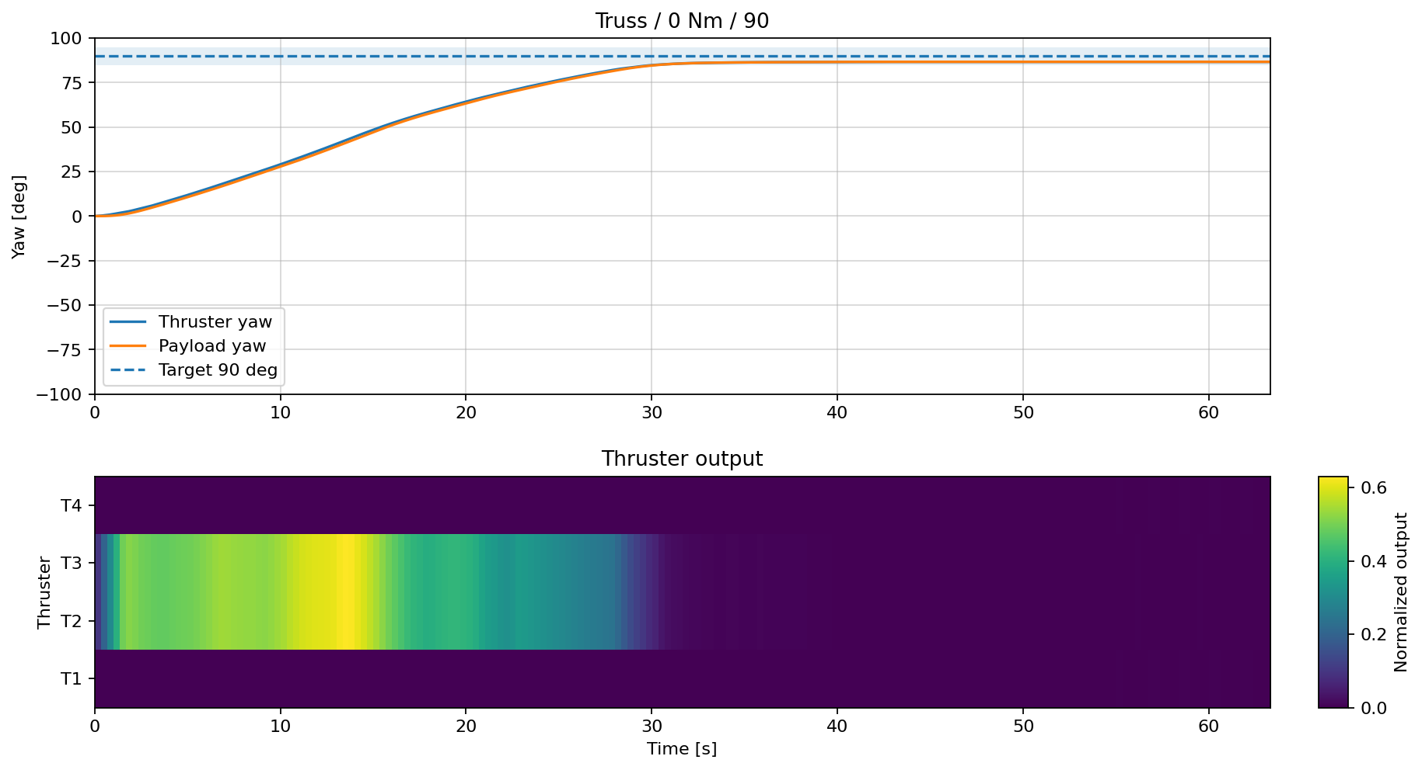
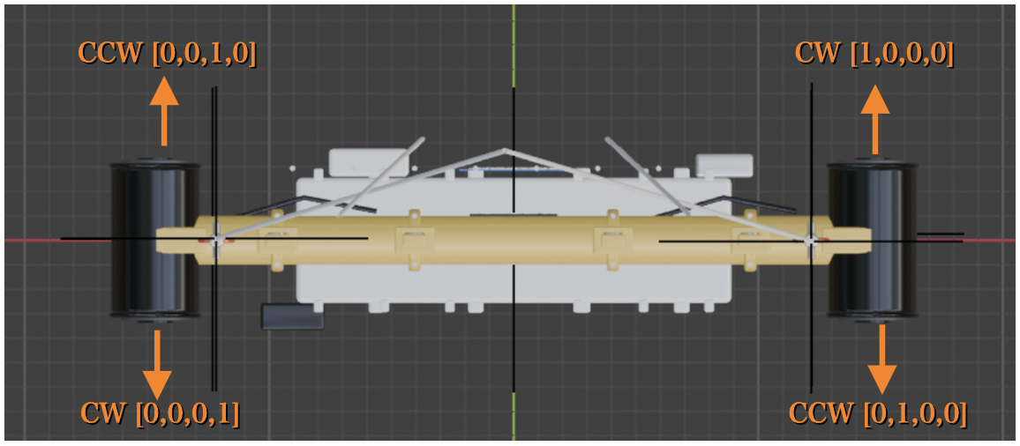
1.2 Reinforcement Learning-Based Yaw Control
Train continuous thrust control for four thrusters to rotate and stabilize the payload at variable target yaw angles.
Target Yaw: −90° to +90°
Reinforcement Learning Control
- Algorithm: SAC (Soft Actor-Critic)
- Target yaw: −90° to +90° (variable)
- Continuous thrust commands for four thrusters
- Training and evaluation under varying payload shapes,
masses, and disturbances
Control Results: Target vs. Actual Yaw
Control Target
Four Thrusters
Results
- Reached the target yaw in approximately 30 seconds
- Reduced thrust as the target was approached
- Maintained yaw with low thrust after reaching the target
形状・質量・外乱条件を変えて学習と評価を実施

Slide 8
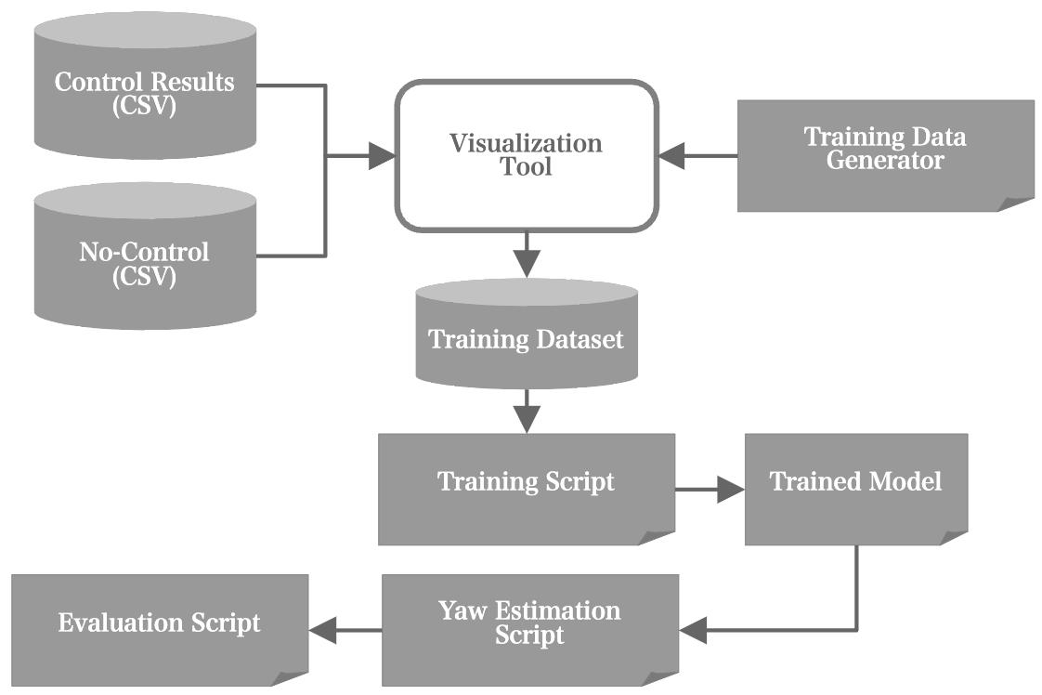
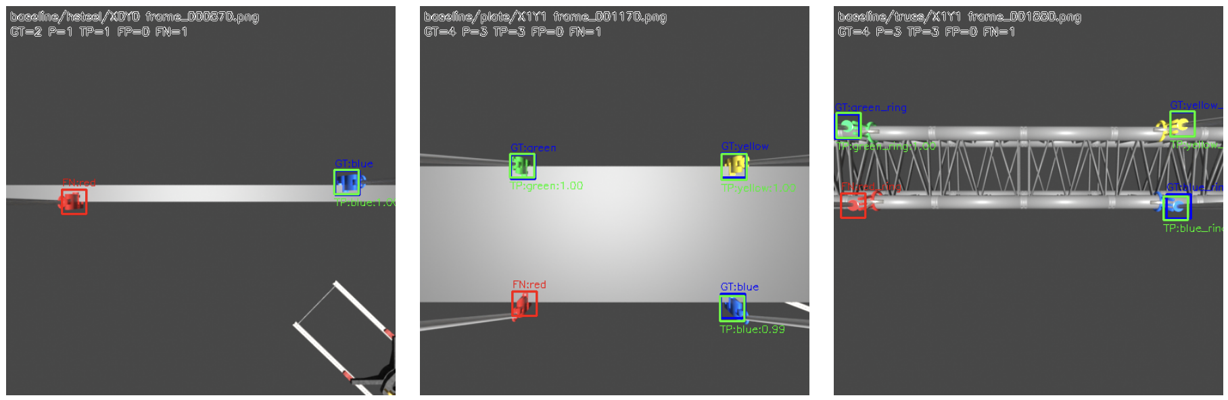
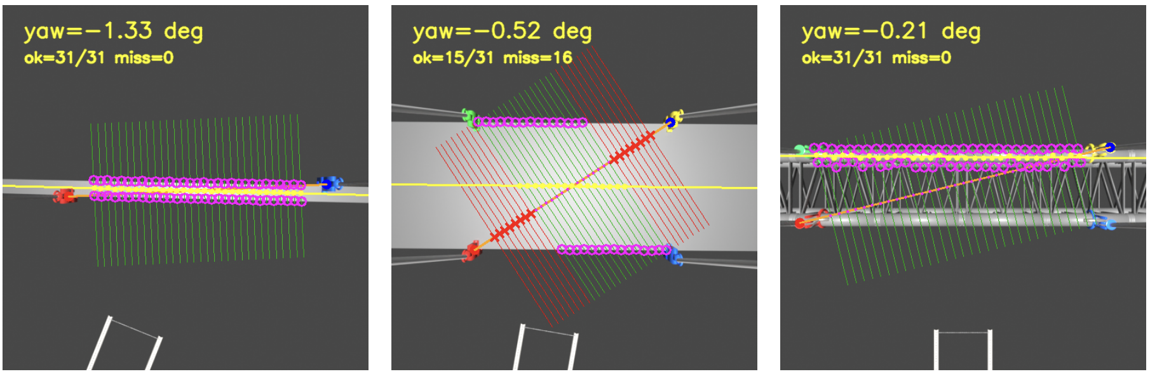
1.3 Image Recognition | Detection and Geometric Estimation
2D Image → Hook Detection → Geometric Yaw Estimation → Control
1. Camera Image and Hook Detection
2. Yaw Estimation Results
Key Concept
Image recognition detects keypoints,
while yaw is estimated geometrically.

Slide 9
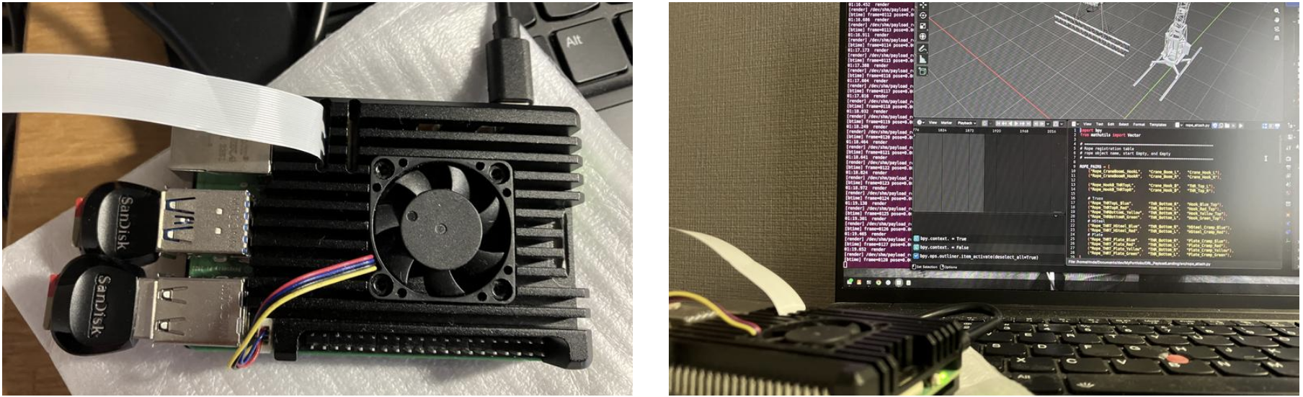
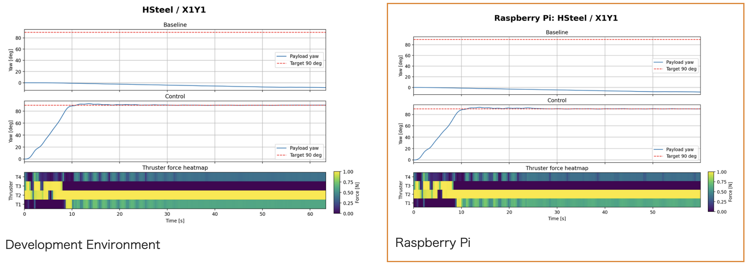
1.4 Raspberry Pi 5 | Closed-Loop Yaw Control
Physics simulation runs on Ubuntu, while Raspberry Pi 5 handles image recognition, yaw estimation, and SAC control.
Raspberry Pi 5 Processing and Connection
Control Frequency
3 Hz / 333 ms
Processing Time on Raspberry Pi 5
Average: 68.3 ms
Maximum: 124.0 ms
Control Results
Ubuntu-Only (Left) vs. Raspberry Pi 5 Closed-Loop Control (Right)

Slide 10
2. Fine-tuning
Improve 6D pose estimation by fine-tuning models trained on synthetic images with real-world images.
Publication
GitHub: https://rindajones.github.io/projects/6d-pose-estimation/

Slide 11
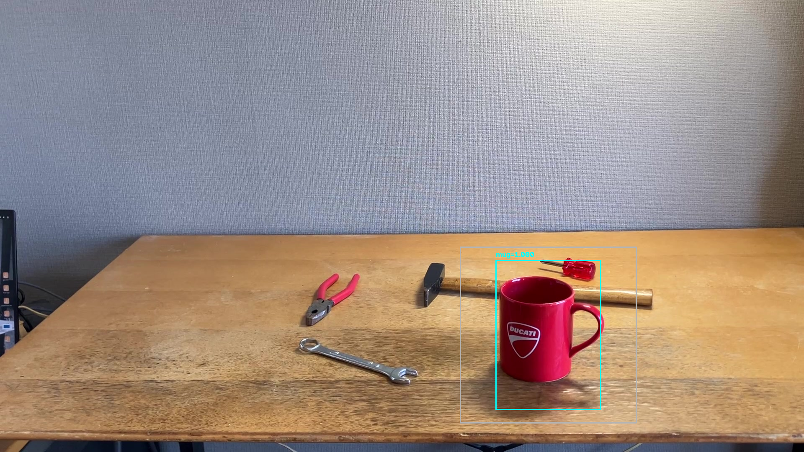
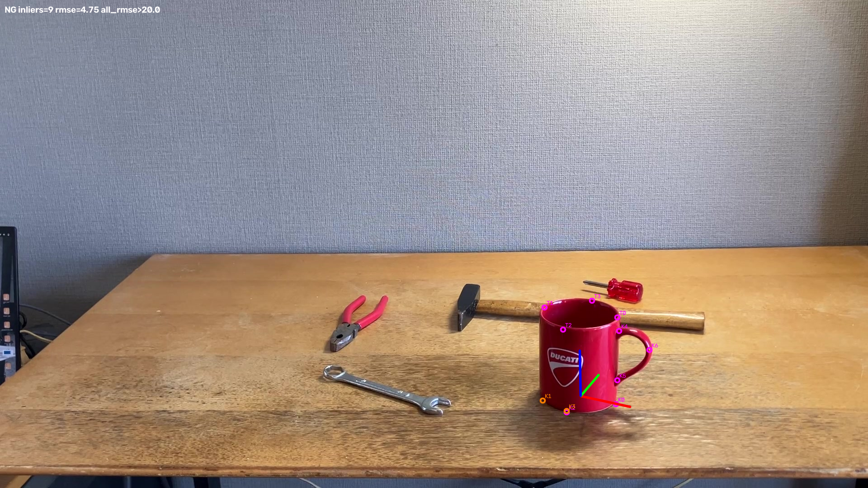
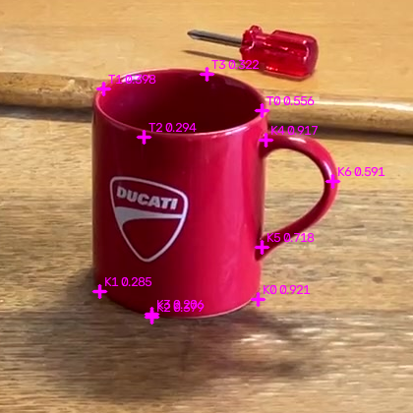
2.1 Overview | 6D Pose Estimation from Monocular RGB Images
Object Detection → Keypoint Detection → 6D Pose Estimation (PnP)
1. Object Detection
3. 6D Pose Estimation
f
Image Cropping
2. Keypoint Detection

Slide 12
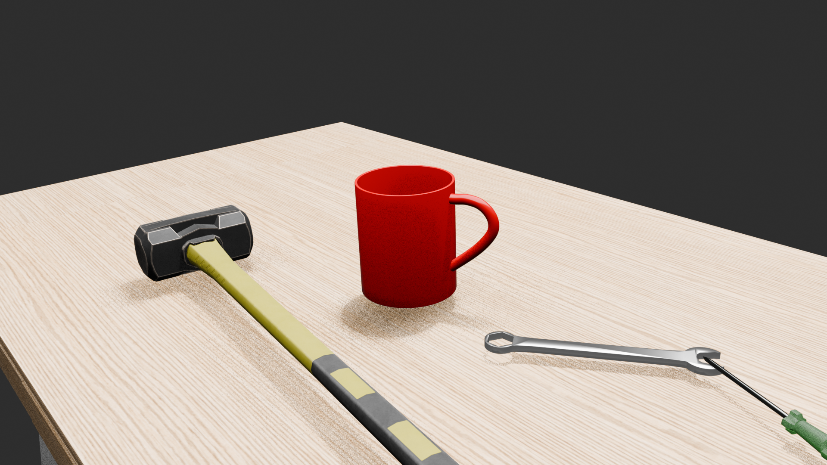
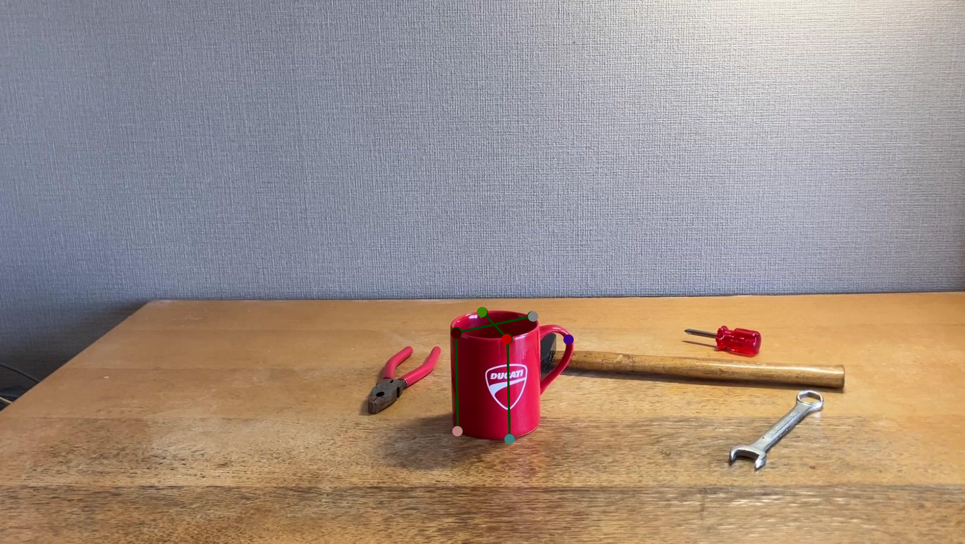
2.2 Fine-Tuning | From Synthetic to Real Images
Generate training data using Blender and fine-tune with a small set of real images.
Synthetic Images (Sim)
Real Image
Training Pipeline
Pre-training on 3,000 Synthetic Images
↓
3D Model Fitting and Ground Truth Generation
↓
Fine-Tuning on 173 Real Images
YouTube Videos
https://youtube.com/shorts/THVDTcLsF0w?feature=share
https://youtu.be/3KiCMTUQuoI

Slide 13
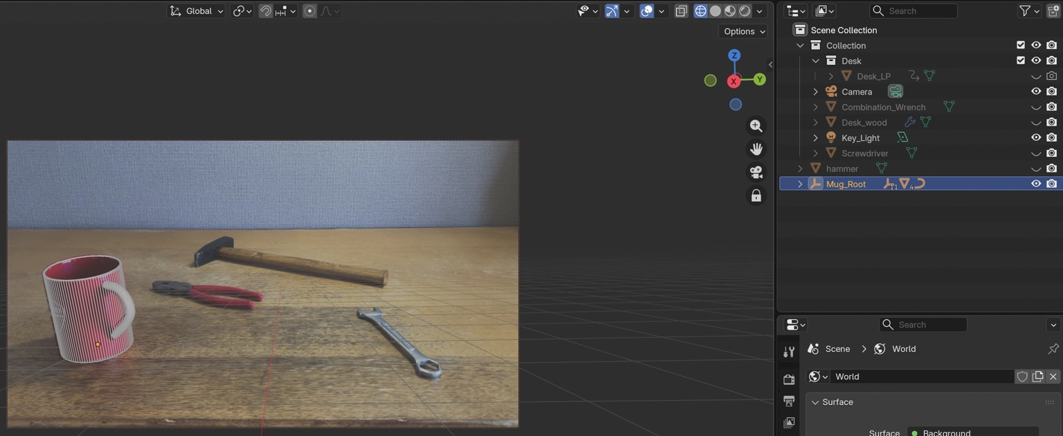
2.3 Ground Truth Generation | Fitting 3D Models to Real Images
Project 3D model keypoints to generate consistent ground truth annotations that are difficult to label manually.
Workflow
1. Align the 3D model with a real image.
2. Project predefined 3D keypoints.
3. Generate 2D ground truth keypoints.
4. Fine-tune the model.
Results
Improved the consistency of ground truth annotations compared with manual labeling.
Real Image + 3D Model Alignment
Accuracy depends on model alignment, camera conditions,
and 3D geometry.
YouTube Video
https://youtu.be/rC1AJGKOdmE

Slide 14
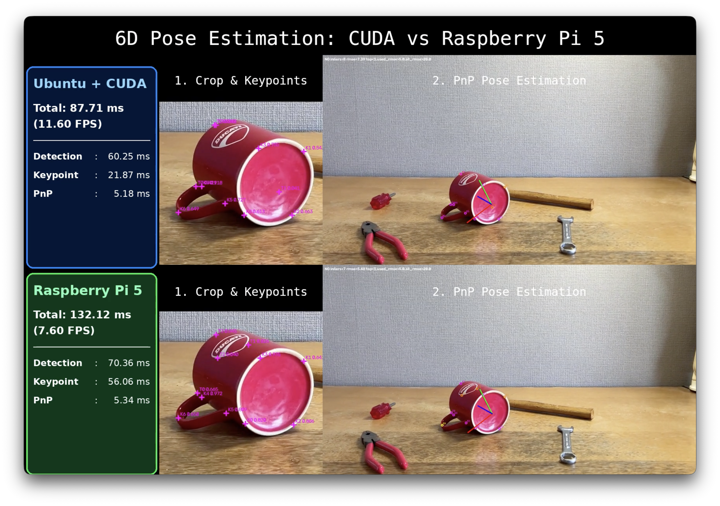
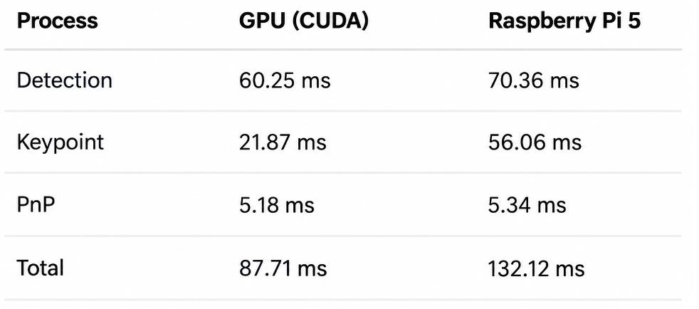
2.4 GPU vs. Raspberry Pi 5
Compare processing speeds using the same image recognition models and pose estimation algorithms
on GPU (CUDA) and Raspberry Pi 5.
Results
Raspberry Pi 5 achieved 7.60 FPS. The main performance gap was
in keypoint detection, while PnP performance was nearly identical.
YouTube Video
https://youtu.be/zFwZ-Rls9bs

Slide 15
3. Drone Control
Integrate vision-based position estimation, PID control, and delivery planning
for autonomous multi-drone delivery.

Slide 16
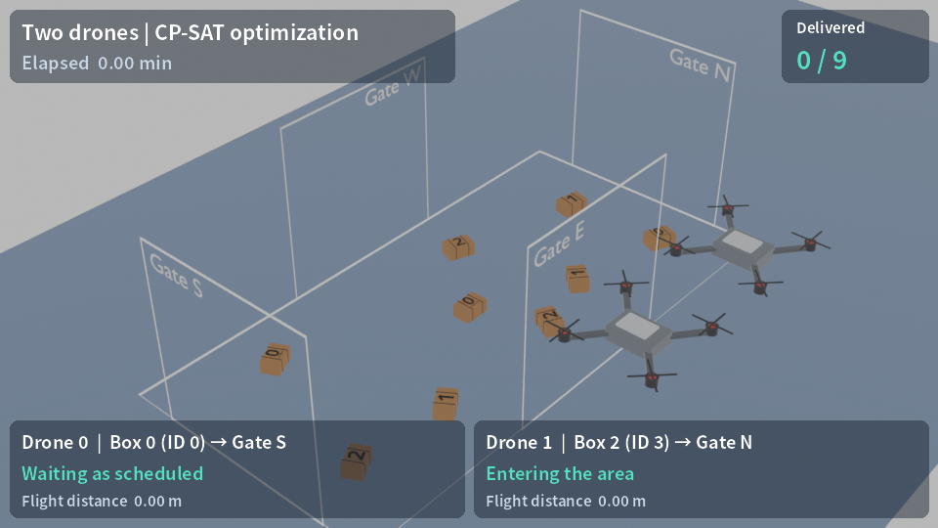
3.1 Overview | Autonomous Delivery of Nine Boxes Using Two Drones
Use image recognition for box alignment, PID for flight control, and CP-SAT for delivery planning.

Slide 17
3.2 PID Control
Control drone motor thrust using PID based on errors between target and estimated states.
Drone Control with PID
Target Position / Orientation
Image-Based and IMU Estimation
PID Control
Error Correction
4 Motors
Flight and Stabilization
Control Architecture
- State Estimation: Estimate box-relative position and orientation from images,
and drone attitude and angular velocity from IMU.
- PID Control: Adjust motor thrust based on position and orientation errors.
- Multi-Rate Control: Maintain IMU-based state estimation and
attitude control between image updates.
Simulation framework: PyBullet / gym-pybullet-drones.

Slide 18
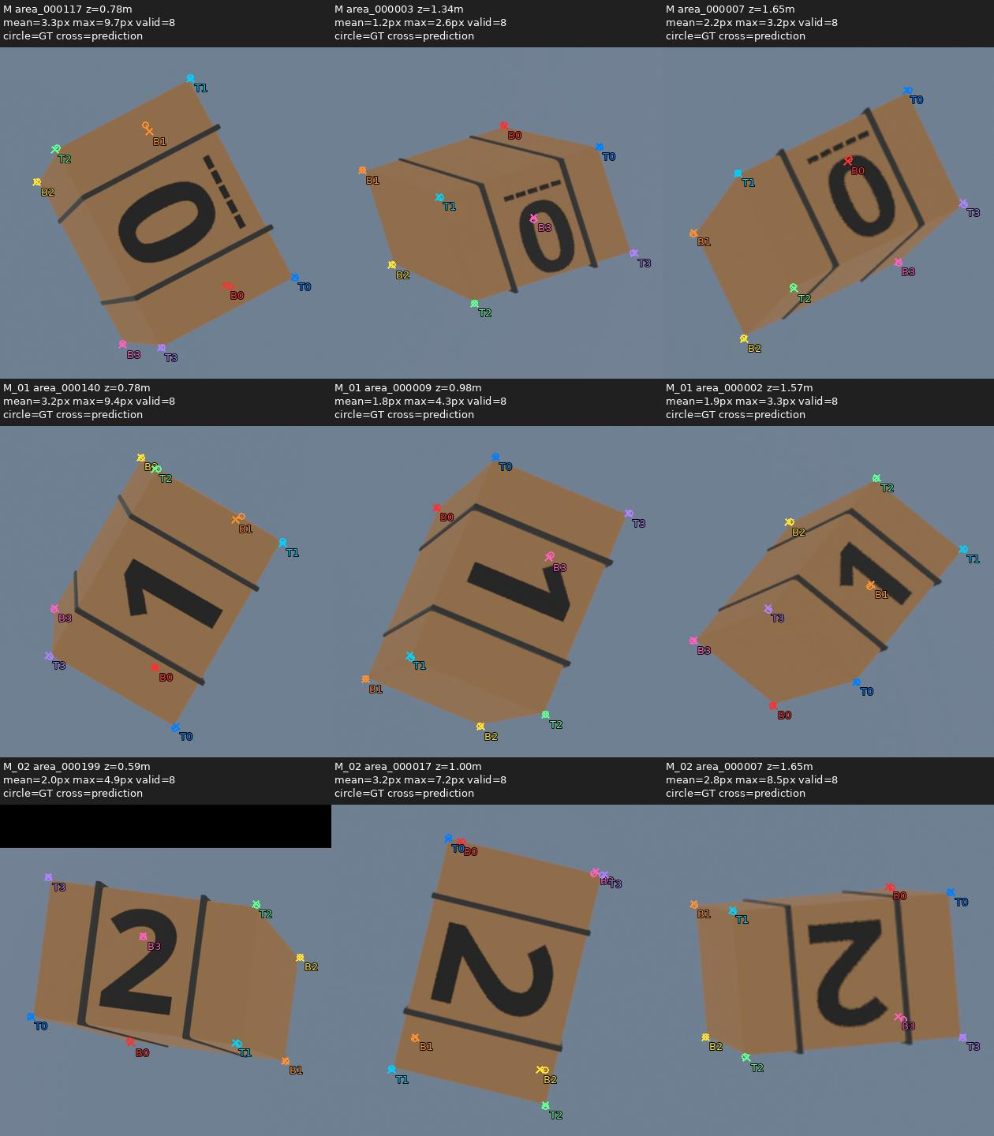
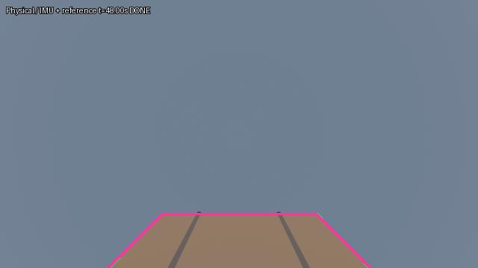
3.3 Image Processing | PnP and Image Matching
Approach: Estimate box-relative position and orientation using keypoints and PnP.
Before Pickup: Align with the box using reference image matching.
YouTube Video
https://youtu.be/Tr1Pd5xofdM

Slide 19
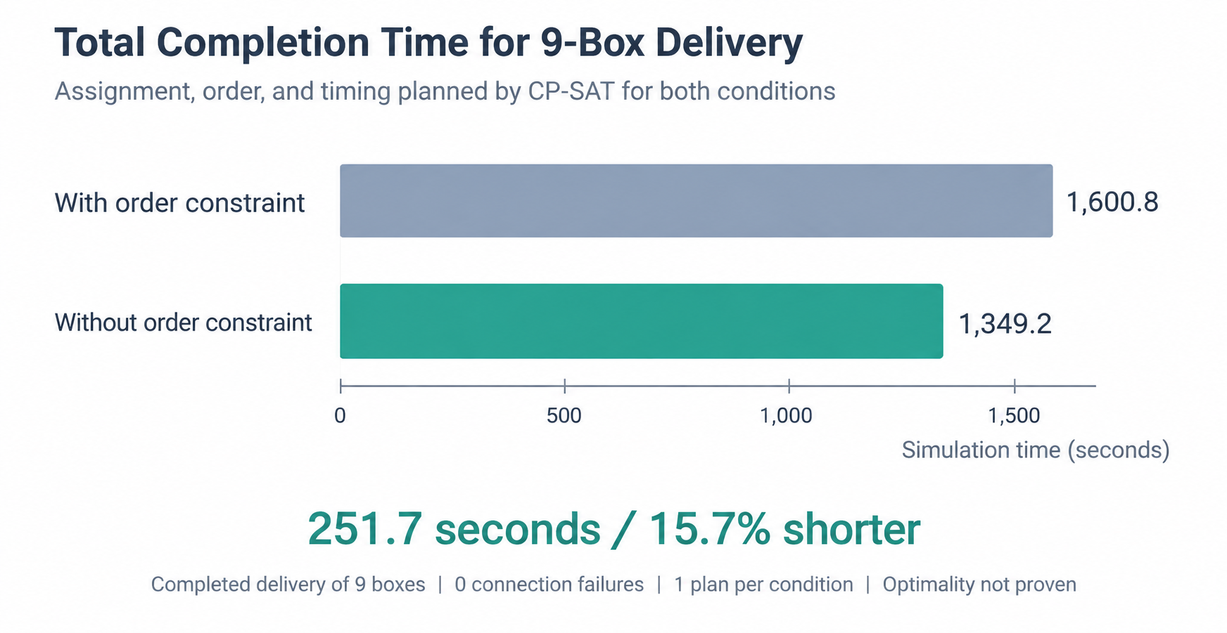
3.4 Delivery Planning | Assignment, Sequence, and Timing with CP-SAT
Plan box assignments, delivery sequences, and waiting times for two drones.
Removing the numerical delivery order constraint reduced total delivery time by 15.7% in this simulation.
YouTube Video
https://youtu.be/XLUYuL7K9-U

