Slide 1
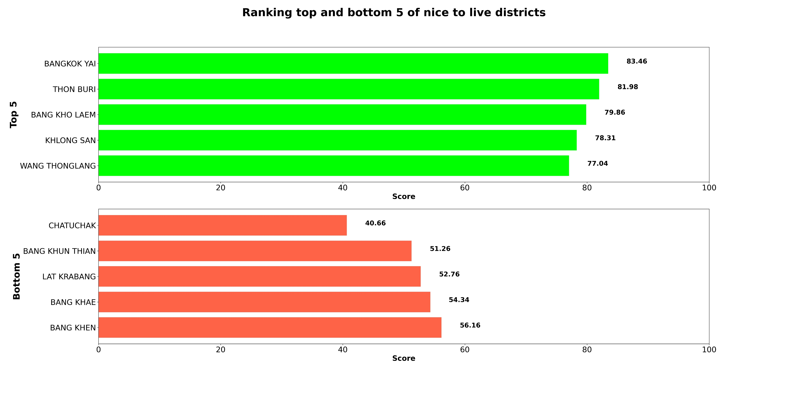
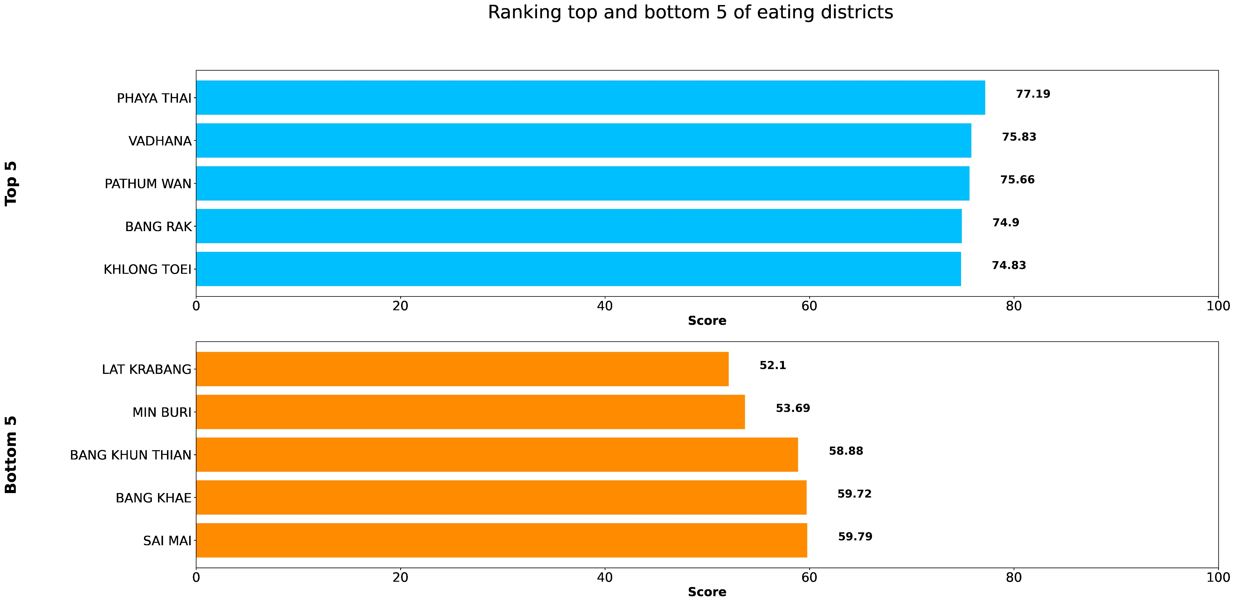
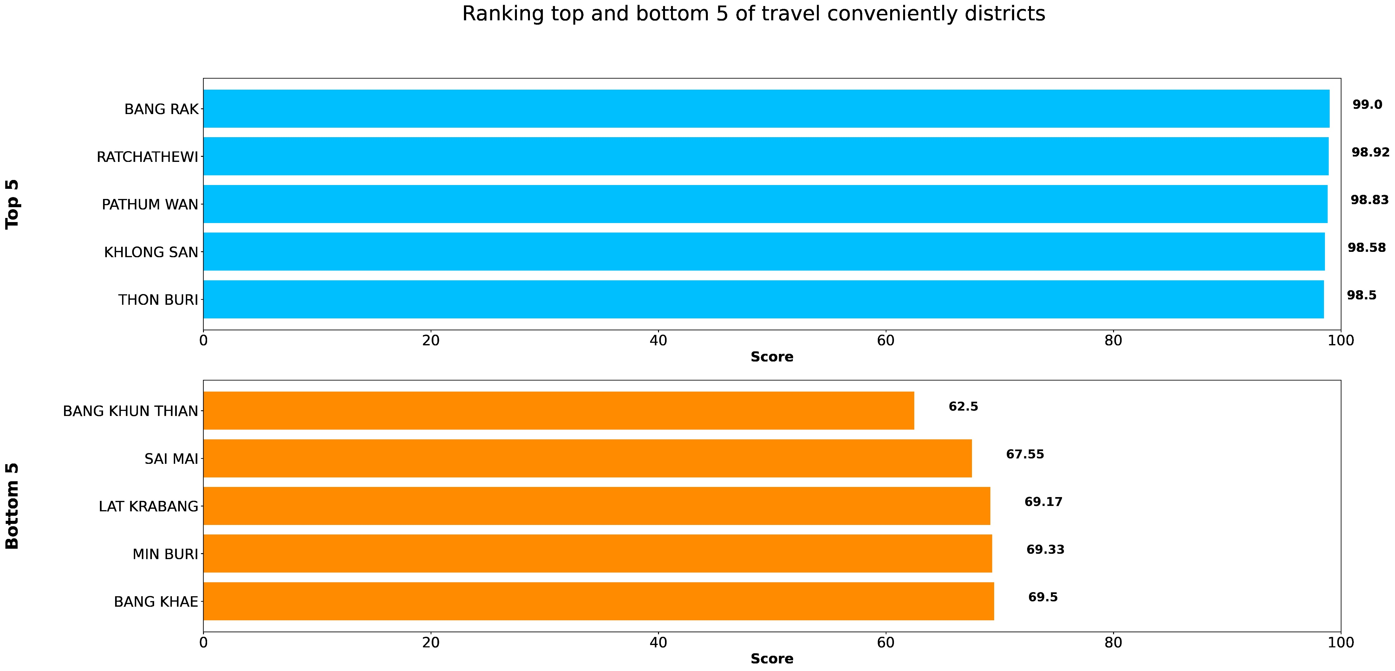
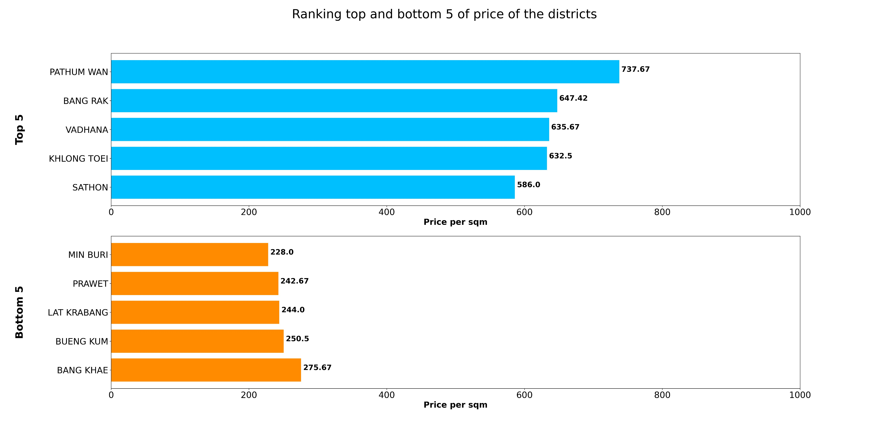
Calculated from
Eating
Traveling
# of case
Price per sqm
Moving to Bangkok 101
Nice to live
Eating
Travel conveniently
Expensive to cheap

