Slide 1
Basic Premise and Hypotheses
The type of photosynthesis that will dominate on a planet will depend on the incident flux and the availability of oxidizable substrate.
The detectability of the reflectance signal will depend on type of photosynthesis, surface density and distribution of the organisms, cloud cover, etc.

Slide 2
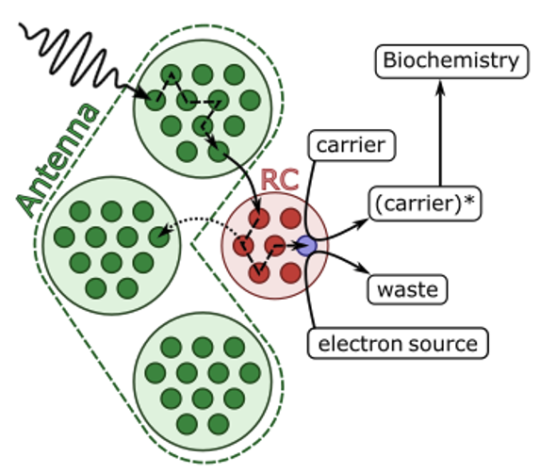
General Model of a Photosynthetic Reaction Centre
Previous model:
We assumed an oxygenic reaction centre (RC) fed energy by an antenna.
The antenna was optimized to different light environments but the RC was fixed.
No way of comparing different forms of photosynthesis (oxygenic, anoxygenic, hydrogenic, etc.).

Slide 3
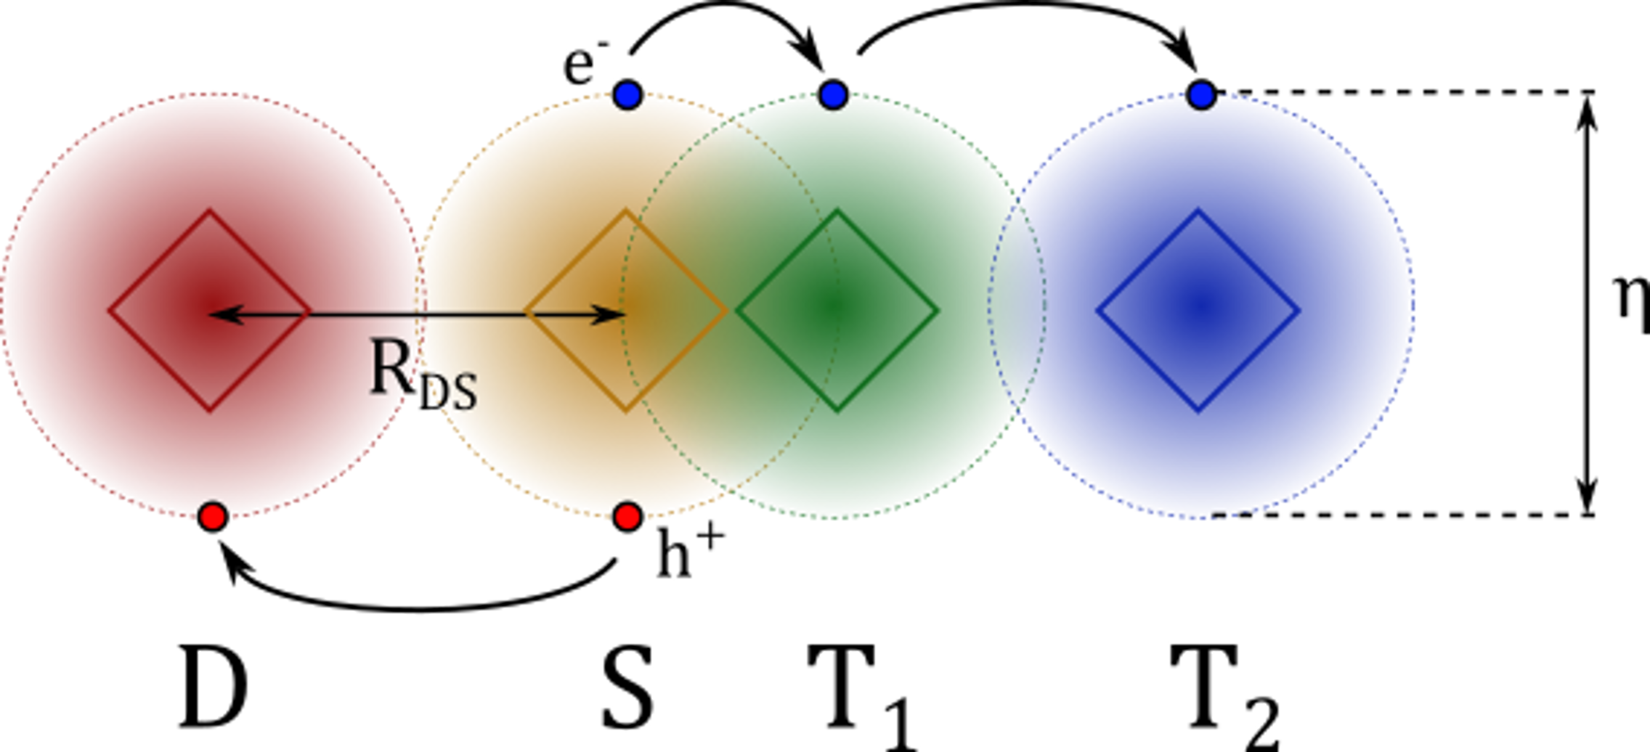
General Model of a Photosynthetic Reaction Centre
New model:
Assume the RC is composed of 4 redox co-factors (D, S, T₁, T₂).
(1) The antenna excites a special pigment, S, creating an exciton (electron-hole pair).
(2) Electron transfers to T₁ then T₂.
(3) Donor, D, reduces S (equivalent to hole transfer from S to D).
(4) T₂ denotes electron to some redox carrier. D is replaced.
(5) The redox carrier kickstarts carbon fixation.

Slide 4
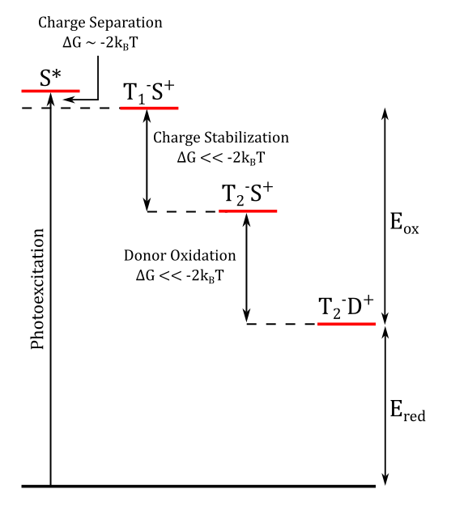
Thermodynamics of the RC
Thermodynamically, the RC has to look something like this.
4 overall states of the systems, defined by the location of the electron and hole on the 4 co-factors.
E_{ox} is the energy that is needed to oxidize the donor. We can think of this as the running cost of the RC.
E_{red} is the surplus energy left over to reduce the acceptor. This energy is used to carry out all the anabolic reactions need for life.

Slide 5
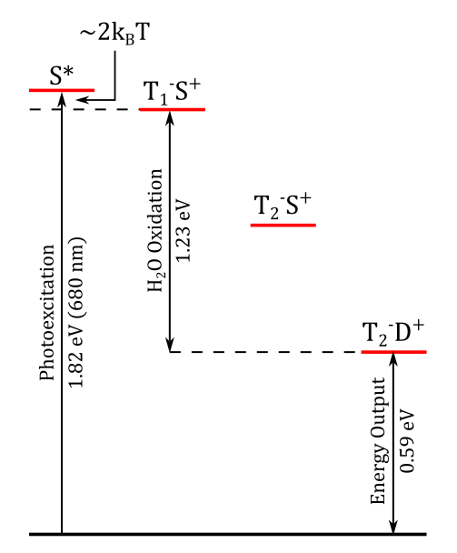
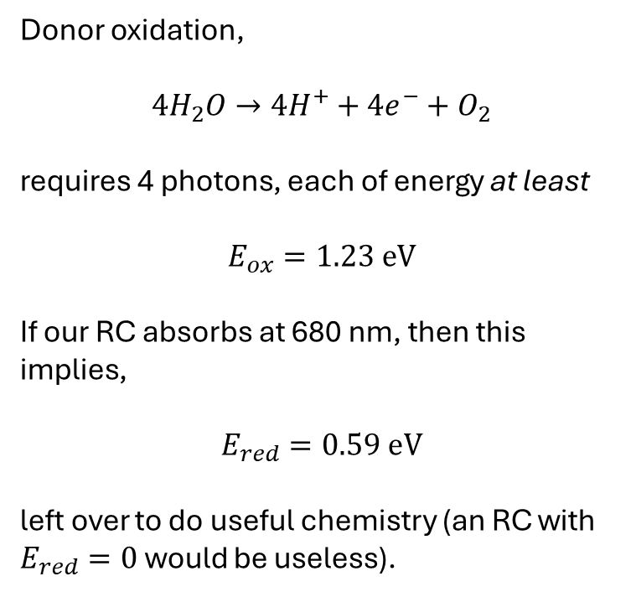
(1) Oxygenic Photosynthesis
Donor oxidation,
$$4H_{2}O→4H^{+}+4e^{−}+O_{2}$$
requires 4 photons, each of energy at least
$$E_{ox}=1.23 eV$$
If our RC absorbs at 680 nm, then this implies,
$$E_{red}=0.59 eV$$
left over to do useful chemistry (an RC with $E_{red}=0$ would be useless).

Slide 6
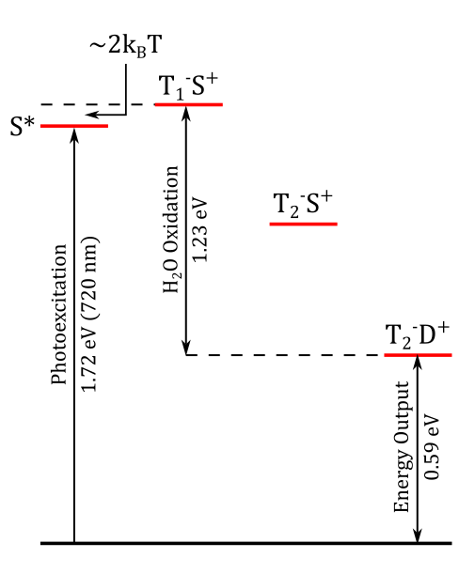
(2) Far Red Oxygenic Photosynthesis
Identical to ‘normal’ oxygenic photosynthesis but S* is slightly red-shifted.
This is a survival strategy in some cyanobacteria.
Astrobiology people are very interested in this.
Doesn’t seem to be very effective (survive not thrive).
We could use this to bench mark our simulations.

Slide 7
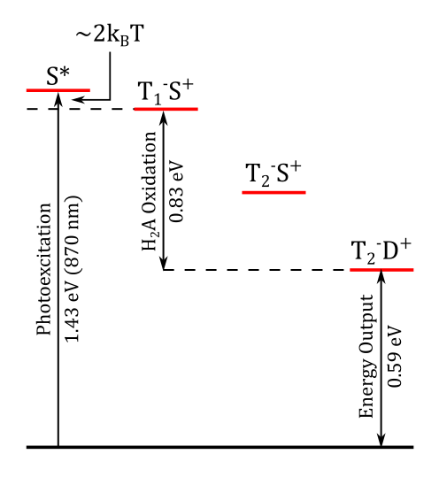
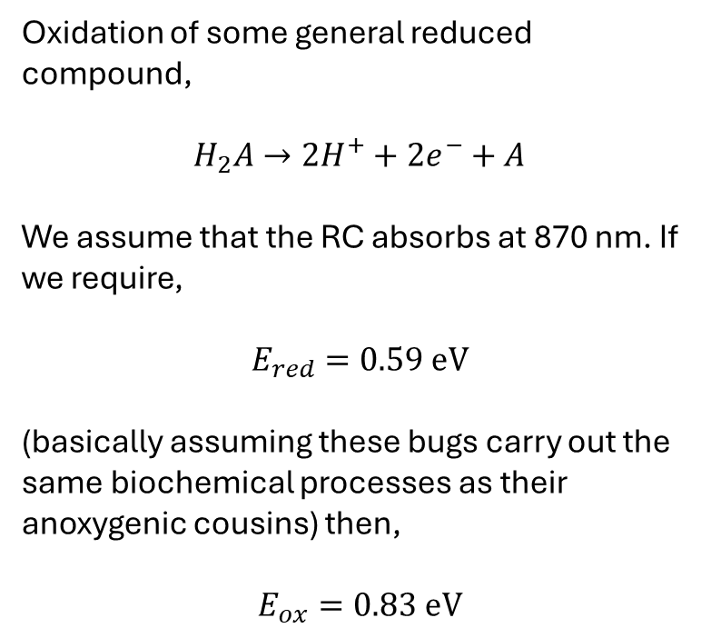
(3) Anoxygenic Photosynthesis
Oxidation of some general reduced compound,
$$H_{2}A→2H^{+}+2e^{−}+A$$
We assume that the RC absorbs at 870 nm. If we require,
$$E_{red}=0.59 eV$$
(basically assuming these bugs carry out the same biochemical processes as their anoxygenic cousins) then,
$$E_{ox}=0.83 eV$$

Slide 8
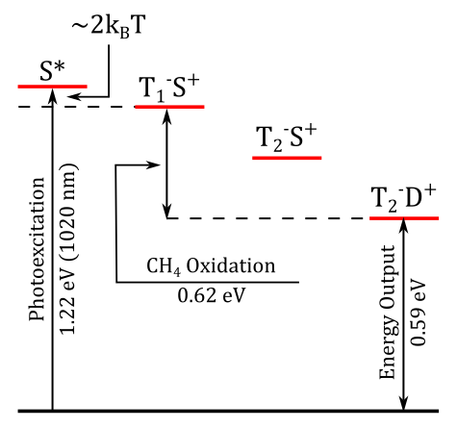
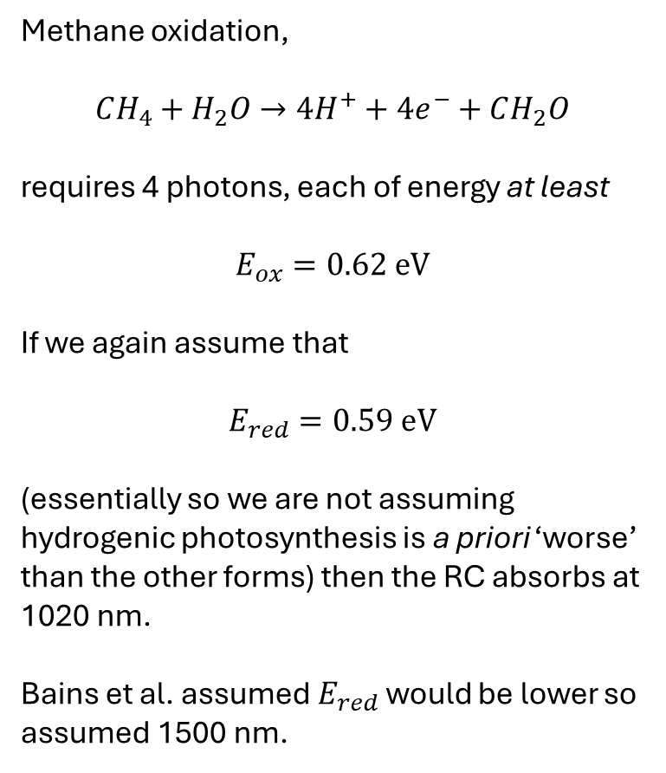
(4) NIR (Hydrogenic) Photosynthesis
Methane oxidation,
$$CH_{4}+H_{2}O→4H^{+}+4e^{−}+CH_{2}O$$
requires 4 photons, each of energy at least
$$E_{ox}=0.62 eV$$
If we again assume that
$$E_{red}=0.59 eV$$
(essentially so we are not assuming hydrogenic photosynthesis is a priori ‘worse’ than the other forms) then the RC absorbs at 1020 nm.
Bains et al. assumed $E_{red}$ would be lower so assumed 1500 nm.

Slide 9
How this connects to exo-planets
Given an incident spectral flux, we can predict which type of photosynthesis will dominate.
They will each have a different reflectance edge which Andrew can model.
(3) We can perform a simple simulated observation, with some photobiology to support the assumption of a particular reflectance model.
Things for which I could use your input
Currently, the model will most likely choose the form of photosynthesis that best lines up with the incident flux maximum (since all 4 forms are equally as ‘good’ for the same photoexcitation rate).
We need to think about substrate availability. Oxygenic photosynthesis evolved mainly due to the wide availability of H₂O compared to H₂S, not due to more flux at 680 nm rather than 870 nm.
Currently the model gives a single best population for a given light. We need to think about heterogeneity of different forms of photosynthesis across the planet surface.

