Slide 1
LIVE GTM PIPELINE CONTEXT
Candidate Go-to-Market Pipeline
Signal flow map
Job signals
Role context
Evidence
Human review
I use a Candidate Go-to-Market system to turn market signals, role context, and real conversations into clearer fit decisions, role-relevant proof, and context-aware follow-up.
Write-back
Review gates turn raw context into next-step judgment
Each cycle sharpens the evidence and shows me what to learn next from the market.
20K+
6
1
job-market signals screened with review rules
repeatable gates from signal to proof and follow-up
loop connecting market feedback, proof, and learning
Johanna Fan · Marketing / GTM / Customer Signal Analytics
Homepage · Hero

Slide 2
WORKFLOW
Quality over quantity.
A high-quality application is not just a submission. It is selected with care, tailored to the role, backed by proof, sent through a credible path, and reviewed for what should change next.
Roadmap for each application
01
02
03
04
05
06
Find the right role
Tailor the resume to the JD
Prepare proof
Apply
Connect with relevant people
Improve the next cycle
Johanna Fan · Marketing / GTM / Customer Signal Analytics
Homepage · Workflow

Slide 3
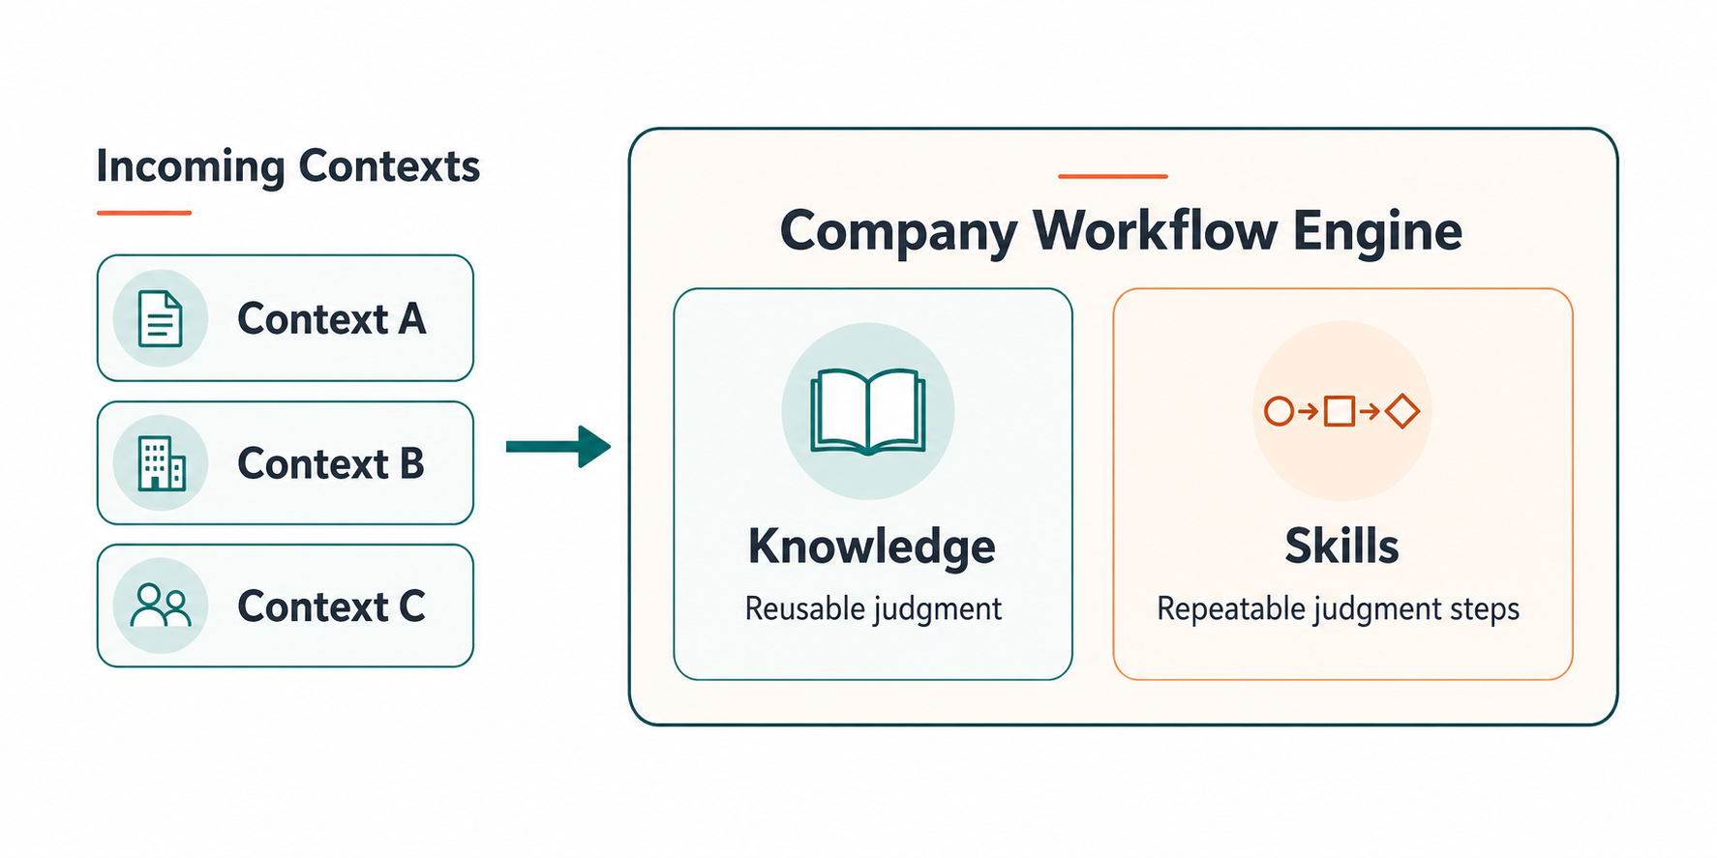
RELIABILITY LAYER
AI-assisted skill layer
A workflow becomes more valuable when each run makes the next one sharper.
After each role, company signal, or stakeholder question moves through the roadmap, I use AI to externalize the judgment: what mattered, what was missing, what could not be claimed, and where human review changed the decision.
Repeated patterns become one reusable AI skill for source order, audience context, KPI questions, guardrails, review points, and write-back behavior.
The next run starts from a clearer method.
Johanna Fan · Marketing / GTM / Customer Signal Analytics
Homepage · Reliability

Slide 4
MARKETING FIT
Why it matters for Marketing / GTM analytics
Before the dashboard
Upstream work shapes decision quality
Good marketing analytics depends on the work that happens before the dashboard: clean source context, meaningful audience logic, focused KPI questions, and handoffs that turn reporting into clearer campaign, channel, audience, or workflow decisions.
Clean source context
01
02
Meaningful audience logic
This pipeline practices that same pattern. Each role, company read, or conversation becomes a small GTM signal system.
03
Focused KPI questions
04
Handoff-ready readout
Current ownership: source context, claim boundaries, handoff-ready proof, and questions that make reporting useful.
Turns into decisions about
Campaign
Channel
Audience
Workflow
Johanna Fan · Marketing / GTM / Customer Signal Analytics
Homepage · Marketing Fit

Slide 5
CONVERSATION
Where this work could fit
Send a quick read
Most useful
Least relevant
Best-fit team
If this way of working feels relevant to your team, I would value your read on where it fits best: marketing analytics, GTM operations, customer signal work, reporting handoff, or another part of the workflow.
A quick read in one or two sentences...
A small reply is enough.
Send a quick read
Which part feels most useful, least relevant, or what kind of team would know how to use this work well?
Johanna Fan · Marketing / GTM / Customer Signal Analytics
Homepage · Conversation

Slide 6




System Architecture
Workflow logic, frontend, database, and hosting
Frontend
ASP.NET Core Blazor
Data Base
Workflow Logic
Supabase Postgres
Claude skills automation
Hosting
Azure App Service
Public-safe implementation view
No private outreach content, raw CRM records, tokens, or internal table details shown.

