Slide 1
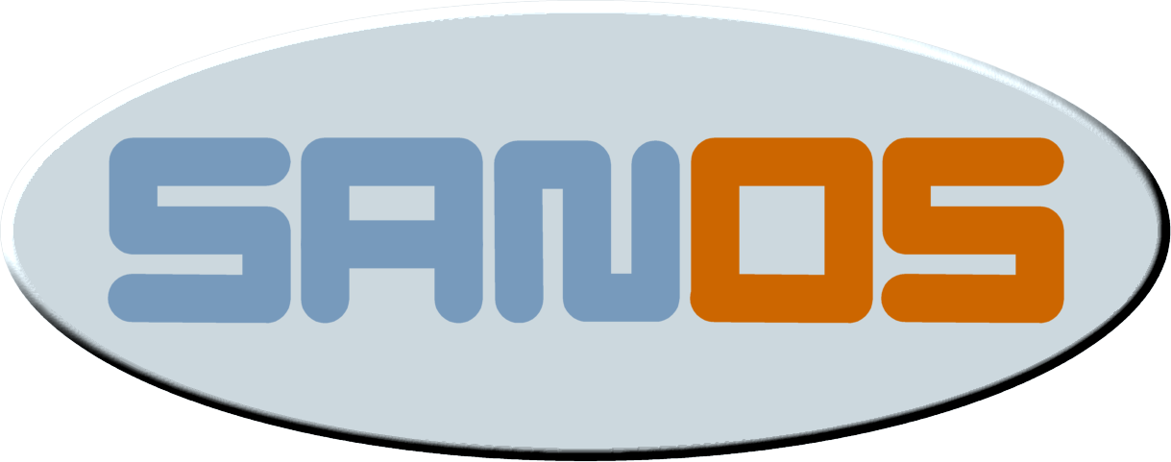
jbox
sanos in a virtualized world
presentation for ssg, intel corp.
september 25th, 2006
Michael Ringgaard (mri@jbox.dk)
Bjarne Hansen (bhansen4@gmail.com)

Slide 2


who are we...
Michael Ringgaard
Michael Ringgaard is a Systems Architect at Computer Sciences Corporation. His main focus is software architecture frameworks for the Java and Microsoft platforms. Recent work includes distributed architecture support components including a persistence framework with a fully distributed object cache. Since 2001 Michael has also worked on sanos, a minimalistic operating system kernel for running java server applications.
Before joining CSC, Michael worked for Tele Danmark A/S, where he was lead architect working on a distributed CTI and call-center solution.
Michael holds a M.Sc. in Computer Science from Aarhus University.
Bjarne Hansen
Bjarne Hansen is a Systems Architect and Technical Evangelist at Computer Sciences Corporation. For the last 10 year he has been working with service oriented architectures on Microsoft and Java platforms. He has participated in a number of large scale system integration projects in the financial and government sectors.
Prior to working at CSC, he has worked as a consultant for the Danish Institute of Technology (DTI).
He holds a M.Sc. in Computer Science from Aarhus University.

Slide 3
agenda
history of sanos project
sanos highlevel architecture
usage scenarios
  bare metal technologies
  zero entropy systems
  application appliances
paravirtualization of sanos
the road ahead

Slide 4
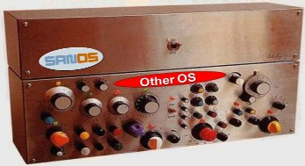
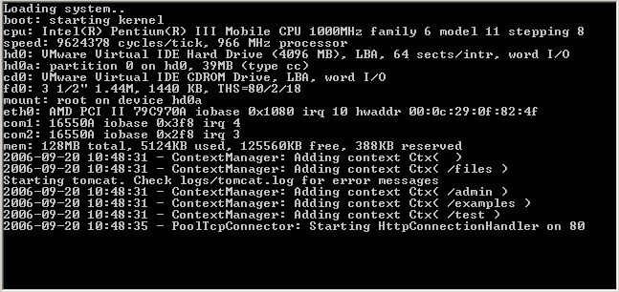
sanos
sanos is an open source minimalistic x86 os kernel for java based server appliances running on standard pc hardware.
enables you to run java server applications without the need to install a traditional host operating system like windows or linux.
kernel was developed as part of an experiment on investigating the feasibility of running java server applications without a traditional operating system only using a simple kernel.
alternatively, you can use sanos as a small kernel for embedded server applications written in c.
sanos has a fairly standard posix api.

Slide 5
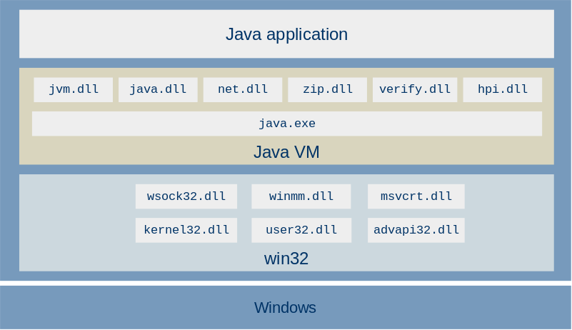
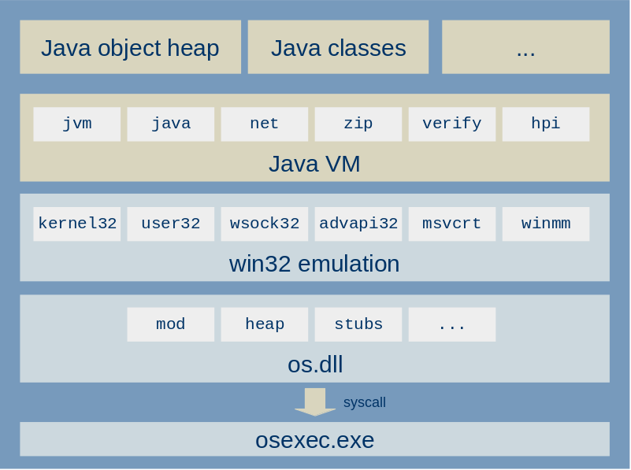
history of sanos
why write our own os?
sanos started as an experiment in 2001
why use a complex os to run a single application?
os emulator runnning under windows
the goal was to run a jvm under a simple os emulator
the emulator just needed a kernel and a boot loader to run standalone
september 2002 sanos was released

Slide 6
sanos features
open source (bsd license)
runs on ia-32
written in c (msvc) and x86 asm
uses pe executables
single address space
self configuring (pci, pnp)
tcp/ip networking stack with bsd socket interface
boots from floppy, hard disk, cdrom, and network
posix operating system api
802.3, arp, ip, tcp, udp, dhcp, dns, sntp, syslog, cifs/smb, telnet, ftp, http
ne2000, eepro100, sis900, pcnet32, rtl8139, 3c905, and tulip nics
small (50.000 lines of code, 350 kb binary)

Slide 7
java on sanos
app
Java server application (e.g. tomcat, jboss)
sdk
Java 2 SDK (rt.jar, tools.jar)
jvm.dll
java.dll
jvm
hpi.dll
net.dll
zip.dll
verify.dll
wsock32.dll
winmm.dll
msvcrt.dll
win32
jinit.exe
kernel32.dll
user32.dll
advapi.dll
kernel
os.dll
krnl.dll
boot
osldr.dll
boot

Slide 8
sanos kernel architecture
api
syscall
object
hndl
io
memory
thread
boot
vfs
socket
ldr
kmalloc
vmm
queue
start
dfs
devfs
pipefs
smbfs
tcpsock
udpsock
dhcp
tcp
icmp
udp
timer
cdfs
ip
procfs
kmem
buf
arp
netif
iomux
ether
loopif
dev
pframe
pdir
sched
block
stream
packet
fd
console
serial
3c905c
dbg
ide
video
kbd
null
nvram
pcnet32
(...)
ne2000
trap
ramdisk
bus
(nic...)
pnp
pci
hw
cpu
fpu
iop
pic
pit
apm

Slide 9
performance
remember that there is no code faster than no code.
taligent's guide to designing programs
it is the cpu that executes your application, not the operating system
hotspot vm is the same as on windows
theading
  very fast context switching, sysenter/sysexit
  no spin locks
memory
  most memory mangement done by the jvm
  single process design uses cpu cache and tlb very efficiently
  Doug Lea's malloc is consistently among the fastest and most space-efficient implementations; in many cases it particularly excels at saving memory, where other allocators suffer from fragmentation
disk i/o
  udma support
  disk caching
  no overhead for legacy performance optimizations (cylgroups, read ahead, interleave etc.)
network i/o
  pci bus mastering
  tcp/ip checksum offloading
  no-copy packet buffers

Slide 10
bare metal technologies
bare metal technology = running applications directly on top of (virtual) hardware
recent advances in virtualization technologies has put a renewed interest in bare metal technologies
focus has moved away from operating systems as strategic platforms to soa architectures and virtualization platforms
traditional functionality moves out of the operating system
bea has recently announced its jrockit vm on bare metal
Notes:
SOA architectures (and more generally grid technologies) requires a lot of server and customers are looking at options for managing all these servers in a cost-effective way. When you add fault tolerant configurations and multi-stage environments (development, test, UAT, production, dark center) a modern SOA installation ends up with hundreds of servers. There is a huge potential in streamlining deployment and operation of these environments.
Dragging around multi-gigabyte operating systems and platforms, that require constant patching and upgrading seems like a waste of resources. If your virtualization platform handles deployment of your systems and manages the servers this removes a lot of the rationale for using these large operating system platforms in the first place. Also, when the OS runs inside a virtual machine support for all kinds of hardware devices is no longer a big advantage. The virtualization platforms focus the operating systems role towards serving the applications. This is where technologies like sanos shows that even large applications does not require a large complex operating system. BEA has recently announced its JRockit VM on Bare Metal. This is a version of JRockit running directly on top of a hypervisor. The large number of bare bone Linux distributions, as well as the many virtual appliances in VMware's virtual appliance contest shows a huge interest in bare metal technologies. We also see that appliances, which used to be only routers and switches, are moving up in the value chain to DNS , DHCP, SAN, NAS, firewalls, security platforms, etc.

Slide 11
zero entropy servers
zero entropy server = server that does not hold any persistent state itself
persistent state maintained in rdbms, san, nas, etc.
these systems are popular because of
  low maintenance costs (no backup)
  easy scalability (just add more servers)
  simple deployment (just make a copy of a server image)
  fault-tolerance (just start the system on another server)
  virus immunity (readonly system)

Slide 12
application appliances
(virtualization +) bare metal + zero entropy = (virtual) application appliance
large operating systems not well-fitted for application appliances
increasing interest in the market:
  large number of bare bone linux distributions
  many virtual appliances in vmware's virtual appliance contest
appliances are moving up in the value chain

Slide 13

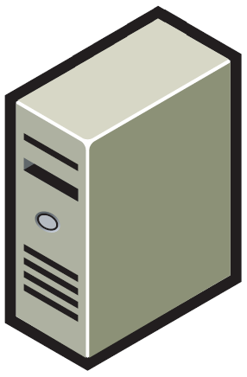
end-to-end enterprise management
vm image
repository
virtual machine management
deploy
manage
virtual machines
virtual machines
virtual machines
build service
vlan
app
app
app
app
app
app
app
app
app
app
app
app
app
app
app
vsan
os
os
os
os
os
os
os
os
os
os
os
os
os
os
os
build
vmm
vmm
vmm
application repository
execute
execute
execute
source
code
deployment
configs
3rd party
components
packaged
apps/os
physical servers

Slide 14
paravirtualization of sanos
sanos runs as an ordinary guest on vmware, virtualpc, bochs, and qemu
sanos should be able to run unmodified on xen using intel vt enabled processors
paravirtualizing can improve performance of emulation (on non-vt processors?)
vmware virtual machine interface (wmi) still in experimental stage
paravirtualizing sanos
  move kernel from ring 0 to ring 1
  replace privileged instructions with vmi calls
  coordinate mmu and apic functions with the hypervisor
  virtual time management

Slide 15
nop-pay for no-use vmcalls
struct vmops
{
...
void (*disable_int)();
void (*enable_int)();
...
};
struct vmops vmops;
__declspec(naked) void hw_enable_int()
{
__asm
{
push ebx
mov ebx, dword ptr [esp+4]
sub ebx, 2
mov word ptr [ebx], 0x9090
sub ebx, 4
mov dword ptr [ebx], 0x909090fb
mov dword ptr [esp+4], ebx
pop ebx
ret
}
}
vmops.enable_int();
call [vmops+nn]
kernel detects hypervisor on runtime
performance sensitive operations replaced by vm calls
vmops implementation for hw, vmi, xen, etc.
overhead when running on real hardware
just-in-time replacement of vm calls
...
call [vmops+0x08]
...
...
sti
nop
nop
nop
nop
nop
...

Slide 16
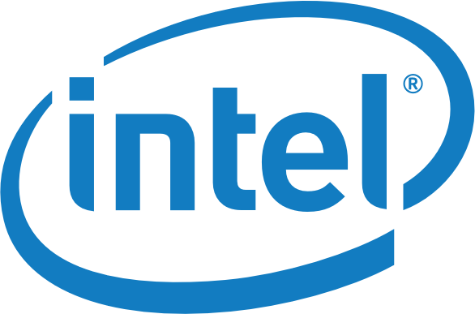
the road ahead
questions?
comments!
what’s next…
read more about sanos on http://www.jbox.dk/sanos
download sanos from http://www.jbox.dk/sanos/download.htm

