Slide 1
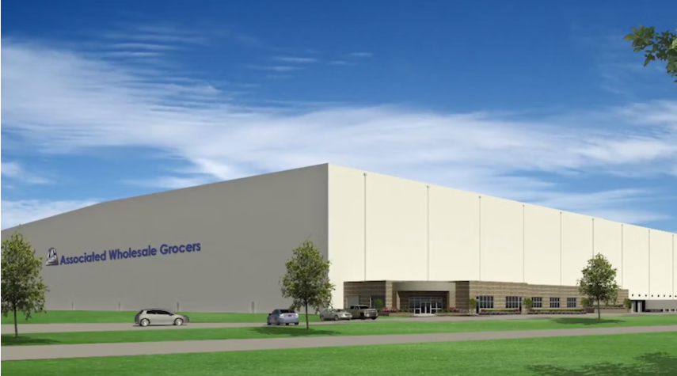
the Impact of AWG Retail Programs on New Product Sales
Group D: Ringing Song, Shiyun Lu, Jiayi Zheng, Lingyao Gao, Mia Wu

Slide 2
CONTENt
Core Business Problem
Analysis Model
Exploratory Analysis
Limitations & Bias
Next step

Slide 3
Core Business Problem
AWG PROGRAM:
AIM Autoship → Automatic shipment of new products.
One Source (with Acosta) → In-store display and sales representative support.
Main question
Do these programs improve early sales performance and product adoption for new items?
sub question
Which program—or combination—is more effective?
Are effects consistent across brands, categories, or states?
Notes:
自动补货系统，降低新品进货风险
Automatic replenishment system to reduce the risk of stocking new products.
门店陈列与销售代表支持
In-store display and sales representative support.

Slide 4
Analysis Model
link to 7
Program Participation
Outcome Variables
Total Billed Quantity within 3 Months After Item Launch
Total Sales Amount within 3 Months After Item Launch
Distribution Rate within 3 Months After Item Launch
Factor
Contextual Variables
Brand
Category
State
Only participate in AIM
Only participate in One-Source
Participate in both
None

Slide 5
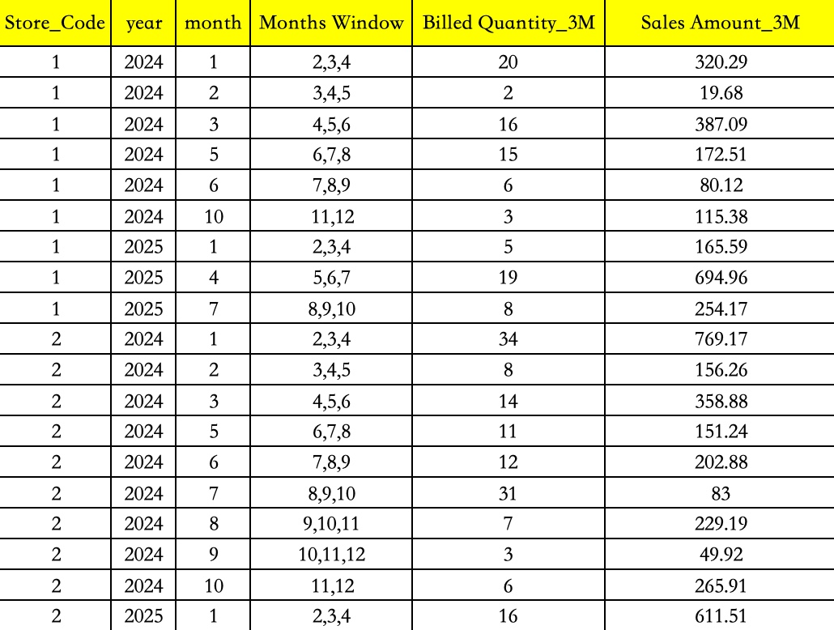
Outcome variables
  Total Billed Quantity/Sales Amount for each Store within 3 Months After Item Launch
  Key points:
  3 months after item launch
  for each store, aggregate billed quantities and sales amounts of all new items sold during their respective three-month post-launch periods

Slide 6
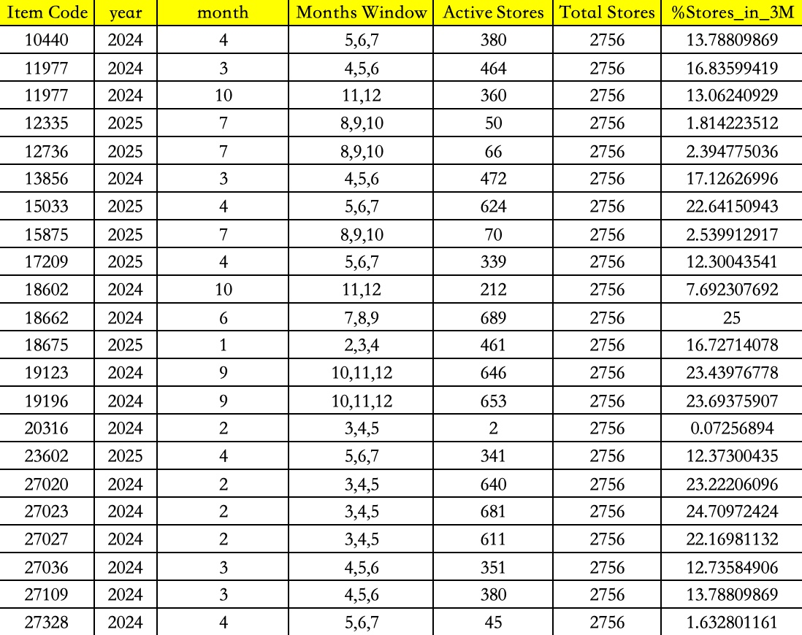
link to 4
Outcome variables
  Distribution Rate within 3 Months After Item Launch
  Key points:
  3 months after item launch
  for each item, within its 3-month post-launch period:
number of stores that sold at least one unit of that item
*100%
total number of stores

Slide 7
Data Overview
Participation
AWG All store List 10.1
Sales_Launch
Sales_Data_Raw
Sales_Launch_Brand
Sales_Launch
AIM NEW ITEM LIST AS OF 08.14
ONE SOURCE STORE LIST 8.26
all_month
Participation
Brands_Categories
Sales_Launch_Brand
Sales_Data_Metrics
Item_Store_Coverage_3M_with_window
calculate metrics
​Store
Store * item * year * month
Store * item * year * month
Store * item * year * month
Notes:
Store相关
Item相关 – 日期 code 年
Excel截图
Store x product x date

Slide 8
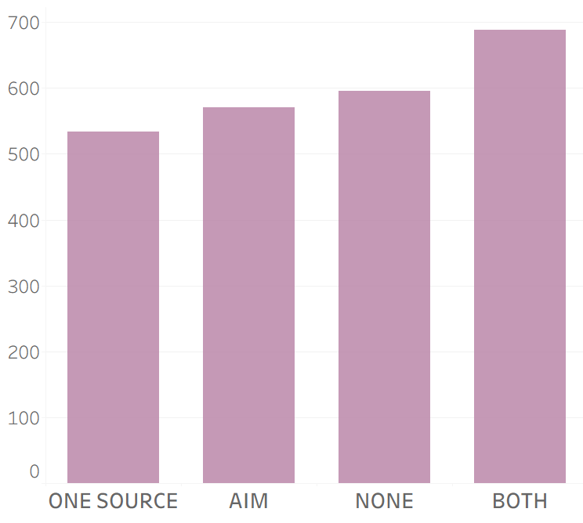
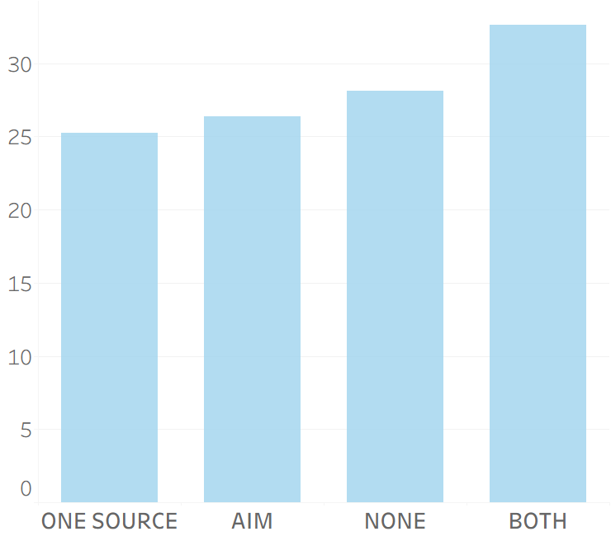
Exploratory Analysis
Average Sales per Store by Program (dollars)
Average Billed Quantity per Store by Program (orders)

Slide 9
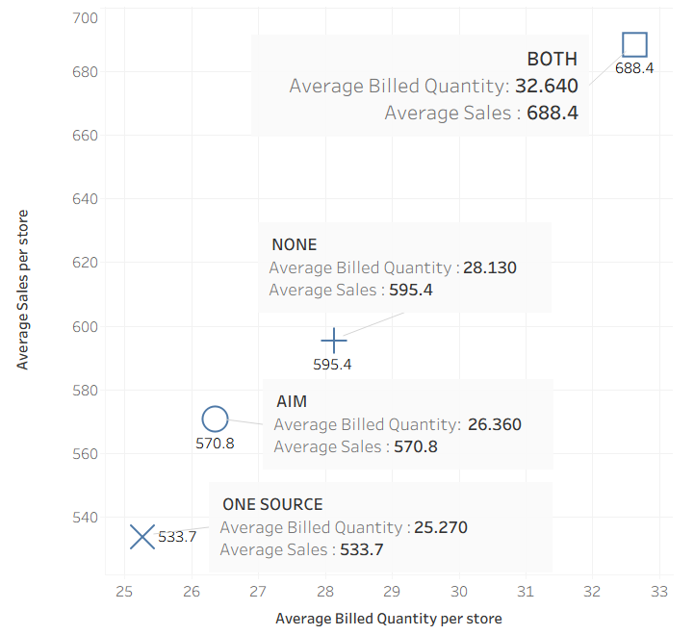
The top-ranked stores are those that have participated in both programs.
Among the stores that have only participated in one project, store participating in the AIM performs better​.

Slide 10
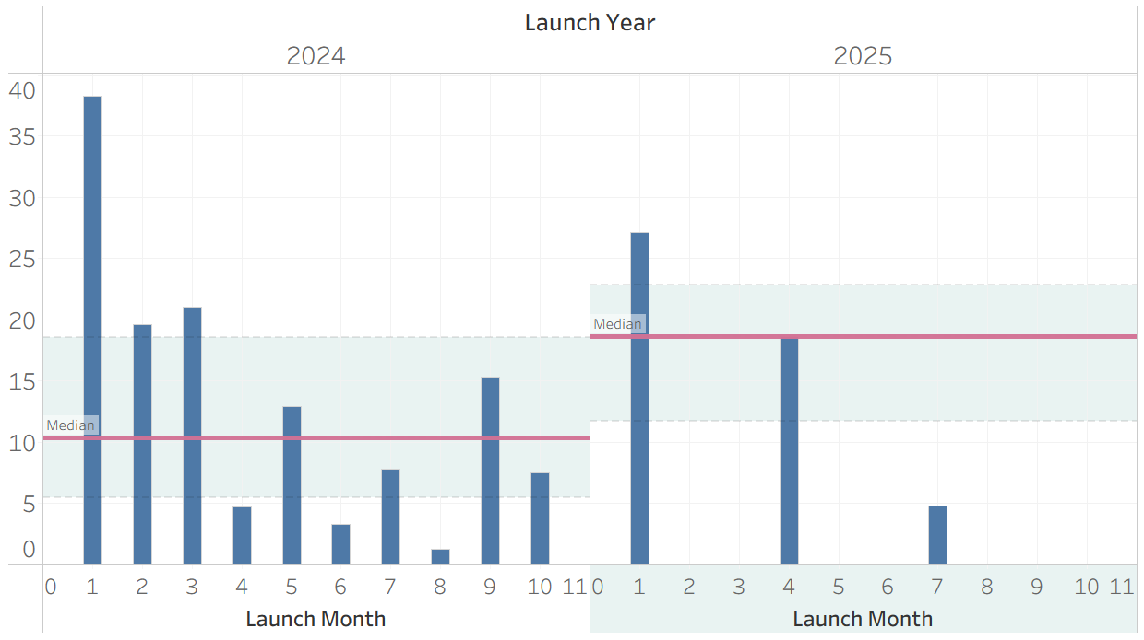
Average Store Distribution Rate per Month(%)

Slide 11
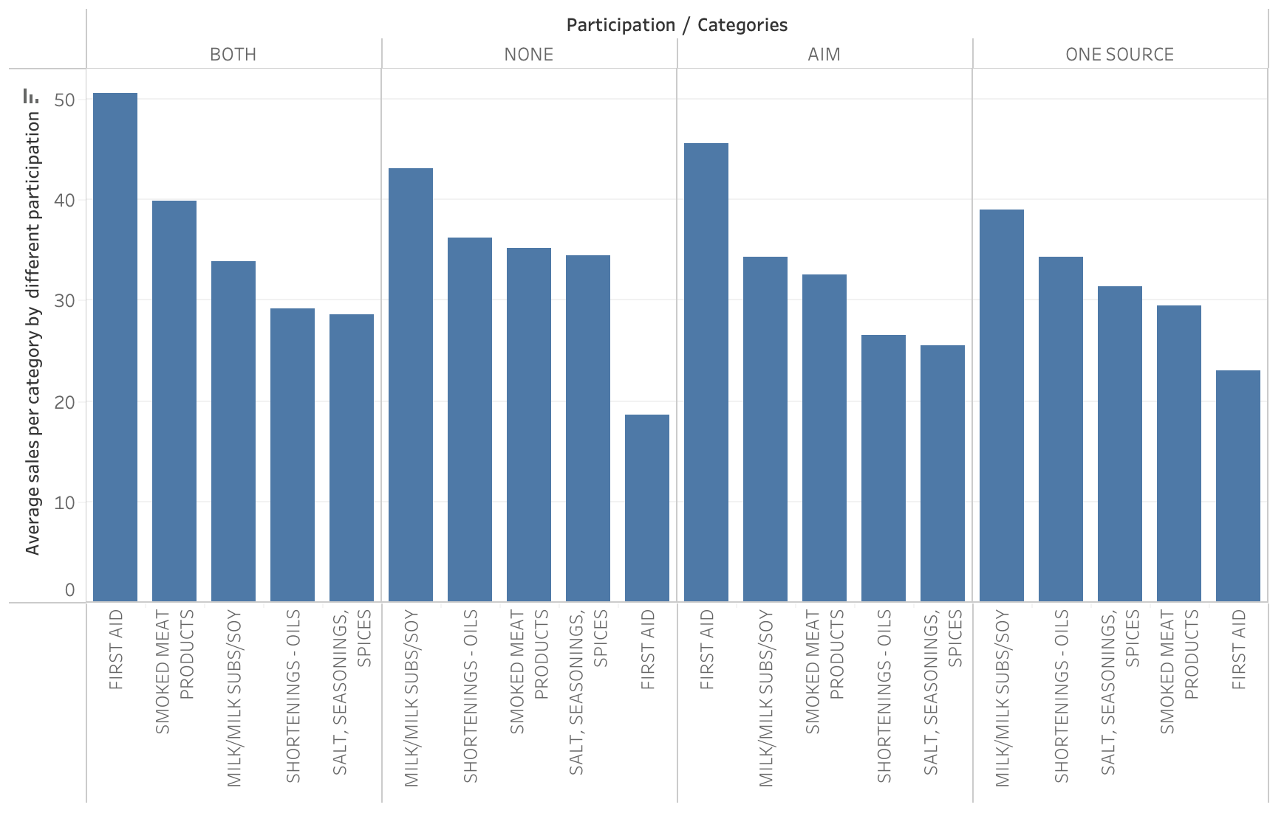
TOP5 Average Sales by Category and Participation

Slide 12
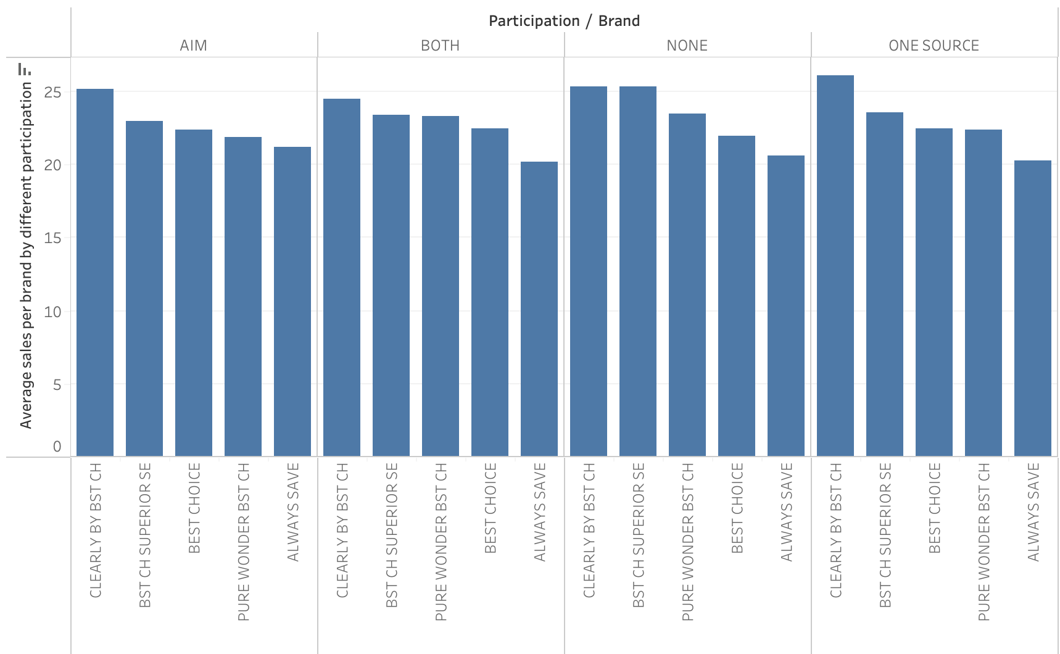
Average Sales by BRAND and Participation

Slide 13
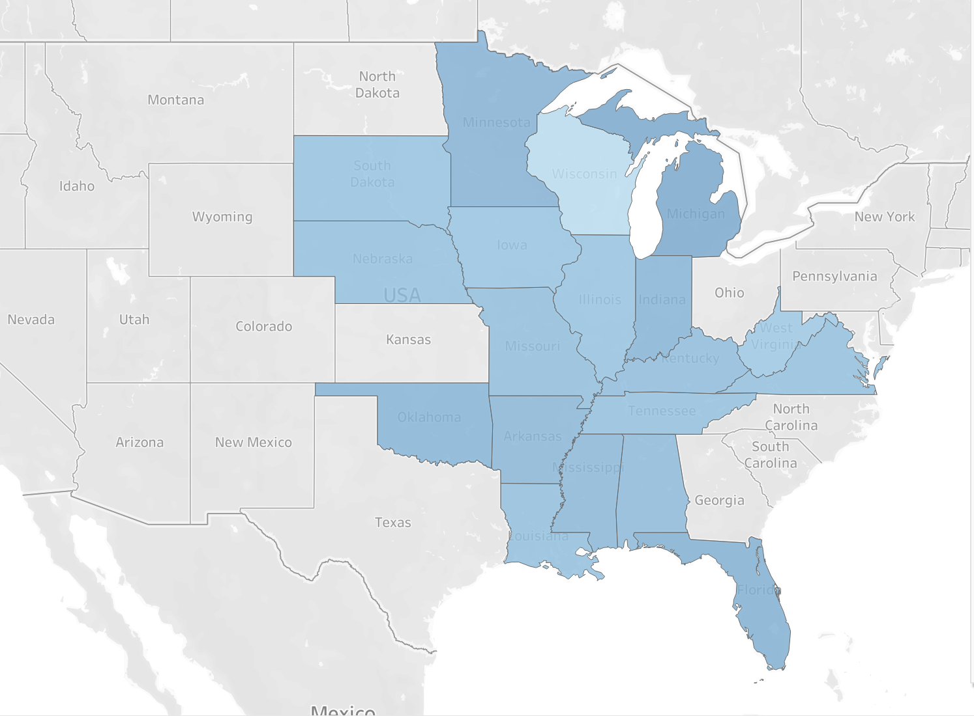
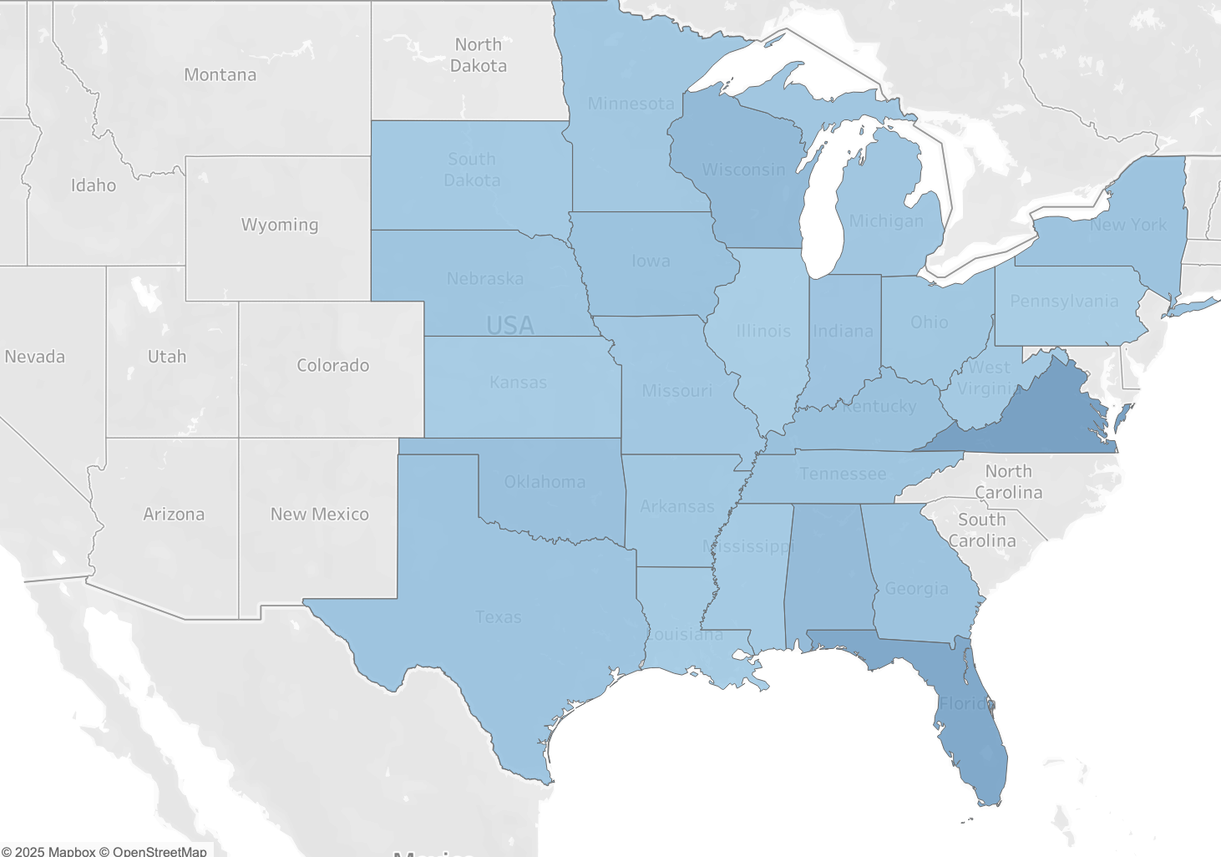

AVERAGE SALES BY STATE AND PARTICIPATOIN
AIM
ONE SOURCE

Slide 14
Limitations & Bias
Program Timing
Seasonality
Data Quality
Only static store-level participation.
Unknown join / exit dates
May overestimate program effects.
Same item appears in multiple monthly launch files → duplicate new launches
Distorts early-sales metrics
Holiday launches or nearby-store effects could inflate results.
Over predict the impact of programs
Notes:
目前 program_status 仍以静态标签为主，我们的第一优先项是构建 store–month 层的 program_status_at_launch；若无法获得精确 start dates，我们将做情景敏感性分析与 bounds 检验，以量化可能的偏差范围。

Slide 15
Next Step
MODELING
Run interaction regressions to estimate program impact
VALIDATION
Check model fit and significance of coefficients
Analyze segment-level effects – how impact differs across programs or categories
Re-run models across different time windows and samples
ROBUSTNESS TESTING
Verify result stability and identify potential biases
Apply panel data with time fixed effects to control for temporal variation

Slide 16
Thank you!

