Slide 1

AWG Program Participation Analysis
Teams I + D
12/15/2025

Slide 2
Content overview
Company Name
1
2
3
Data Methods
Program Participation by Cumulative Sales
Product Category Level Insights
4
5
6
Brand Level Insights
Regional Level Analysis
Final Recommendations

Slide 3
Dataset Overview
The analysis is based on a cleaned, final, store-level dataset
Sales outcomes and program participation information are consolidated into a single table
Data Alignment
Each store appears exactly once in the dataset
Program participation status is consistently defined at the store level
Analytical Implications
Eliminates mismatched or duplicated records
Ensures sales metrics are correctly aligned with program participation
Supports valid comparison across participation groups
Company Name
Data Preparation & Dataset Structure

Slide 4
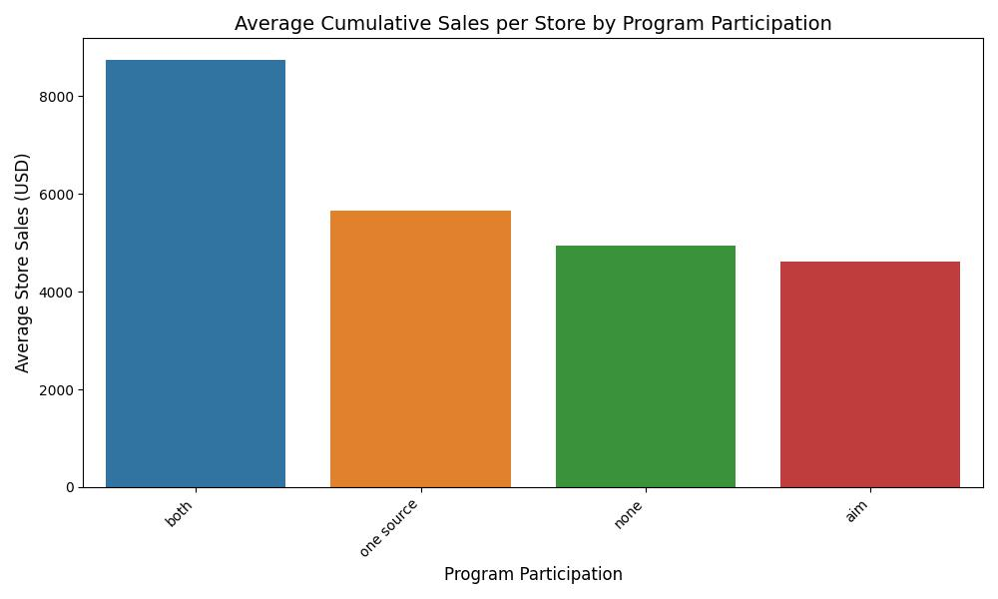
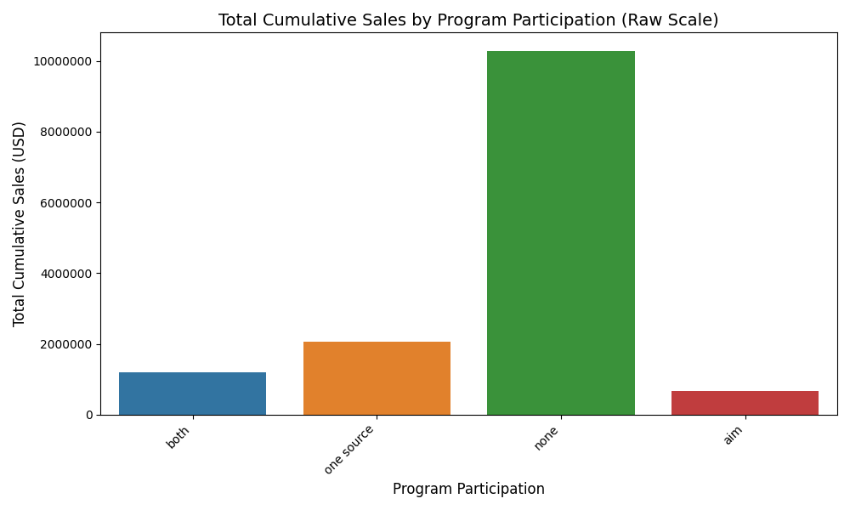
Stores in “both” programs significantly outperform all other groups in average sales, demonstrating effect of dual enrollment.
Teams !
Program Participation by Cumulative Sales

Slide 5
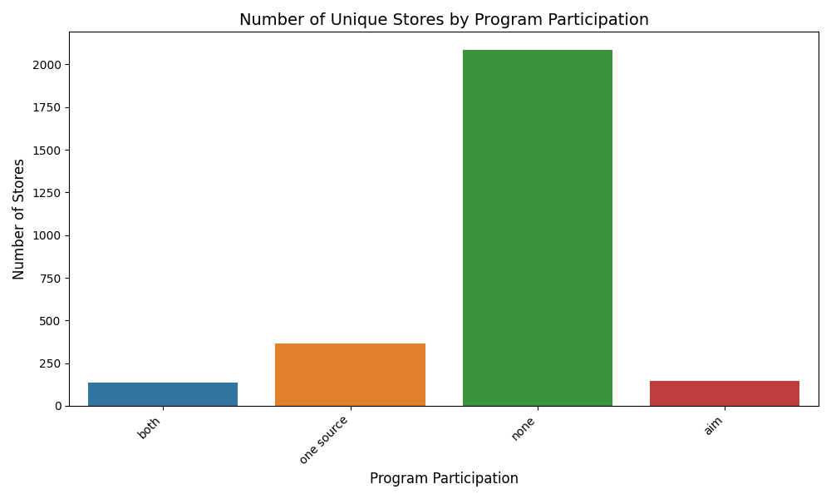
“Cumulative” metric distinction
Team I
Program Participation by Cumulative Sales
Cumulative Sales vs. Average Cumulative Sales
The number of stores not participating in either program vastly outweigh the number of stores participating in any combination of the programs.
2,086 “None” vs. 138 “Both”
Stores not participation in either program drive the highest cumulative sales (~10.3M) but this is due to the group size rather than program effectiveness.
“Both” Program Participation
Stores participating in both programs averaged $8,741 cumulative sales per store vs. stores in neither program which averaged $4,929 per store.
“Both” stores drive sales that are ~54% higher than the next best program (One Source, $5,664 avg per store)

Slide 6

Product Category Level Analysis
Test whether program participation effects vary across different categories — that is, whether Category acts as a moderator of program effectiveness.

Slide 7
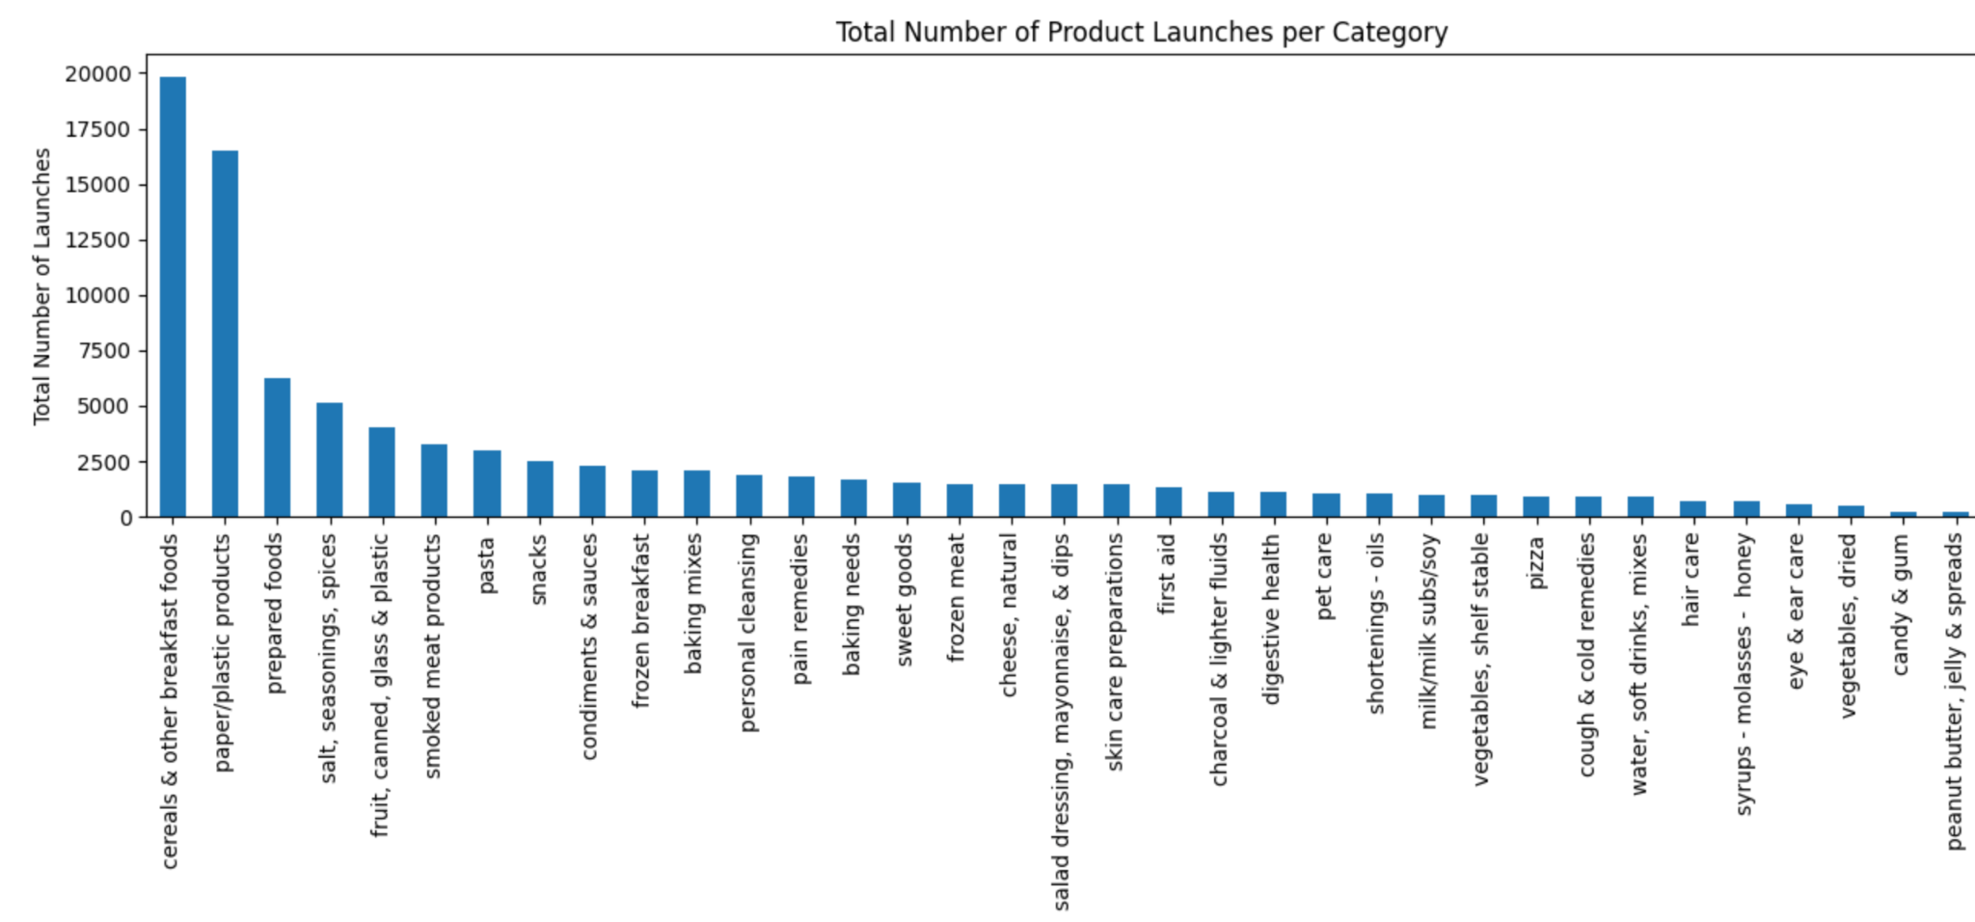
Category Portfolio Overview
Content: The product portfolio shows significant concentration in specific categories, with the top 5 categories dominating AWG's business:
Key Insights:
The top 2 categories represent more than double the product volume of the next three categories combined
These 5 categories account for the majority of AWG's product portfolio
Clear opportunity to focus program efforts where volume is highest
Why This Matters:
Understanding category volume helps prioritize which categories should receive focused program attention and resources.

Slide 8
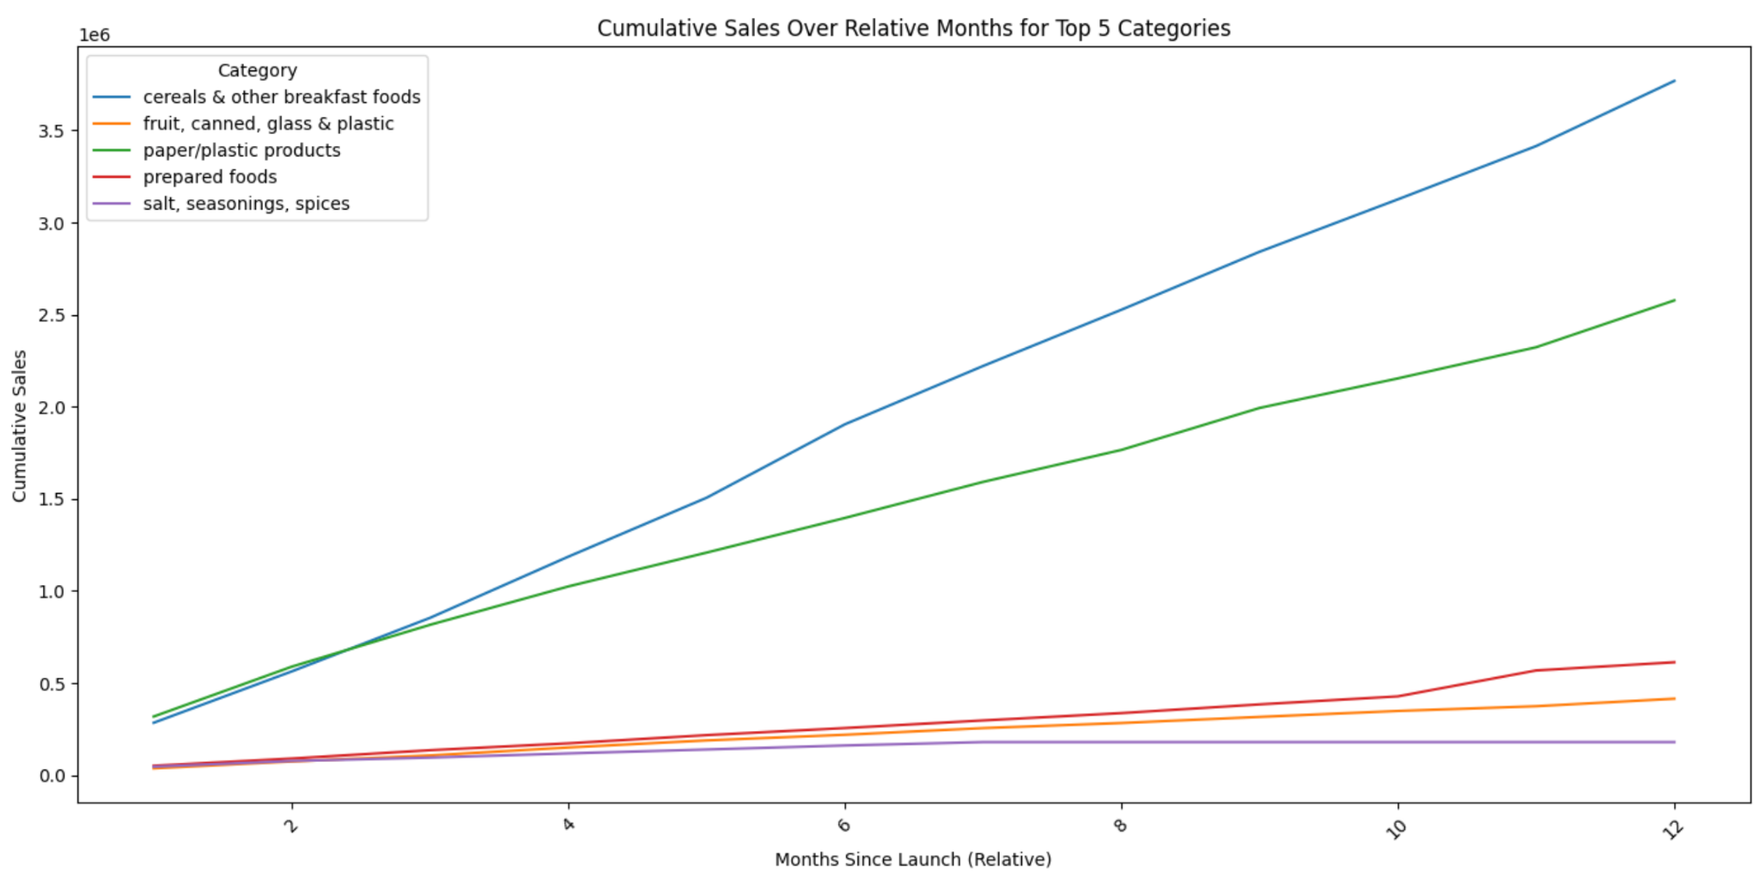
Cumulative Sales Growth Trajectories
Key Insights:
Cereals and paper/plastic drive 85%+ of total sales with consistent, predictable growth
Smaller categories remain relatively flat, showing limited growth under current conditions
Category stability indicates reliable, low-volatility performance

Slide 9
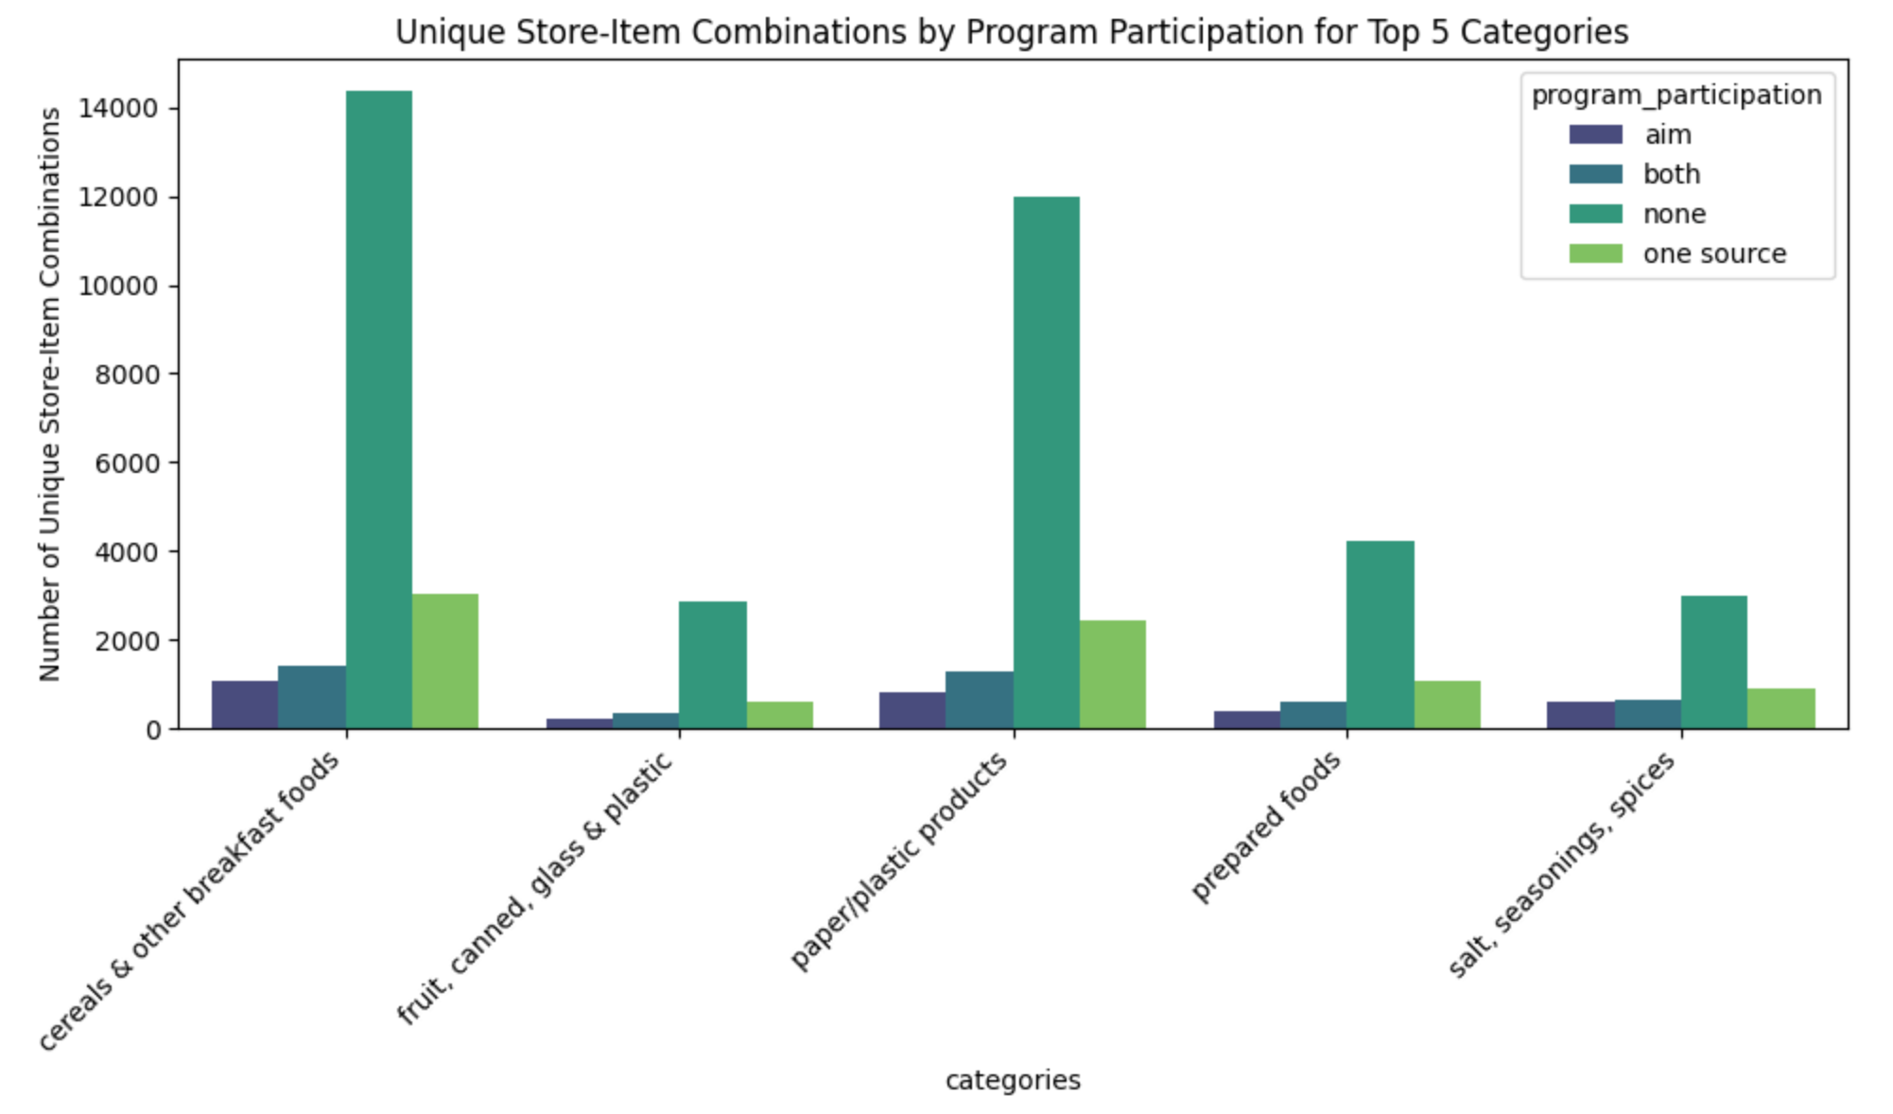
Store Distribution Across Categories
Key Insights:
"None" stores dominate store-item combinations (4-5x more than program participants)
This reflects store count disparity (2,086 "None" vs 138 "Both"), not category breadth differences
Program stores maintain similar category assortment per store
Why This Matters:
Opportunity lies in expanding the number of stores enrolled in programs, not in broadening category assortment within existing program stores.

Slide 10
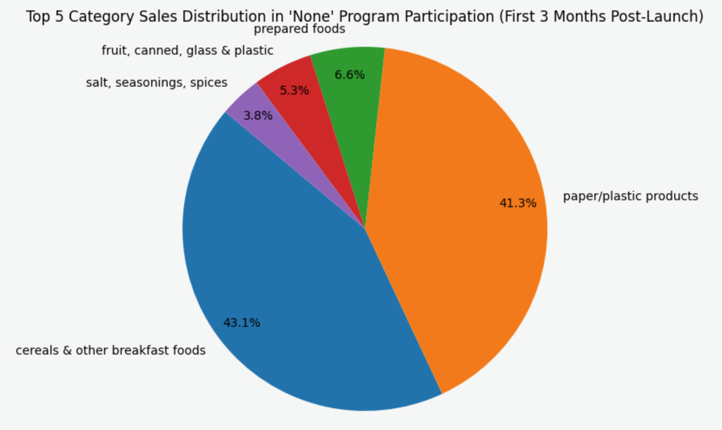
None Program Participation
Baseline Category Performance (No Program Participation)
Key Insights:
Top 2 categories account for 84.4% of early sales in non-participating stores
Establishes natural category mix without program intervention
Why This Matters:
This baseline is critical for measuring true program impact—any shifts from these proportions indicate program effectiveness.

Slide 11
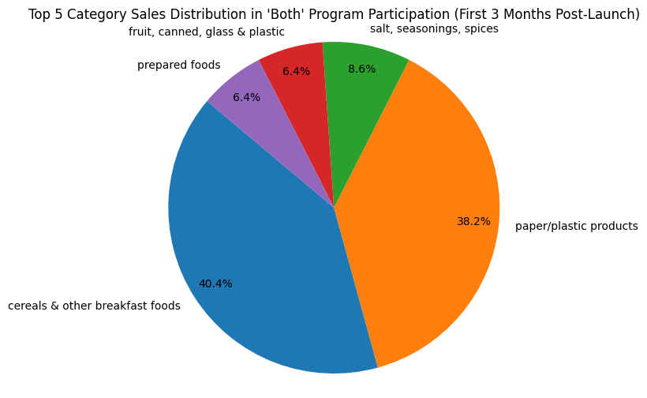
Program Impact on Category MIx
Both Program Participation
Key Insights:
The salt, seasonings, spices category drives 2.2 percentage points
Identical performance in prepared foods and fruits
Why This Matters:
Stores participating in “both” programs increases proportions of the secondary categories without exploiting the core essentials. There is potential growth in revenue for the secondary categories

Slide 12
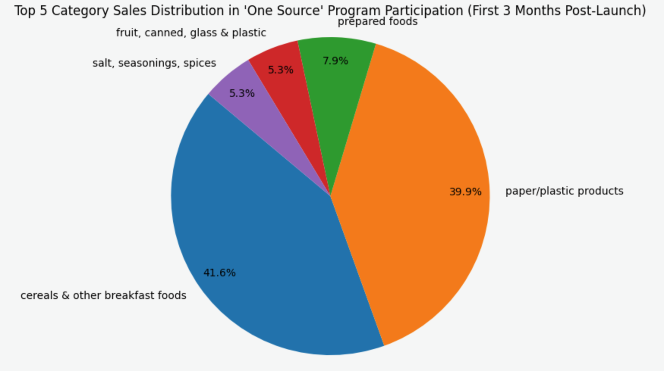
Program Impact on Category MIx
One Source Program Participation
Key Insights:
Prepared foods increase by 2.6 percentage points vs baseline
Core categories remain stable
Balanced growth pattern across category portfolio
Why This Matters:
One Source drives proportional growth without disrupting core business—> ideal for stores wanting to maintain category emphasis while boosting secondary products.

Slide 13
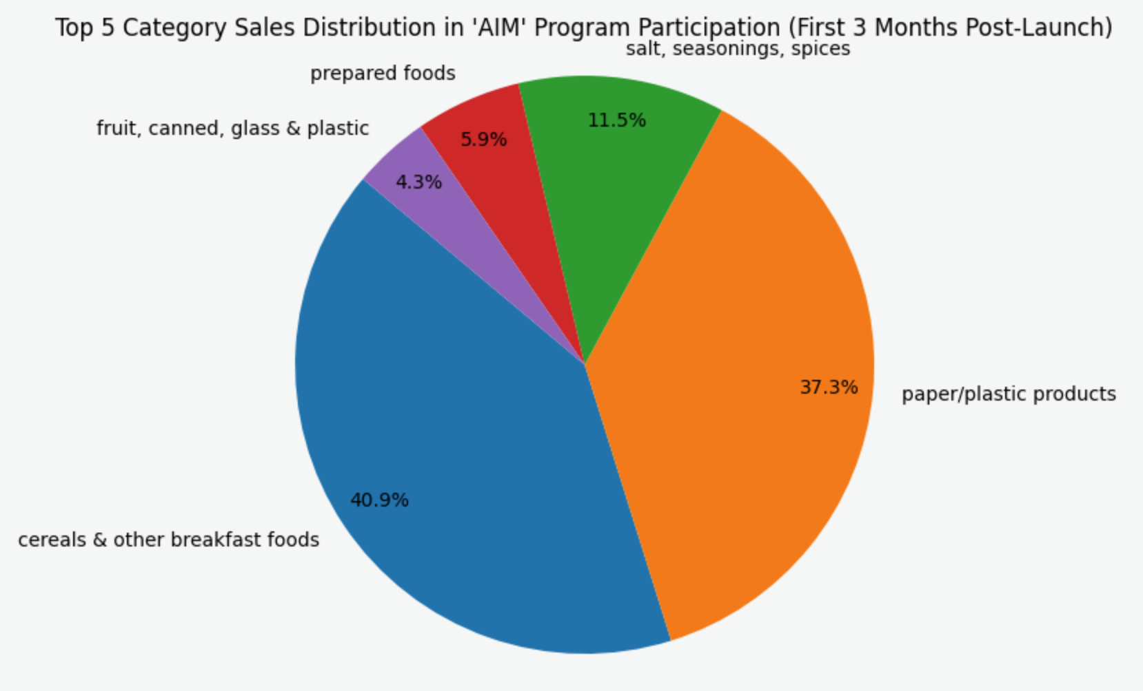
Program Impact on Category Mix
AIM Program Participation
Key Insights:
Salt/seasonings/spices see 3x increase in sales proportion vs baseline
Paper/plastic declines by 4.0pp—largest category shift observed
Indicates strategic rebalancing toward complementary products
Why This Matters:
AIM excels at developing high-potential smaller categories, likely through targeted merchandising or category-specific incentives. Requires investigation: Is paper/plastic decline intentional strategy or unintended consequence?

Slide 14
Program Effectiveness by Category
Which Categories Respond Best to Programs?
Categories Showing Strong Response:
Salt, Seasonings, Spices
3x sales proportion under AIM programs
Major untapped growth opportunity
2.2 percentage point increase under Both programs
Prepared Foods
+2.6pp under One Source (proven growth)
Maintains stable proportion under Both programs
Balanced growth without core disruption
Paper/Plastic Products and Cereal
Represented ~84% of baseline sales
Prime candidates for "Both" program approach due to scale
Categories Requiring Further Investigation:
Paper/plastic under AIM (−4.0pp decline)
Some categories show limited program responsiveness
Notes:
Identical percentage as fruit, canned, glass & plastic for “Both” program

Slide 15
Strategic Recommendations & Next Steps
Category-Specific Action Plan
Proven Winners:
Deploy AIM for Salt/Seasonings Growth: 3x effectiveness demonstrated - expand this program-category pairing aggressively
Use One Source for Prepared Foods: +2.6pp lift with stable core business - ideal for balanced growth stores
High-Priority Investigations:
Test "Both" Programs in High-Volume Categories: Cereals and paper/plastic represent 84% of sales - even small gains = massive dollar impact. Hypothesis: dual enrollment may optimize these categories, but requires controlled testing
Analyze Paper/Plastic Decline under AIM: -4.0pp drop needs root cause analysis before further AIM deployment in this category
Notes:
mmediate Next Steps:
Deep-dive: What makes AIM effective in salt/seasonings? (merchandising, placement, promotions?)
Pilot "Both" programs in 50 stores (cereals/paper-plastic focus) over 6 months with clear KPIs
Investigate paper/plastic + AIM relationship - is this trade-off intentional or correctable?
Build category-specific program playbooks based on proven performance patterns

Slide 16
Category-Level Key Takeaways
Category-Specific Action Plan
Tier 1: Proven Growth Categories
Salt/Seasonings: Deploy AIM (3x effectiveness confirmed)
Prepared Foods: Deploy One Source (+2.6pp lift confirmed)
Tier 2: High-Volume Optimization Candidates
Cereals & Paper/Plastic: 84% of revenue makes optimization critical
Hypothesis: "Both" programs may deliver small percentage gains = large absolute revenue
Status: Requires controlled pilot testing before full deployment
Tier 3: Categories Needing Alternative Strategies
Paper/Plastic under AIM (decline observed - needs investigation)
Categories showing minimal program differentiation
Strategic Pivot: Shift from "enroll all stores in programs" to "match proven program-category combinations, test hypotheses for high-impact opportunities, and investigate underperformers before scaling."
Notes:
Bottom Line: We have strong evidence for some program-category pairs (AIM + salt/seasonings, One Source + prepared foods). For our highest-revenue categories, we have a compelling hypothesis about "Both" programs, but need pilot data before company-wide rollout.

Slide 17
Method of Brand & Region Analysis
Method of Analysis:
uses a regression with interaction analysis
allows us to test not only whether a program works, but also whether it works differently for different brands, regions
Why interaction matters:
A program does not have a single universal effect
The same program may:
  work very well for one brand / region
  have little impact for others

Slide 18
Brand Level Analysis
Test whether program participation effects vary across different brands — that is, whether Brand acts as a moderator of program effectiveness.

Slide 19
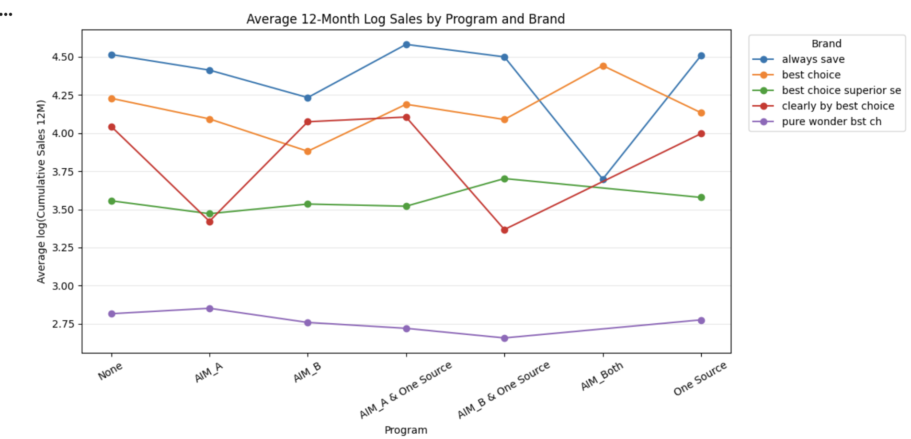
Average 12-Month Sales by Program & Brand
Compared to None:
Always Save:
Most perform similarly to None. Only significant sales uplift under AIM-A & One Source.
Best Choice:
Some benefit, especially under AIM_Both.
Clearly by Best Choice:
Shows almost no sales improvement.
Best Choice Superior Selection:
Most show positive effects, with AIM_B + One Source performing best.
Pure Wonder Best Choice:
Shows no meaningful improvement.

Slide 20
Regional Level Analysis
Test whether program participation effects vary across different regions — that is, whether Region (Division) acts as a moderator of program effectiveness.

Slide 21
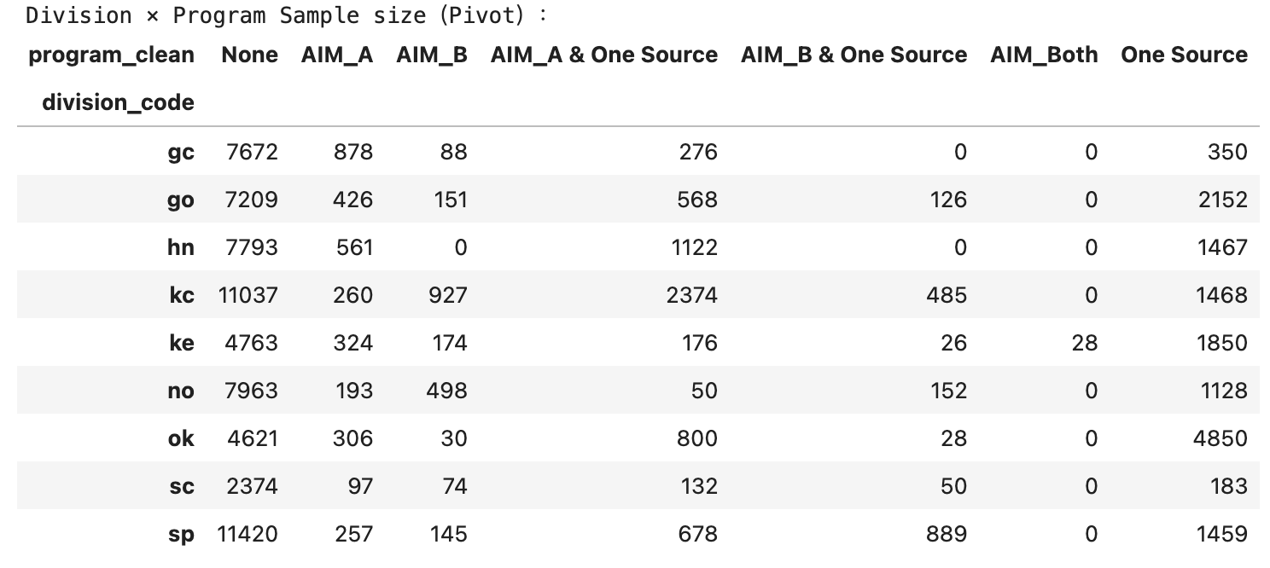
Division × Program Sample Size Overview
Program participation varies substantially across divisions, with None remaining the dominant baseline in all divisions.
Since the sample size of AIM_Both is too small, it is classified as outliner and this data is removed before regression
These imbalances highlight the need for division-level interpretation of program effectiveness.

Slide 22
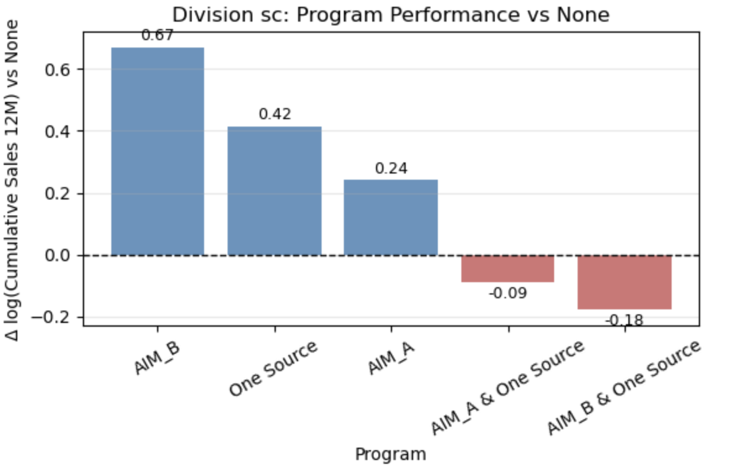
Division sc: Program Performance Relative to None
AIM_B and One Source outperform the None baseline, delivering the strongest positive lift in this division.
In contrast, combined programs underperform, suggesting that stacking programs does not guarantee incremental benefits.
Overall results indicate that simple, standalone programs are more effective in sc.

Slide 23
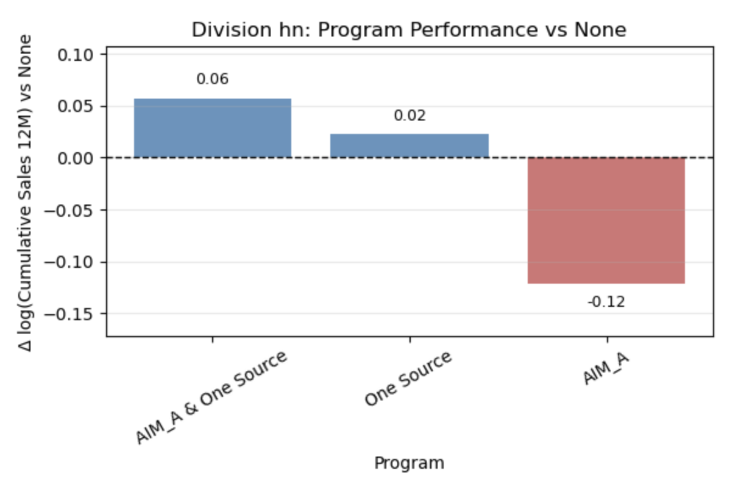
Division hn: Program Performance Relative to None
This division shows limited upside from program participation overall.
Program effects are modest in magnitude, with One Source and AIM_A + One Source slightly outperforming None.
Standalone AIM_A underperforms, indicating potential misalignment between program design and division characteristics.
This division shows limited upside from program participation overall.

Slide 24
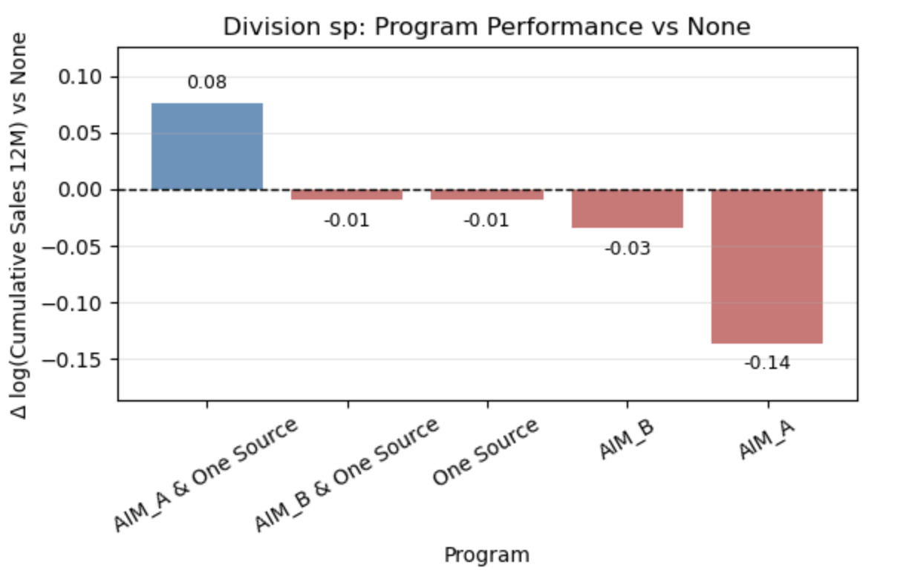
Division sp: Program Performance Relative to None
AIM_A + One Source is the only program with a positive effect relative to None.
All standalone programs perform at or below the baseline.
Results suggest that program success in sp depends on bundled or integrated offerings rather than single programs.

Slide 25
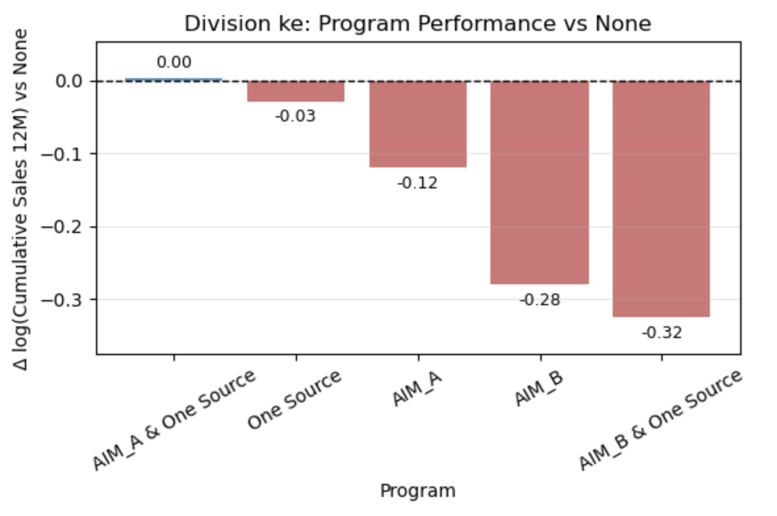
Division ke: Program Performance Relative to None
All programs underperform or barely match the None baseline.
One Source and AIM_B show particularly strong negative effects.
Program participation in ke appears value-destructive rather than value-enhancing.

Slide 26
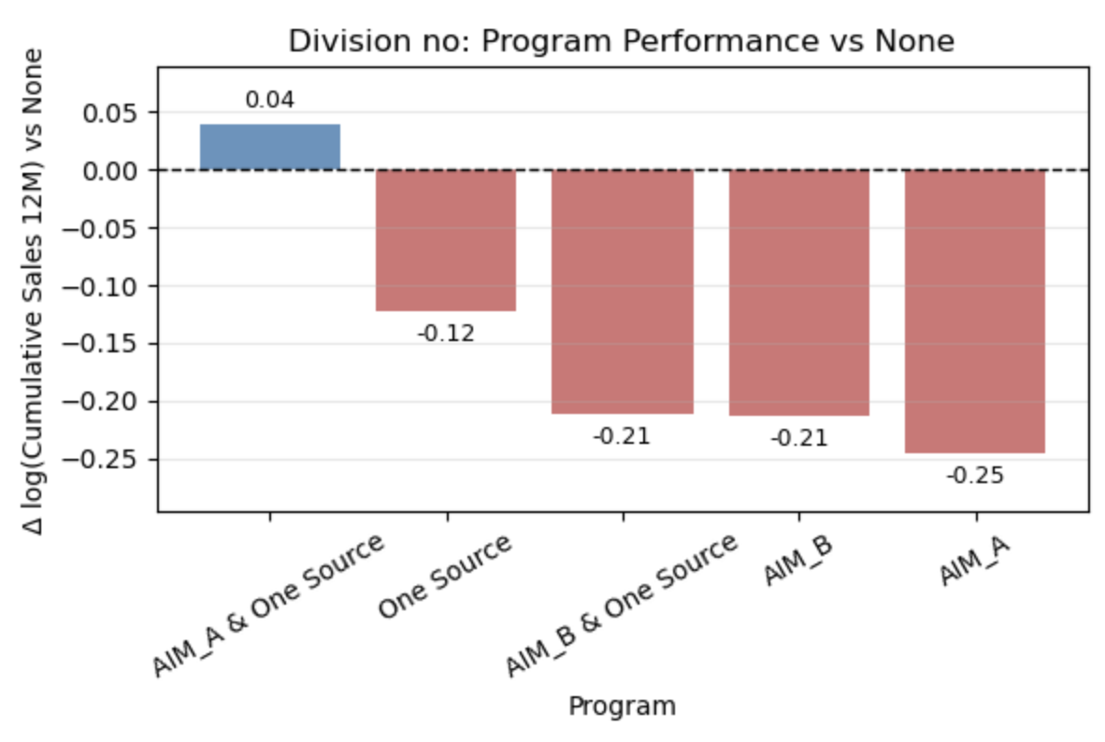
Division no: Program Performance Relative to None
Only AIM_A + One Source shows a slight positive lift relative to None.
All other programs perform substantially worse than the baseline.
Program effectiveness in no is highly conditional and limited to specific combinations.

Slide 27
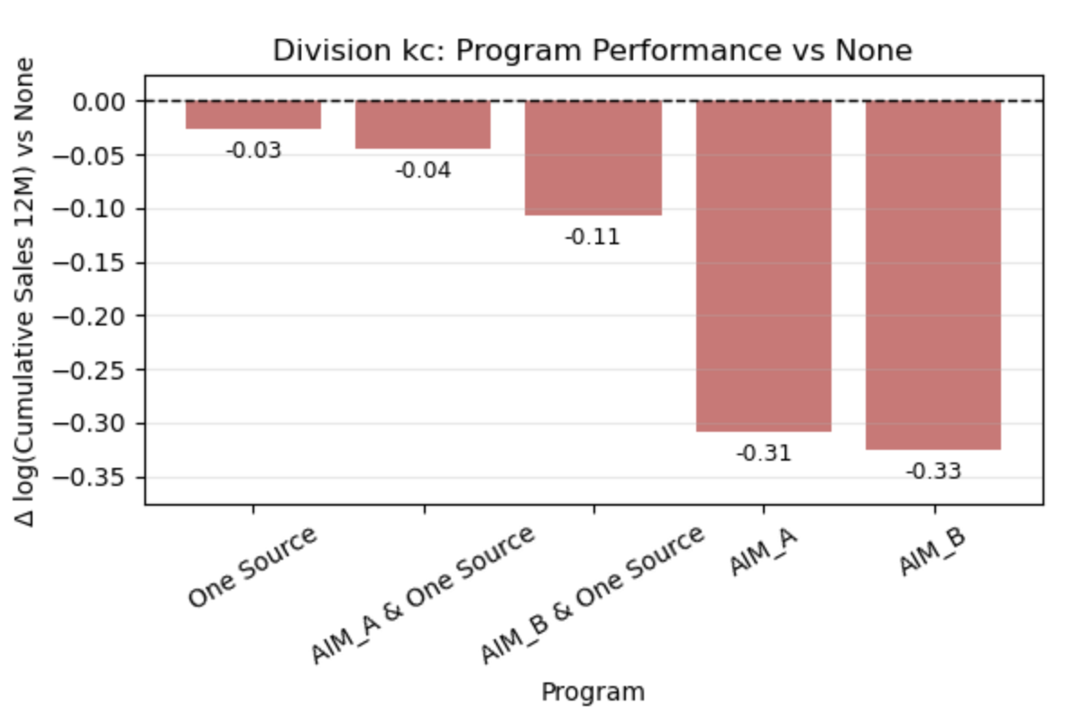
Division kc: Program Performance Relative to None
None of the programs outperform the baseline.
Combined programs, especially AIM_B + One Source, perform the worst.
The strong baseline performance of None suggests limited room for program-driven improvement in this division.

Slide 28
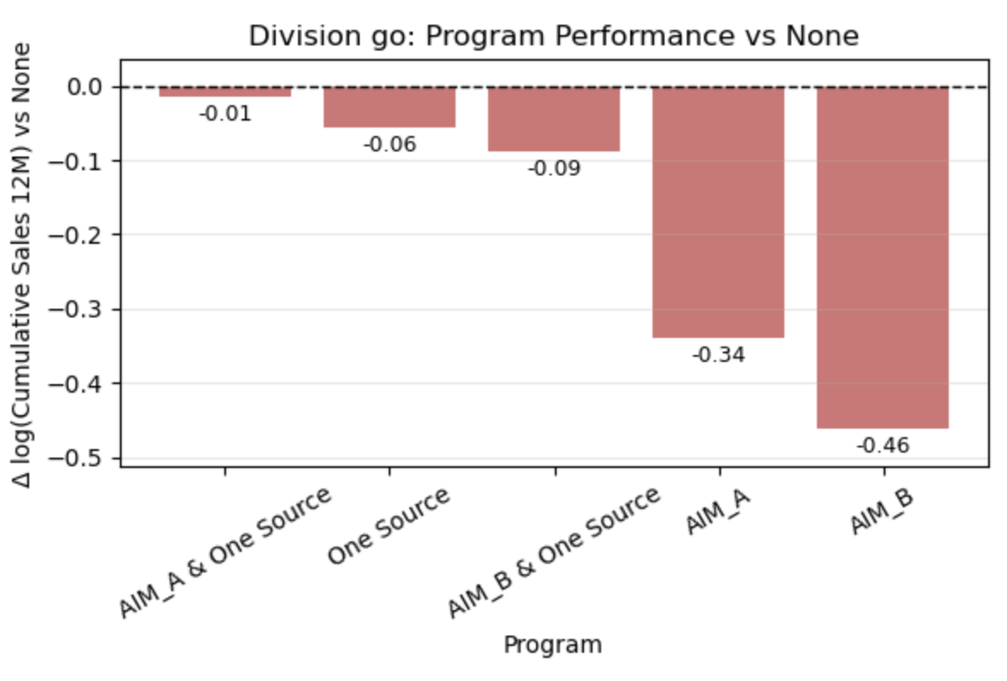
Division go: Program Performance Relative to None
All programs consistently underperform relative to None.
Standalone AIM programs exhibit particularly large negative effects.
Given the large sample sizes, these results are unlikely to be driven by noise.

Slide 29
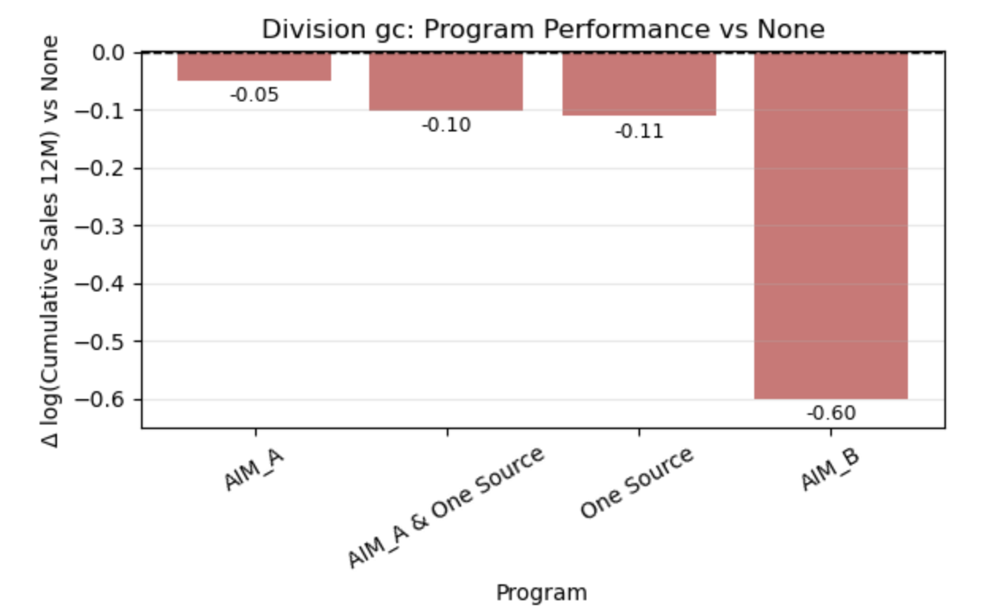
Division gc: Program Performance Relative to None
Every program performs worse than None, with AIM_B showing the largest decline.
The negative effects persist despite substantial sample sizes.
Program participation does not appear to generate incremental value in gc.

Slide 30
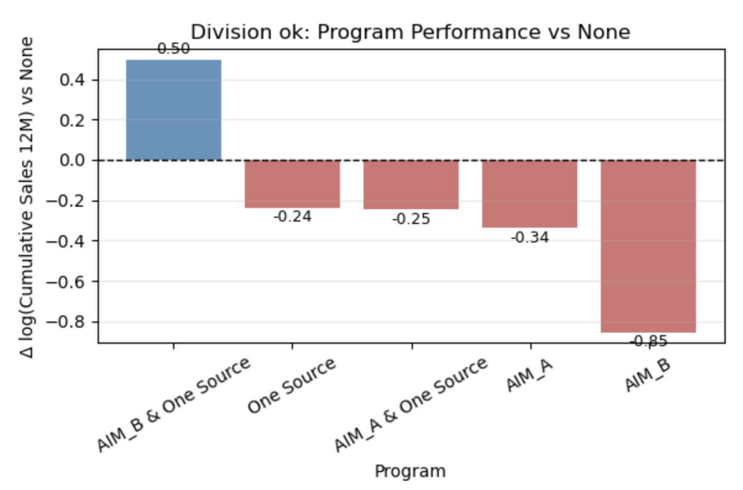
Division ok: Program Performance Relative to None
AIM_B + One Source is the only program with a strong positive effect, clearly outperforming None.
All other programs significantly underperform.
This division exhibits strong program selectivity, where only specific combinations succeed.

Slide 31
Final Recommendation
General Level
Brand level
Regional level
Most programs do not consistently outperform None across brands or regions.
Deploy programs selectively, not universally.
Program effectiveness is highly brand- and region-specific; avoid one-size-fits-all rollout.
Give priority to promoting "Best Choice Superior Selection"
Re-evaluate "Pure Wonder Best Choice", reduce inventory, stop promoting in new projects, or carry out product upgrades
Always Save: Performs well in the None group and is suitable for non-program stores.
Best Choice: It has been improved under AIM_Both and is suitable for all participating stores of the programs.
Division ok: Forced combination strategy
Division sc and ke: Single program advantage
Division sc: AIM_B stands out alone
Division ke: AIM_Both performed well (highest in the bar chart)
Other Divisions (go, kc, no) - significantly reduce input. Transfer resources to high-return regions such as ok and sc.

Slide 32
Thank you
Questions?

