Slide 1


Values & Justice
By: Matt Ring

Slide 2
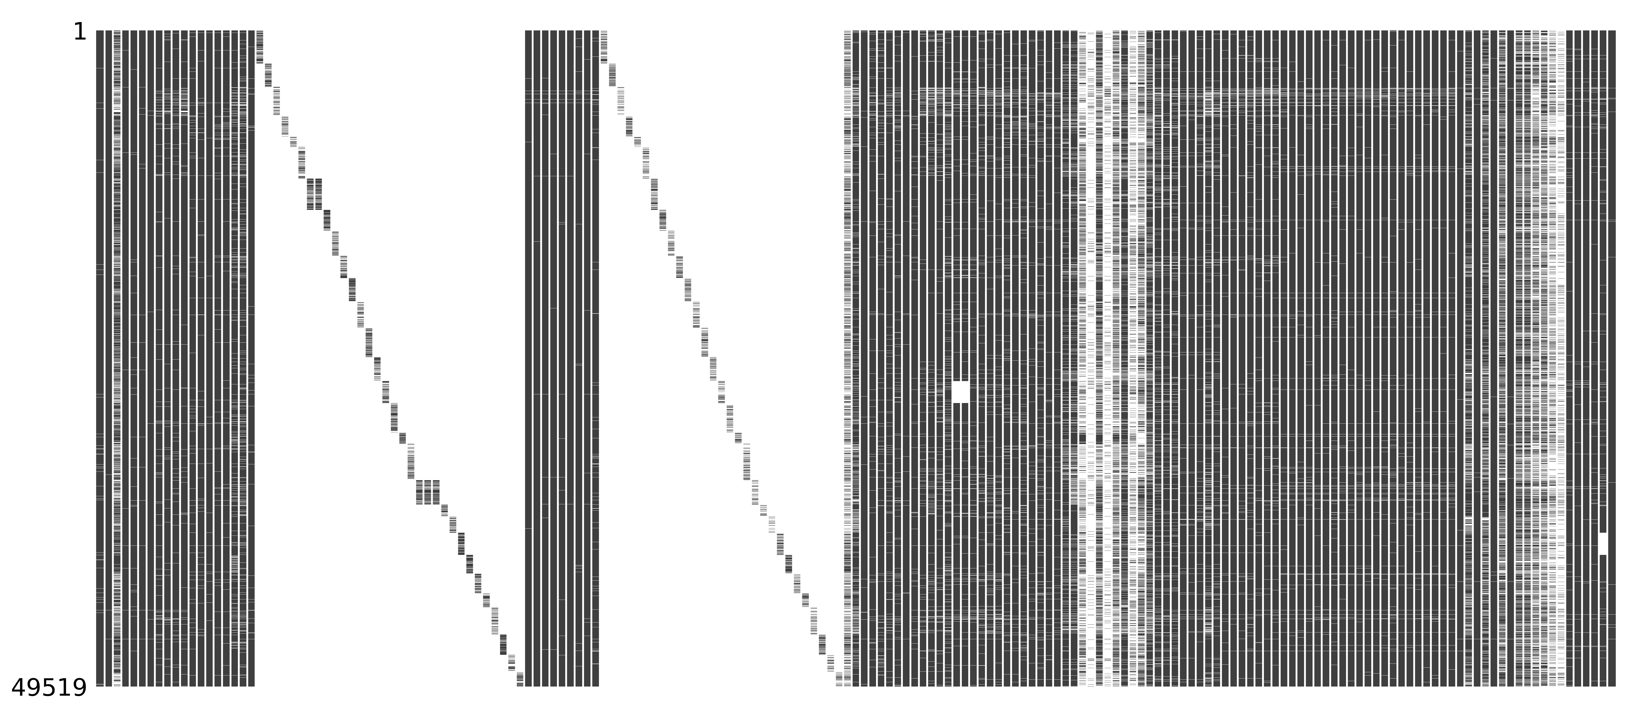
Data & Cleaning
ESS 2018
Justice and Fairness
Timing of Life
Human Values
Politics
Media and Social Trust
Notable Packages
Missingno
Column Removal
Mixed-Type Responses
Country-Specific
Interpretability
Reordering Responses
Notes:
Image
Raw data w/ missing values in white
Subsetting
Time of Life
17 columns
Ideal age marry (age, none - 000, never - 111)
Interpretability
Reordering
Human Values
1 – “Most like me”
Note
Columns missing values systematically

Slide 3
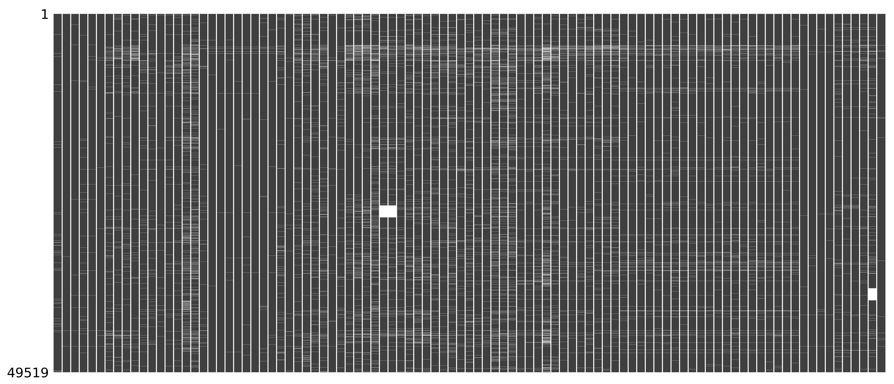
Data & Cleaning
Missing Values
Columns
More than 10% missing
Which columns?
Finally, dropped rows with missing values
How many removed?
Dimensionality
~25,500 rows
97 columns
Notes:
Image
Just before remaining observations removed
Missing
Columns
Timing of Life Age of grandchildren, marriage, children, etc.
Thus not losing older participants
Rows
~24,000 (48%) removed
Refused, didn’t know, didn’t answer
Dimensionality
Columns
51% removed
Mostly Timing of Life information

Slide 4
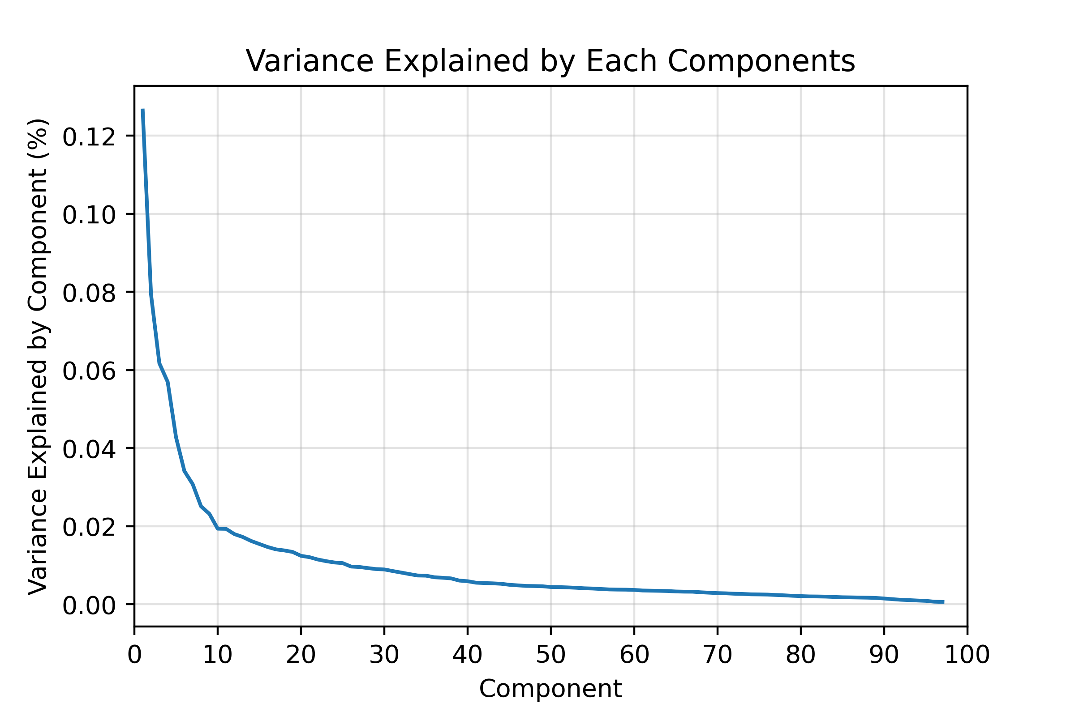
PCA
Notable Packages
Altair
Robust Scaler
34 columns with outliers
Range of Responses
Scree Plot
10 Components Selected
Difficult to Describe After 5
Notes:
Outliers
Large Range
Minutes of news per day
16+ hours/day
24 hours/day value…
Bounded Responses – Common answers
Trust
Yes/No

Slide 5
PCA
Component 1
Don’t feel they have “a say” or “influence”
Low internet usage
Socially conservative
Component 3
Distrust government and parties
High internet usage
Socially liberal
Component 4
Doesn’t value safety, modesty, or empathy
Component 5
Important to be rich
Unimportant to be modest
Principal Component | Variation Explained (%) | Interpretation
1 | 13 | Feel Disenfranchised
2 | 8 | News Consumption
3 | 6 | Distrust Institutions
4 | 6 | Individualism
5 | 4 | Materialism
Notes:
Explanations
Disenfranchised
UNSATISFIED WITH DEMOCRACY
“Political system” doesn’t allow for a say in government or influence on politics
Interested in Politics
News
0.98 – time spent consuming news
Distrustful
National government
Government transparency
Parties
Government doesn't care
UNSATISFIED WITH DEMOCRACY
Individualism
Disagreed with human values questions about sacrificing for environment, society, etc.
Materialism
High internet usage

Slide 6


Policy Relevance
Dissatisfaction with Democracy [1 & 3]
Spanned political ideology
Influence vs. Institutions
Potential age differences
Internet Usage [1 & 3]
Follow social divisions
Media [2]
High variance in political news consumption
Potential measure of disengagement
Personal Ideological Axes [4 & 5]
Social and economic individualism
Notes:
Dissatisfaction, Distrust, Disenfranchisement, Disengagement
- Who is likely to feel this way?
Democracy
Right
Concerned with “lack of influence”
Left
Concerned with institutions
Potential age differences
Internet
More Liberal = More Internet Usage
(immigration and LGBTQ+ rights)
Ideologies
Personal Social & Economic Freedoms

