Slide 1


Values & Justice
By: Matt Ring

Slide 2
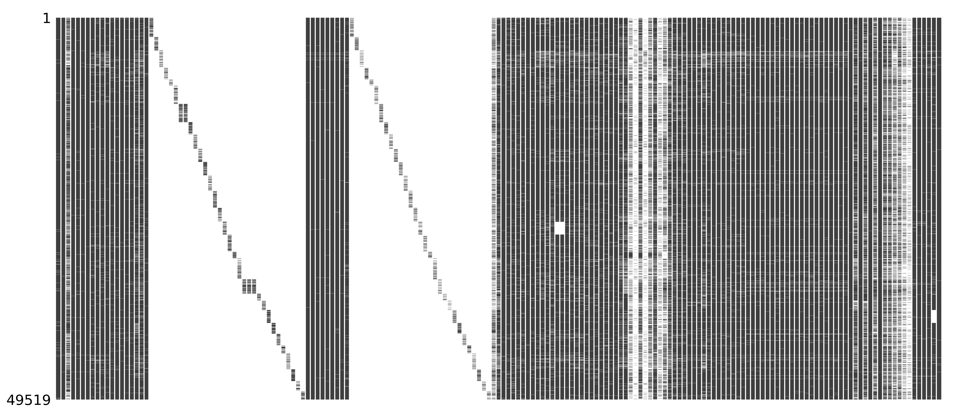
Data & Cleaning
ESS 2018
Justice and Fairness
Timing of Life
Human Values
Politics
Media and Social Trust
Notable Packages
Missingno
Column Removal
Country-specific
Mixed-type responses
Interpretability
Reordering responses
Notes:
2018
Justice & Fairness
Timing of Life
Image
Raw data w/ missing values in white
Subsetting
Countries
Diagonal
Mixed-Type
17 Time of Life columns
Ideal age marry
Interpretability
Reordering
Human Values
1 – “Most like me”

Slide 3
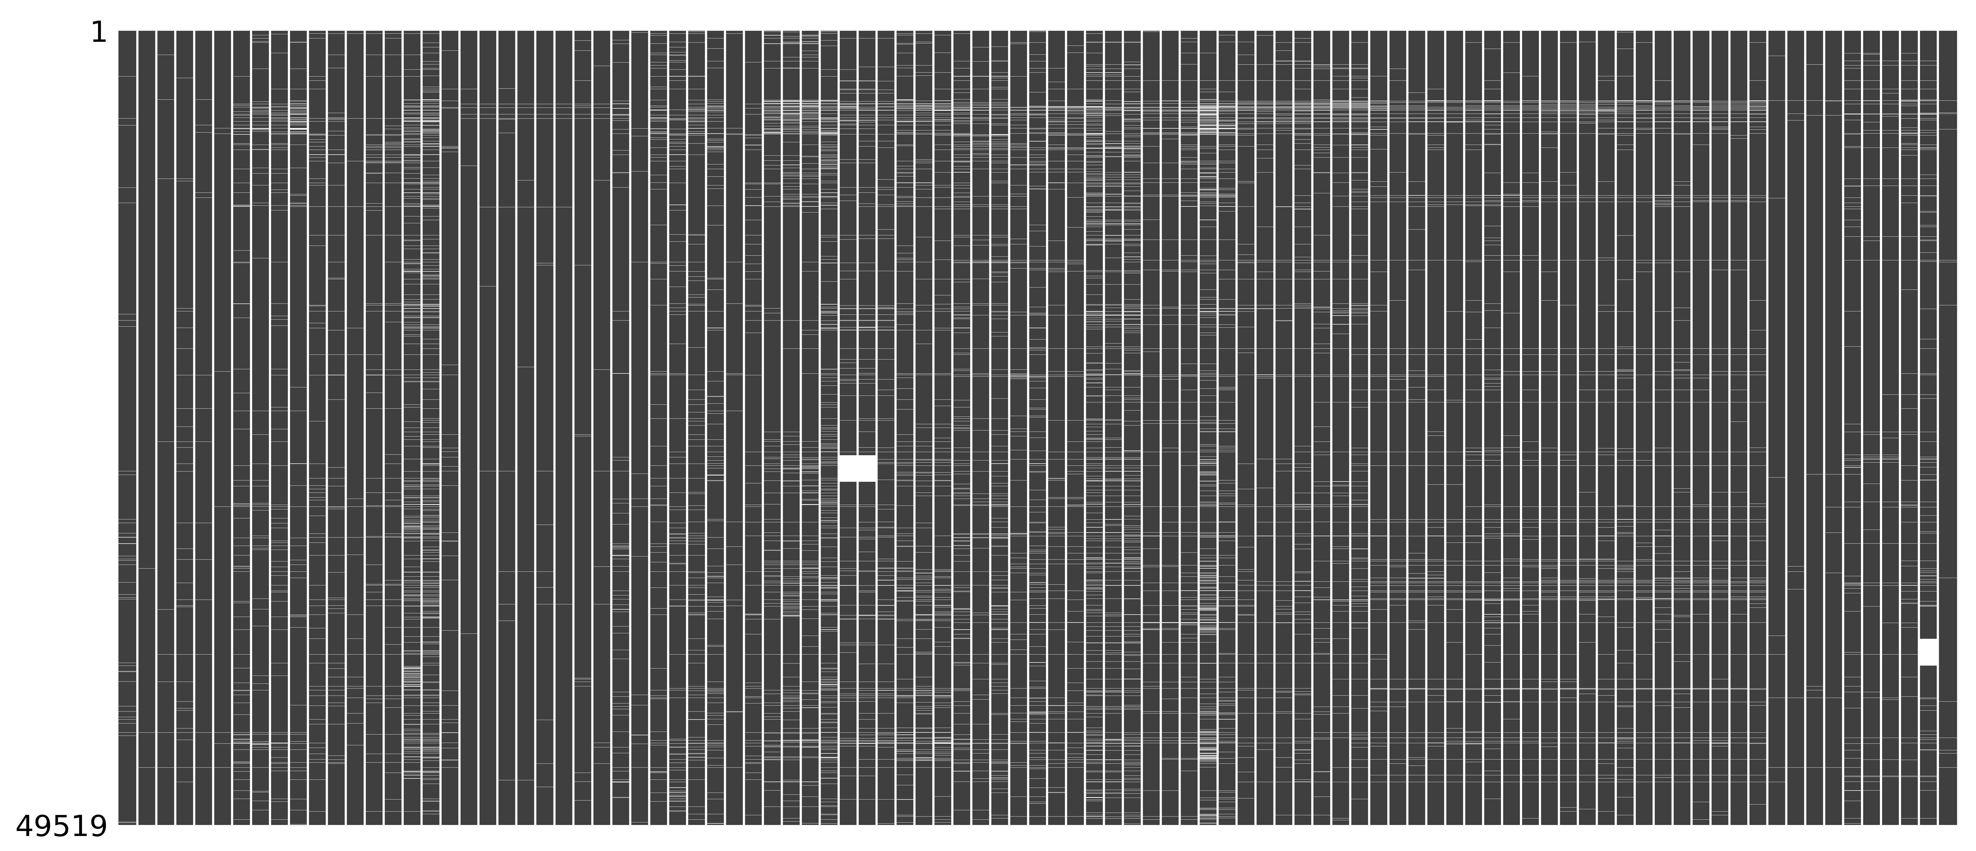
Data & Cleaning
Missing Values
Columns
More than 10% missing
Dropped rows with missing values
Dimensionality
~25,500 rows
97 columns
Notes:
Image
Just before remaining observations removed
Missing
Columns
Timing of Life
Rows
Refused, didn’t know, didn’t answer
Hungary
Missing block
Immigration questions
Dimensionality
Columns
51% removed
Mostly Timing of Life information
Half of rows & columns

Slide 4
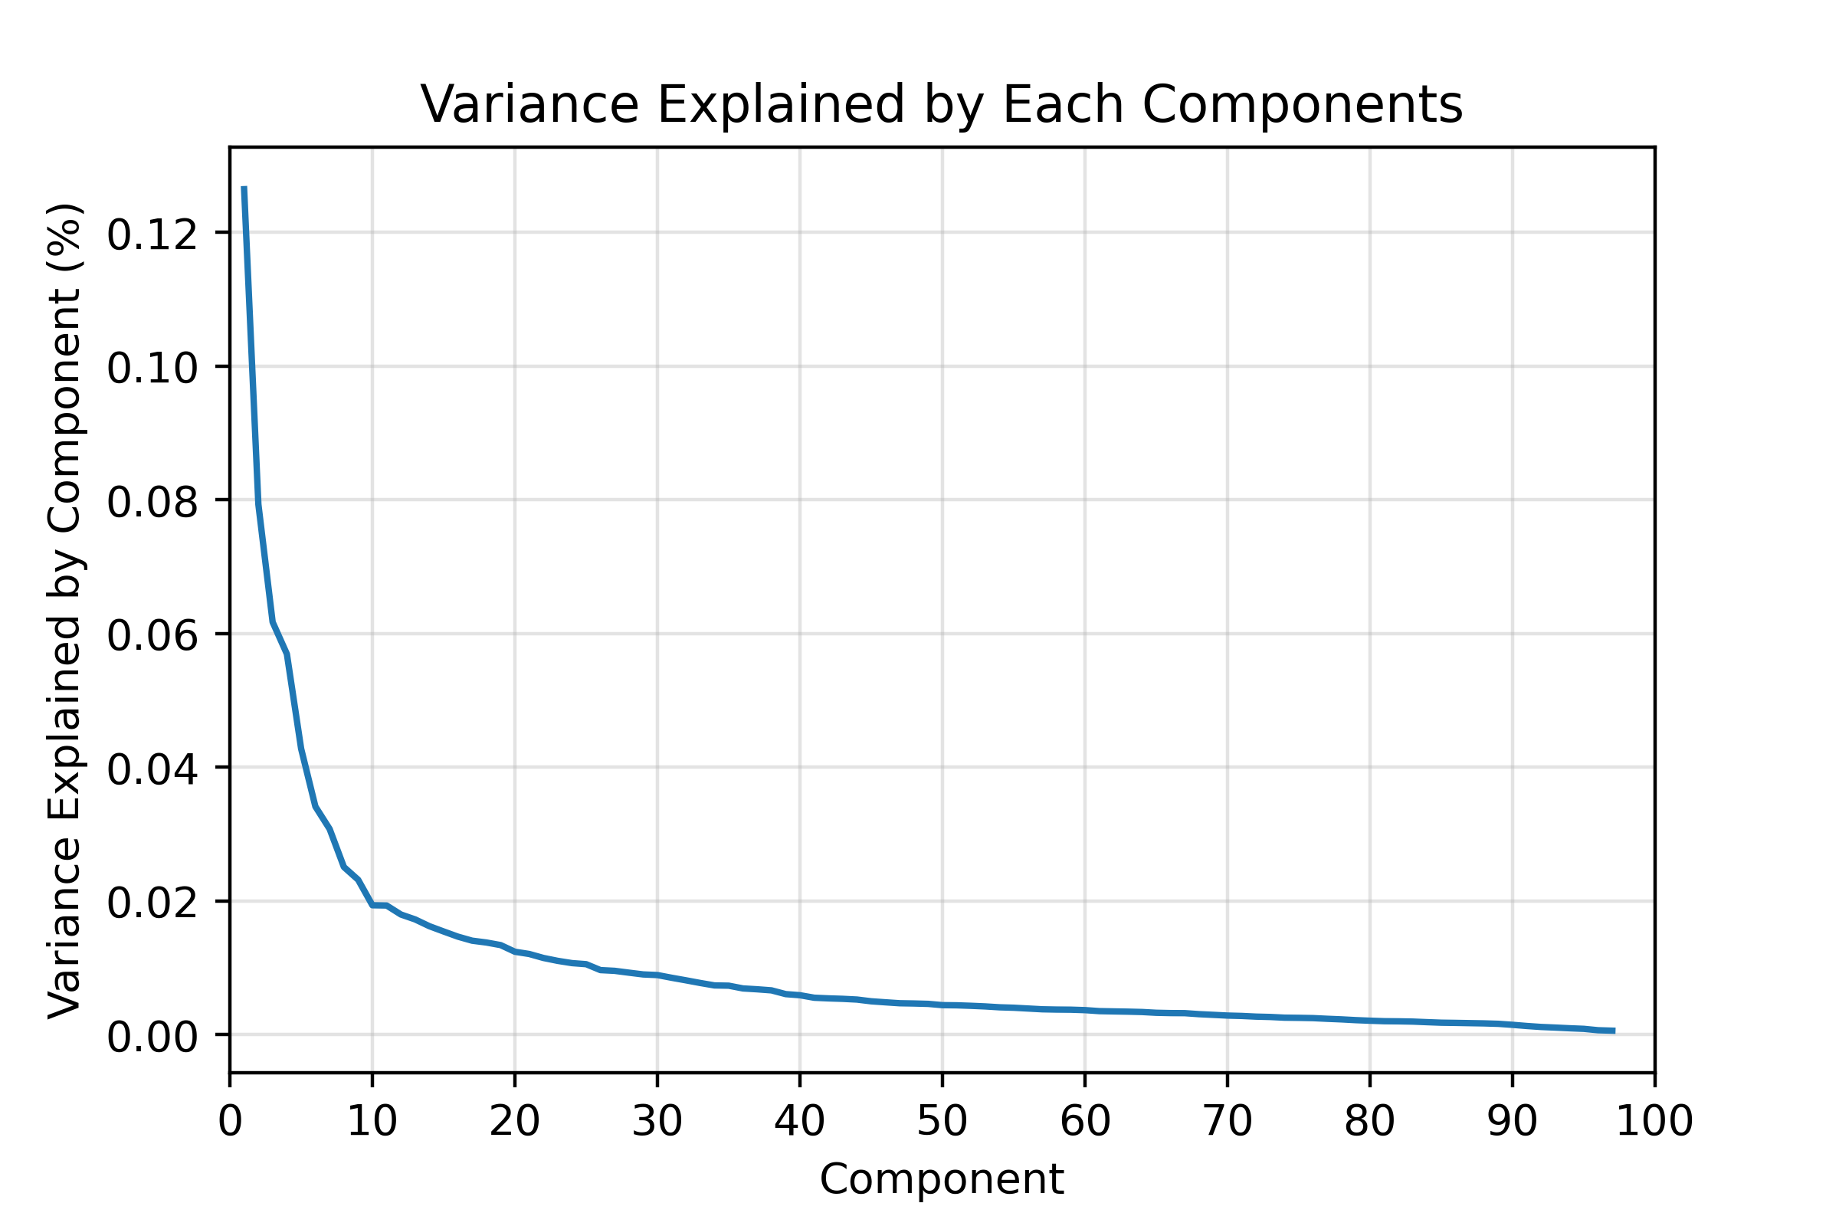
PCA
Notable Packages
Altair
Robust Scaler
34 columns with outliers
Broad range or common response
Scree Plot
10 components selected
Difficult to describe after 5
Notes:
Altair Elbow plot
Outliers
Large Range
Minutes of news per day
Common answers
Trust
Yes/No

Slide 5
PCA
Component 1
Don’t feel they have “a say” or “influence”
Low internet usage
Socially conservative
Component 3
Distrust government and parties
High internet usage
Socially liberal
Component 4
Doesn’t value safety, modesty, or empathy
Component 5
Important to be rich
Unimportant to be modest
Principal Component | Variation Explained (%) | Interpretation
1 | 13 | Feel Disenfranchised
2 | 8 | News Consumption
3 | 6 | Distrust Institutions
4 | 6 | Individualism
5 | 4 | Materialism
Notes:
Explanations
Disenfranchised
UNSATISFIED WITH DEMOCRACY
News
0.98 – time spent consuming news
Distrustful
UNSATISFIED WITH DEMOCRACY
National government
Transparency
Government doesn't care
Individualism
Disagreed with sacrificing for environment, society, etc.
Materialism
High internet usage

Slide 6
Main Takeaways & Policy Relevance
Dissatisfaction with Democracy [1 & 3]
Spanned ideology and potentially age
Disenfranchisement vs. Distrust
Engagement
Internet Usage [1 & 3]
Follow social divisions
Media Consumption [2]
Split in engagement
Notes:
- No specific policy takeaways, just broad results
- Numbers represent principal components
Democracy
Similar sentiments, different types
Engagement with politics
Medium of Engagement
Method of contact = who you reach
Consumption
Broad range of political engagement/interest
Apoliticism

Slide 7
Questions?

