Slide 1
UE20CS971– Project Phase – 1
End Semester Assessment
Project Title : Adaptive Study Planning for Self-Directed Learners
Presented by : Rohit Saji (PES2PGE24DS201)
Project Guide : Prof. Ramesh Prakash Guledgudd
Program : M.Tech in Data Science & AI, PES University

Slide 2
Agenda
03 Problem Statement
04 Abstract & Scope
05 Literature Survey
06 Suggestions from Review-3
07 Proposed Methodology / Approach
08 Design Approach & Constraints
09 Architecture
10 Design Description & Details
11 Technologies Used
12 Project Progress
13 Live Demo
14 References
15 Any Other Information

Slide 3
Problem Statement
Self-directed learners commit to a fixed plan — “two hours a day, finish by the 30th” — then reality drifts within days, and the plan never adjusts.
Who & where it hurts. Online-course, exam-prep and self-study learners with no instructor to set the pace. Time-trackers only record; static planners never revise — neither learns the pace you actually achieve.
Why it bites. The finish date silently goes stale while the plan still shows it as valid, so the learner has no trustworthy signal of how far off-track they are.
What makes it hard. Evidence is sparse (a few sessions before the first replan) and pace is non-stationary — the method must work from little data and tell a real shift from noise.
The gap we close. A planner that treats the learner’s own logged behaviour as evidence, updates its pace estimate as evidence arrives, and regenerates the plan.

Slide 4
Abstract and Scope
An adaptive study-planning system for a single self-directed learner — plus an honest evaluation of the algorithms behind it.
In scope (Phase-1). The open-loop adaptive planner — pace calibration, change detection, completion projection, and capacity-based replanning — realised in a working, local-first web app.
Rigorously evaluated. Every component compared offline against established baselines on synthetic data with known ground truth: held-out archetypes, bootstrap confidence intervals, and Holm/Benjamini–Hochberg correction.
Out of scope (for now). Closing the loop with verified learning, longitudinal real-data validation, and multi-user / institutional settings — these are Phase-2 and beyond.

Slide 5
Literature Survey
Bayesian calibration — Chen 2024, Zanellati 2024, Zambrano 2024, Mai 2025.
Gap: measures correctness, not planned-vs-actual pace. We use: a hierarchical Bayesian pace estimate with a context-aware shrinkage extension for the low-data stage.
Change-point detection — Saqr 2026, Qiao 2026, Boca de Giuli 2024, Cheng 2024.
Gap: detects a shift but prescribes no action. We use: CUSUM flags a genuine shift, which prompts the learner to replan.
Gaussian-process projection — Pérez-Suay 2024, Chen & Yao 2025, Lin 2024, Huang & Wang 2025, Kayande & Kukreja 2025.
Gap: predicts a single outcome, not a longitudinal burn-up. We use: a GP burn-up with a confidence band and a finish-date range.
Adaptive scheduling (base paper) — Islam 2024, Fabregar & Amorado 2025, Pagano 2026, Liu 2025.
Gap: the plan is solved once, with no feedback from realised pace. We use: we extend predict-then-optimize into a loop with capacity-based booking.
SRL analytics — Alhazbi 2024, de Barba 2025, Uzun 2025, Butt 2025.
Gap: measures behaviour but never feeds it back. We use: dashboards report adherence, streaks and burn-up, and feed replanning.
Each technique is strong in isolation; none closes the loop from realised pace back to the plan — that loop is our contribution.

Slide 6
Suggestions from Review - 3
From my guide (Review-3): explore LLM-guided practice sessions — a live LLM that watches the learner’s work in a practice/test session (e.g. their code) and guides: nudges when stuck, suggests improvements, but never completes it. Scoped as a Phase-2 exploration.
Self-initiated since Review-3:
Redesigned the scheduler — retired the brittle day-by-day packer for a capacity-based booking model, re-validating calibration, detection and projection on the new regime (Ch 4.4).
Made the evaluation defensible — held-out learner archetypes, bootstrap CIs, Holm/BH correction, and honest reporting of nulls (Ch 4.3, 6).
Grounded the synthetic data — the generator is calibrated against the OULAD public dataset so the regime resembles real behaviour (Ch 5.2).

Slide 7
Proposed Methodology / Approach
The adaptive loop: logged sessions → pace calibration (hierarchical Bayesian + context shrinkage) → change detection (CUSUM) → progress projection (Gaussian process + cold-start) → capacity replanning (booking model).
Every model was chosen by offline comparison, not by assumption.
Real win — the context-shrinkage calibrator beats the Bayesian incumbent on prospective, short-history pace (the low-data regime the planner depends on); Holm-surviving.
Honest null — no exotic detector beats the CUSUM frontier, so we ship CUSUM (the fastest) because detection only raises a human-confirmed prompt.
Validated, not yet shipped — a split-conformal correction restores the GP interval’s coverage (the raw GP under-covers); shipped in Phase-2.
Method: per-component metrics, bootstrap CIs, Holm/Benjamini–Hochberg correction, an oracle ceiling. A DP scheduler won on deadline drift but was retired with the day-by-day design.

Slide 8
Design Approach & Constraints
Key decisions
Local-first & event-sourced — every action is an immutable event in the browser (IndexedDB); every view is derived by replaying the log. Offline-capable, with per-user data isolation.
Split compute by need — model-fitting over accumulated history runs in a Python service (Bayesian + shrinkage calibration, CUSUM); views derived from the local log run in the browser (GP projection, booking, dashboards).
One behaviour, two implementations — the TypeScript client engine is mirrored by a Python engine, kept aligned by a golden-fixture parity harness, so the evaluated code is the shipped code.
Constraints & dependencies — single learner, commodity CPU-only hardware, sparse data; every service call is token-verified. Supabase is the data hub; an offline research pipeline supplies the selected models and is not in the request path.

Slide 9
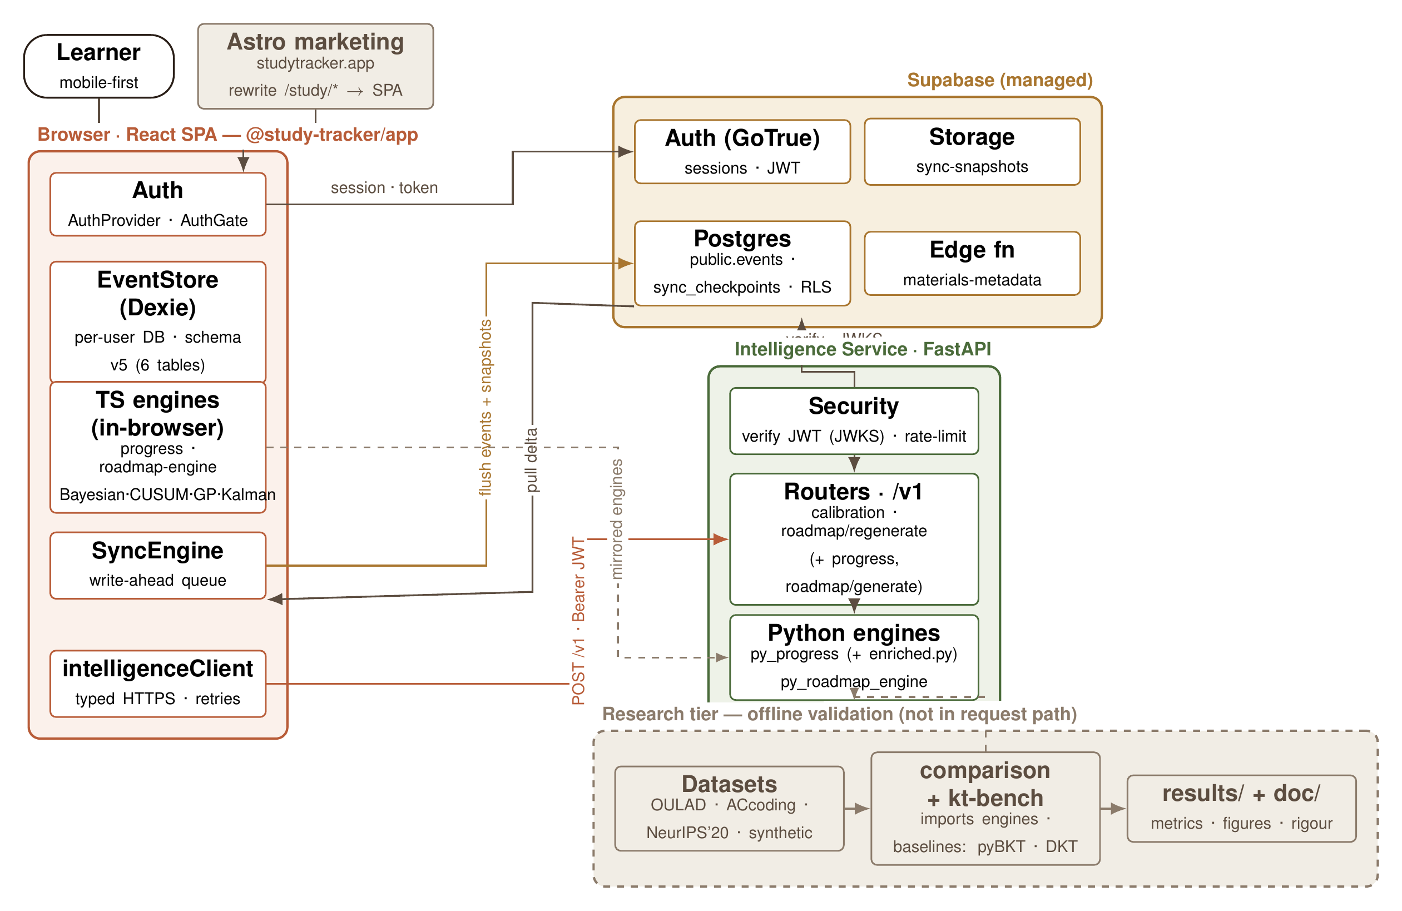
Architecture
The delivered system in three tiers: a local-first React client, a Python intelligence service that fits the statistical models, and Supabase as the data hub. The offline research tier supplies the selected models and is not in the request path.

Slide 10
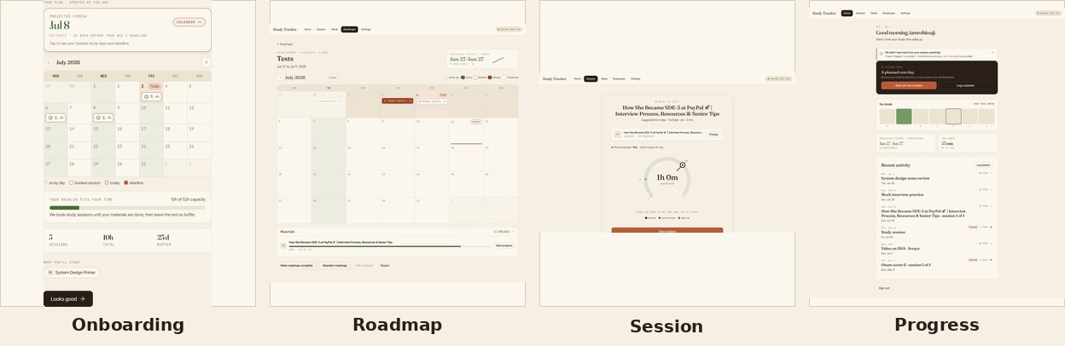
Design Description & Details
Key sequence (log → calibrate → replan): session logged → append-only event log (IndexedDB) → POST /v1/calibration (token-verified) → Bayesian + shrinkage pace & CUSUM → GP burn-up re-projected in the browser → a divergence raises a recalibration prompt → the learner replans and the plan re-books.
Event-sourced — nothing mutable is stored; Home, Week, Roadmap and the projection are all derived by replaying ~18 event kinds.
Server fits models; browser derives views — model-fitting is the only computation that crosses the wire.
The four core screens (shown live in the demo):

Slide 11
Technologies Used
Frontend — React 19, Vite, TypeScript, Dexie / IndexedDB, date-fns
Intelligence service — FastAPI, Python 3.12, NumPy / SciPy, PyJWT, Docker
Data & platform — Supabase (auth, Postgres, storage), Vercel
Research pipeline — uv workspace, NumPy, an offline comparison harness that imports the shipped engines
Testing — Vitest, fast-check, Playwright, pytest, ruff
Monorepo — pnpm + uv, one repository with two workspaces
Why this stack — local-first for an offline-capable core loop; a thin Python service only where a model must fit accumulated history; one repo so the evaluated code is the shipped code.

Slide 12
Project Progress
Phase-1 status — essentially complete (~92%).
Report / dissertation: 100% · Product web app: 90%
Intelligence engines (TS + Py): 90% · Research & evaluation: 90%
Done: literature survey, engines + intelligence service, and the offline evaluation.
You are here: Phase-1 ESA (Jul 2026).
Path to Phase-2: Phase-2 starts Aug 1, 2026; Phase-2 ESA between Sep 20 and Oct 25, 2026.

Slide 13
Live Demo
Live walkthrough of the working app — the full adaptive loop:
1 Onboarding — a full roadmap is generated from a deadline, weekly hours and materials.
2 Roadmap calendar — the whole plan as bookings, with capacity warnings and replan levers.
3 Study session — Pomodoro timer + player, logged to the local-first event store.
4 Progress + calibration — the burn-up and finish date re-project right after that session.
~6 minutes · seeded demo account.

Slide 14
References
[1] M. Islam et al., “Predicting Student Performance and Optimizing Study Schedule using Deep Learning and Dynamic Programming,” ICCIT, IEEE, 2024. (base paper)
[2] Chen et al., “A Hierarchical Bayesian Model of Adaptive Teaching,” Cognitive Science, 2024.
[3] A. Zanellati et al., “Hybrid Models for Knowledge Tracing: A Systematic Review,” IEEE TLT, 2024.
[4] M. Saqr et al., “Early Warning Signals Before Dropping Out: Critical Slowing Down,” LAK, ACM, 2026.
[5] Qiao et al., “ML Approaches for Statistical Process Control: A Systematic Review,” Entropy, 2026.
[6] A. Pérez-Suay et al., “Predicting Student Performance from Moodle Logs with Gaussian Processes,” IEEE-RITA, 2024.
[7] Lin et al., “Scaling Gaussian Processes for Learning-Curve Prediction,” arXiv, 2024.
[8] Fabregar & Amorado, “A Study Plan Recommender Based on a Greedy Algorithm,” EECSI, IEEE, 2025.
[9] Pagano et al., “Efficiency of Adaptive Learning Paths,” Interactive Tech. & Smart Education, 2026.
[10] S. Alhazbi et al., “Using Learning Analytics to Measure Self-Regulated Learning,” JCAL, 2024.
[11] P. G. de Barba et al., “A Learning Analytics Rubric for Self-Regulated Learning,” ETR&D, 2025.
Full bibliography (21 references) in the dissertation.

Slide 15
Any other information
Phase-2 outlook
Verified learning (principal novelty) — generate concept-tagged assessments from the learner’s own material with an LLM, estimate genuine mastery with cold-start knowledge tracing, and feed verified mastery back into pace calibration — replacing gameable self-reported time. This closes the loop.
LLM-guided practice sessions (guide-suggested) — live, Socratic in-session coaching that watches the learner’s work and nudges, but never completes it.
Ship the validated refinement — the split-conformal correction for the GP interval’s under-coverage.
Longitudinal validation — adaptive vs static on a real learner’s own logged sessions (schedule adherence and measured learning gain).
Timeline: Phase-2 starts Aug 1; build Aug–Sep; Phase-2 ESA Sep 20–Oct 25, 2026.

Slide 16
Thank You

