Slide 1
UE20CS972– Project Phase – 2
End Semester Assessment
Project Title : Assessment-Verified Closed-Loop Study Planning
Presented by : Rohit Saji (PES2PGE24DS201)
Project Guide : Prof. Ramesh Prakash Guledgudd
Program : M.Tech in Data Science and Artifical Intelligence [sic], PES University
Duration : May 2026 – Oct 2026
Notes:
Name, SRN, guide. One line on what changed since Phase 1: the open-loop pace planner now closes the loop with assessment-verified evidence. Degree spelling and duration mirror the submission guideline; clash flagged to coordinator.

Slide 2
Agenda
03 Problem Statement
04 Abstract & Scope
05 Literature Survey & Gap
06 From Phase-1 Review to Phase-2
07 Proposed Methodology
08 Design Decisions & Constraints
09 Architecture
10 Technologies & Reproducibility
11 Results I: Retrieval + Generation
12 Results II: Mastery + Closed Loop
13 Live Demo
14 References
15 Delivered, Limits, Next
Notes:
20-second arc walk: problem, loop, evidence, demo. Promise honest nulls up front.

Slide 3
Problem Statement
Time logs measure hours, not understanding. A learner can log hours yet fail assessments while the plan still reports healthy (report p11-12).
Fixed plans go stale. A deadline set on day one drifts within days; pace evidence is sparse and non-stationary, and static planners never revise.
What Phase 2 adds. Assessment-verified evidence — grounded items, server grades, mastery tracing — steers the plan instead of predicted grades.
Notes:
Phase-1 pace signal plus the failure it cannot see: self-reported time never checks learning.

Slide 4
Abstract and Scope
Full loop delivered. One-family grounded generation, per-family server grading, BKT mastery, and a verdict gate that replans from grades while refusing what it cannot ground (report p12-13).
Scope fence. (1) Synthetic histories stand in for a classroom wherever it matters. (2) Every number traces to frozen evidence or live code. (3) No learning-gain claim; efficacy is deferred.
Notes:
Read the scope fence aloud; it defuses half the Q&A.

Slide 5
Literature Survey
Tracing — predicts correctness, not planned-vs-actual pace. We use BKT bkt-v1 as the updater.
Generation — fluent but untraceable to source chunks. We use one-family-per-call with recorded citations.
Grading — one signal, or the client decides. We use per-family server authority; the client stays advisory.
Guidance — measures without helping, or helps by leaking answers. We use a gated Nudge-to-Reveal ladder.
Scheduling — solved once, never revised from evidence. We close the loop: grades update mastery, the verdict replans (Table 2.1, p19-20).
Notes:
One line per family: mechanism, metric, gap. Land on the loop row.

Slide 6
From Phase-1 Review to Phase-2
✓ Guide ask: LLM-guided practice → Socratic coach with gated reveal (Ch 4, Sec 5.5.4).
✓ Verified learning → one-family generation plus per-family grading (Ch 4, Sec 5.3).
✓ Mastery estimate → BKT bkt-v1 plus advisory chip (Ch 4, Sec 5.4).
✓ Closed loop → verdict gate plus replan from grades (Ch 4, Sec 6.3).
✓ Pace substrate kept → calibration and projection retained as the loop base (Ch 4).
Notes:
Show responsiveness; point at chapters, not adjectives. 30 s max.

Slide 7
Proposed Methodology / Approach
Fail-closed gate first. Fixed golds score each candidate arm; a breached gate blocks promotion — difficulty calibration stays advisory by design.
Leg A — offline harness. Retrieval, generation, and mastery arms scored on frozen golds (n=30; 754 and 1094-chunk corpora).
Leg B — synthetic replay. Four archetypes over a 32-day span validate the assembled loop; the live matrix is deployment-check only (Fig 4.3, p29).
Leg A: frozen golds
→
Score arms
→
Gate blocks / ships
Fail-closed
Leg B: 4 archetypes
→
Verdict gate
→
Replan from grades
Live matrix: check only

Slide 8
Design Approach & Constraints
One family and one question per call — citations stay auditable. Authority never transfers to the client (Table 4.1, p29).
Budget line: S:off arm $0.00561 at p95 10.5 s; sweep $0.061289; probe 395 calls at $0.099 (Table 5.5, p36).
Stage | Selected (candidates costed, not mixed)
Generation | One-family-per-call, citations recorded
Grading | Per-family server authority; client advisory
Tracing | BKT bkt-v1; adaptive chip advisory-only
Verdict | Jev-1.13 judge, gate 0.7, fail-closed to hold

Slide 9
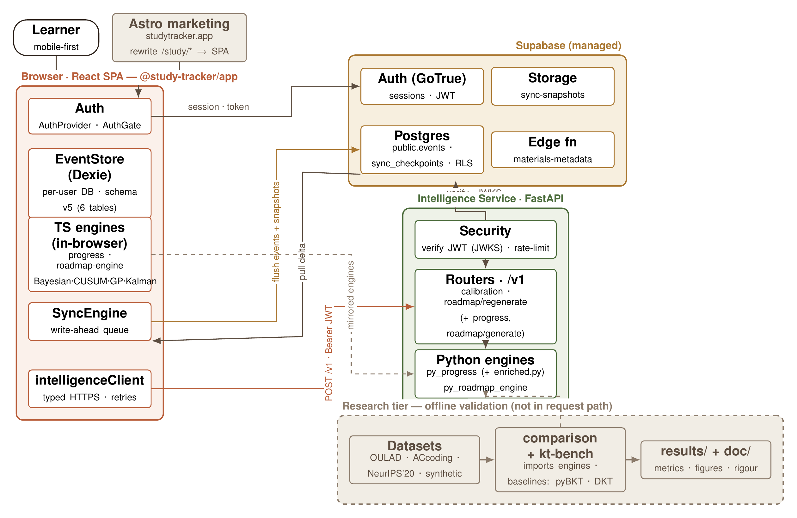
Architecture
Browser client, FastAPI service plus worker, Supabase hub. Qwen3 sidecar (:8200) and Piston sandbox (:2000) are separate compose, never in the request path (Fig 4.4, p30-31).
React client
(bookings, mastery)
→
FastAPI service + worker
(generate, grade, verdict)
→
Supabase hub
(auth, events, storage)
Qwen3 sidecar :8200
(embed + rerank)
Piston sandbox :2000
(code grading)
Worker path only — sidecars are separate compose, not in the request path

Slide 10
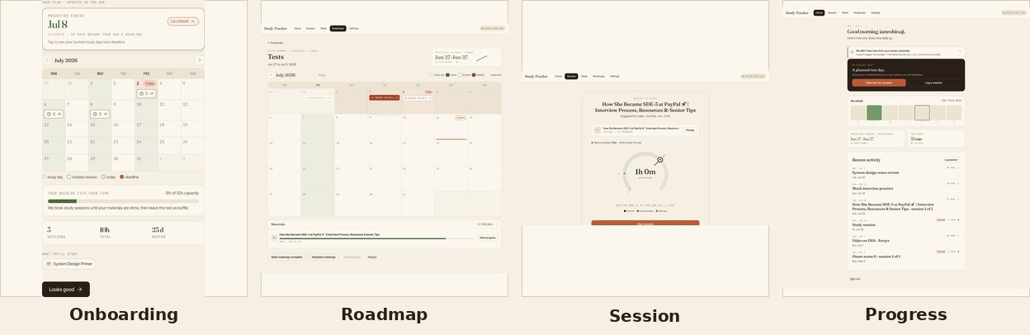
Technologies Used
Frontend — React 19, Vite, TypeScript, Dexie / IndexedDB
Intelligence service — FastAPI, Python 3.12, uv; TS/Py parity to 1e-6
Data and sidecars — Supabase hub; Qwen3 embed/rerank :8200; Piston :2000
Tests — 976 pytest + 65 vitest files + 33 Playwright specs; no CI; X-Request-ID tracing (Tables 5.5/5.6, p36).

Slide 11
Results I: Retrieval + Generation
Rerank lifts recall on both corpora — descriptively. Hybrid+rerank r@1 0.67 / r@3 0.90 / MRR 0.797 on ACCA-754; deltas +16 / +17 / +0.139 on DDIA-1094 (Table 6.1, p43).
S:off ships 0.9667 schema-valid at 0.7241 gold support ($0.00561, p95 10.5 s); groundedness 0.8667, self-judged over six question clusters (p43-44).
Footnote: n=30, descriptive; McNemar n.s.; groundedness self-judged (same model).
Arm (ACCA-754) | r@1 | r@3 | MRR
Dense | 0.60 | 0.77 | 0.706
Hybrid | 0.60 | 0.80 | 0.720
Hybrid + rerank | 0.67 | 0.90 | 0.797
Notes:
Read the footnotes, not the headlines. Retired 788-split absolutes never appear.

Slide 12
Results II: Mastery + Closed Loop
BKT ties on ranking, nearly halves calibration error: live 0.7397 / 0.1401 vs running-proportion 0.7368 / 0.2679 (Table 6.3, p44).
4/4 suggest-replan verdicts convert at confidence 1.0, sufficiency 0.66–0.77, over a 32-day span. No fixed-plan control (Table 6.4, p45).
Footnote: parity on ranking is the finding; conversion is integration behavior, not efficacy.
Model (live) | AUC | ECE
bkt-v1 | 0.7397 | 0.1401
running-proportion | 0.7368 | 0.2679
Week signals
→
Jev-1.13 judge
Gate 0.5 / 0.7
→
Hold: writes nothing
Suggest-replan: copies verdict pair
Notes:
Parity is the finding. Conversion is integration behavior, not efficacy; pre-fix 4/4 holds were the defect removed.

Slide 13
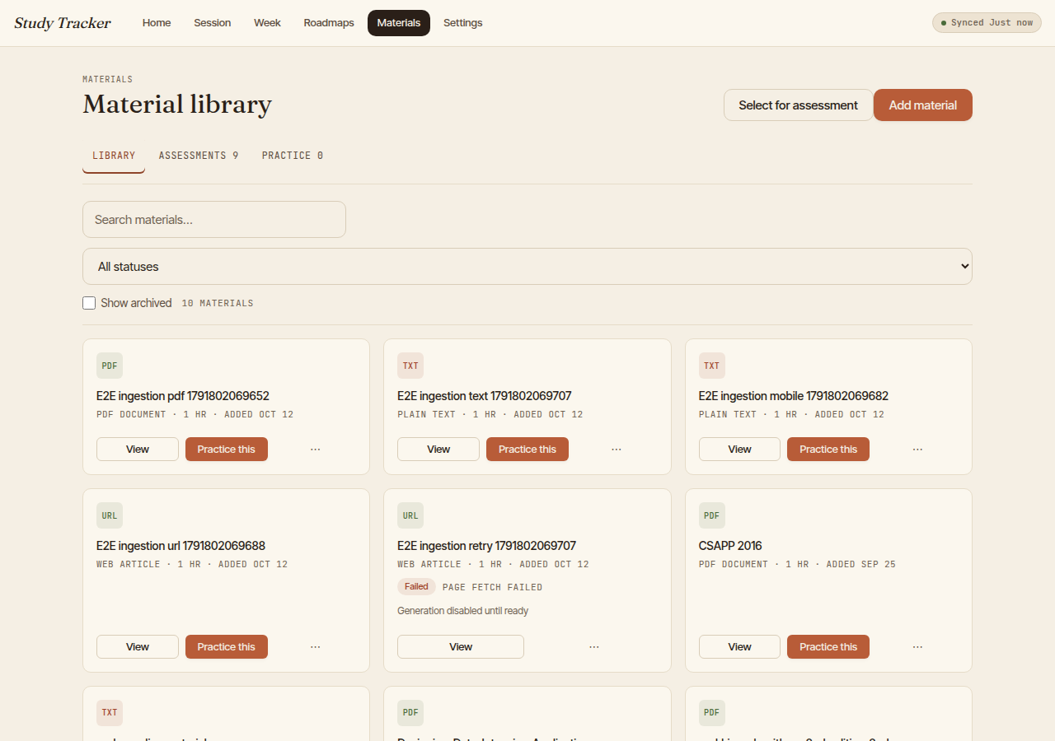
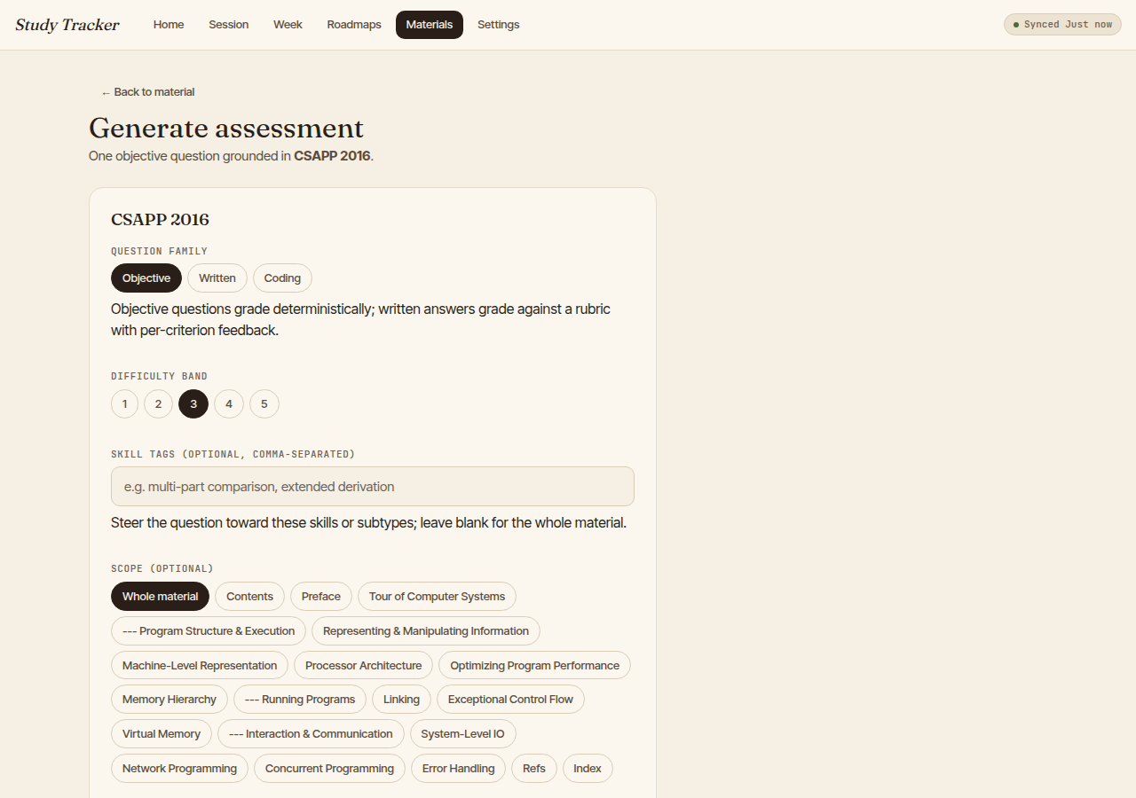

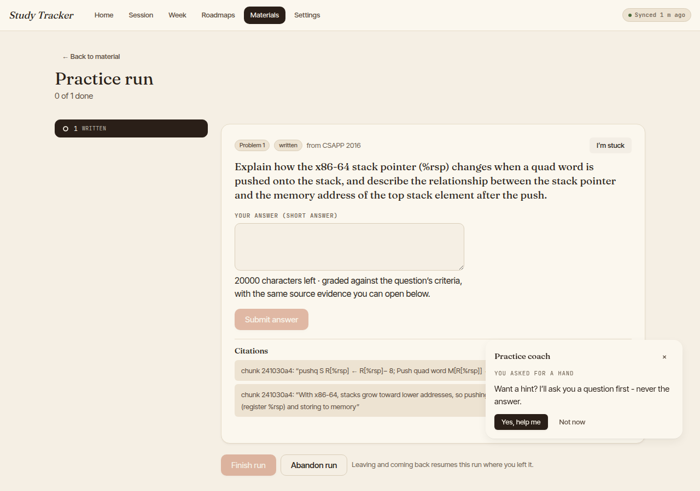
Live Demo
Live walkthrough of the running loop (·6 min, seeded account): materials → generation → taking/review → practice/coach → evidence trail.
Kill-switch: advance to the stills below. Fallback stills, left to right: library, generation config, review, practice run — Figs 5.1–5.4.
Notes:
90 s path: one week of one archetype end to end. Fig 5.6 stays out until re-captured (error state); evidence claim on slide 12 stands without it.

Slide 14
References
[1] M. Islam et al., Predict-then-optimize study planning, ICCIT, IEEE, 2024. (base paper)
[2] B.S. Bloom, The 2 sigma problem, Educational Researcher, 1984.
[3] A.T. Corbett and J.R. Anderson, Knowledge tracing, UMUAI, 1994.
[4] A.M. Chen et al., Hierarchical Bayesian adaptive teaching, Cognitive Science, 2024.
[5] A. Zanellati et al., Hybrid models for knowledge tracing, IEEE TLT, 2024.
[6] P. Lewis et al., Retrieval-augmented generation, NeurIPS, 2020.
[7] G.V. Cormack et al., Reciprocal rank fusion, SIGIR, 2009.
[8] Lecture-to-quiz item generation, Computers and Education: AI (year pending verification).
[9] Short-answer rubric grading, EDUCON, 2024 (authors pending verification).
[10] J. Zhang et al., Think-aloud gaming the system, LAK, 2026.
Full 31-entry bibliography in the dissertation.
Notes:
Bloom to Corbett to RAG/hybrid to rubric to LAK26. Venue+year fallbacks flagged for verification.

Slide 15
Delivered, Limits, Next
Delivered. Closed loop delivered and integrated: grounded generation, server grading, BKT mastery, verdict replan — live-verified end to end (Ch7, p48-50).
Limits. Synthetic-only evidence; self-judged groundedness; difficulty unmeasured; week 5 unobserved; no control arm; harness FAIL gate stands (Threats, p47).
Next. Real-learner study with held-out validation — the test that would change the claim — plus multi-band calibration.
Notes:
End on the test that would change the claim.

Slide 16
Thank You
Notes:
Q&A; backup slides ready.

Slide 17
Caveats
Week 5 not observed for all four archetypes (n.o.) — 0.000 marks an unobserved week, never measured zero (p46, A.1 p51).
Harness gate reads FAIL by design: difficultyMeanAbsBandError fires because difficulty calibration is unmeasured (p42, p47).
Groundedness 0.8667 is self-judged: generator and judge share the same model over six question clusters; no independent rerun or human audit (p43, p47).
Coding gate clears only on the judged pair: 0.5349 judged vs 0.371 full-denominator; never quote 0.5349 alone (p43-44, p47).
Written cutoff 0.6/0.10 shipped on a met-class of two pairs; train split favoured 0.7 (p44).
No fixed-plan control arm: 4/4 conversions are integration behavior, not efficacy (p46-47).
Notes:
Show only when asked. Full honesty sheet.

Slide 18
Verdict instants
Per-user decidedAt values, post-fix replay: all four converted (Table A.2, p52).
User | Verdict | decidedAt | Converted
steady | suggest_replan | 2026-10-14T12:00:11.235Z | yes
crammer | suggest_replan | 2026-10-14T12:00:07.156Z | yes
struggling | suggest_replan | 2026-10-14T12:00:07.606Z | yes
returning | suggest_replan | 2026-10-14T12:00:07.515Z | yes
Notes:
Provenance only.

Slide 19
DDIA golds
DDIA second-corpus gold set, 30 question stems verbatim (Table A.3, p52-54). Answer snippets live in the dissertation.
1. What does it mean for a data system to be reliable?
2. What is the difference between a fault and a failure?
3. How does the book define scalability?
4. What does operability mean as an aspect of maintainability?
5. What does schema flexibility mean in the document model?
6. What are the roots of the relational model?
7. What drove the adoption of NoSQL databases?
8. Why are declarative query languages preferred over imperative APIs?
9. What is an advantage of SSTables over log segments with hash indexes?
10. How do B-trees and LSM-trees compare on read performance?
11. How common are secondary indexes in relational databases?
12. How does leader-based replication work?
13. What guarantee prevents reading stale data after your own write?
14. What is the biggest problem with multi-leader replication?
15. When can quorum reads generally expect the most recent value?
16. How does skew affect batch jobs?
17. What is consistent hashing?
18. Where does the acronym ACID come from?
19. What is the most basic transaction isolation level?
20. Which isolation level is named in the chapter on weak isolation?
21. How strong is serializable isolation?
22. What extra element appears in distributed transactions compared to single-node ones?
23. What does the FLP result prove about consensus?
24. What does consistency mean in the CAP theorem?
25. What illusion does linearizability give?
26. What technique orders events across leaders?
27. What is a batch processing system?
28. What is the difference between event time and processing time?
29. Who questioned the lambda architecture?
30. What does exactly-once mean for stream processing?
Notes:
Corpus-rigor proof. Full stems plus answer snippets in Table A.3.

Slide 20
Rerun contract
Hold these fixed (Table 5.5, p36):
• Chunks ~400 tokens / ~30 overlap; 768-d Qwen3 sidecar embeddings; top-5 owner-scoped chunks per call; top-50 candidates before rerank.
• Generation temp 0.3, reasoning off, 30 s timeout, 4096 max output tokens; at most one repair.
• BKT p_init 0.15, p_learn 0.1, p_slip 0.05, p_guess 0.2; loop gates evidence 0.5 / confidence 0.7.
• Golds: 30 objective + 6 written + 4 coding; attempt gate K=5 over 3 fold hashes.
Notes:
A repetition beyond these budgets is a new run, not a rerun.

Slide 21
Test inventory
Engineering rigor behind the delivered code (Table 5.6, p36; counts collected 2026-10-23):
• 976 pytest tests across 57 files (intelligence service).
• 65 vitest files (app plus engines); 37 hook plus 77 feedback tests passing.
• 33 Playwright spec files; 11 harness pure-function unit tests.
• No CI gate; coverage not measured.
Notes:
No CI is the disclosed gap.

Slide 22
Budgets
Every run has a fixed budget, and the budget is part of the claim (report p44; journal p6-7):
• S:off delivered arm: $0.00561, latency p95 10.5 s.
• S-layer sweep aggregate: $0.061289 over 361 requests.
• Generation probe: 395 calls at $0.099 across 13 arms.
• Structured-output latency p50 3973 ms / p95 10547 ms; dip replay used 7 of 15 Jev calls.
Notes:
Budgets are claims; beyond-budget is a new run.

Slide 23
Pre-fix contrast
Report only as the defect the fix removed, never as a second result (p45):
• Pre-fix replay: 4/4 hold at confidence 0.18–0.34 on span-zero neutral inputs.
• Input fix opened states; confidence 1.0 would also clear the old 0.9 gate.
• Gate moved 0.9 → 0.7; 0.8 candidate rejected after a live 0.79 sample fell in the 0.79–0.85 band.
• Dip replay: 4/4 hold at 0.28–0.35; Sep-12 pin flips one archetype without clearing the gate.
Notes:
"Not a second result."

