Slide 1
UE20CS972– Project Phase – 2
End Semester Assessment
Project Title : Assessment-Verified Closed-Loop Study Planning
Presented by : Rohit Saji (PES2PGE24DS201)
Project Guide : Prof. Ramesh Prakash Guledgudd
Program : M.Tech in Data Science and Artifical Intelligence [sic], PES University
Duration : May 2026 – Oct 2026
1 / 23
Notes:
Present name, SRN PES2PGE24DS201, guide Prof. Ramesh Prakash Guledgudd, M.Tech Data Science and AI, May to Oct 2026. One line on what changed since Phase 1: the open-loop pace planner now closes the loop with assessment-verified evidence. Degree spelling follows the guideline; the clash is already flagged to the coordinator, so do not improvise a correction on stage.

Slide 2
Agenda
03 Problem Statement
04 Abstract & Scope
05 Literature Survey & Gap
06 From Phase-1 Review to Phase-2
07 Proposed Methodology
08 Design Decisions & Constraints
09 Architecture
10 Technologies & Reproducibility
11 Results I: Retrieval + Generation
12 Results II: Mastery + Closed Loop
13 Live Demo
14 References
15 Delivered, Limits, Next
2 / 23
Notes:
20-second arc walk: problem, loop, evidence, demo. Promise honest nulls up front.

Slide 3
Problem Statement
Hours do not prove learning. A learner can log hours each week and still fail the related assessment, while the plan keeps reporting healthy. The gap is that time is recorded but understanding is not checked (report p11-12).
Fixed plans go stale. A deadline set on day one drifts within days. Pace evidence is sparse and shifts over time, and a static plan never revises itself.
What Phase 2 adds. Assessment evidence now steers the plan. Grounded questions, server grades, and mastery tracing decide whether the roadmap holds or replans.
3 / 23
Notes:
Open with the Phase-1 pace signal, then the failure it cannot see. Self-reported time never checks learning: a learner can log every hour and still fail the assessment while the plan reports healthy. Fixed plans drift within days because pace evidence is sparse and shifts. Phase 2 answers with assessment evidence that steers the plan. Keep this under 45 seconds.

Slide 4
Abstract and Scope
What was built. A closed loop on the Phase-1 planner: one-family grounded generation, per-family server grading, BKT mastery, and a verdict gate that replans from grades and refuses what it cannot ground (report p12-13).
Scope fence. First, synthetic histories stand in for a classroom wherever the claim needs a learner. Second, every number traces to frozen evidence or live code. Third, no learning gain is claimed. Efficacy waits for a real-learner study.
4 / 23
Notes:
Read the scope fence aloud; it defuses half the questions. Full loop delivered on the Phase-1 base. Synthetic histories stand in wherever the claim needs a learner. Every number traces to frozen evidence or live code. No learning gain is claimed; efficacy is deferred to a real-learner study. Point to report pages 12 to 13.

Slide 5
Literature Survey
Tracing predicts correctness, not pace. BKT bkt-v1 is the updater.
Generation reads well but loses its source. One family per call with recorded citations.
Grading needs one authority. The server grades per family. The client stays advisory.
Guidance should help without leaking. A gated ladder: nudge to hint to targeted help to reveal.
Plans should revise from evidence. Grades update mastery and the verdict replans (Table 2.1, p19-20).
5 / 23
Notes:
One line per family: mechanism, metric, gap. Tracing predicts correctness, not pace, so BKT bkt-v1 is the updater. Generation reads well but loses its source, so one family per call with citations. Grading needs one authority, so the server grades per family and the client stays advisory. Guidance should help without leaking, so a gated ladder. Scheduling is solved once and never revised, so grades update mastery and the verdict replans. Land on the loop row in Table 2.1, pages 19 to 20.

Slide 6
From Phase-1 Review to Phase-2
Each Phase-1 review ask now has a home. LLM-guided practice lives in the Socratic coach with gated reveal (Ch 4, Sec 5.5.4).
Verified learning is built in. One-family generation plus per-family grading (Ch 4, Sec 5.3). Mastery uses BKT bkt-v1 with an advisory chip (Ch 4, Sec 5.4).
The loop closes. A verdict gate replans from grades (Ch 4, Sec 6.3). Pace calibration and projection stay as the base (Ch 4).
6 / 23
Notes:
Show review responsiveness in 30 seconds. Each Phase-1 ask maps to a shipped stage with a chapter pointer: coach, verified generation and grading, BKT mastery chip, verdict replan, retained pace base. Do not defend adjectives; point at chapters.

Slide 7
Proposed Methodology / Approach
Gate first, then two legs. A fail-closed gate scores each candidate arm on fixed golds. A breached gate blocks promotion. Difficulty calibration stays advisory because it is unmeasured.
Leg A is offline scoring. Retrieval, generation, and mastery arms are scored on frozen golds: n=30 sets on 754-chunk and 1094-chunk corpora.
Leg B is synthetic replay. Four archetypes over a 32-day span validate the assembled loop. The live matrix only checks deployment (Fig 4.3, p29).
Leg A: frozen golds
→
Score arms
→
Gate blocks / ships
Fail-closed
Leg B: 4 archetypes
→
Verdict gate
→
Replan from grades
Live matrix: check only
7 / 23

Slide 8
Design Approach & Constraints
One family and one question per call. Citations stay auditable. Authority never moves to the client (Table 4.1, p29).
Budgets are part of the claim. Shipped arm S:off costs $0.00561 at p95 10.5 s. The full sweep cost $0.061289. The probe ran 395 calls at $0.099 (Table 5.5, p36).
Stage | Selected (candidates costed, not mixed)
Generation | One-family-per-call, citations recorded
Grading | Per-family server authority; client advisory
Tracing | BKT bkt-v1; adaptive chip advisory-only
Verdict | Jev-1.13 judge, gate 0.7, fail-closed to hold
8 / 23

Slide 9
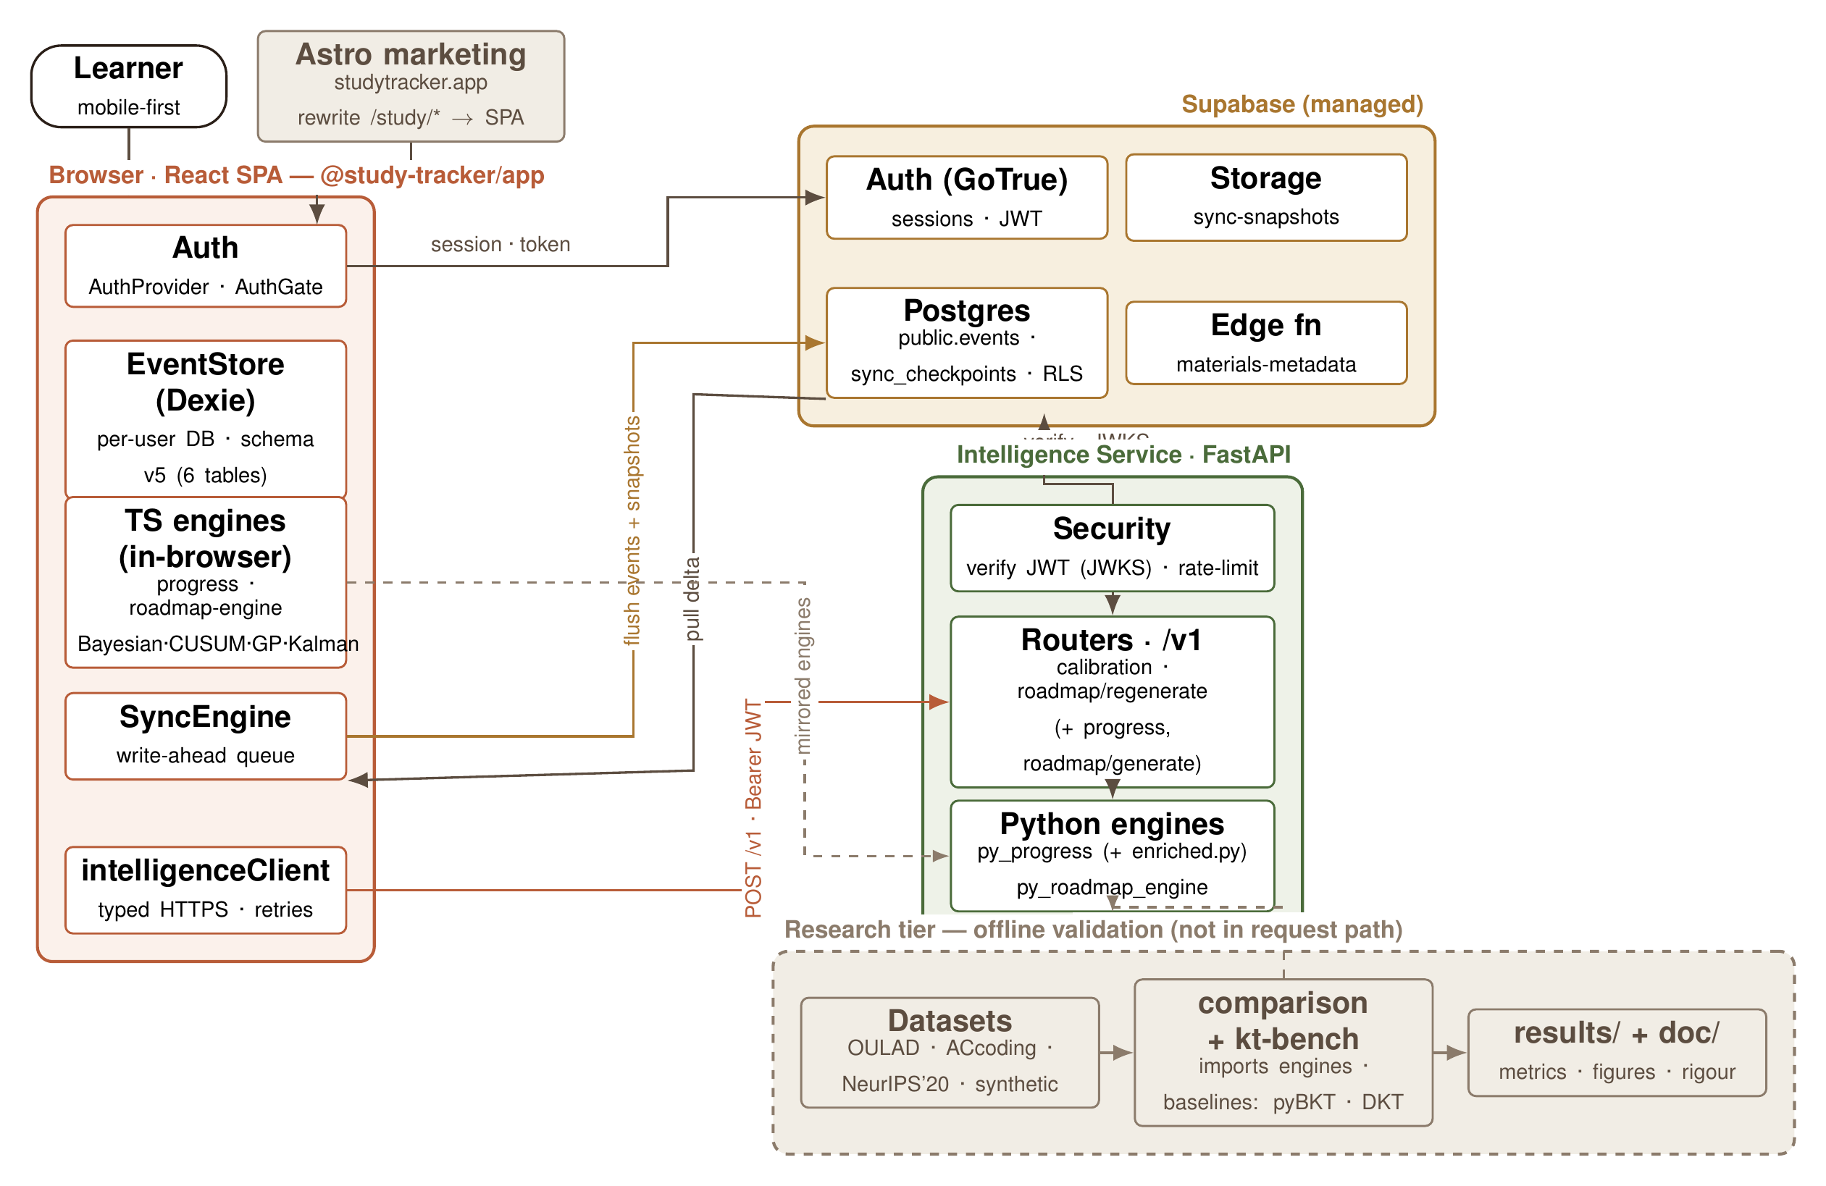
Architecture
Browser client plus FastAPI service and worker plus Supabase hub. The Qwen3 sidecar on port 8200 and the Piston sandbox on port 2000 are separate compose services. They never sit in the request path (Fig 4.4, p30-31).
React client
(bookings, mastery)
→
FastAPI service + worker
(generate, grade, verdict)
→
Supabase hub
(auth, events, storage)
Qwen3 sidecar :8200
(embed + rerank)
Piston sandbox :2000
(code grading)
Worker path only , sidecars are separate compose, not in the request path
9 / 23

Slide 10
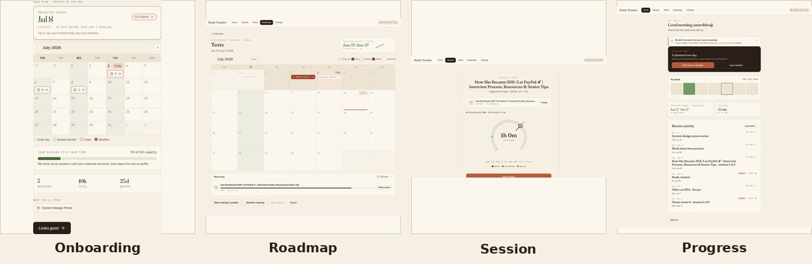
Technologies Used
Frontend is React 19, Vite, TypeScript, with Dexie and IndexedDB. The intelligence service is FastAPI on Python 3.12. TypeScript and Python engines match to 1e-6.
Data and sidecars use the Supabase hub with Qwen3 embed and rerank on 8200 and Piston on 2000. Tests total 976 pytest plus 65 vitest files plus 33 Playwright specs. No CI. Tracing uses X-Request-ID (Tables 5.5 and 5.6, p36).
10 / 23

Slide 11
Results I: Retrieval + Generation
Rerank lifts recall on both corpora. Read this as descriptive. Hybrid plus rerank: r@1 0.67, r@3 0.90, MRR 0.797 on ACCA-754. Deltas on DDIA-1094: +16, +17, +0.139 (Table 6.1, p43).
S:off ships at low cost. 0.9667 schema-valid at 0.7241 gold support ($0.00561, p95 10.5 s). Groundedness 0.8667, self-judged over six clusters (p43-44).
Footnote: n=30, descriptive only. McNemar not significant. Same model judges groundedness.
Arm (ACCA-754) | r@1 | r@3 | MRR
Dense | 0.60 | 0.77 | 0.706
Hybrid | 0.60 | 0.80 | 0.720
Hybrid + rerank | 0.67 | 0.90 | 0.797
So what: rerank helps retrieval on both corpora, but with n=30 this is descriptive. It ships because quality holds at fixed cost.
11 / 23
Notes:
Read the footnotes, not just the headlines. Rerank lifts recall on both corpora, but n=30 is descriptive and McNemar is not significant. The shipped S:off arm is 0.9667 schema-valid at 0.7241 gold support. Groundedness at 0.8667 is self-judged by the same model over six clusters. Retired 788-split absolutes never appear. Table 6.1 and pages 43 to 44.

Slide 12
Results II: Mastery + Closed Loop
BKT ties on ranking, halves calibration error. Live 0.7397 and 0.1401 against 0.7368 and 0.2679 for running proportion (Table 6.3, p44).
All four verdicts convert. Suggest-replan at confidence 1.0, sufficiency 0.66 to 0.77, over 32 days. No fixed-plan control (Table 6.4, p45).
Footnote: parity on ranking is the finding. Conversion is integration behavior, not efficacy.
Model (live) | AUC | ECE
bkt-v1 | 0.7397 | 0.1401
running-proportion | 0.7368 | 0.2679
Week signals
→
Jev-1.13 judge
Gate 0.5 / 0.7
→
Hold: writes nothing
Suggest-replan: copies verdict pair
So what: BKT wins on calibration, not ranking. The loop integrates end to end, but efficacy needs a real-learner study.
12 / 23
Notes:
Parity is the finding. BKT ties on ranking at 0.7397 versus 0.7368 and nearly halves calibration error at 0.1401 versus 0.2679. The judge proposes and the code gate disposes through the verdict router. All four suggest-replan verdicts convert at confidence 1.0 with sufficiency 0.66 to 0.77 over 32 days, but there is no fixed-plan control, so conversion is integration behavior, not efficacy. Tables 6.3 and 6.4, pages 44 to 45.

Slide 13
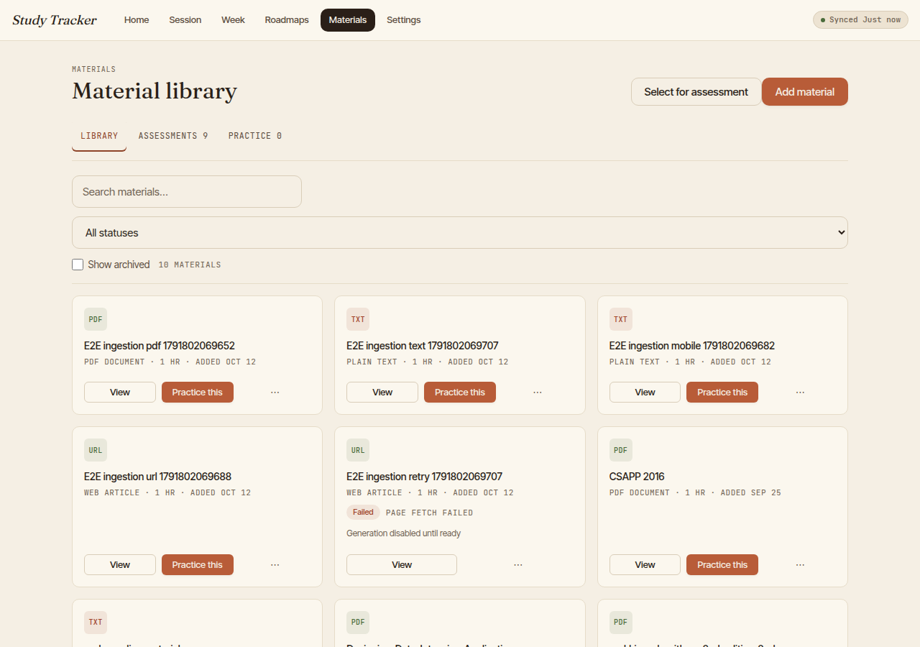
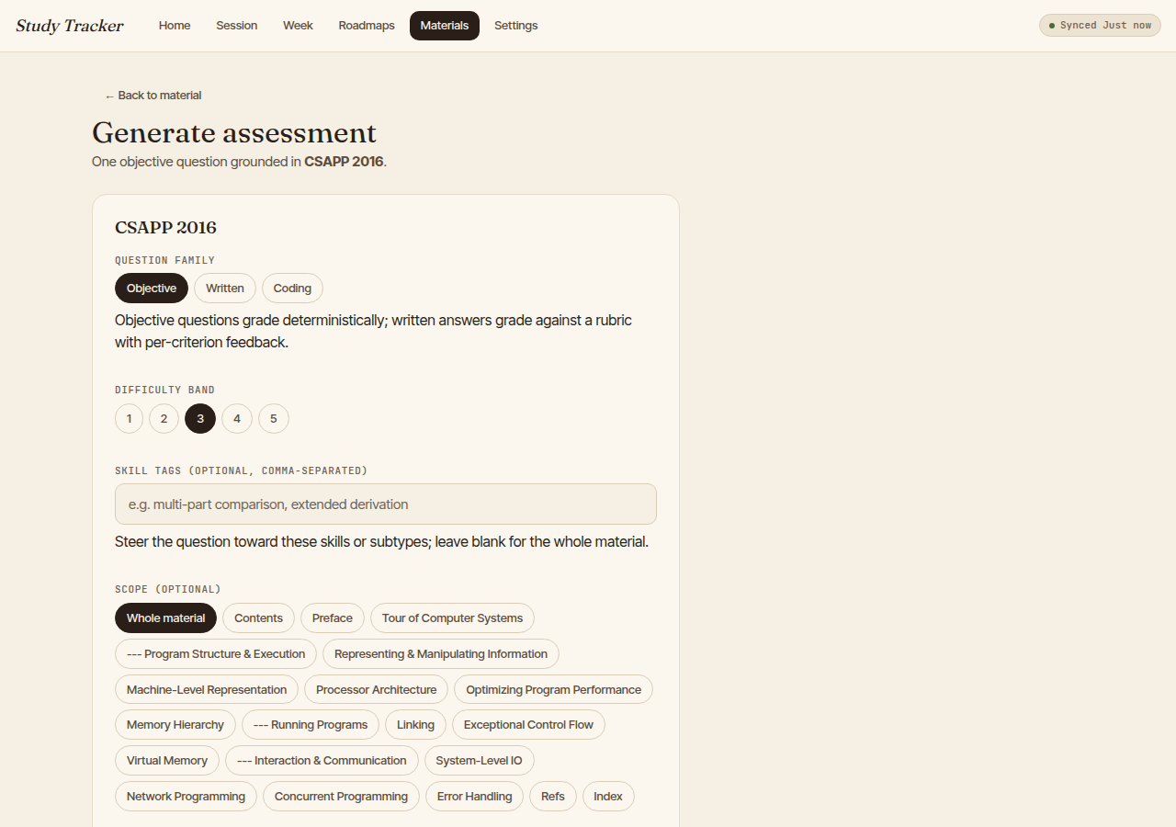

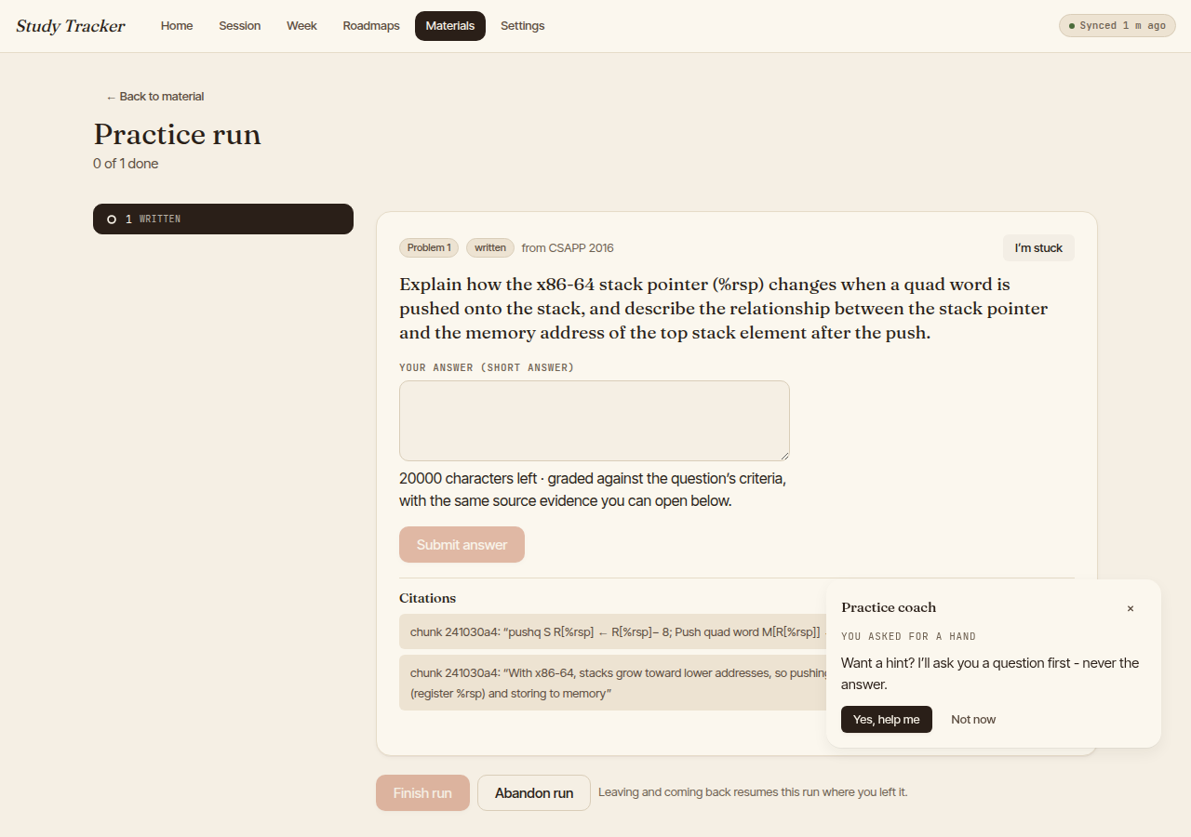
Live Demo
Live walkthrough of the running loop, about 6 minutes on a seeded account. Path: materials to generation to taking and review to practice and coach to the evidence trail.
If the network fails, advance to the stills below. From left to right: library, generation config, review, practice run. These are Figs 5.1 to 5.4.
13 / 23
Notes:
Six-minute path on a seeded account: materials, generation config, taking and review, practice run with coach, evidence trail. Narrate what each screen proves. Kill switch: if the network fails, advance to the stills below, left to right: library, generation config, review, practice run, Figures 5.1 to 5.4. Fig 5.6 re-capture is still pending and stays out of the deck.

Slide 14
References
[1] M. Islam et al., Predict-then-optimize study planning, ICCIT, IEEE, 2024. (base paper)
[2] B.S. Bloom, The 2 sigma problem, Educational Researcher, 1984.
[3] A.T. Corbett and J.R. Anderson, Knowledge tracing, UMUAI, 1994.
[4] A.M. Chen et al., Hierarchical Bayesian adaptive teaching, Cognitive Science, 2024.
[5] A. Zanellati et al., Hybrid models for knowledge tracing, IEEE TLT, 2024.
[6] P. Lewis et al., Retrieval-augmented generation, NeurIPS, 2020.
[7] G.V. Cormack et al., Reciprocal rank fusion, SIGIR, 2009.
[8] Lecture-to-quiz item generation, Computers and Education: AI (year pending verification).
[9] Short-answer rubric grading, EDUCON, 2024 (authors pending verification).
[10] J. Zhang et al., Think-aloud gaming the system, LAK, 2026.
Full 31-entry bibliography in the dissertation.
14 / 23
Notes:
Bloom to Corbett to RAG/hybrid to rubric to LAK26. Venue+year fallbacks flagged for verification.

Slide 15
Delivered, Limits, Next
Delivered. The closed loop is integrated: grounded generation, server grading, BKT mastery, verdict replan, verified live end to end (Ch 7, p48-50).
Limits. Synthetic evidence only. Self-judged groundedness. Difficulty unmeasured. Week 5 unobserved. No control arm. Harness FAIL gate stands (p47).
Next. A real-learner study with held-out validation, the test that would change the claim. Then multi-band calibration.
So what: the loop is real and integrated. The claim stops at integration; the next study tests learning.
15 / 23
Notes:
End on the test that would change the claim. Delivered and integrated, verified live end to end, Chapter 7 pages 48 to 50. Limits are stated on the slide: synthetic only, self-judged groundedness, unmeasured difficulty, unobserved week 5, no control, FAIL gate stands per Threats page 47. Next is a real-learner study with held-out validation, then multi-band calibration.

Slide 16
Thank You
16 / 23
Notes:
Q&A; backup slides ready.

Slide 17
Caveats
Week 5 not observed for all four archetypes (n.o.) — 0.000 marks an unobserved week, never measured zero (p46, A.1 p51).
Harness gate reads FAIL by design: difficultyMeanAbsBandError fires because difficulty calibration is unmeasured (p42, p47).
Groundedness 0.8667 is self-judged: generator and judge share the same model over six question clusters; no independent rerun or human audit (p43, p47).
Coding gate clears only on the judged pair: 0.5349 judged vs 0.371 full-denominator; never quote 0.5349 alone (p43-44, p47).
Written cutoff 0.6/0.10 shipped on a met-class of two pairs; train split favoured 0.7 (p44).
No fixed-plan control arm: 4/4 conversions are integration behavior, not efficacy (p46-47).
17 / 23
Notes:
Show only when asked. Full honesty sheet.

Slide 18
Verdict instants
Per-user decidedAt values, post-fix replay: all four converted (Table A.2, p52).
User | Verdict | decidedAt | Converted
steady | suggest_replan | 2026-10-14T12:00:11.235Z | yes
crammer | suggest_replan | 2026-10-14T12:00:07.156Z | yes
struggling | suggest_replan | 2026-10-14T12:00:07.606Z | yes
returning | suggest_replan | 2026-10-14T12:00:07.515Z | yes
18 / 23
Notes:
Provenance only.

Slide 19
DDIA golds
DDIA second-corpus gold set, 30 question stems verbatim (Table A.3, p52-54). Answer snippets live in the dissertation.
1. What does it mean for a data system to be reliable?
2. What is the difference between a fault and a failure?
3. How does the book define scalability?
4. What does operability mean as an aspect of maintainability?
5. What does schema flexibility mean in the document model?
6. What are the roots of the relational model?
7. What drove the adoption of NoSQL databases?
8. Why are declarative query languages preferred over imperative APIs?
9. What is an advantage of SSTables over log segments with hash indexes?
10. How do B-trees and LSM-trees compare on read performance?
11. How common are secondary indexes in relational databases?
12. How does leader-based replication work?
13. What guarantee prevents reading stale data after your own write?
14. What is the biggest problem with multi-leader replication?
15. When can quorum reads generally expect the most recent value?
16. How does skew affect batch jobs?
17. What is consistent hashing?
18. Where does the acronym ACID come from?
19. What is the most basic transaction isolation level?
20. Which isolation level is named in the chapter on weak isolation?
21. How strong is serializable isolation?
22. What extra element appears in distributed transactions compared to single-node ones?
23. What does the FLP result prove about consensus?
24. What does consistency mean in the CAP theorem?
25. What illusion does linearizability give?
26. What technique orders events across leaders?
27. What is a batch processing system?
28. What is the difference between event time and processing time?
29. Who questioned the lambda architecture?
30. What does exactly-once mean for stream processing?
19 / 23
Notes:
Corpus-rigor proof. Full stems plus answer snippets in Table A.3.

Slide 20
Rerun contract
Hold these fixed (Table 5.5, p36):
• Chunks ~400 tokens / ~30 overlap; 768-d Qwen3 sidecar embeddings; top-5 owner-scoped chunks per call; top-50 candidates before rerank.
• Generation temp 0.3, reasoning off, 30 s timeout, 4096 max output tokens; at most one repair.
• BKT p_init 0.15, p_learn 0.1, p_slip 0.05, p_guess 0.2; loop gates evidence 0.5 / confidence 0.7.
• Golds: 30 objective + 6 written + 4 coding; attempt gate K=5 over 3 fold hashes.
20 / 23
Notes:
A repetition beyond these budgets is a new run, not a rerun.

Slide 21
Test inventory
Engineering rigor behind the delivered code (Table 5.6, p36; counts collected 2026-10-23):
• 976 pytest tests across 57 files (intelligence service).
• 65 vitest files (app plus engines); 37 hook plus 77 feedback tests passing.
• 33 Playwright spec files; 11 harness pure-function unit tests.
• No CI gate; coverage not measured.
21 / 23
Notes:
No CI is the disclosed gap.

Slide 22
Budgets
Every run has a fixed budget, and the budget is part of the claim (report p44; journal p6-7):
• S:off delivered arm: $0.00561, latency p95 10.5 s.
• S-layer sweep aggregate: $0.061289 over 361 requests.
• Generation probe: 395 calls at $0.099 across 13 arms.
• Structured-output latency p50 3973 ms / p95 10547 ms; dip replay used 7 of 15 Jev calls.
22 / 23
Notes:
Budgets are claims; beyond-budget is a new run.

Slide 23
Pre-fix contrast
Report only as the defect the fix removed, never as a second result (p45):
• Pre-fix replay: 4/4 hold at confidence 0.18–0.34 on span-zero neutral inputs.
• Input fix opened states; confidence 1.0 would also clear the old 0.9 gate.
• Gate moved 0.9 → 0.7; 0.8 candidate rejected after a live 0.79 sample fell in the 0.79–0.85 band.
• Dip replay: 4/4 hold at 0.28–0.35; Sep-12 pin flips one archetype without clearing the gate.
23 / 23
Notes:
"Not a second result."

