Slide 1
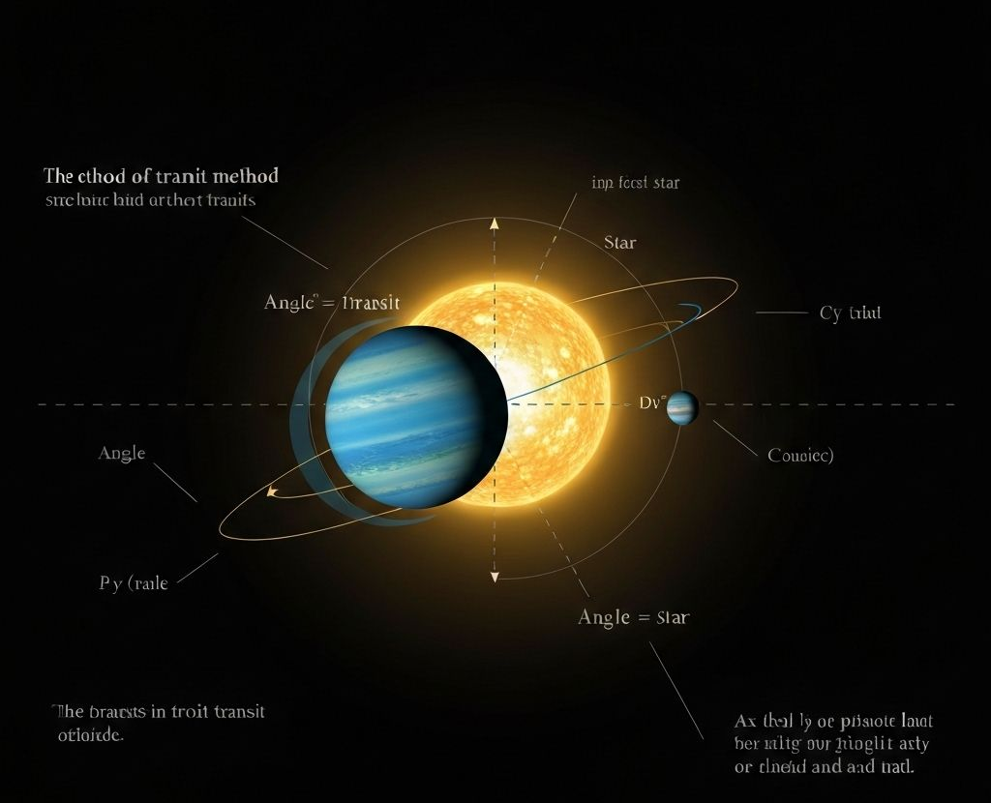
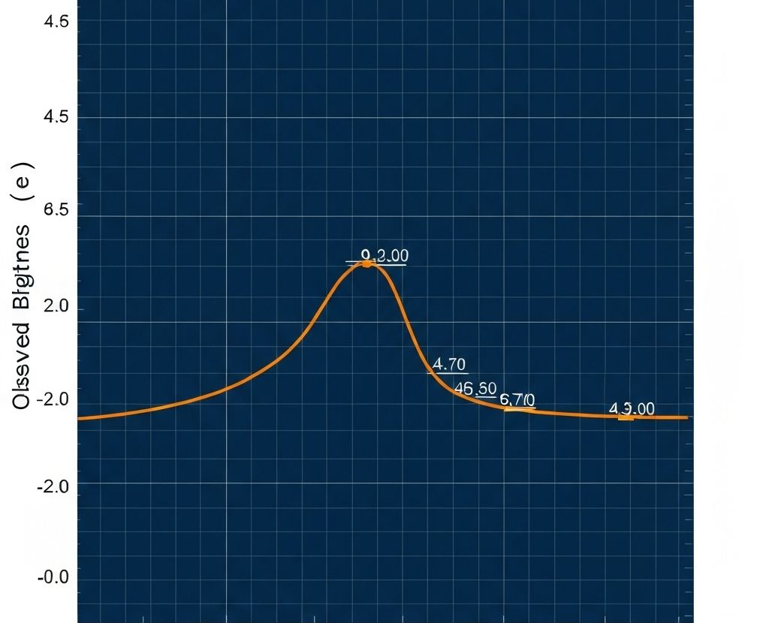
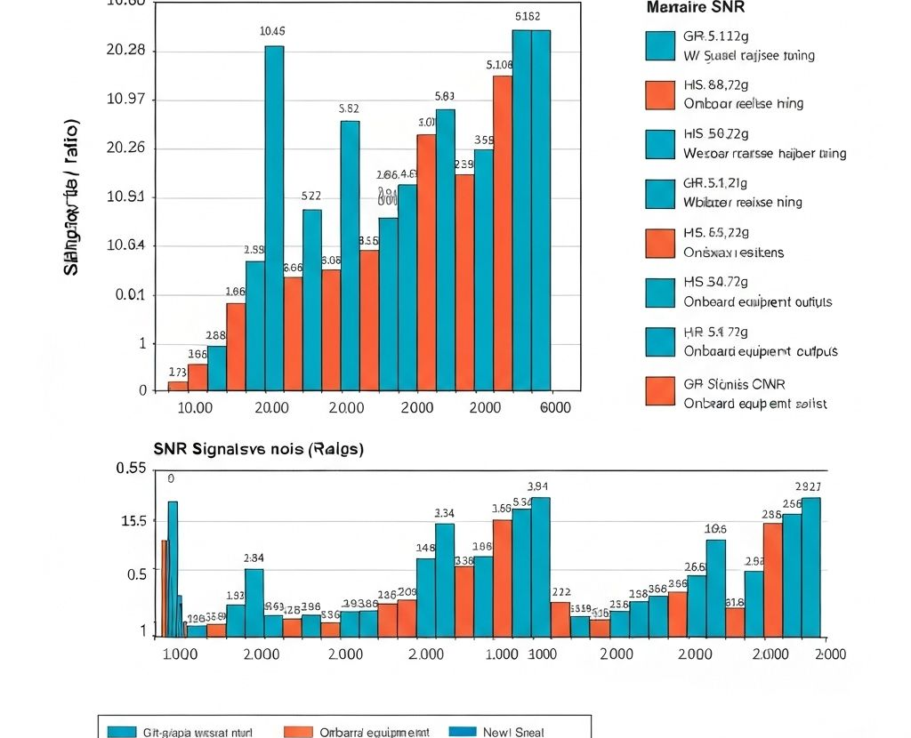

PLANET PIONEERS · AIAS+ 2026 STUDENT SHOWCASE
EXO
PLAIN
ExoPlain: An Interactive, Explainable AI Platform
for Exoplanet Discovery
AI FOR SCIENCE
INTERACTIVE ML
From TESS light curves and candidate parameters to interpretable evidence for human review
Planet Pioneers · Student research team · NASA Space Apps Challenge 2025
Authors: [student names] · School: [school] · Mentor: [mentor]
Transit geometry
Light-curve evidence
Signal quality
Interactive exploration
01
Research problem and contribution
04
System architecture and data contracts
Transit surveys produce large time-series datasets, but a brightness dip alone does not confirm a planet. Stellar variability, eclipsing binaries, instrumental noise and processing artifacts can create similar signatures. ExoPlain connects candidate measurements, FITS processing, experimental classifiers and a language-model explanation layer so learners can trace how an input becomes an assessment.
Next.js / TypeScript client
Next.js API routes
Manual form, FITS upload, 3D exploration and results interface.
Format measurements and call Gemini 2.5 Pro.
Research question: How can an interactive AI system make exoplanet evidence easier to interpret while preserving uncertainty and the distinction between screening and confirmation?
Python / Flask service
Model artifacts
02
End-to-end analysis pipeline
Parse FITS, normalize, resample, extract features and run RF.
Serialized RF/scaler plus CNN, LSTM and MLP checkpoints.
1 · Acquire
2 · Clean
3 · Represent
4 · Classify
5 · Explain
INPUT
FITS or 16 fields
MODEL EVIDENCE
37 features + probability
OUTPUT
assessment + rationale
Upload FITS or enter 16 orbital, transit, stellar and position fields.
Select TIME/flux columns, remove invalid rows and median-normalize.
Interpolate to 2,048 points and compute 37 engineered features.
Scale features, run Random Forest and compare sequence models.
Send labeled evidence to Gemini for a readable assessment.
05
Explainability design and safeguards
Current architecture has two paths. Manual candidate entry calls Gemini directly. FITS upload calls the Python feature service and Random Forest. The production goal is one auditable pipeline in which the classifier supplies evidence and the language model explains it.
Evidence selection
Structured generation
Manual entry sends submitted measurements. FITS analysis sends labeled features and Random Forest probability.
Gemini returns a Boolean assessment and five important features with relevance descriptions.
Readable result
Intended role
03
Data preparation and modeling methods
Users connect the assessment to transit depth, periodicity, stellar context and signal quality.
The explanation supports learning and candidate triage, not scientific confirmation.
A · Labels and dataset
B · Signal preprocessing
Known implementation gaps
Training scripts use TESS light curves and TFOPWG dispositions. CP/KP/PC map to positive; FP/Unknown map to negative. Documentation reports 7,638 curves and strong class imbalance. Provenance and target grouping require audit.
The FITS service finds common time and flux columns, removes NaN/Inf samples, requires at least 100 valid points, normalizes by median flux and linearly interpolates every curve to 2,048 points.
The manual Gemini route maps answers to fixed 85%/15% confidence and defaults missing answers toward true. The upload route can return randomized fallback features when the Python service fails. Both behaviors must be removed or visibly labeled before scientific use.
C · Random Forest
D · Sequence models
06
Current evidence and reproducibility status
The feature path standardizes 37 engineered variables and trains class-balanced trees with a stratified 80/20 split. The model stores feature importance and AUC metadata.
The 1D CNN uses five convolution blocks: 64, 128, 256, 512 and 512 channels. LSTM downsamples to 256 timesteps with 32 hidden units. An MLP provides a dense baseline.
Artifact
Repository evidence
Status
E · Training controls
F · Transit physics
Interactive system
Manual input, FITS upload, results and 3D exploration
Implemented
Seed 42, Adam with learning rate 10⁻³, weight decay 10⁻⁴, ReduceLROnPlateau, early stopping, gradient clipping, dropout and augmentation.
Inputs include period, epoch, impact parameter, duration, depth, radius, temperature, insolation, SNR, stellar properties, magnitude and sky position. Transit depth δ ≈ (Rₚ/R★)².
FITS feature pipeline
Cleaning, normalization, interpolation and 37 features
Implemented
Model experiments
RF, CNN, LSTM and MLP code with checkpoints
Implemented
37-feature vector
Training scale
README reports 7,638 TESS curves and 95.4% positives
Needs audit
Distribution statistics · dip/peak counts at 1σ-3σ · three depth proxies · variance/RMSE · skewness/kurtosis · dominant frequency and band powers · rolling statistics · trend/R² · autocorrelation at lags 1/5/10 · periodicity strength
Performance
CNN loss and RF AUC reported in repository
Not reproduced
Model
Representation
Purpose
Main risk
Complete-system accuracy
No grouped held-out test or calibration analysis
Not established
Random Forest
37 scaled features
Primary FITS classifier
Leakage or duplicate targets
1D CNN
Raw 2,048-point sequence
Local transit morphology
Class imbalance
07
Validation plan and technical milestones
LSTM
256-step pooled sequence
Longer temporal context
Short events lost in pooling
1 · Dataset audit
2 · Leakage-safe split
MLP
Flattened 2,048 points
Dense baseline
High parameter count
Record TIC IDs, sectors, label source and dates. Resolve Unknown labels and duplicates.
Group observations by star so repeat sectors cannot enter both train and test.
3 · Baselines and ablations
4 · Calibration
Compare every model with simple rules and remove feature families one at a time.
Report reliability curves, Brier score and threshold tradeoffs.
5 · External validation
6 · Explanation study
Test on a later sector or independently curated candidate set.
Measure whether students identify evidence, uncertainty and follow-up needs.
Required reporting
ROC-AUC and PR-AUC · precision, recall and F1 · confusion matrix · calibration and Brier score · latency · failure examples
Failure modes to isolate
Eclipsing binaries
Stellar variability
Instrument artifacts
Low-SNR transits
Distribution shift
Missing metadata
Final system rule
Present outputs as candidate-screening evidence, publish calibrated uncertainty, disclose fallbacks and require human review before confirmation.
TAKE-HOME MESSAGE
Project sources: ExoPlain Next.js routes; web_fits_feature_server.py; random_forest_exoplanet_model.py; cnn1d_exoplanet_model.py; lstm_exoplanet_model.py; train_python_model.py; repository README. Scientific context: NASA Exoplanet Archive, TESS and TFOPWG dispositions. Repository-reported model values have not been independently reproduced.
ExoPlain connects raw exoplanet evidence, machine-learning predictions and readable explanations in one learning workflow. The next priority is rigorous validation, calibrated uncertainty and removal of simulated fallbacks.
Notes:
ExoPlain technical poster. All text boxes, section headers, process blocks and tables are editable. Images come from the project assets. Reported model values originate in the project repository and require independent reproduction.

