Slide 1
Chapter 1
Posttransfer:
Why D36N does not release the substrate

Slide 2
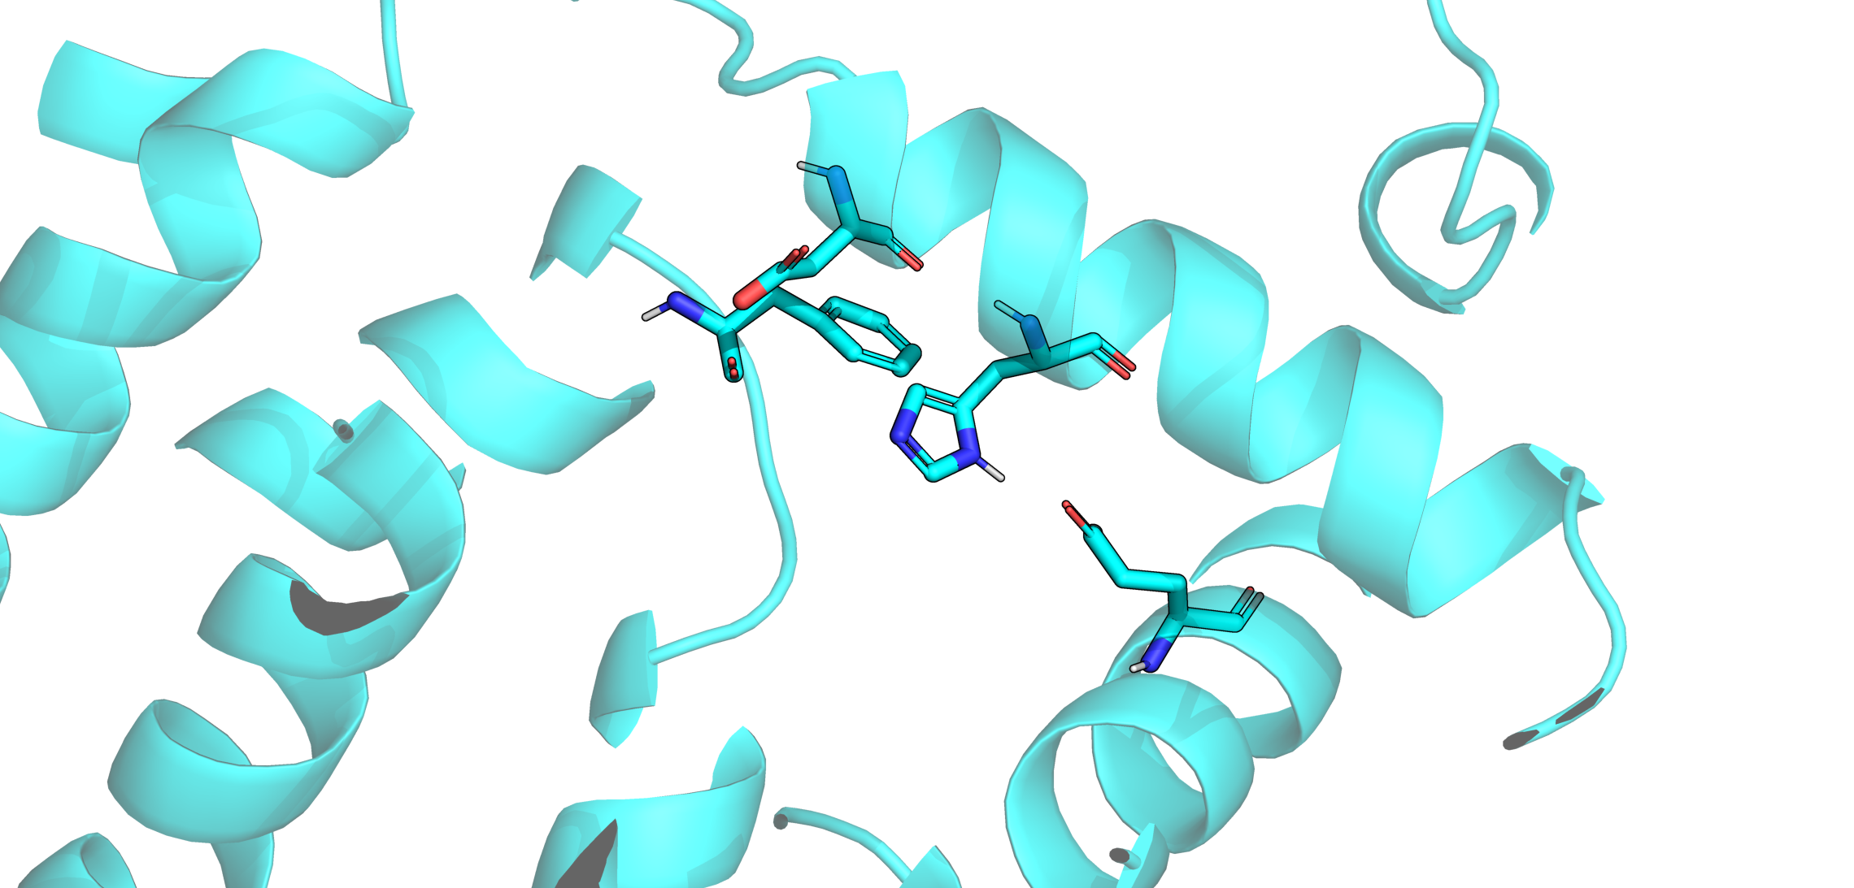
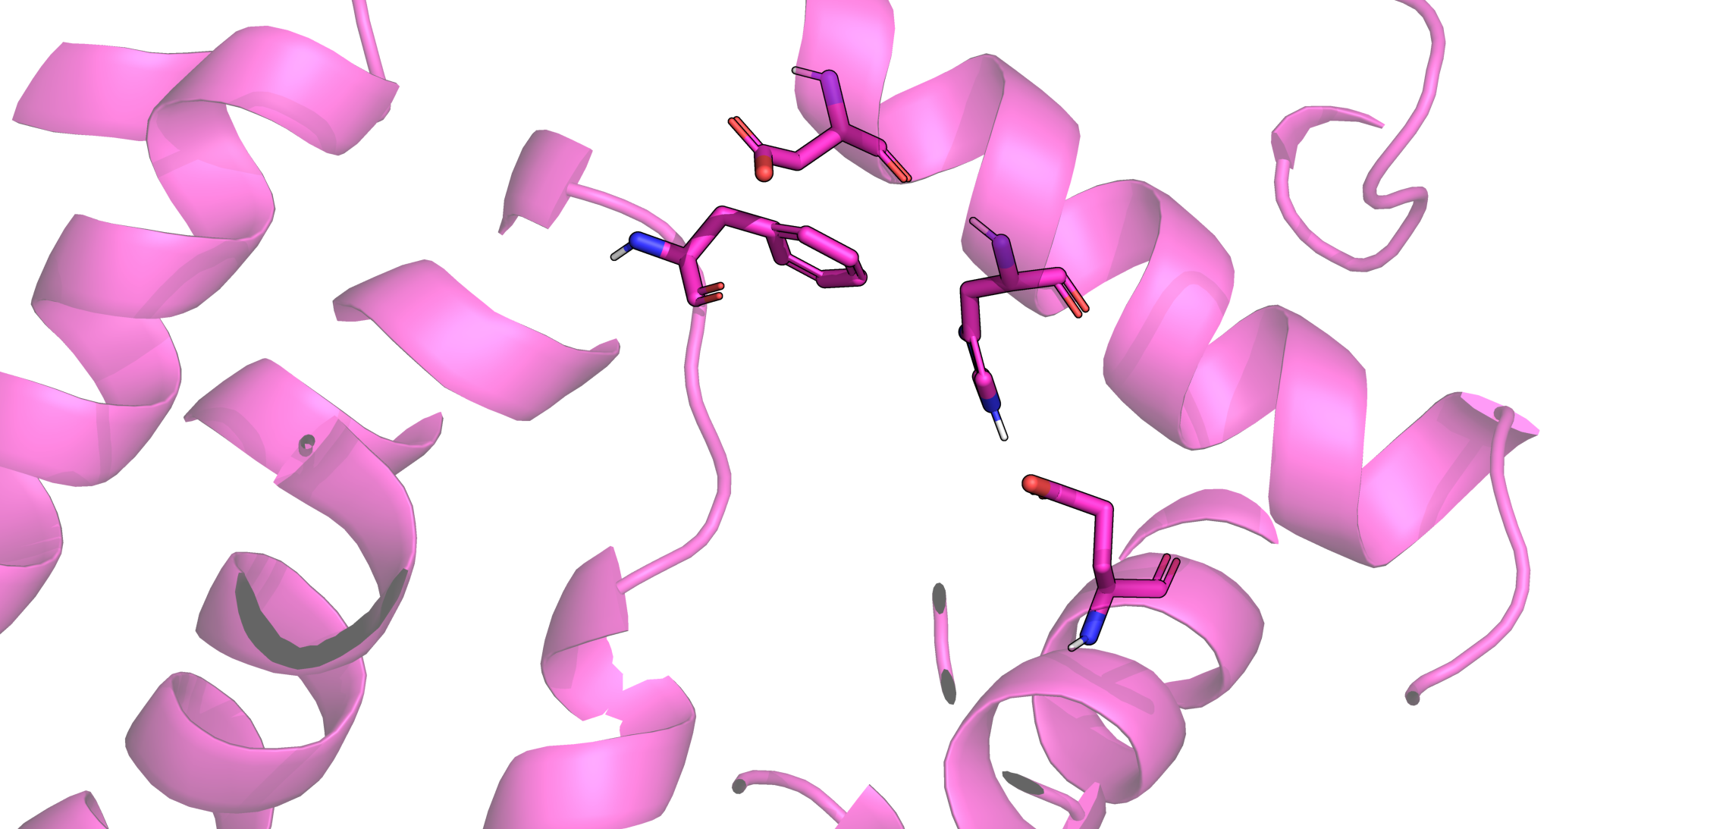
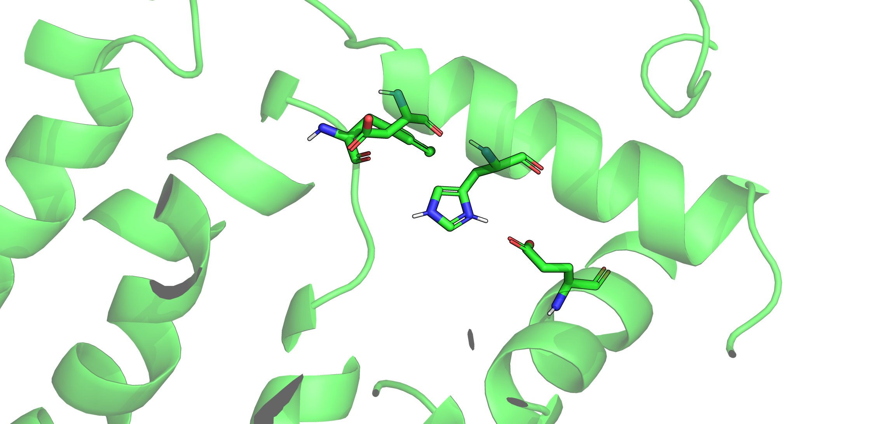
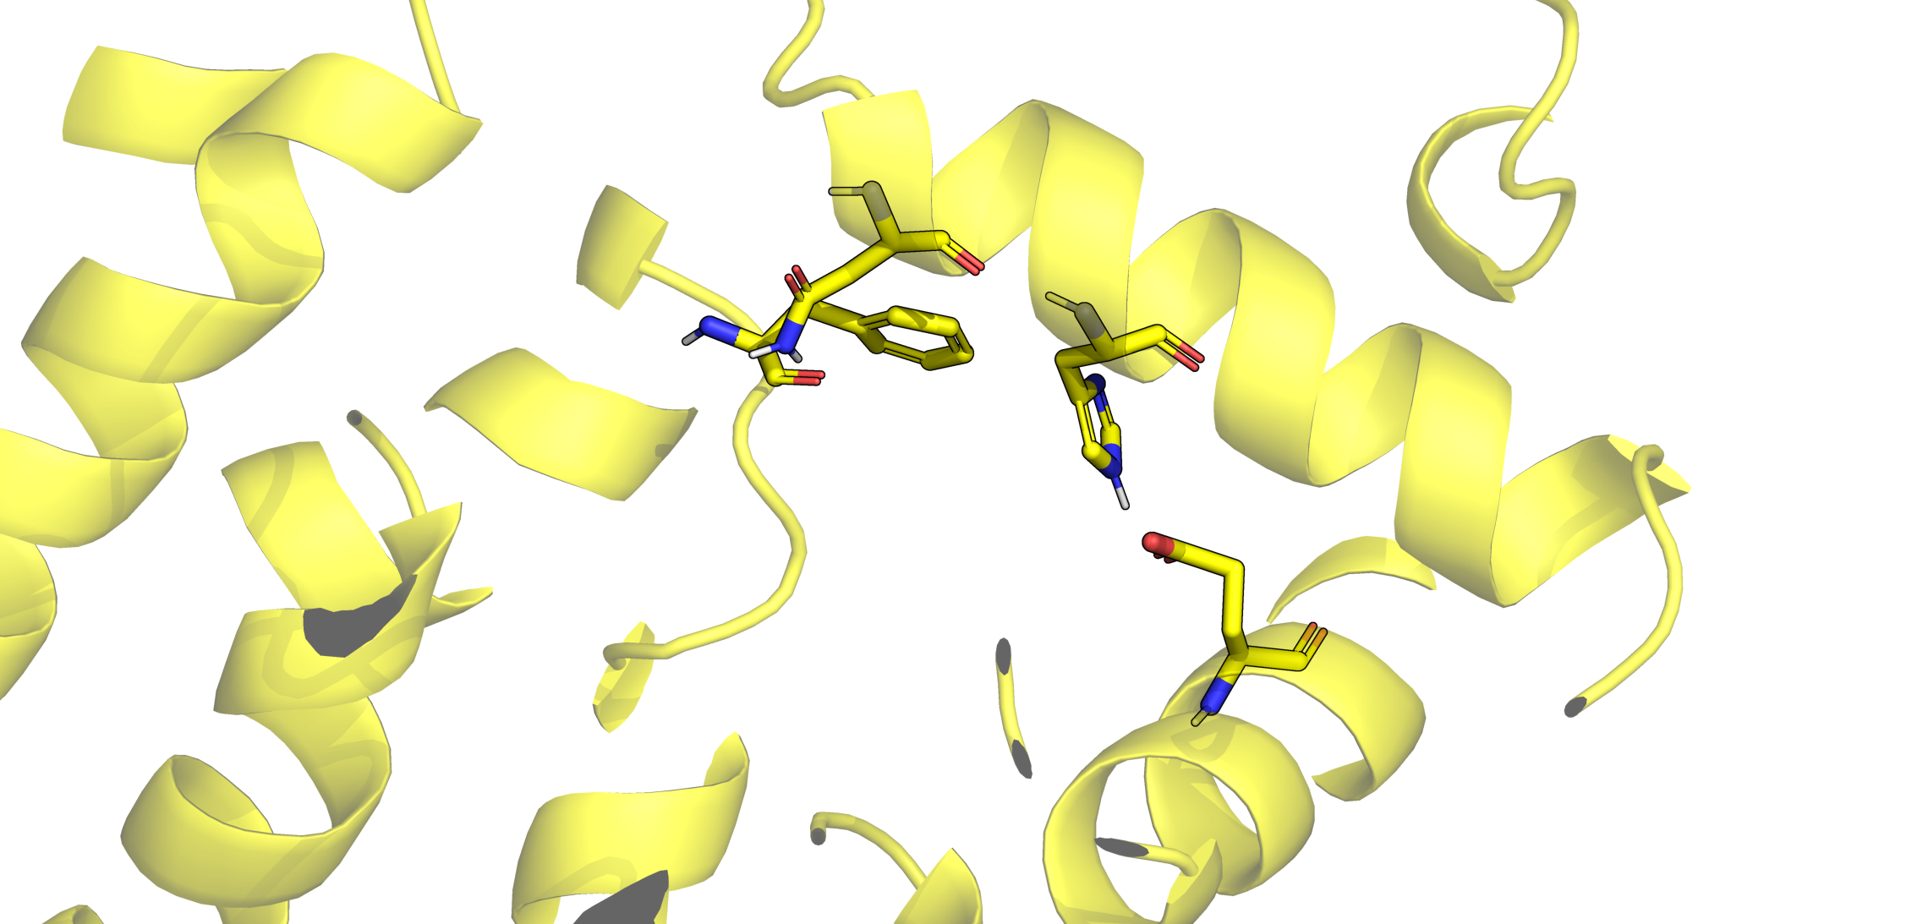
D36H40ε
D36H40δ
D36
H40
F163
E75
D36H40ε/δ
N36H40ε

Slide 3
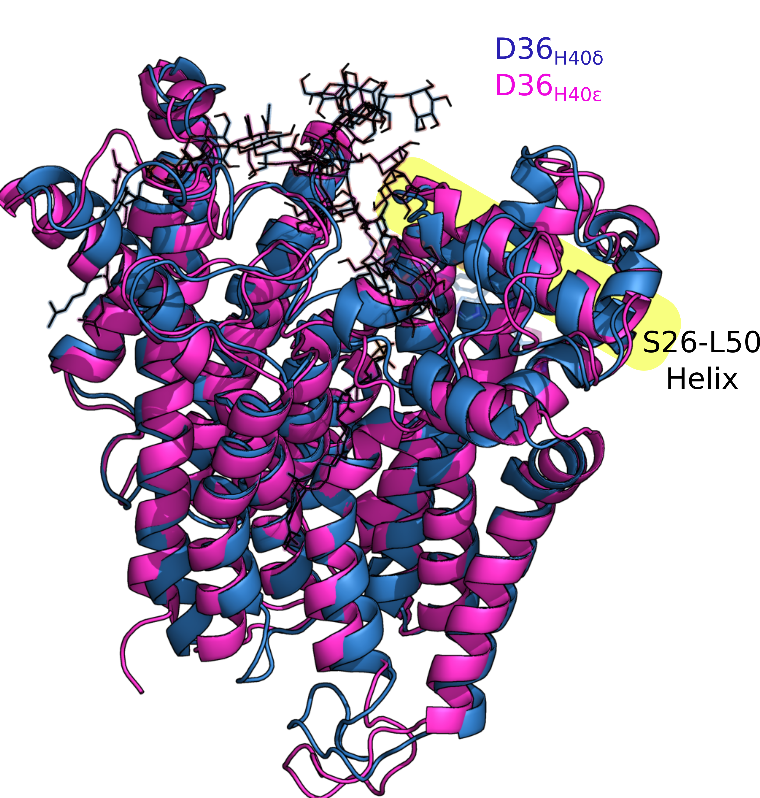
D36H40ε
D36
H40
F163
E75
D36H40δ

Slide 4
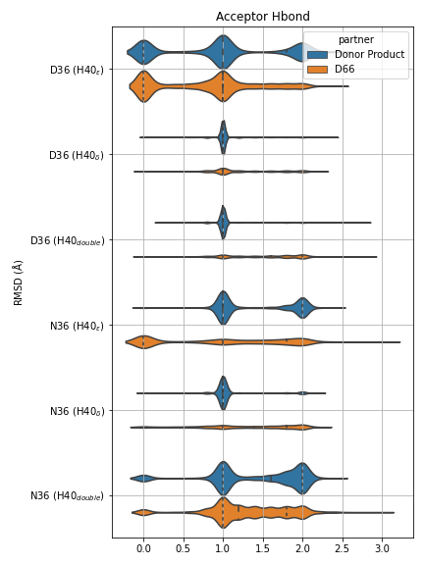
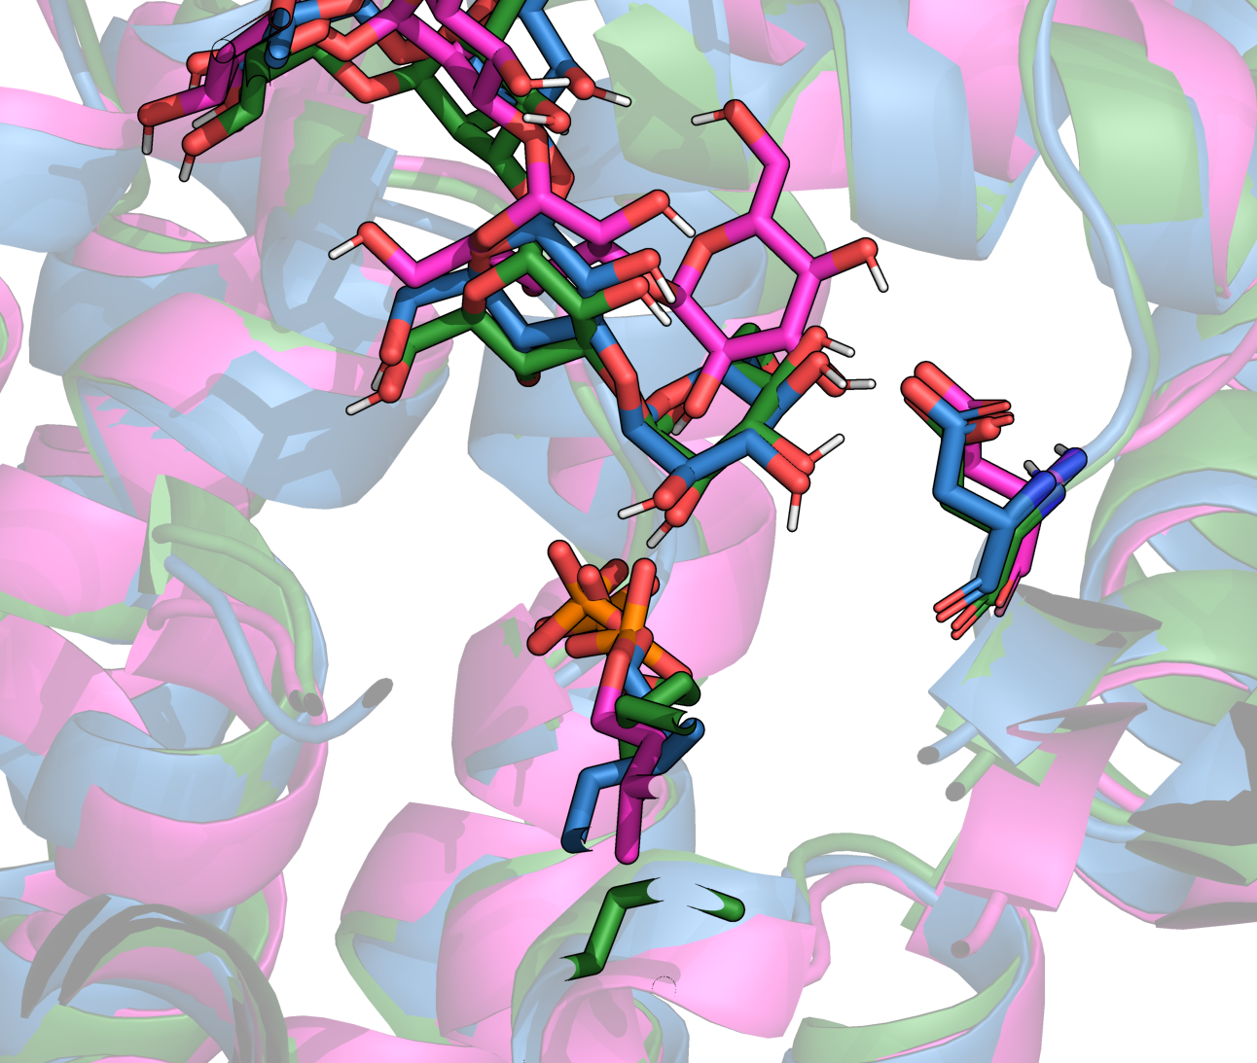
Acceptor product
D66
Donor product

Slide 5
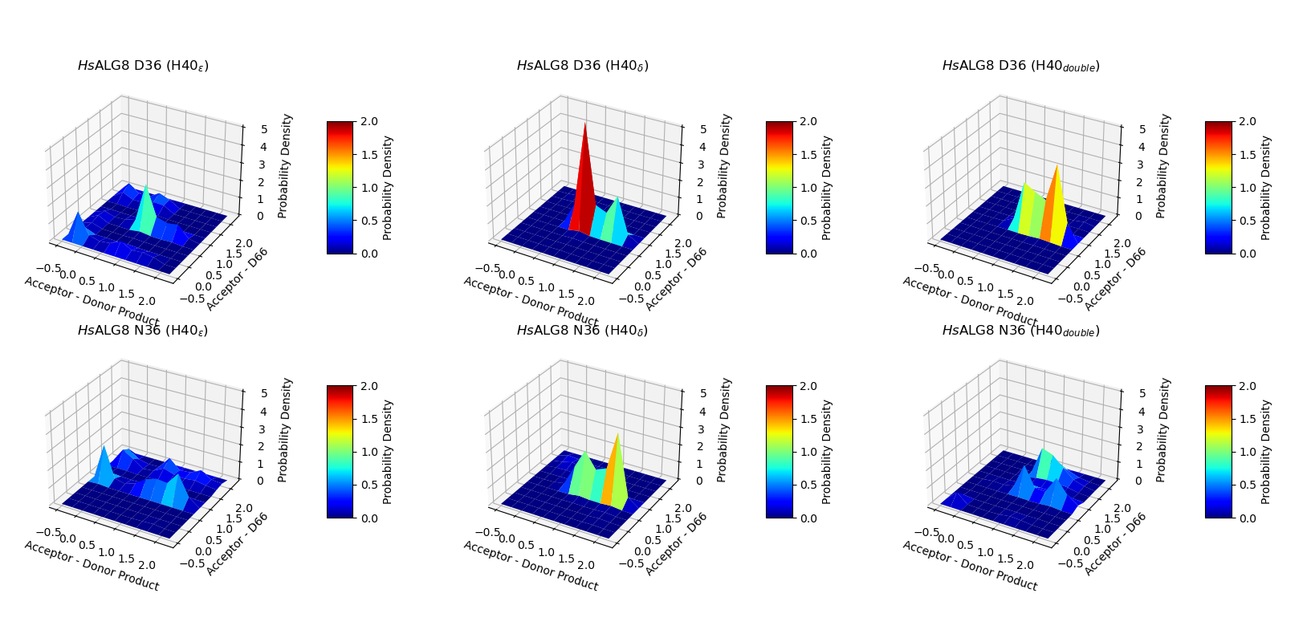
H-bond counts

Slide 6
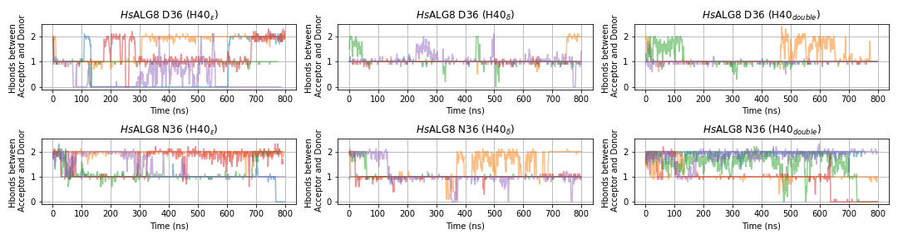
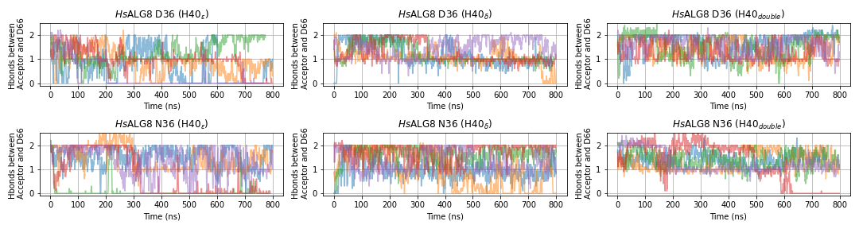

Slide 7
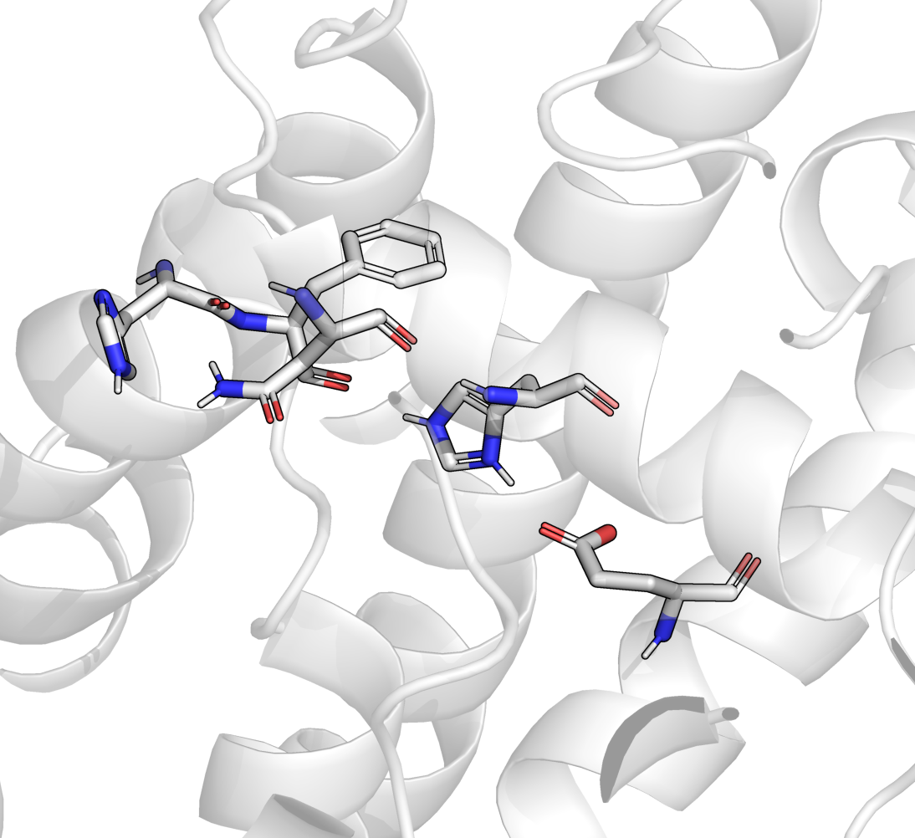
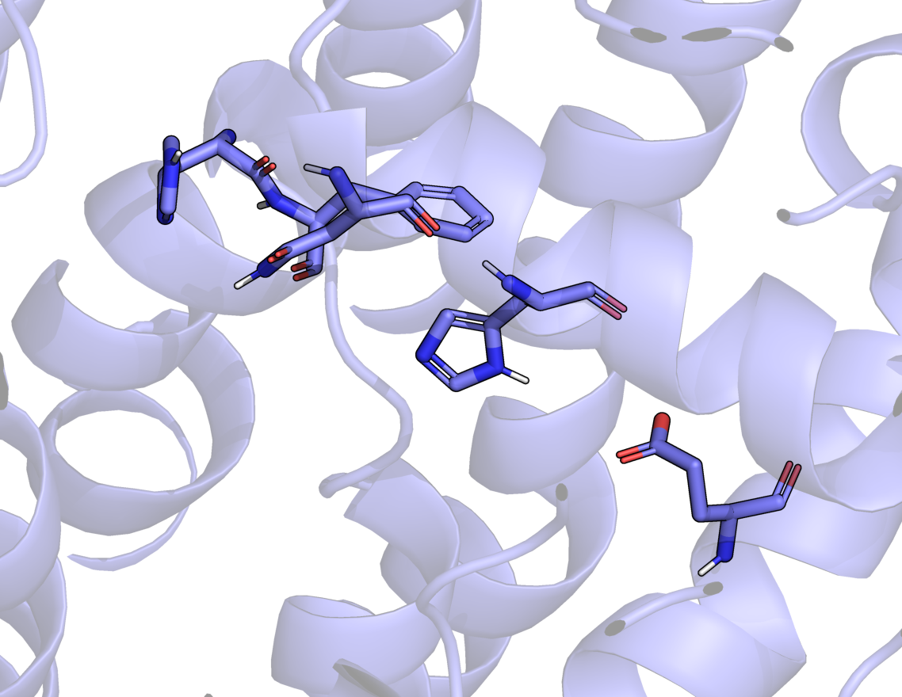
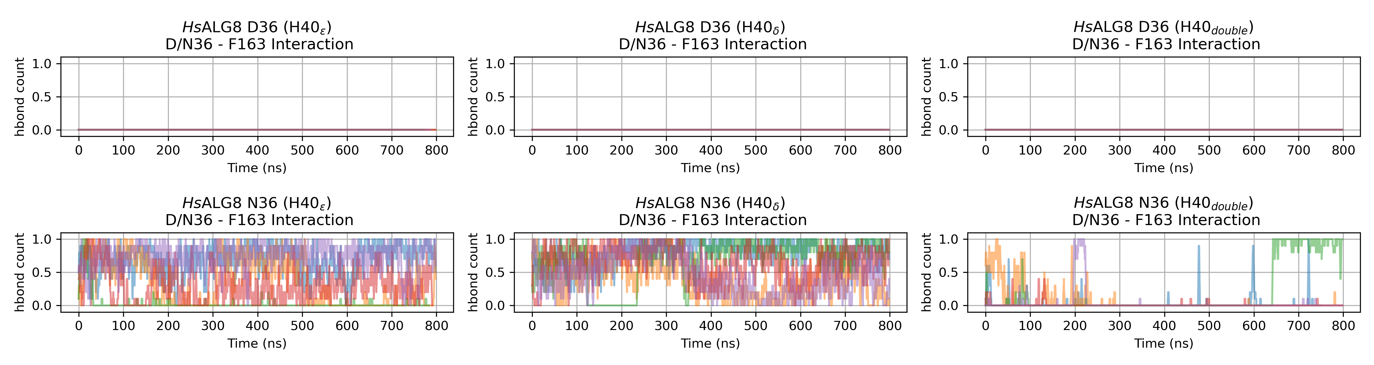
N36H40δ
N36H40ε/δ
In this case, H40 forms H-bond with F163, N36 forms H-bond with H162 instead.

Slide 8
Summary of Chapter 1
- The protonation state of H40 seems to be very crucial for the flexibility of the enzyme, especially the S24-L50 helix. In the D36H40ε simulations ,we observe helix opening and substrate product leaves the active site (losing hbond with donor and D66)
- In D36N, this helix remains closed because of the extra N36-F163 Hbond

Slide 9
Chapter 2
Pretransfer:
Why is Mannose not transferred?

Slide 10
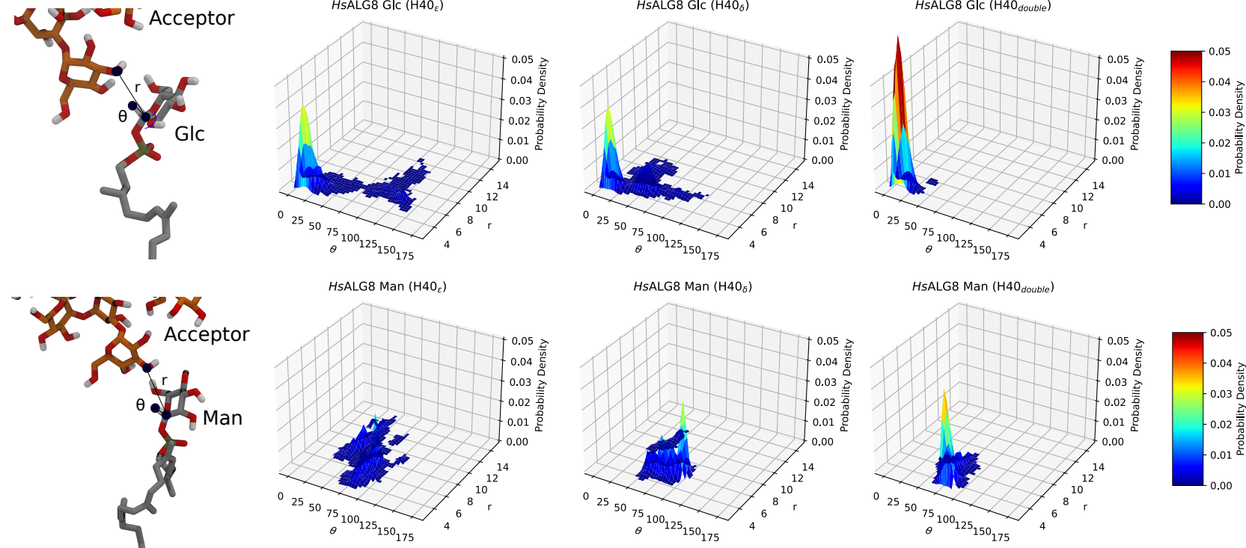
Active Geometry

Slide 11
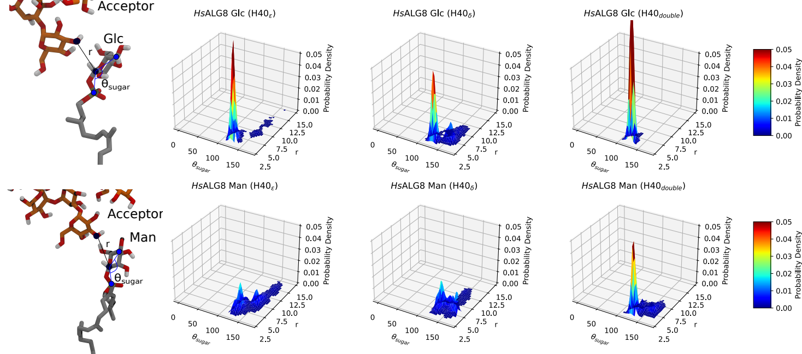
Mannose donor fails to form a “bent” conformer because of the C2-hydroxyl hydrogen bond with the phosphate group

Slide 12
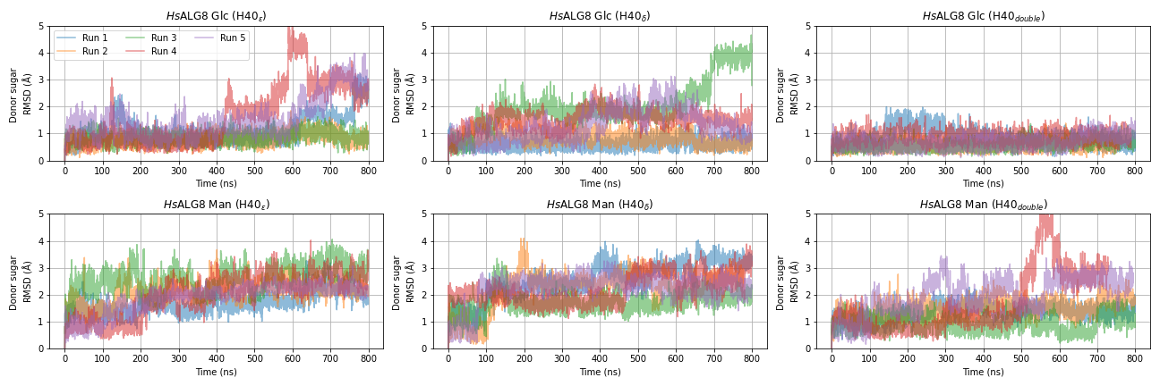
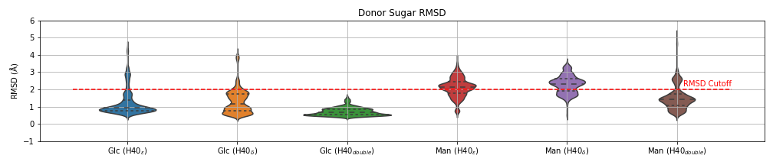

Slide 13
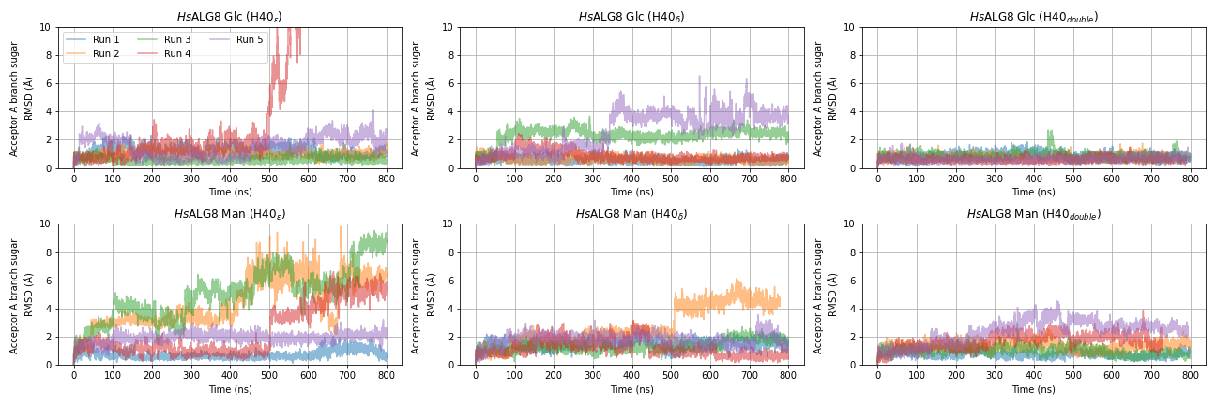
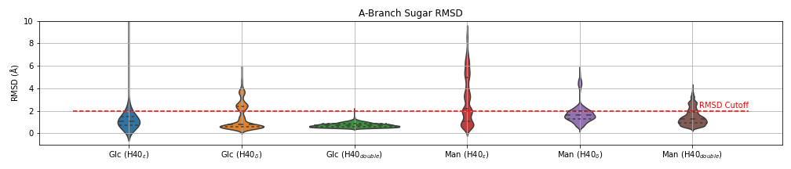

Slide 14
Summary of Chapter 2
- Simulation shows high selectivity of Glc over Man. Potentially because of the conformational limit of the Man-donor.
- Strong correlation between the H40 protonation state and the substrate stability:
    D36H40ε/δ >> D36H40δ > D36H40ε
- Note that the Hbond between H40 and E75 is well-resolved in the EM structure.

Slide 15
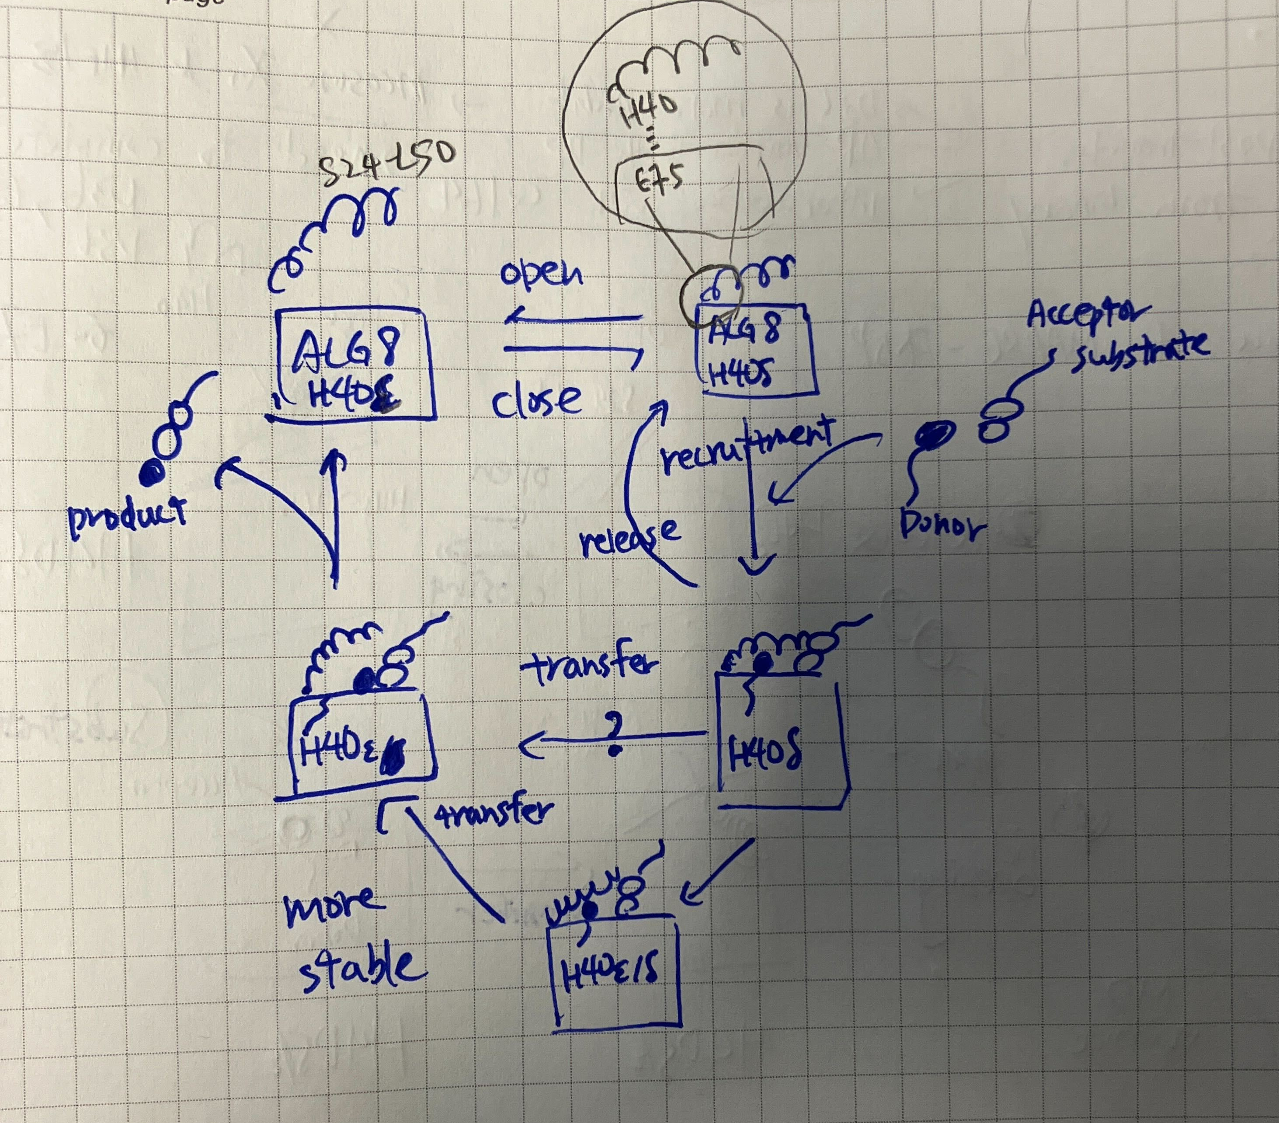
Hypothesis
H40 protonation state regulates the substrate recruitment and release:
- D36H40ε induces an open ALG8 conformation. → Product release
- D36H40δ induces the tightening of the active site geometry by hbond with E75.
→ substrate recruitment and donor selection.
- D36H40ε/δ makes the active geometry super stable. → catalysis

