Slide 1


Slide 2

INTERNAL INCIDENT REPORT
The PLC is Healthy. SCADA is Healthy. So Why Can't We See the Data?
Bearing Temperature Sensor = 78°C · SCADA displays: COMMUNICATION FAILURE
WHERE DID THE COMMUNICATION BREAK?

Slide 3
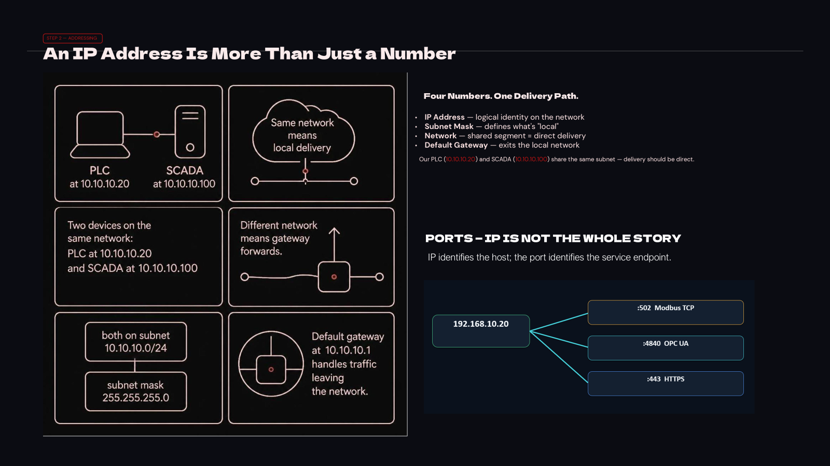

Slide 4

Before Networking: What Does One Device Need to Talk to Another?
Before a single byte moves, every device on the network must resolve four fundamental questions. Miss one, and the data never arrives.
WHO? Identity
WHERE? Location
MAC address on the local segment; IP address on the network layer.
Subnet defines "local." Default gateway routes all traffic beyond the segment.
WHICH SERVICE? Port
HOW? Protocol
Port number identifies the application endpoint — Modbus TCP, OPC UA, HTTPS.
The language both sides must agree on — Modbus TCP, OPC UA, and others.
Our running example: a PLC reads 78°C. All four questions must be answered for that value to reach the operator screen.

Slide 5
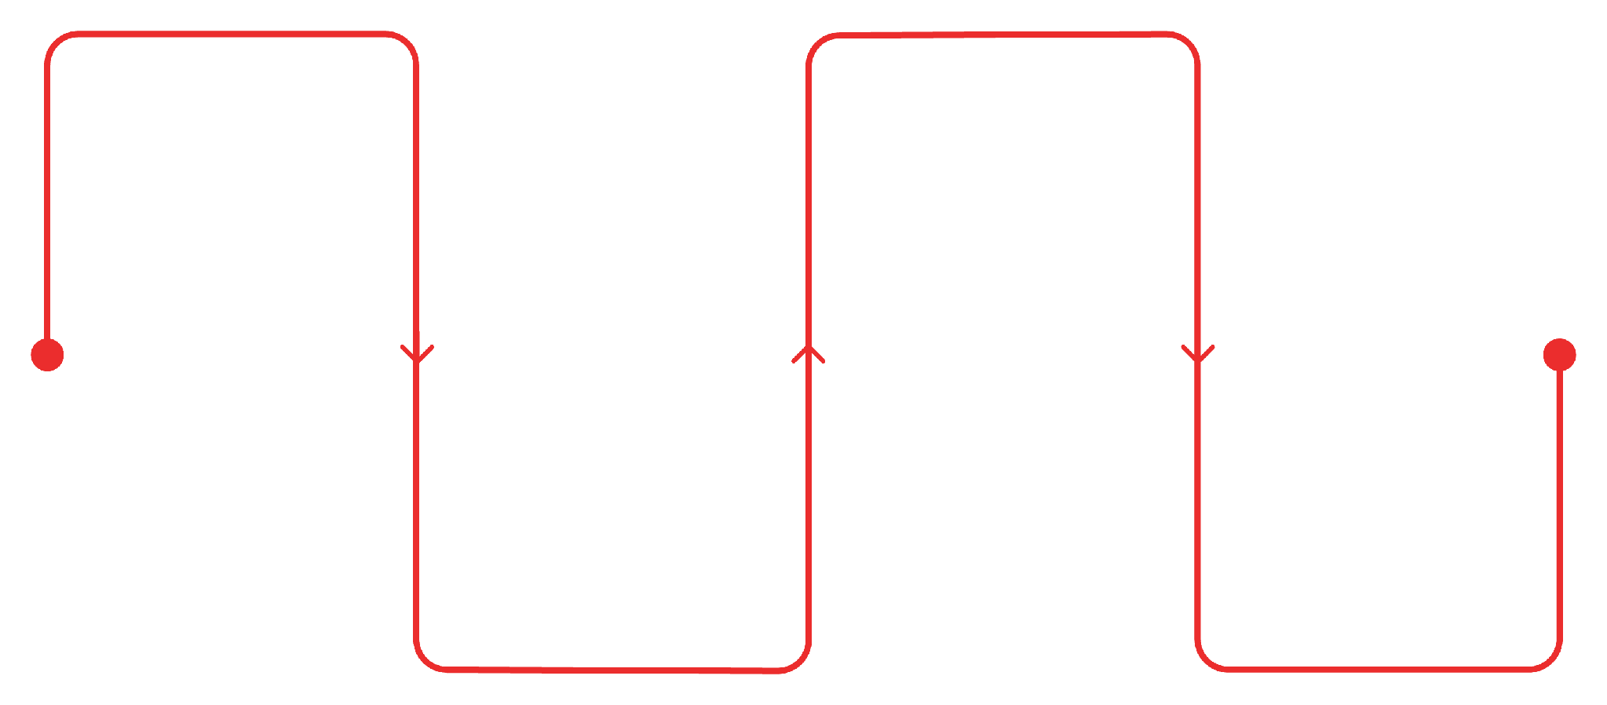
STEP 3 — INFRASTRUCTURE
Who Moves the Data?
Three devices stand between our PLC and SCADA. Each makes a decision — not a dictionary definition.
Switch
Firewall
Reads MAC, forwards within LAN
Inspects traffic, allows or blocks
Router
SCADA
Reads IP, connects networks, selects path
Receives data from the network
Each device either passes the data through — or stops it cold.

Slide 6
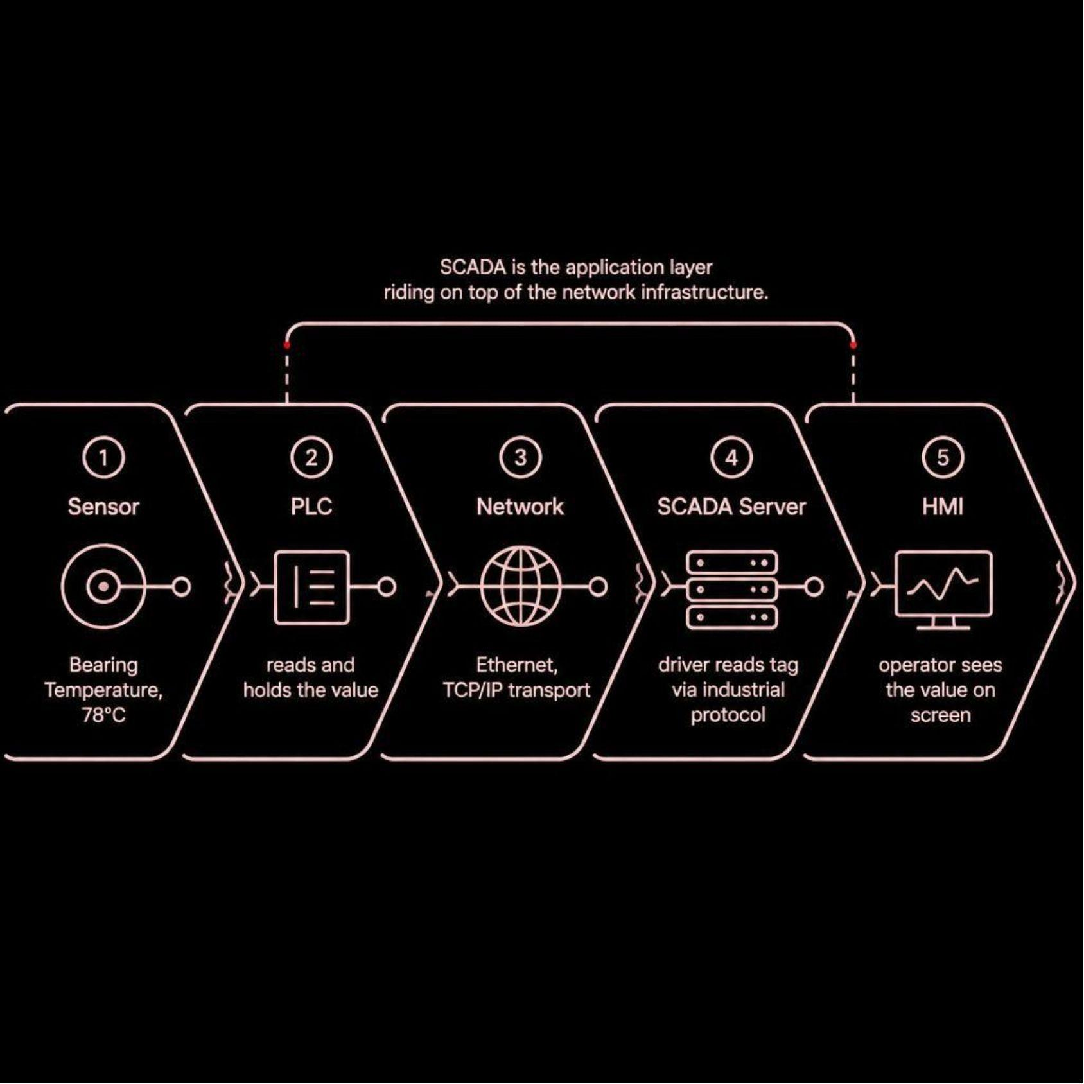
STEP 5 — ARCHITECTURE
So Where Does SCADA Actually Fit?
Let's Follow One Piece of Data
Trace 78°C from sensor to screen. At which point could it disappear?
01
02
PLC
Temperature Sensor
Reads 78°C
Holds value in register
03
04
Industrial Protocol
TCP / IP Stack
Modbus TCP / OPC UA
Encapsulates packet
05
06
Switch → Router → Firewall
SCADA Driver → Tag → HMI
Forwards or blocks
Displays value
Sensor → PLC → Protocol → TCP/IP → SCADA Driver → Tag → HMI
One failure anywhere in this chain — and 78°C never reaches the operator.

Slide 7
















INDUSTRIAL INFRASTRUCTURE & FIELD ARCHITECTURES
Network Topologies in SCADA
Star Topology
Ring Topology
Bus Topology
Single backbone cable with terminating resistors and tap drops for multi-drop serial devices.
Dedicated point-to-point connections from a central managed switch to PLCs, HMIs, and drives.
Devices connected in a closed circular loop. One break activates backup path in <10ms recovery.
High redundancy Protocol setup
Lowest cable cost Trunk break halts bus
Fault isolated Switch is SPOF
Mesh Topology
Tree Topology
Hybrid Topology
Full or partial point-to-multipoint links providing dynamic self-healing data rerouting.
Tiered hierarchical star dividing plant control into core, distribution, and local cell layers.
Combines resilient Ring backbones with localized Star clusters and serial Bus gateways.
Zero downtime High wiring complexity
Modular expansion Root dependency
Optimized balance Complex diagnostics
SCADA Rule: Topologies dictate latency, fault isolation, and packet loss impact between PLC register & HMI screen.

Slide 8
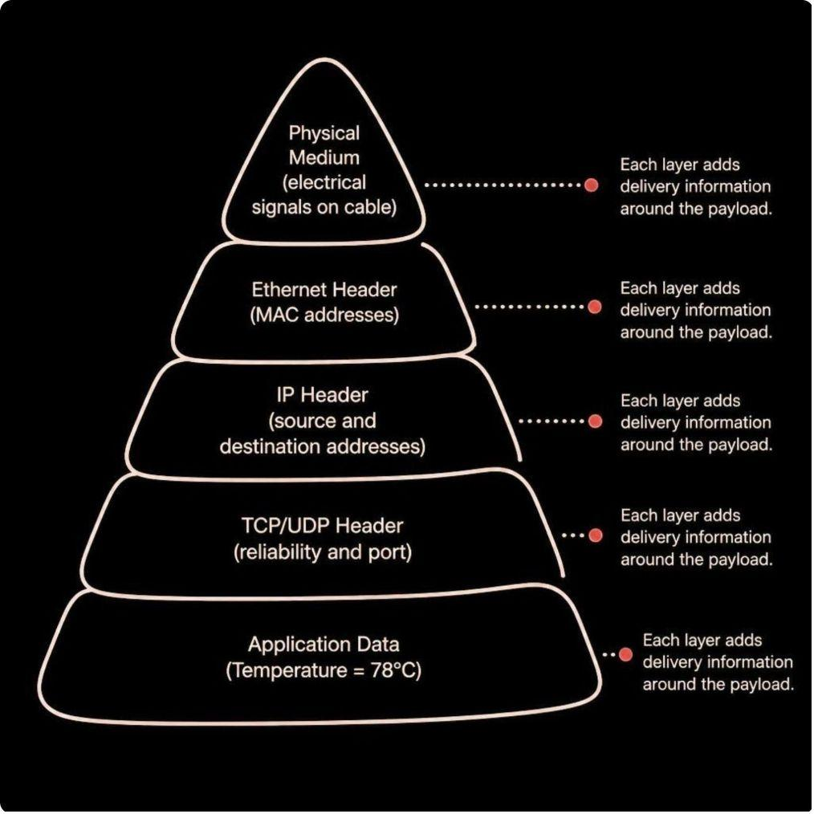





STEP 4 — ENCAPSULATION
78°C Doesn't Travel Alone
Every tag on a P&ID is more than a number — it is a complete data journey from a physical process element all the way to the operator's screen. Encapsulation is the step that binds measurement, transmission, and display into one trusted signal.
Physical Process
Sensor measures temperature, pressure, or flow at the field device
Signal Transmission
4–20 mA or digital signal travels through the I/O network
Encapsulation
Tag metadata, units, alarms, and scaling are bound to the raw value
Operator Screen
Engineered value displayed with full context on the HMI/SCADA
Key Insight: Without encapsulation, a raw signal is just a number. Encapsulation gives it meaning, units, alarm limits, and traceability — turning data into actionable information.

Slide 9
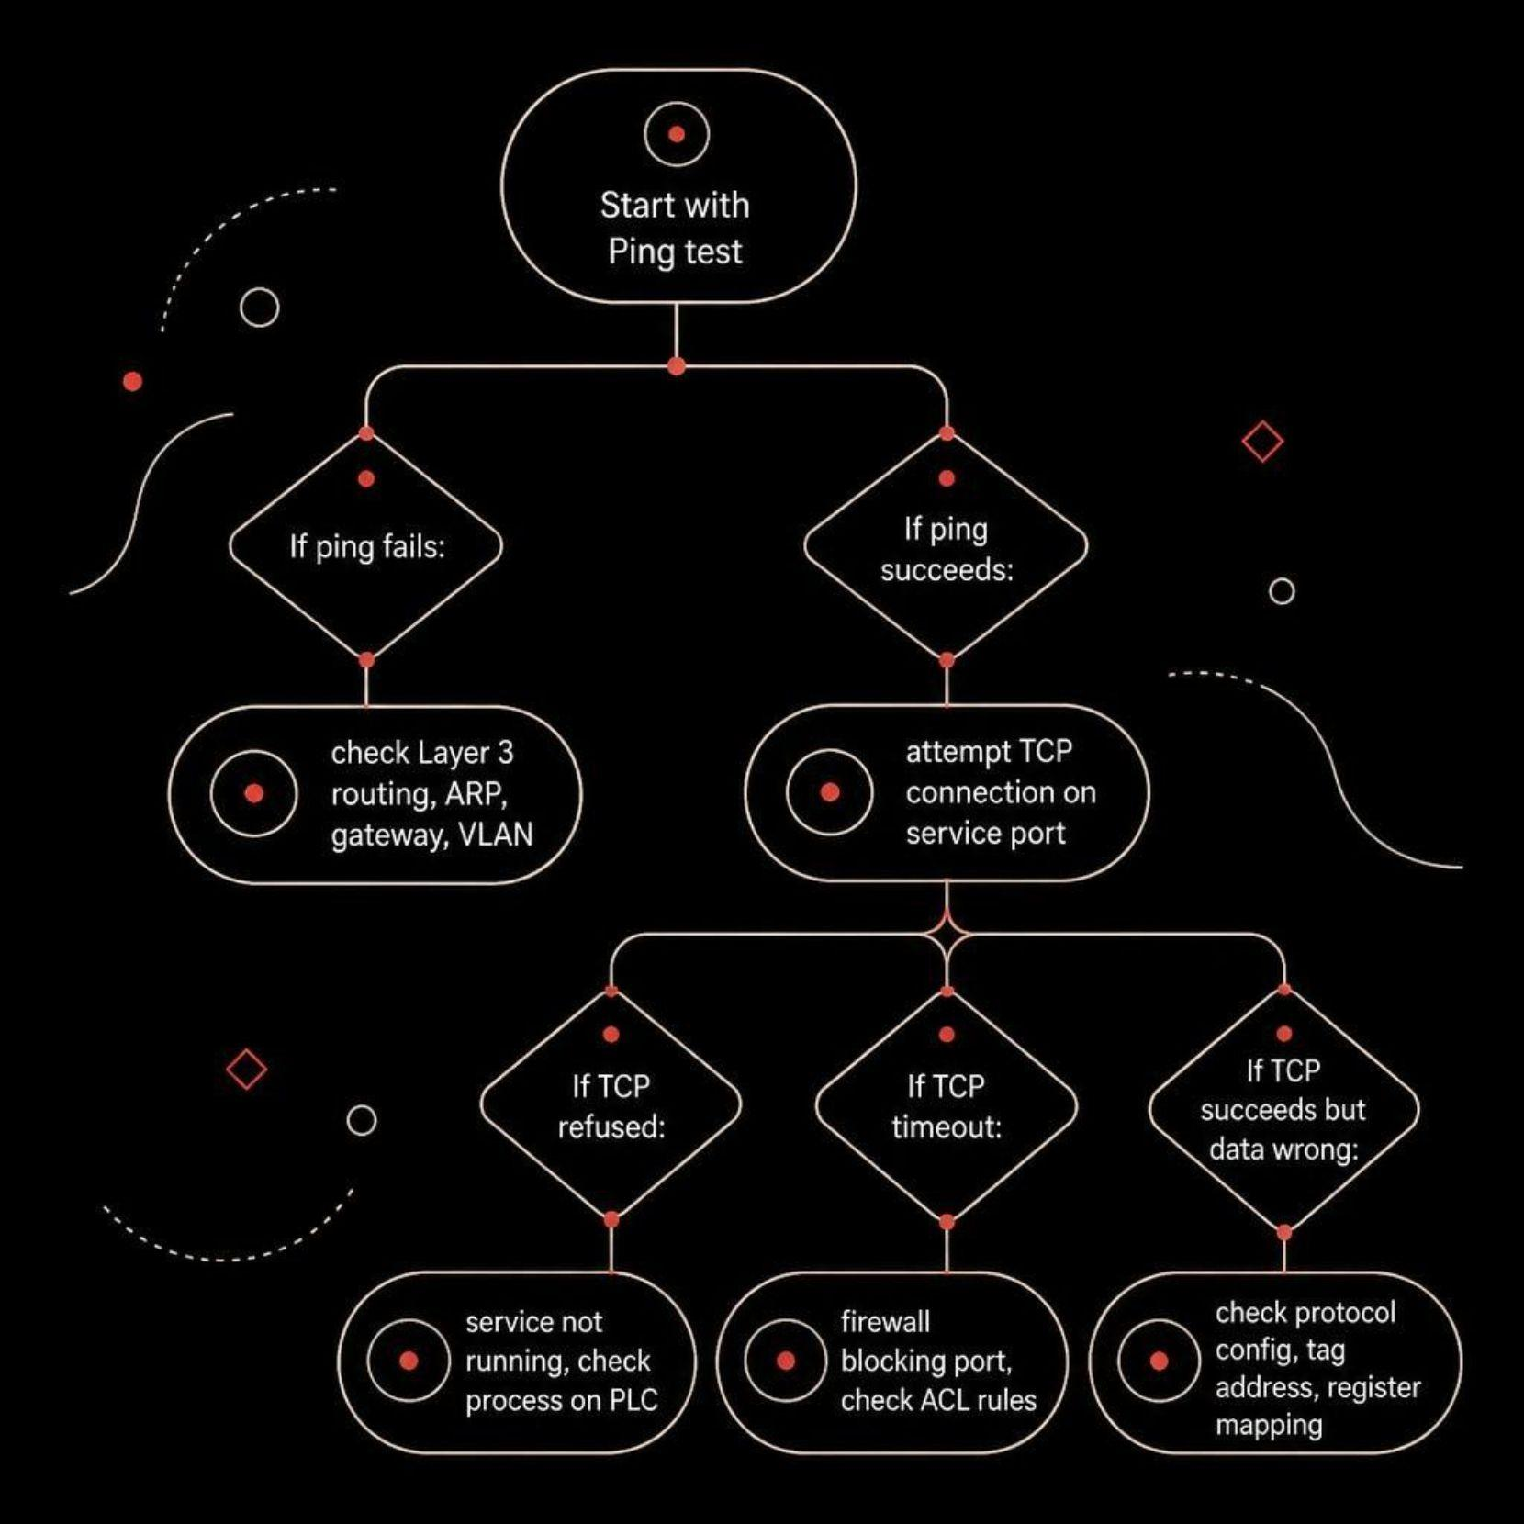
Diagnostic Workflow: Ping Succeeds, TCP Fails
This is the most common scenario in SCADA troubleshooting: the network path is clear, but the application layer is blocked. Don't stop at ping.
What each result tells you
Ping succeeds → Layer 3 (IP routing) is fully functional
TCP connection refused → No service is listening on that port
TCP connection timeout → Firewall is silently dropping the SYN packet
Next Steps
Check firewall ACLs — is port 502 (or 4840) explicitly permitted?
Verify the service is running on the PLC or server
Use telnet <ip> <port> or nc -zv to test port reachability directly

Slide 10
VLANs: Logical Segmentation on Shared Infrastructure
Typical SCADA VLAN Layout
The Silent Killer: VLAN Misconfiguration
VLAN | Segment | Typical Hosts
VLAN 10 | Control | PLCs, RTUs, sensors
VLAN 20 | HMI / SCADA | Operator workstations
VLAN 30 | Servers | Historian, application servers
A device can be physically connected and show a link light while being logically isolated on the wrong VLAN — unable to reach any of its intended services.
Segmentation creates security boundaries; routing and firewalls decide what may cross them
Always verify switch port VLAN membership when a device "appears connected but can't reach anything"
Inter-VLAN traffic requires an explicit routing policy — never assume it flows freely

Slide 11
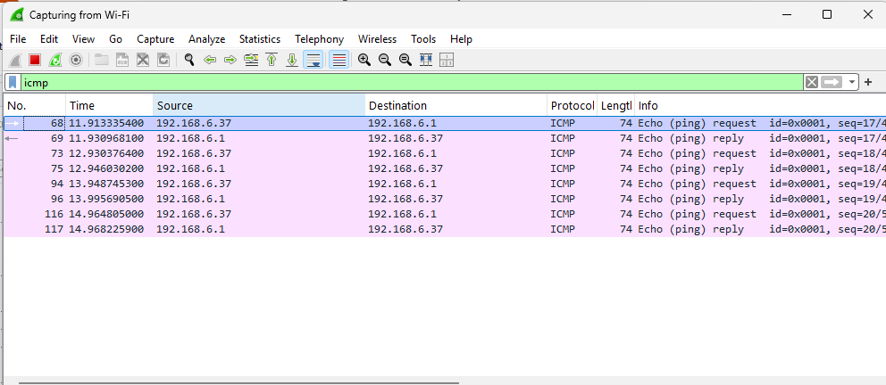
Wireshark: Making Invisible Packets Visible
Wireshark reveals what the network actually sees — not what you believe it should see. It is the ground truth tool for SCADA network diagnostics.
Inspect Each Layer
Ethernet — Source and destination MAC addresses; confirm ARP resolution
IP — Verify correct source/destination IPs; catch routing errors
TCP/UDP — Confirm expected ports; spot retransmissions and resets
Application — Validate Modbus function codes, OPC UA handshakes, protocol responses
What to Look For
TCP RST packets — connection actively refused
SYN with no SYN-ACK — firewall silently dropping
Excessive retransmissions — packet loss or congestion
Malformed protocol frames — misconfigured driver or firmware bug

Slide 12
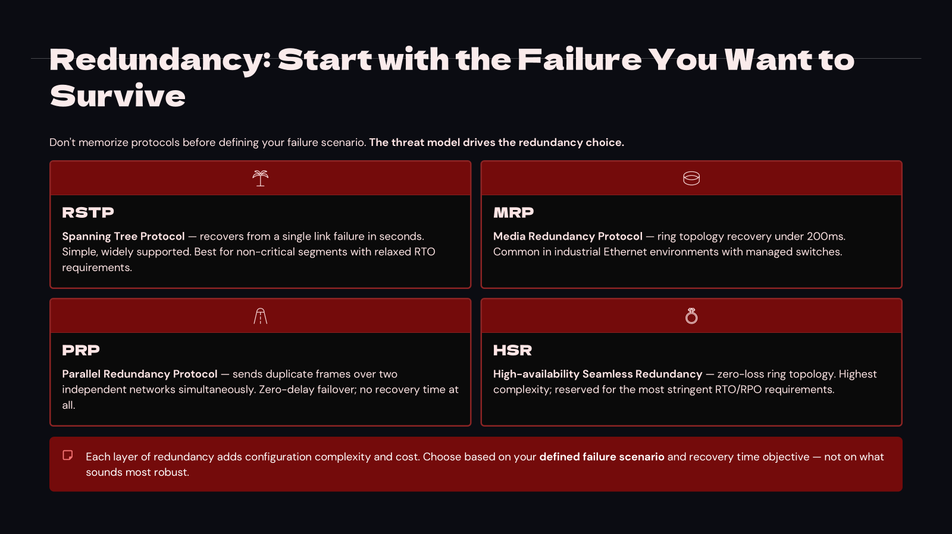

Slide 13
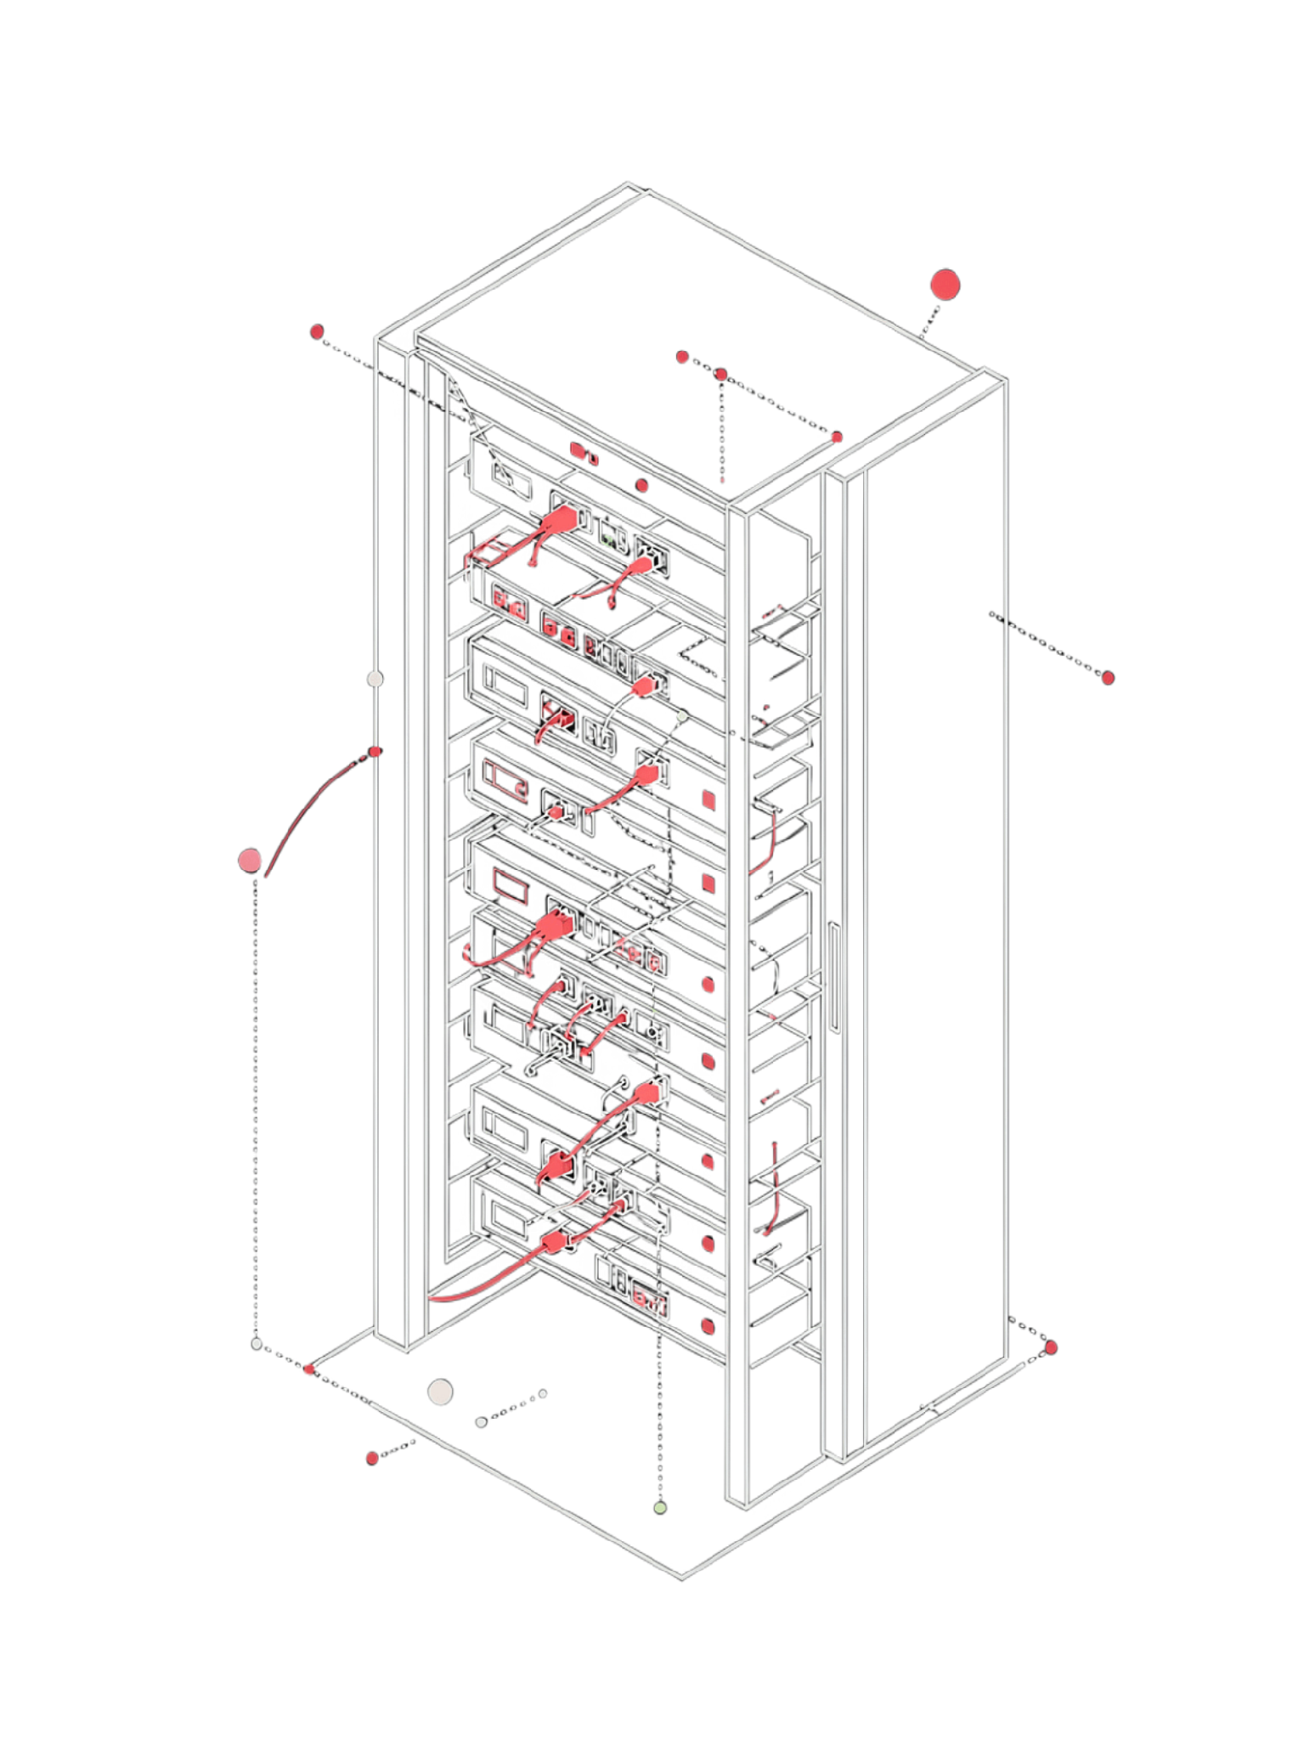
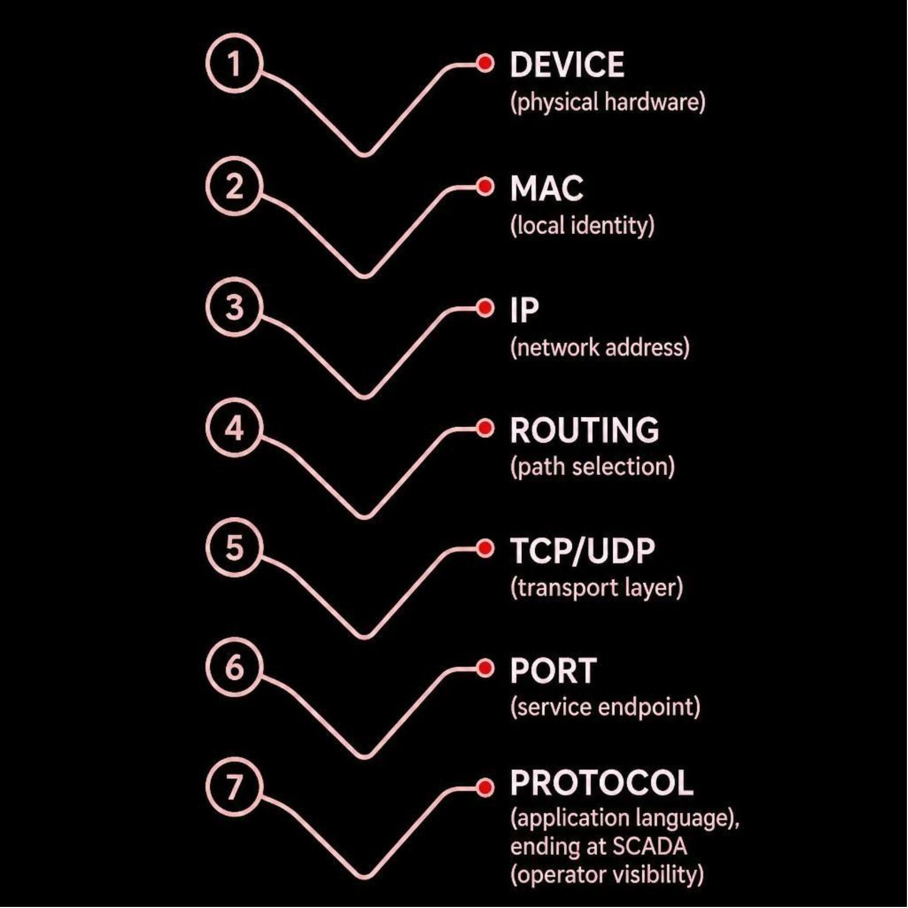
TAKEAWAY
You Don't Need to Memorize Networking. Follow the Data.
Questions?

