Slide 2

INTERNAL INCIDENT REPORT
The PLC is Healthy. SCADA is Healthy. So Why Can't We See the Data?
Bearing Temperature Sensor = 78°C · SCADA displays: COMMUNICATION FAILURE
WHERE DID THE COMMUNICATION BREAK?

Slide 3




STEP 1 — THE FOUNDATION
Before Networking: What Does One Device Need to Talk to Another?
Our PLC has a value — Temperature = 78°C. To deliver it, four questions must be answered:
WHO?
WHERE?
Device identity — MAC address on the local segment
IP address — logical location on the network
WHICH SERVICE?
HOW?
Port number — the specific application listening
Protocol — the language both sides understand

Slide 4
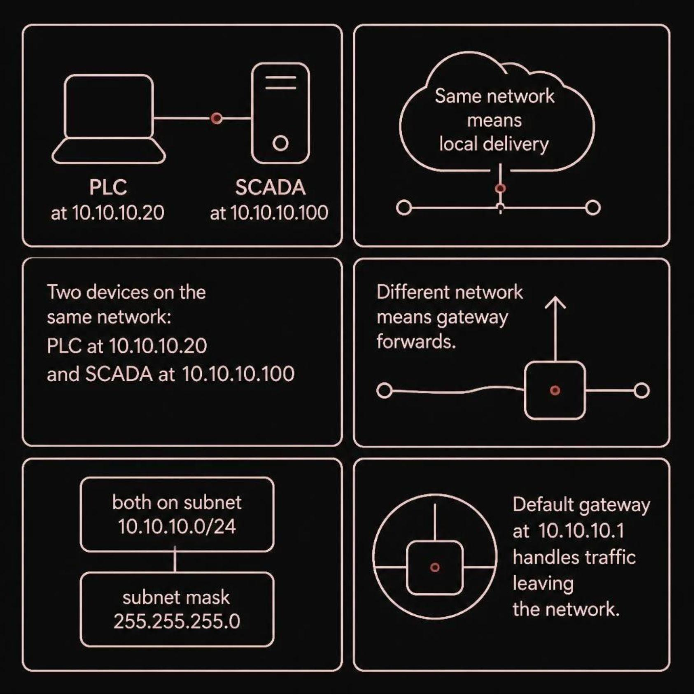
STEP 2 — ADDRESSING
An IP Address Is More Than Just a Number
Four Numbers. One Delivery Path.
IP Address — logical identity on the network
Subnet Mask — defines what's "local"
Network — shared segment = direct delivery
Default Gateway — exits the local network
Our PLC (10.10.10.20) and SCADA (10.10.10.100) share the same subnet — delivery should be direct.

Slide 5
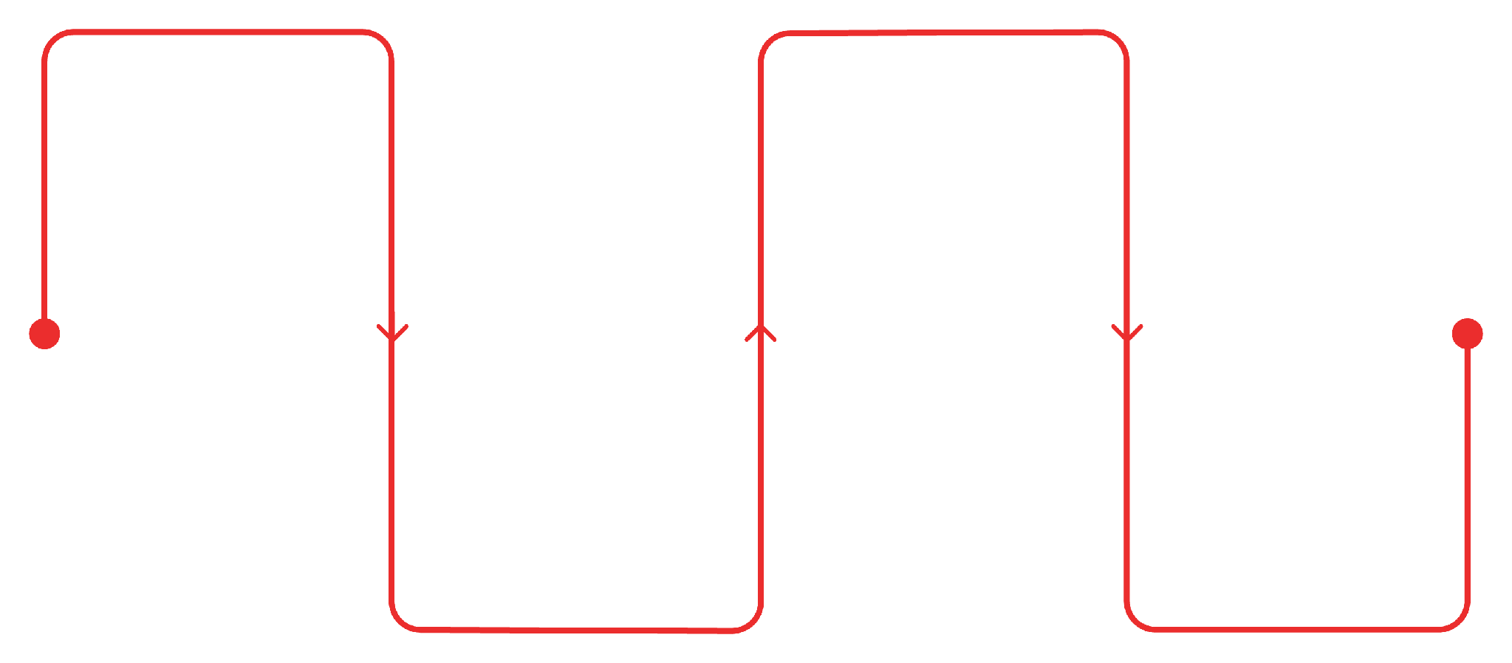
STEP 3 — INFRASTRUCTURE
Who Moves the Data?
Three devices stand between our PLC and SCADA. Each makes a decision — not a dictionary definition.
Switch
Firewall
Reads MAC, forwards within LAN
Inspects traffic, allows or blocks
Router
SCADA
Reads IP, connects networks, selects path
Receives data from the network
Each device either passes the data through — or stops it cold.

Slide 6
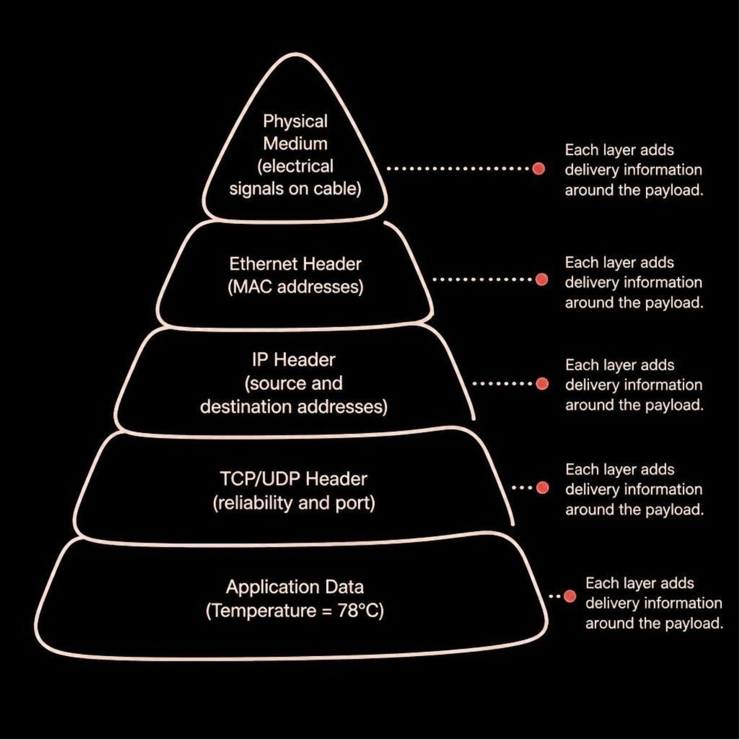
STEP 4 — ENCAPSULATION
78°C Doesn't Travel Alone
The Payload Never Changes
Temperature = 78°C sits at the core. Every layer wraps delivery instructions around it.
At the destination, layers are stripped in reverse. The value arrives intact — if every layer did its job.

Slide 7
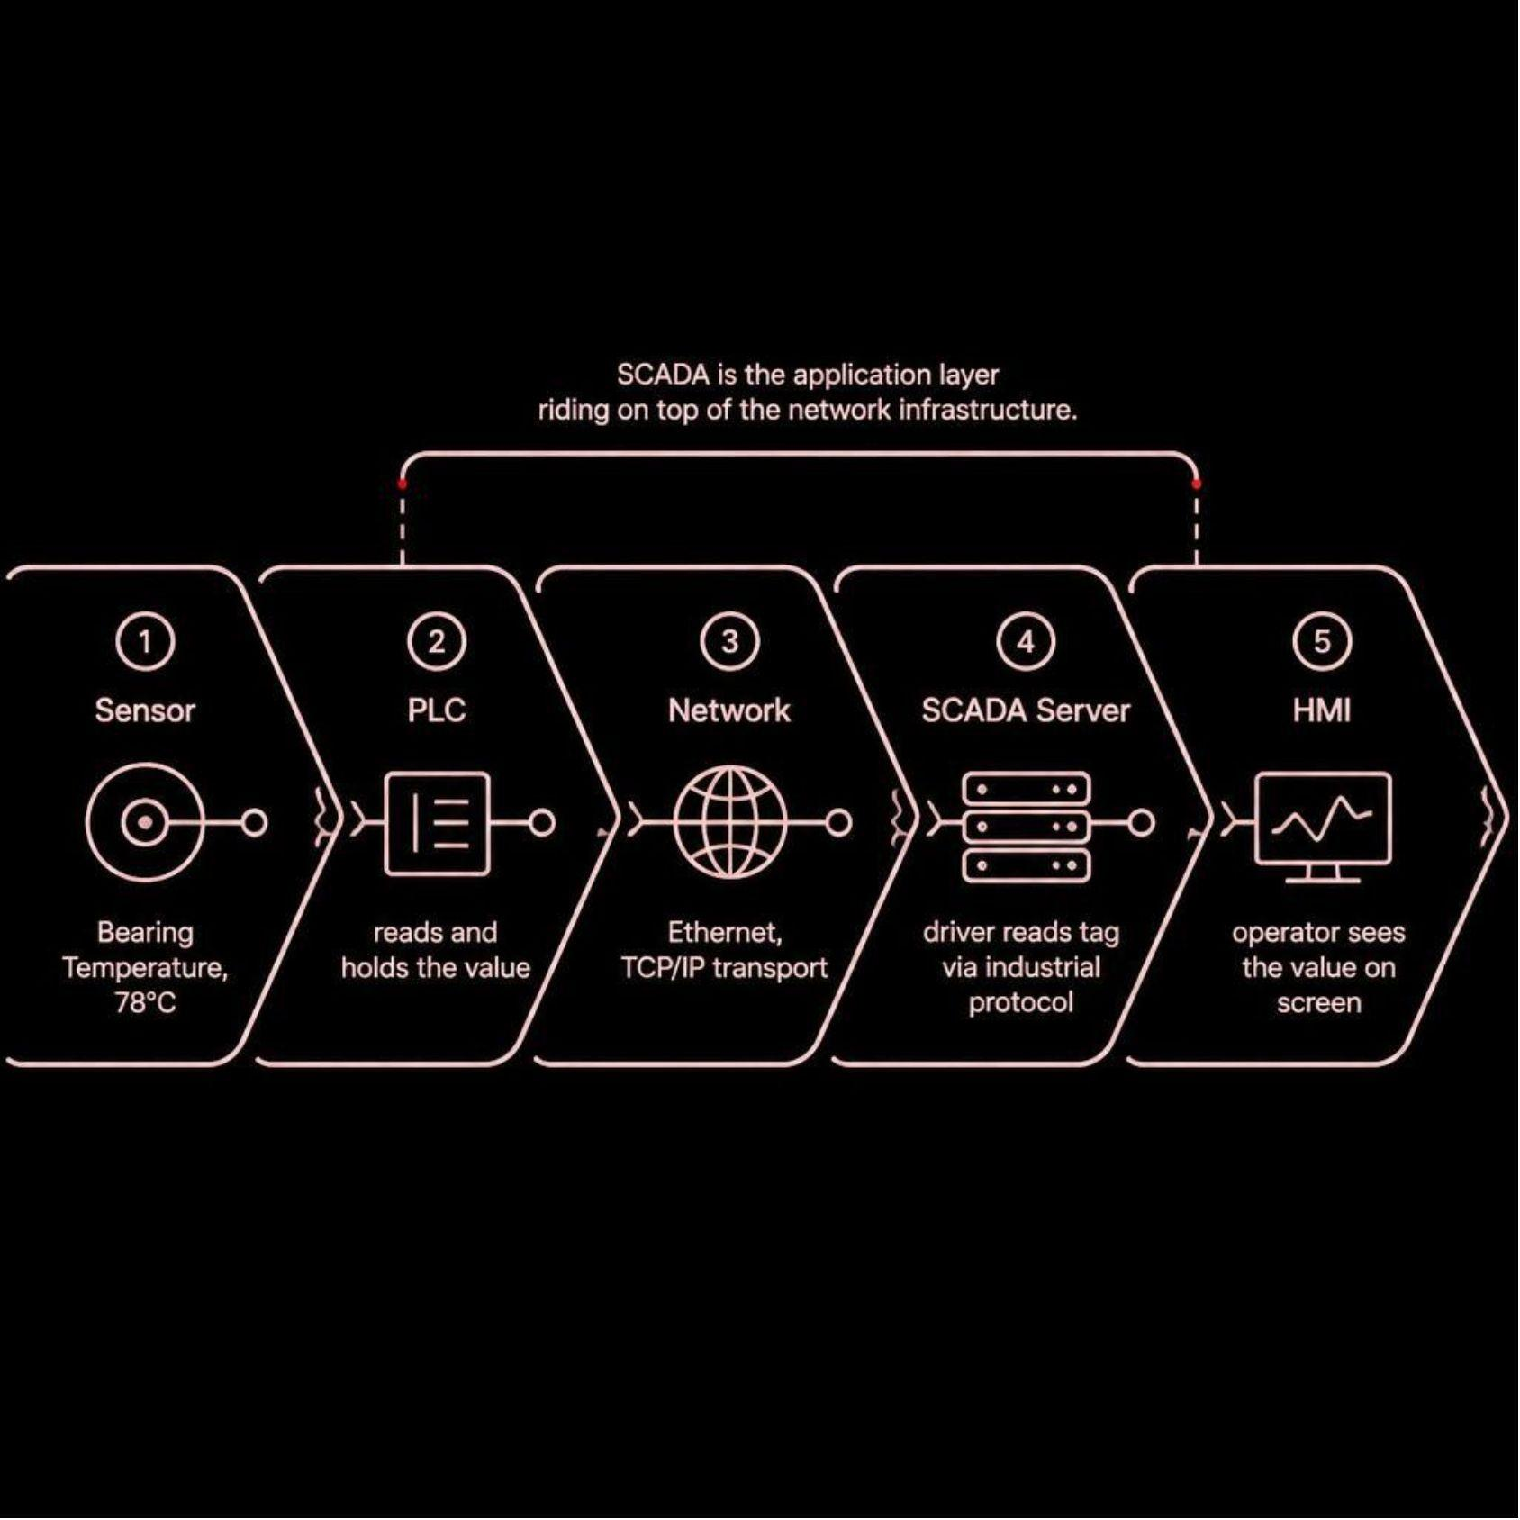
STEP 5 — ARCHITECTURE
So Where Does SCADA Actually Fit?
SCADA Is an Application — Not the Network
SCADA uses the network. It doesn't replace it. A failure anywhere upstream — sensor, PLC, switch, firewall — breaks the chain.
Sensor → PLC → Protocol → TCP/IP → SCADA Driver → Tag → HMI

Slide 8
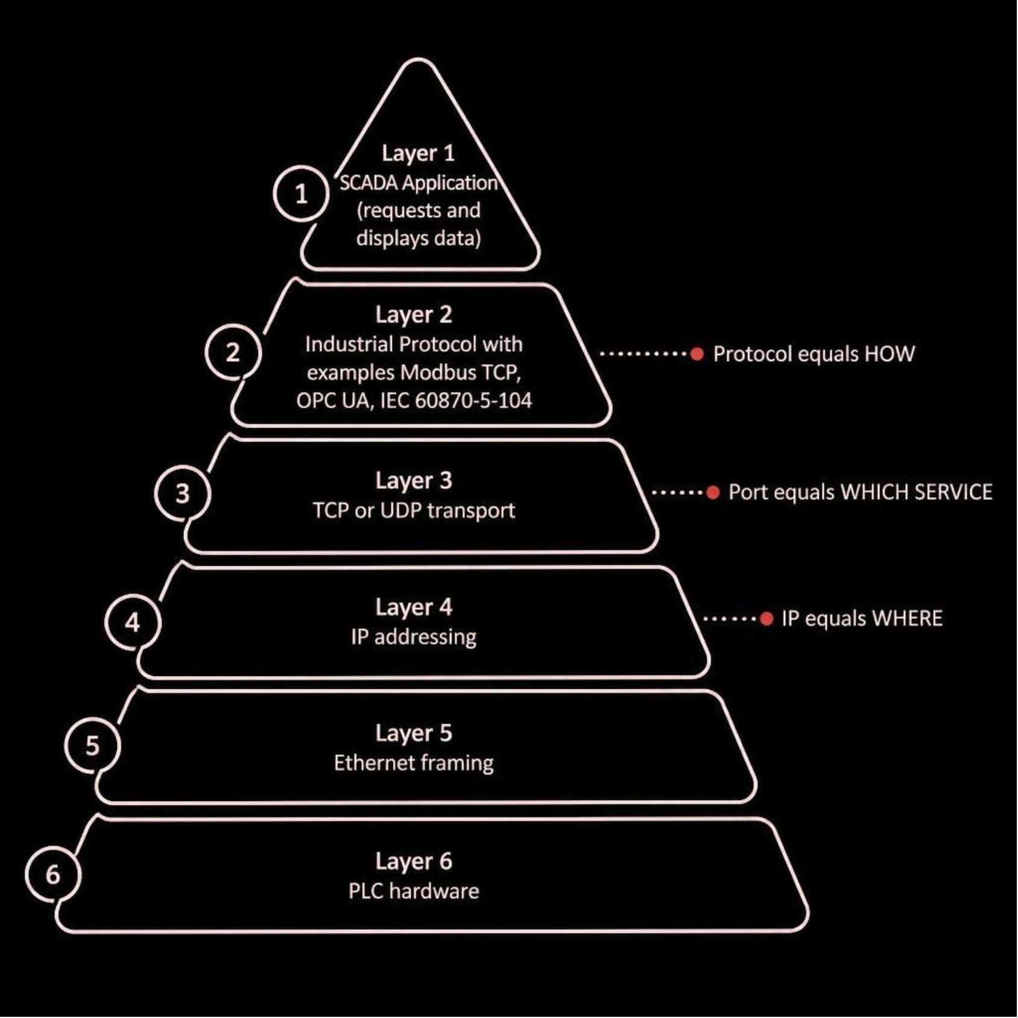
STEP 6 — PROTOCOLS
Networking Gives Us the Road. Protocol Gives Us the Language.
Three Layers. Three Jobs.
IP → Where is the device?
Port → Which service is listening?
Protocol → How does the application communicate?
All three must align. One mismatch — and SCADA sees nothing.

Slide 9

INVESTIGATION
Let's Follow One Piece of Data
Trace 78°C from sensor to screen. At which point could it disappear?
01
02
Temperature Sensor
PLC
Reads 78°C
Holds value in register
03
04
Industrial Protocol
TCP / IP Stack
Modbus TCP / OPC UA
Encapsulates packet
05
06
Switch → Router → Firewall
SCADA Driver → Tag → HMI
Forwards or blocks
Displays value
One failure anywhere in this chain — and 78°C never reaches the operator.

Slide 10
INCIDENT RESPONSE
SCADA Says Communication Failure — Where Would You Look?
✅ PLC Running
✅ Switch Link
✅ Ping to PLC
Operational
Port active
Reply received
🔴 SCADA Tag
🔴 TCP Service Test
Frozen
Connection refused
Ping succeeds. TCP fails. Network path is clear — but the service isn't reachable. What do you investigate next?

Slide 11
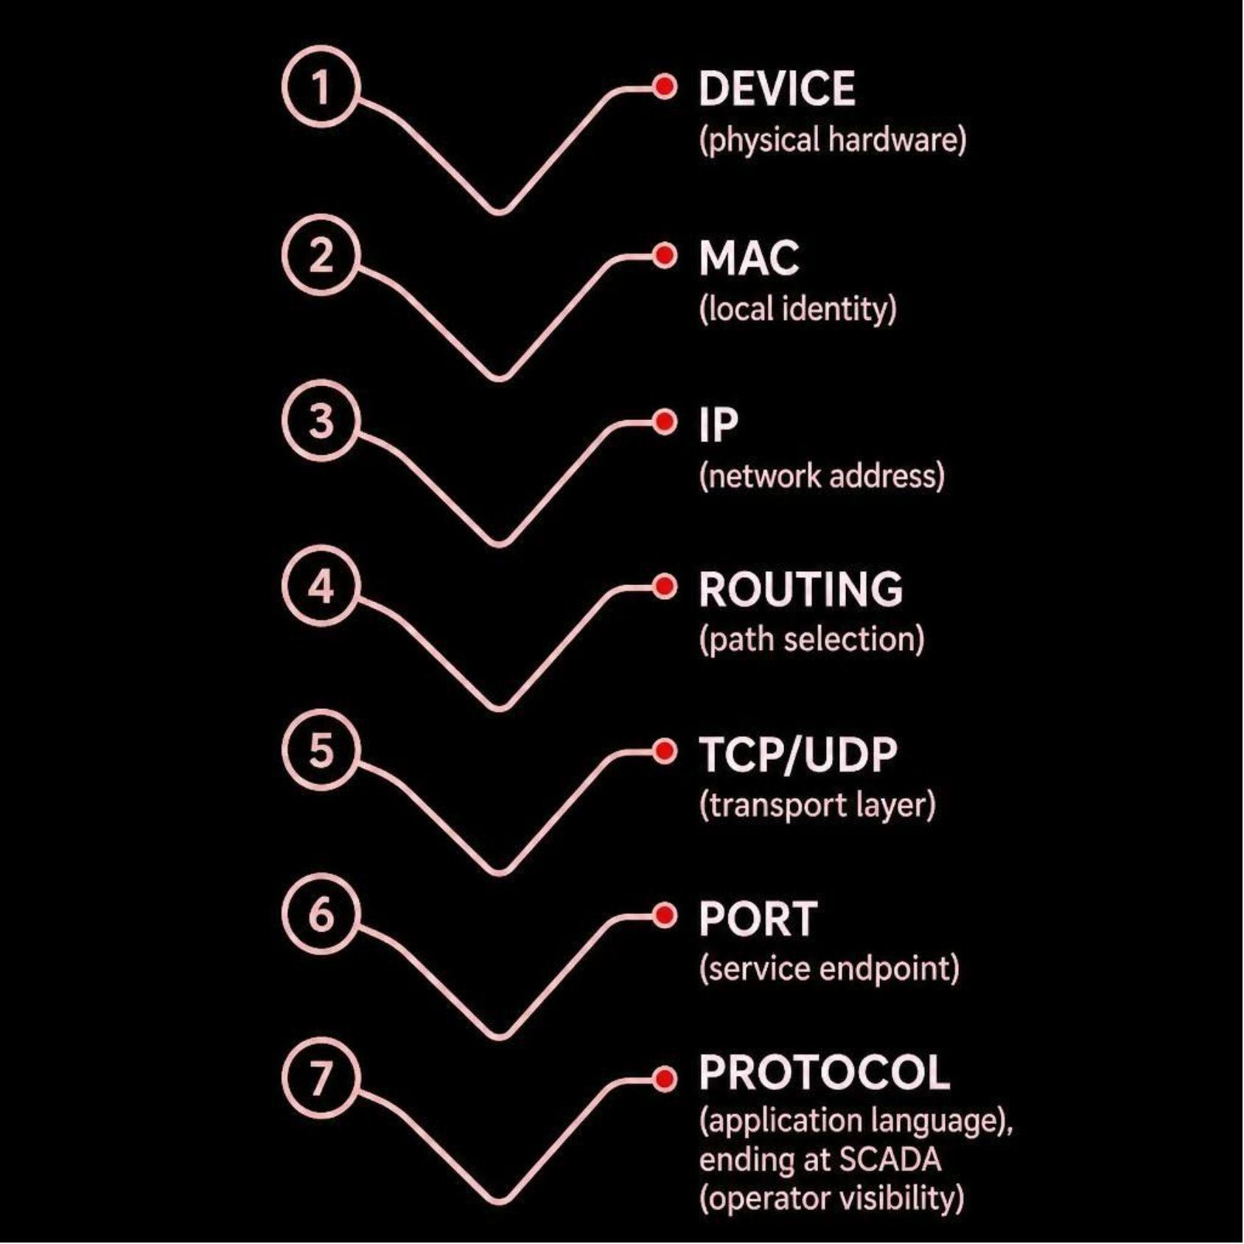
TAKEAWAY
You Don't Need to Memorize Networking. Follow the Data.
When SCADA says 'Communication Failure' — don't guess. Follow the data path.
Every concept in this session maps to one real question: where is my data right now?
Questions?

