Slide 1
Enhancing Web Analytics with AI
Exploration of Sentiment Analysis, Keyword Extraction, and Text Summarization
Jasneet Singh

Slide 2
Introduction
Overview: Introduction to AI in web analytics.
Purpose: Focus on sentiment analysis, and text summarization.
Scope: To enhance understanding of user interactions on websites.

Slide 3
Project Components Overview
Sentiment Analysis: Using BERT models to gauge the emotional tone from texts extracted from websites or PDFs.
Text Summarization: Leveraging summarization pipelines to condense large volumes of text into concise summaries.
Streamlit API: Creating a UI to handle all the inputs in url or pdf form

Slide 4
Tool 1: Sentiment Analysis
How It Works: Utilizes Bert For SequenceClassification for sentiment classification.
Practical Use: Customer feedback analysis, social media monitoring.

Slide 5
Tool 2: Text Summarization
Function: Employs summarization pipeline for concise summaries.
Application: Quick information digestion from long texts like user reviews.

Slide 6
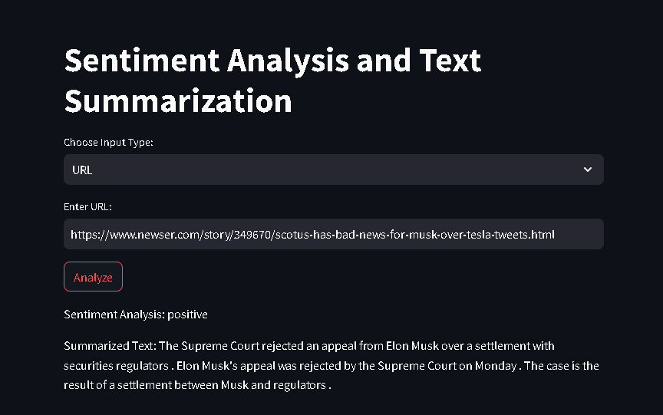

Slide 7
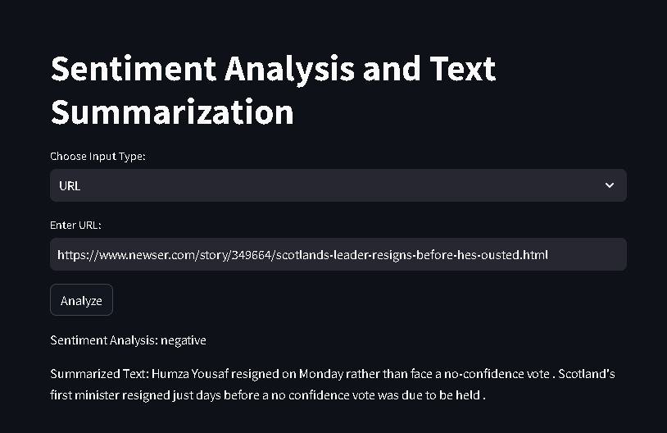

Slide 8
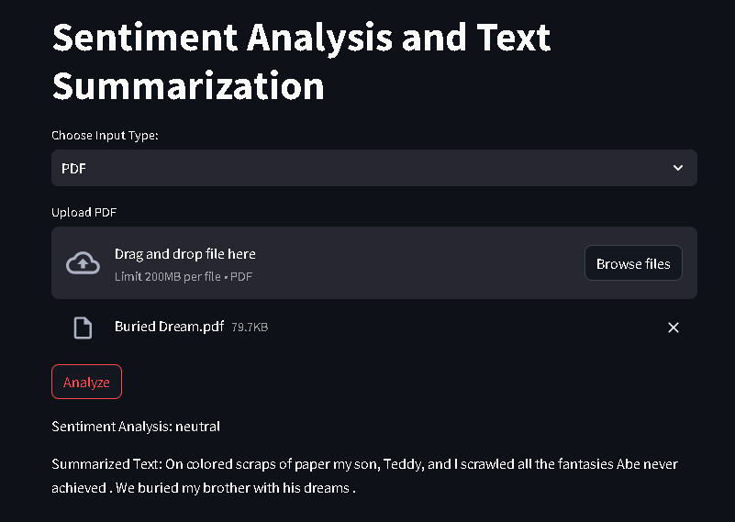

Slide 9
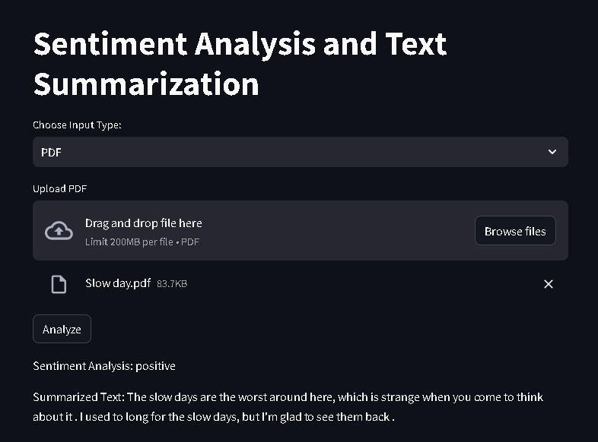

Slide 10
Case Study: Application of AI Tools
Review analysis on an e-commerce site.
Outcomes: Improved content strategy and user experience.

Slide 11
Challenges and Solutions
Challenges in Implementation: Data privacy, large data handling.
Solutions: Privacy-by-design, scalable processing infrastructures.

Slide 12
Future Enhancements
Advancements: Advanced emotional analysis for deeper sentiment insights.
Impact on Web Analytics: Multi-language support for global applicability.

Slide 13
Conclusion
Recap: AI tools provide comprehensive insights into user behavior.
Benefits: Enhanced user engagement and tailored content strategies.

