Slide 1
Capitol Collaboration Scenario 3a
Digital Communication WS17/18
Abed Naseri Douraki
Jaswanth Moturi
Pooya Oladazimi
Redona Kajmaku
Rinku Kanti Chowdhury
Shreya Chatterjee

Slide 2
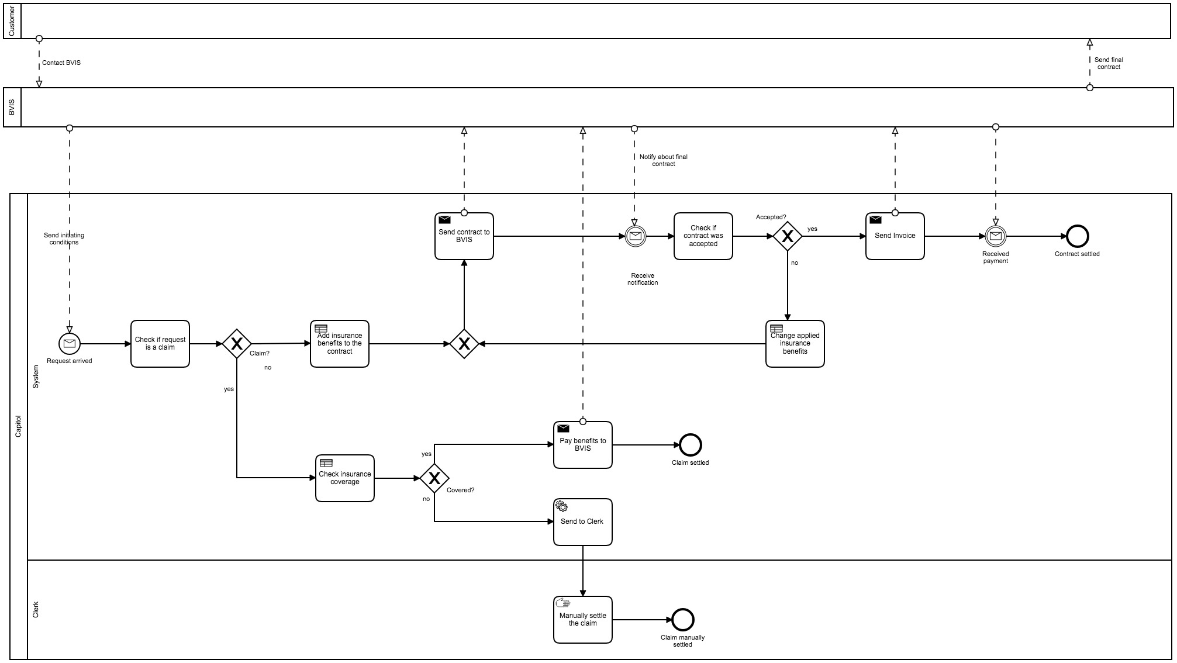
First Process Model

Slide 3
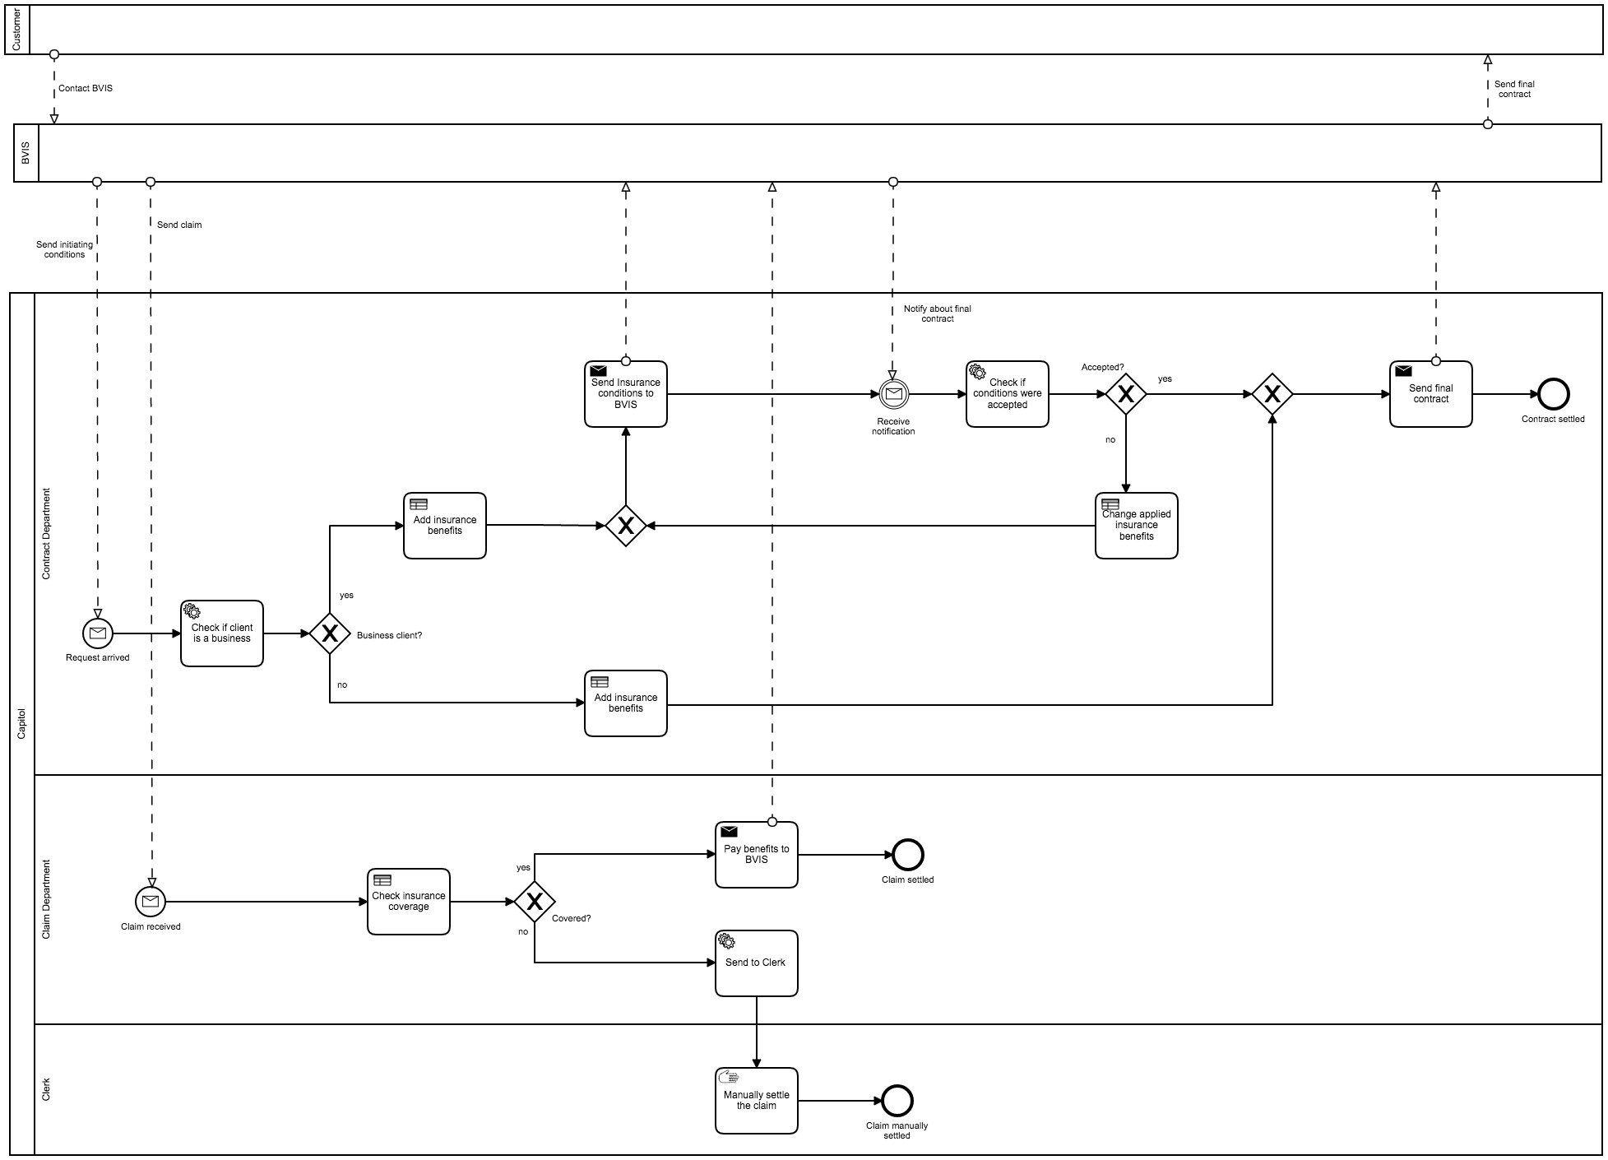
Second process model

Slide 4
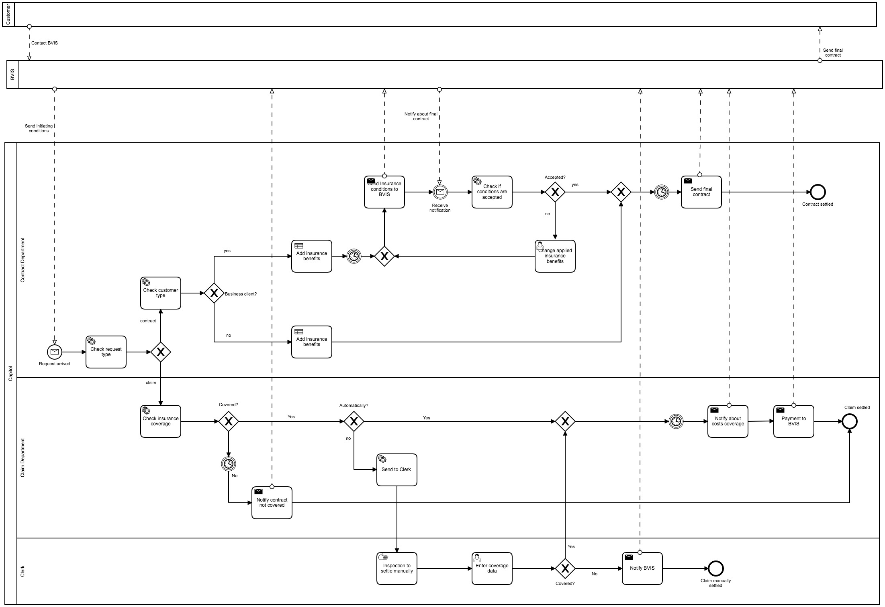
Final process model

Slide 5
The Contract
Changed mostly from the first to the second model

Slide 6
First Model
Second Model

Slide 7
Second Model
Final Model

Slide 8
The claim process
Changed mostly during the implementation process

Slide 9

First Model
Second Model

Slide 10
Second Model
Final Model

Slide 11
What changed?
Defined type for every task
Incoming start message
Differencing between business and private clients
Invoicing for applying benefits to the contract
New tasks to notify about costs coverage in liability cases
Returning in the system after manual task
Modified business rule tasks
Redefinition of swim lanes
Timing tasks

Slide 12
Technical Issues Faced
Protocol issues when setting up the server
Configuring the database
Synchronization of send-receive message with BVIS
Outdated and not informative resources in Camunda community

Slide 13
Last Model
First Model

Slide 14
From the start to the final process it was a process itself
Today
Start of the project

