Slide 1

Customer Relationship Management PowerPoint Slides
This slide is 100% editable. Adapt it to your needs and capture your audience's attention.
SCM management processes
Supplier and interfaces
Customer relationship management
01
02
10
Return and rework
03
Customer service
09
04
New product development and commercialization
08
Demand forecasting
07
05
Manufacturing flow and scheduling
06
Inventory control
Order fulfillment

Slide 2
Instructions To Edit This Slide
This slide has been made in PowerPoint using basic PowerPoint shapes, and all graphics are 100% editable in PowerPoint.
You can change color, size and orientation of any element to your liking, and add/edit any piece of text anywhere.

Slide 3
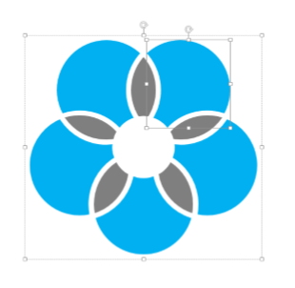
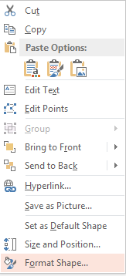
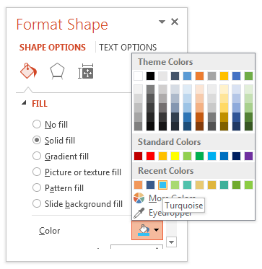
Resize Any Shape And Edit Color
The entire slide has been made in PowerPoint itself, and you can edit the color of any component in this graphic. To change the color, just right click the object to highlight it, and then follow instructions -
1
2
3
Right click on the object or shape that you want to change the color of.
Choose Format Shape in the dialog box.
Choose “Fill” in the Format Shape box then “Solid” or “Gradient” depending on the appearance of the object. Change colour as shown in the picture.

Slide 4
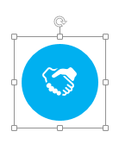
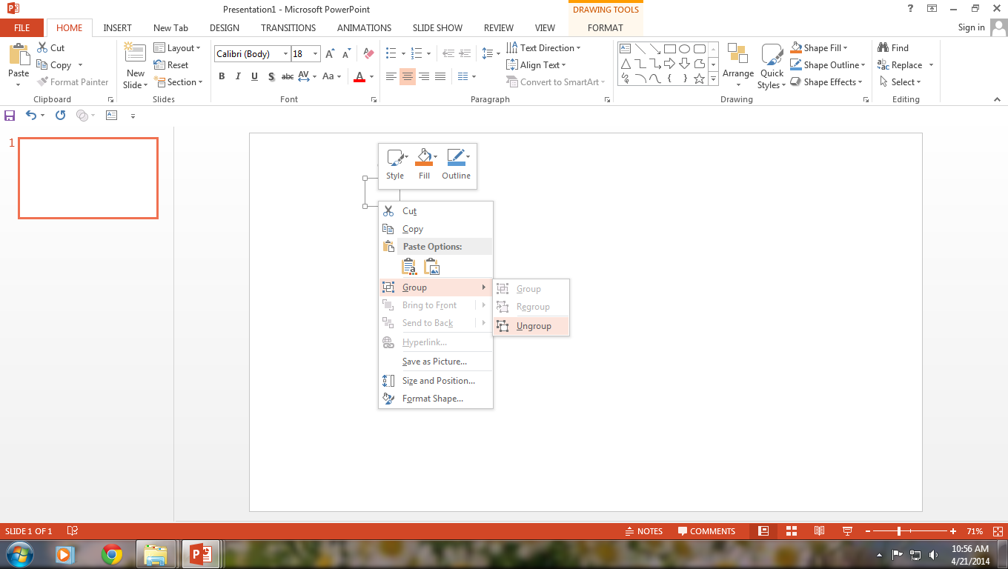

Use Your Own Icons In Any Slide
You can replace the icons in this slide with any icons you like from our site, or completely remove them if required -
1
2
3
The icons we have shown are just for demo purposes. You can replace these icons with the correct icons to suit your message. We have a large collection of icons to choose from.
To replace any icon, double click on it and select it, and then right click it to ungroup it.
Delete the icon and replace it with any icon or graphic from our site.

Slide 5
Select From Thousands Of Editable Icons On Every Topic
These icons are available at the Icons section on www.slideteam.net

Slide 6
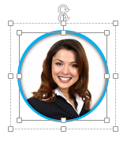
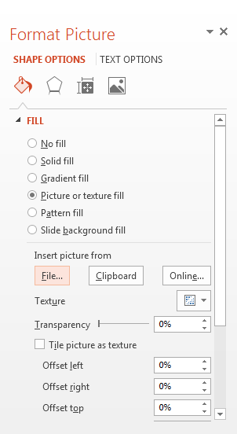
Replace Image In This Slide With Your Own
The image we have shown in this slide is for demo purposes only. You can replace this image with your own -
1
2
3

Slide 7
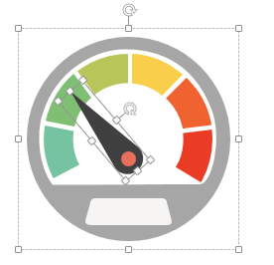
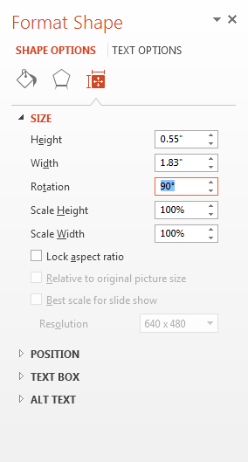
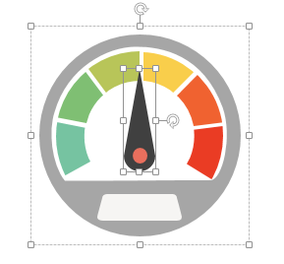
Change Orientation Of Any Graphic
You can change the angle of any graphic in this slide e.g. if the slide has a needle, or any other shape, you can just select it and change the angle to suit your requirement.
1
2
3
For example, you can select the Dashboard Needle by double clicking on it, and then right click it once to highlight it.
Choose Format Shape in the dialog box.
Choose “Size” in the Format Shape box then “Rotation” and enter your preferred rotation angle. Once the angle is to your liking, adjust the position of the needle back to the centre. You can also just rotate it using the rotate icon on the top of the shape itself once it is highlighted.

