Slide 1

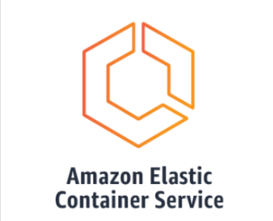
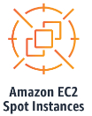
EC2 Spot Fleet Vs ECS Fargate
Build
Prepared By : Pratap R Padhy

Slide 2
Agenda
What is Spot Instances
Spot Instances: Pros and Cons
Jenkins Build using Spot Instance – Current State
What is AWS Fargate?
Fargate: Pros and Cons
Jenkins Build using ECS – Proposed
Price
Reference

Slide 3
What is Spot Instances
AWS has three tiers of EC2 instances. They are:
On-Demand Instances: This is generally the default option when you create an EC2 instance. Most of the time, when you see any EC2 pricing online, it refers to the On-Demand pricing. On-Demand instances are the most expensive because you have no commitment to AWS. You can terminate the instance at any time and only pay for how long you use the instance.
Reserved Instances (RIs): RIs are a billing construct instead of being an actual EC2 instance tier. RIs can be significantly (40-60%) cheaper than On-Demand instances. However, in return for the discount, you have to make a long term commitment (1-year or 3-year).
Spot Instances: AWS has a lot of spare compute capacity (unused EC2 instances) which they offer as Spot Instances. Spot Instances are generally the cheapest option (50%-80% lower than On-Demand) amongst the three. However, since Spot Instance availability is predicated upon the demand, Amazon provides no guarantee that once you get a Spot Instance you can run it indefinitely. This is the biggest difference between On-Demand and Spot Instances.

Slide 4
Spot Instances: Pros and Cons
Pro: Spot Instances are cheap:
Spot instances can be almost 90% cheaper than On-Demand prices and 30-60% cheaper than Reserved Instances. This can lead to significant savings when it comes to your EC2 infrastructure expenses.
Con: Spot Instances can get terminated:
AWS can terminate your Spot Instances with a 2-minute termination warning. This requires that the applications using Spot Instances need to fault-tolerant.
A lot of applications hesitate to use Spot Instances because using Spot Instances can end up make the application more unreliable.

Slide 5




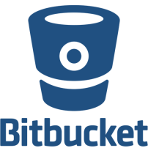

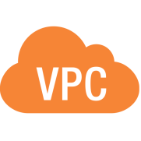
Jenkins Build using Spot Instance – Current State
Enterprise Non Prod
Build
NonProd
Build
Deployment Servers
QA
Build
Dev
Common Prod
Build
.
.
Note : The spot fleet run all time, never destroyed

Slide 6
What is AWS Fargate?
AWS Fargate is a technology that you can use with Amazon ECS to run containers without having to manage servers or clusters of Amazon EC2 instances. With Fargate, you no longer have to provision, configure, or scale clusters of virtual machines to run containers. This removes the need to choose server types, decide when to scale your clusters, or optimize cluster packing.
Fargate: Pros and Cons
Pro
Less Complexity
Better Security
Lower Costs
Simplicity
Better Security
Con
Less Customization
Limited Regions Available

Slide 7


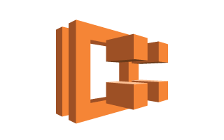


Jenkins Build using ECS – Proposed
Enterprise Non Prod
Build
NonProd
Start ECS task
Build
Deployment Servers
Create Jenkins
Slave ECS Task
ECS API
QA
Build
Fargate
Destroyed
Dev
Common Prod
Build
.
.
Note : Container will be destroyed after the build complete

Slide 8
Price :
EC2 Spot Fleet :
GP : t2.micro , 1 CPU
UNIX : $0.0035 per Hour (2.52 per Month)
Window : $0.0081 per Hour
Fargate :
Total vCPU charges = # of Tasks x # vCPUs x price per CPU-second x CPU duration per day (seconds) x # of days
Total vCPU charges = 5 x 1 x 0.000011244 x 18000 x 30 = $30.36 (Running daily 5Hrs)
EC2 Fleet | hr/$ | month/$
unix | 0.0035 | 2.52*29=73.08
window | 0.0081 | 5.8*29=168.2
Fargate |  | 30.36
Note : With the new strategies Farget will run per build ONLY, it will not run continuously.
Ref :
https://aws.amazon.com/ec2/spot/pricing/
https://aws.amazon.com/fargate/pricing/

Slide 9
Reference :
https://aws.amazon.com/blogs/compute/cost-optimize-your-jenkins-ci-cd-pipelines-using-ec2-spot-instances/
https://tomgregory.com/jenkins-jobs-in-aws-ecs-with-slave-agents/
https://plugins.jenkins.io/amazon-ecs/
https://aws.amazon.com/blogs/devops/building-a-serverless-jenkins-environment-on-aws-fargate/

