Slide 1
Retail Sales Analysis
Ravindra nath Rinku

Slide 2
Business Problem
1.Retail business facing:
Uneven sales performance
Customer retention issues
Delivery inefficiencies
2.Need for data-driven decisions

Slide 3
Objectives
Identify revenue drivers
Analyze customer behavior
Evaluate city & store performance
Improve operational efficiency

Slide 4
Dataset Overview
Customer: age, gender
Product: category
Sales: quantity, price, revenue
Location: city
Operations: store type, delivery status

Slide 5
Data Preparation
Removed missing values
Removed duplicates
Converted date format
Created revenue column

Slide 6
Exploratory Data Analysis
Category-wise revenue
City-wise performance
Revenue trends over time
Distribution of sales

Slide 7
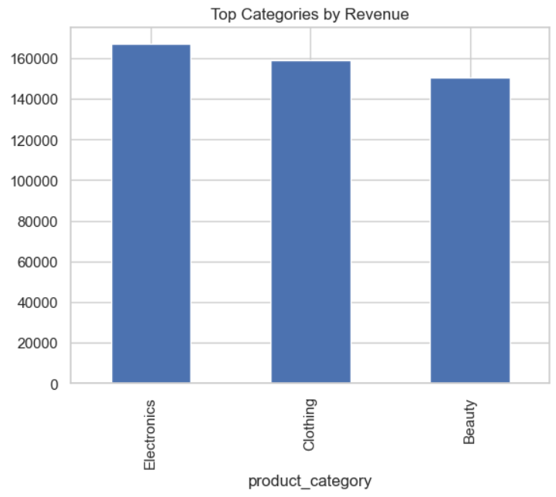
📊 Revenue by Category
Insight:
Few categories generate majority revenue

Slide 8
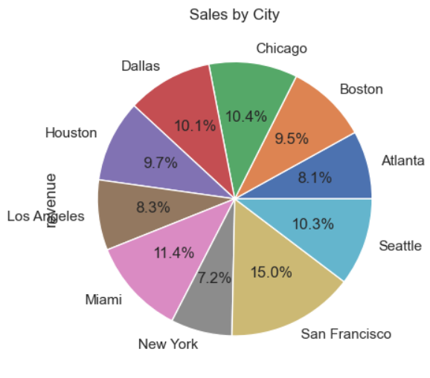
📊 Top Cities by Revenue
Insight:
Sales concentrated in key cities

Slide 9
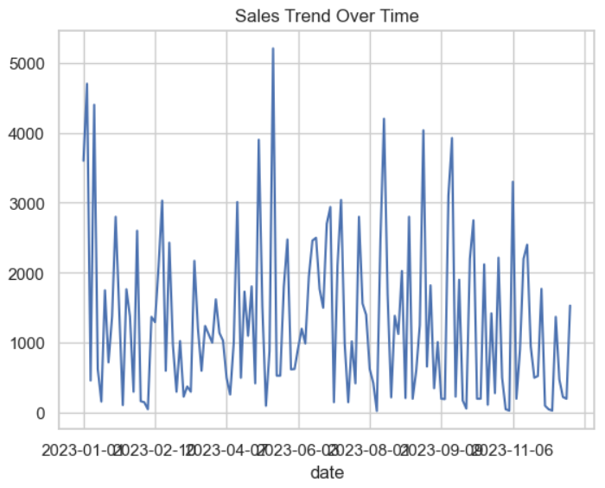
📊 Revenue Trend
Insight:
Shows fluctuations & seasonal trends

Slide 10
Advanced Analysis
Correlation (price vs quantity)
Customer segmentation
Hypothesis testing

Slide 11
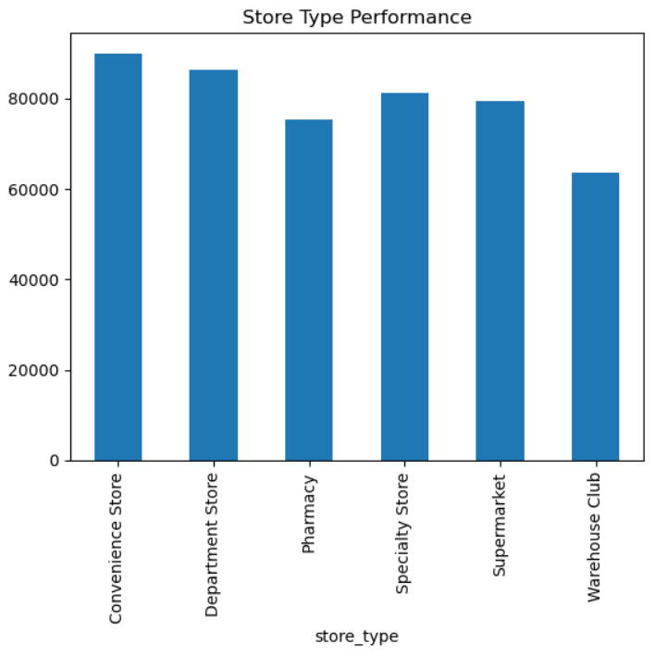
Store Type Performance

Slide 12
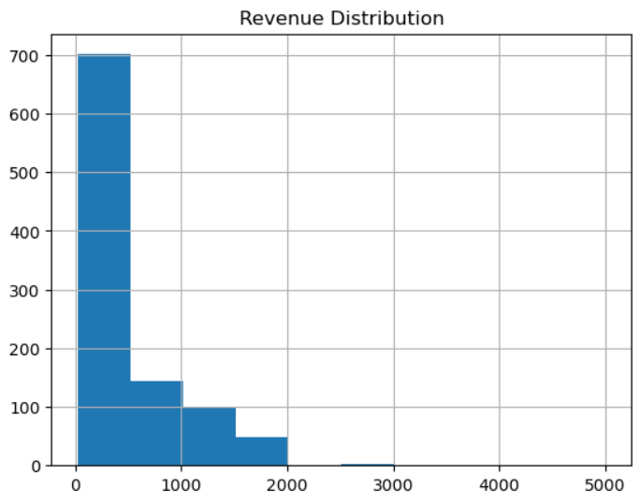
Revenue Distribution

Slide 13
Key Findings
High-value customers drive revenue
Few products dominate sales
Regional variation exists
Delivery impacts performance

Slide 14
Implementation Plan
Short-term: Improve delivery
Medium-term: Loyalty programs
Long-term: AI & expansion

Slide 15
Recommendations & Conclusion
Focus on top products
Target high-value customers
Improve delivery systems
Expand in high-performing cities

