Slide 1

A
MINOR PROJECT
ON
AWS EFS
SUBMIT BY :-
RINKU SHARMA
SUBMIT TO :-
ASHISH MITTAL SIR

Slide 2
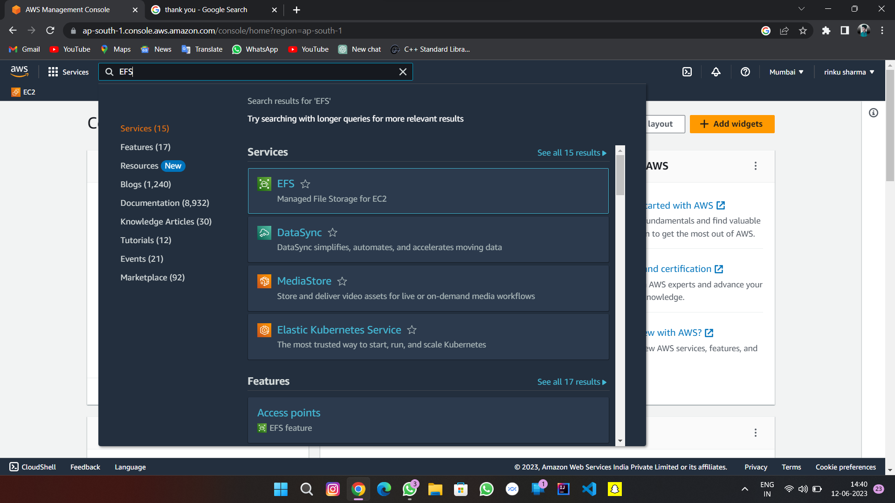

Slide 3
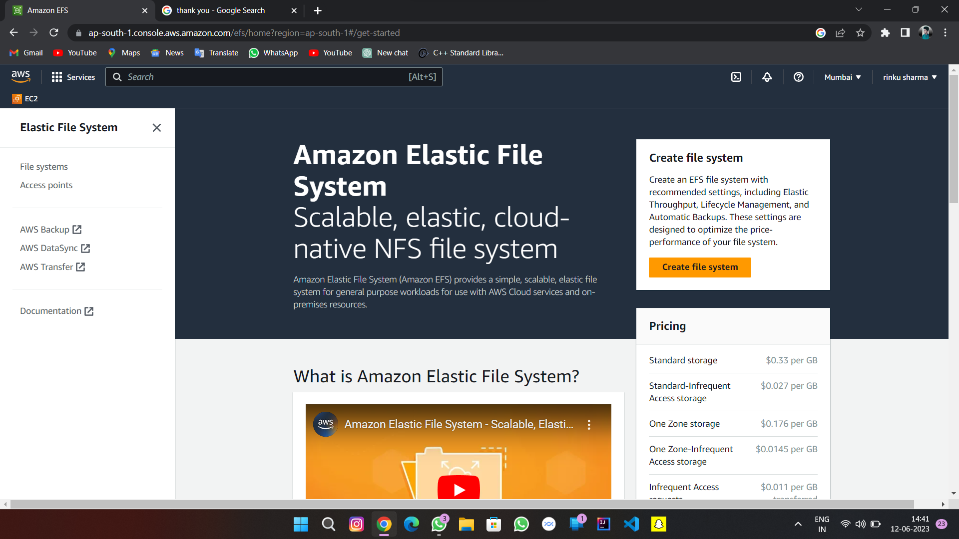

Slide 4
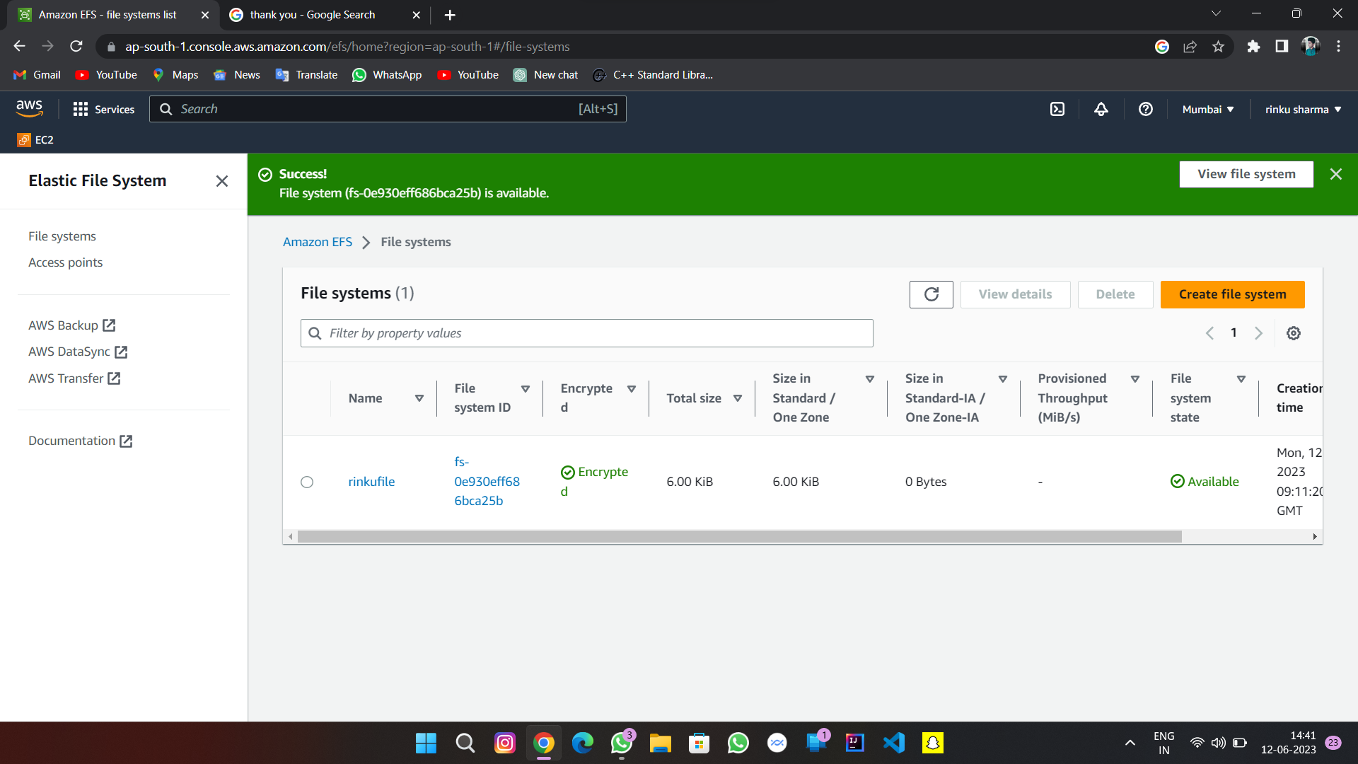

Slide 5
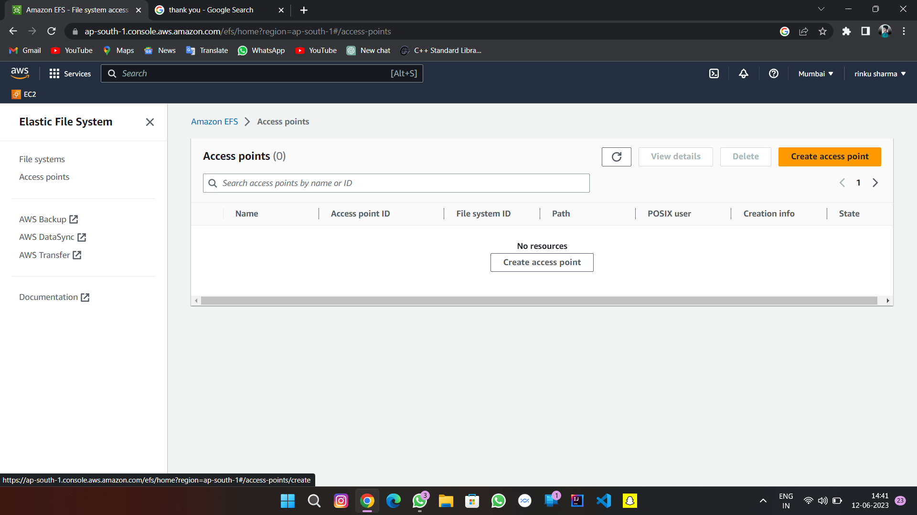

Slide 6
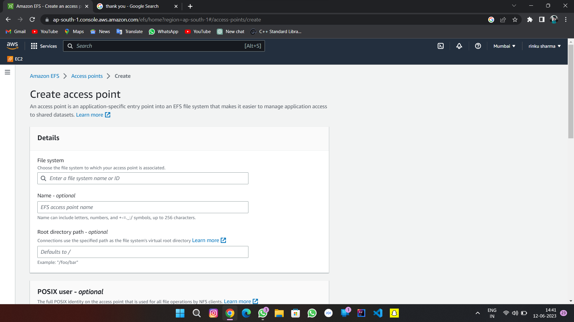

Slide 7
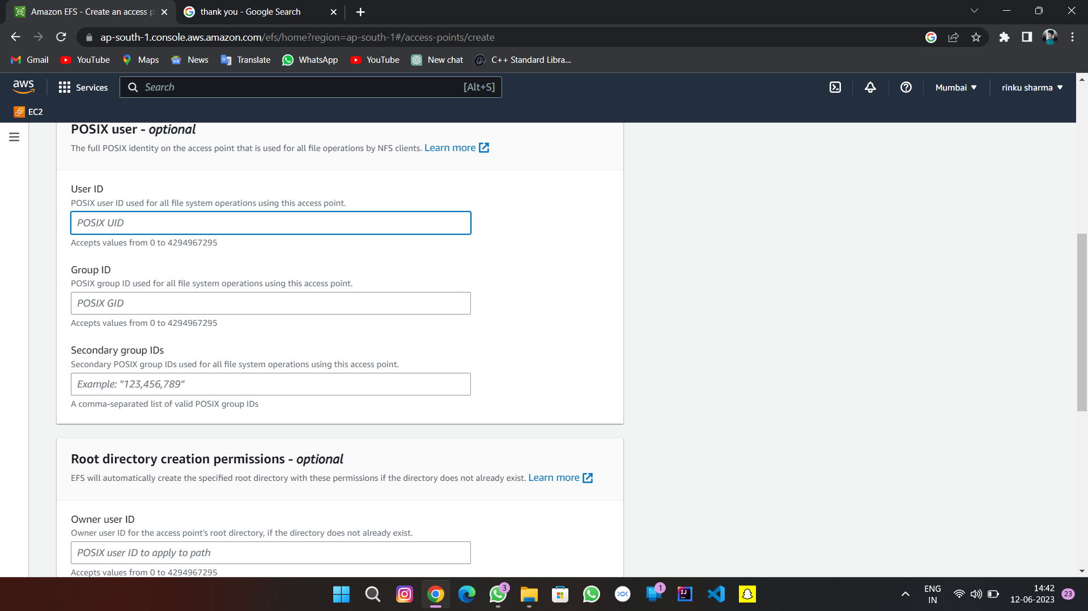

Slide 8
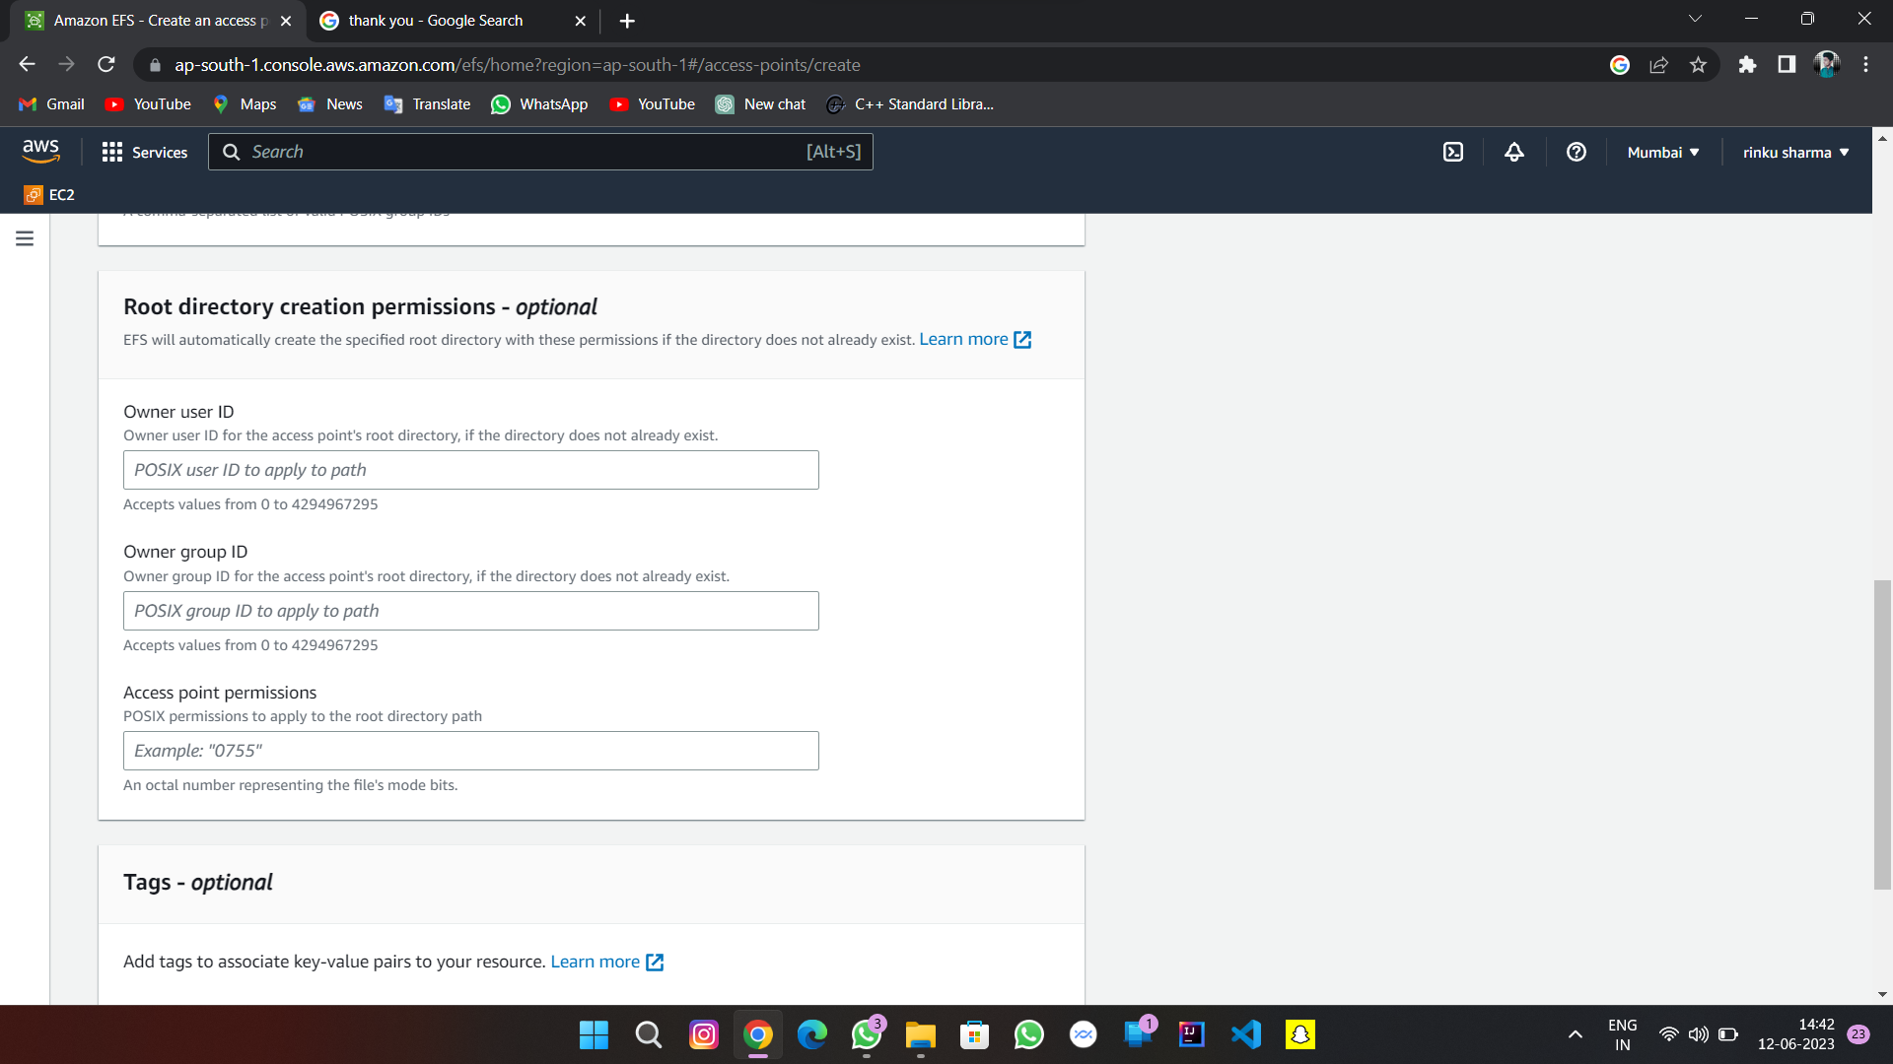

Slide 9
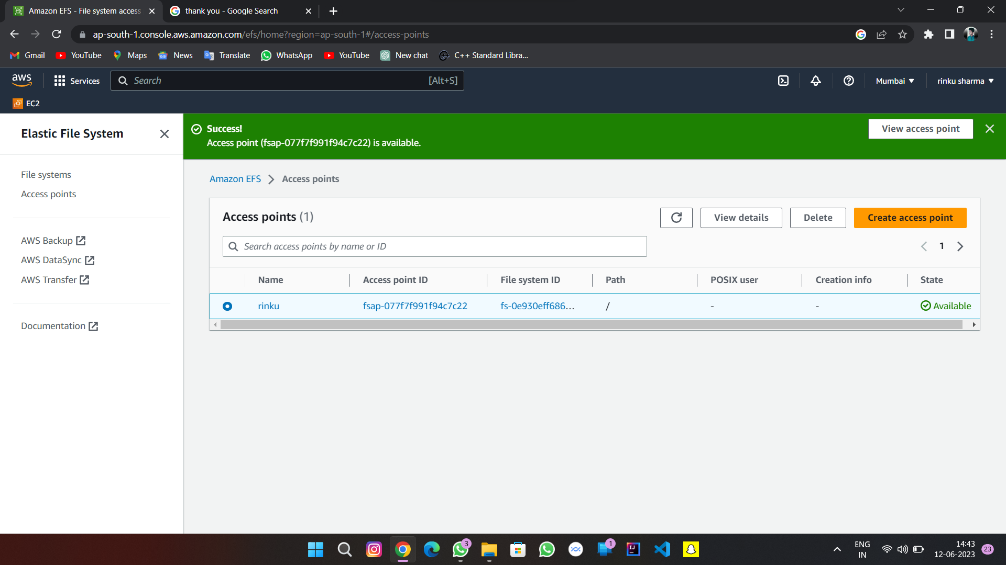

Slide 12


