Slide 1

A
PRESENTATION ON
ANSIBLE
“ping-playbook”
BY
RINKU SHARMA
TO
ASHISH MITTAL SIR

Slide 2
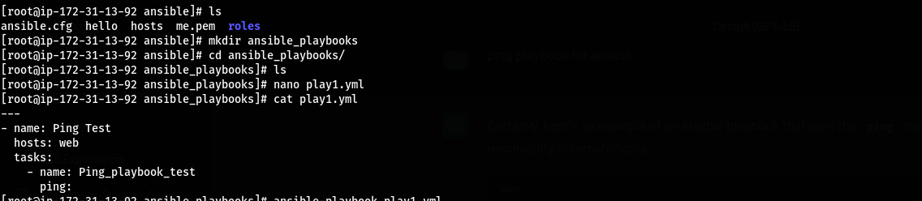

Slide 3
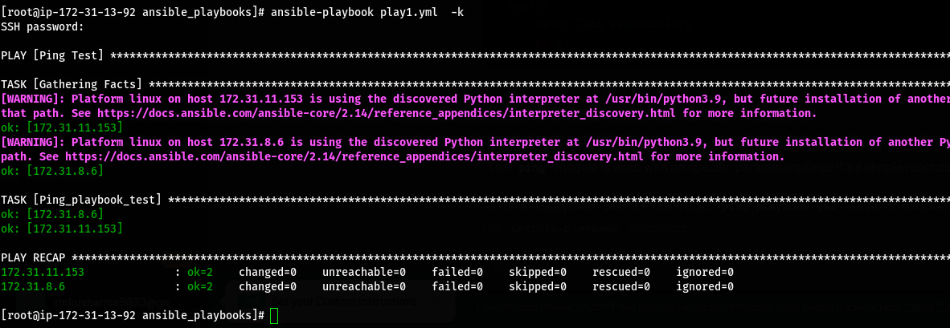

Slide 4
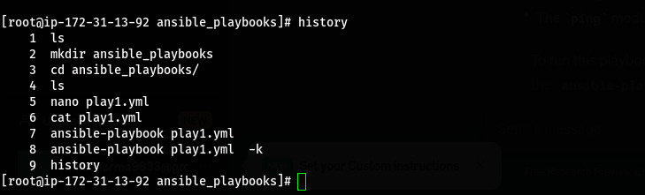

Slide 5
THANK
YOU

