Slide 1


A
MINOR PROJECT
ON
ANSIBLE INSTALLATION AND PING MODULE
BY
RINKU SHARMA
TO
ASHISH MITTAL SIR

Slide 2

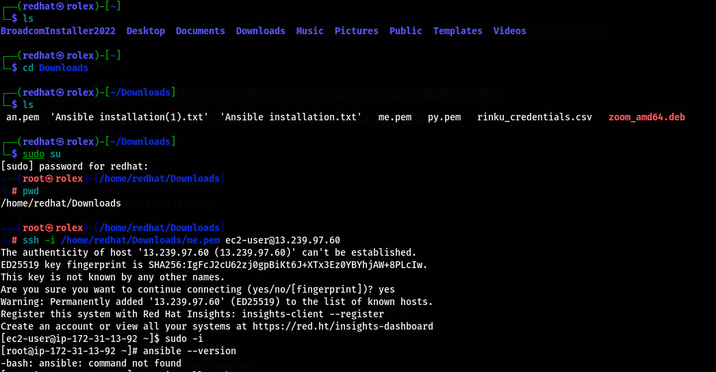
INSTALLING ANSIBLE
Step1: go to aws console and launch a redhat instance
Step2: now connect the instance via ssh
Step3: after the connecting the instance check the ansible is present or not if not follow my command

Slide 3
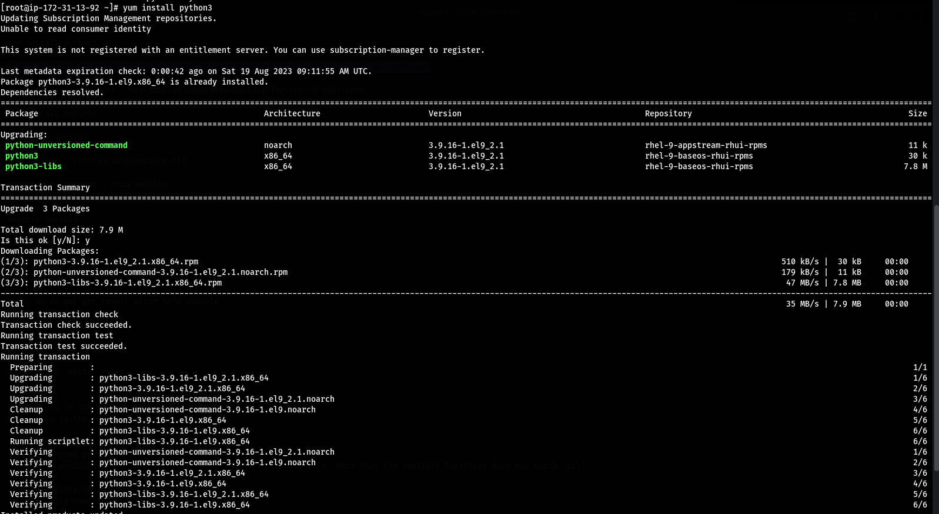
Install python 3

Slide 4
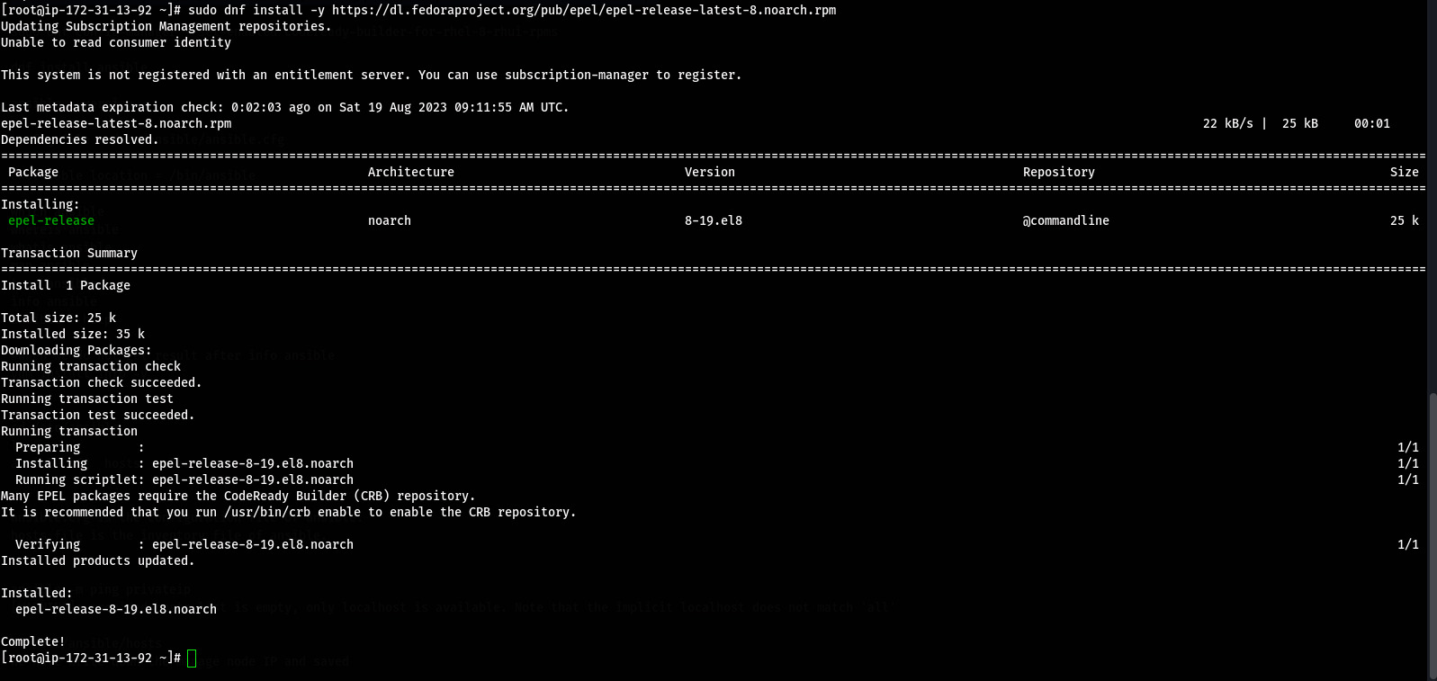
Run following cmd : sudo dnf install -y https://dl.fedoraproject.org/pub/epel/epel-release-latest-8.noarch.rpm

Slide 5

Run cmd: sudo dnf config-manager --set-enabled codeready-builder-for-rhel-8-rhui-rpms

Slide 6
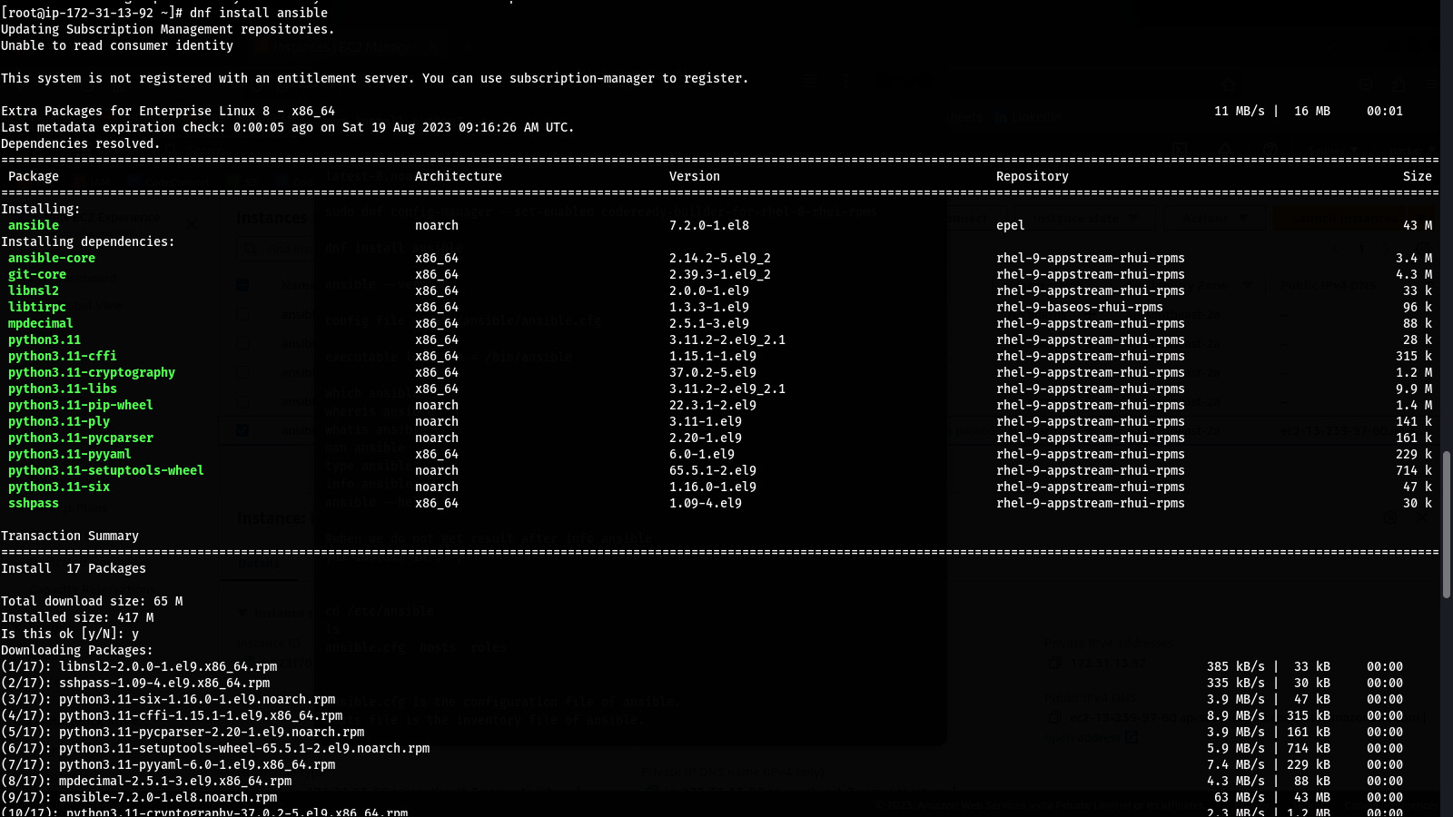
Run : dnf install ansible

Slide 7
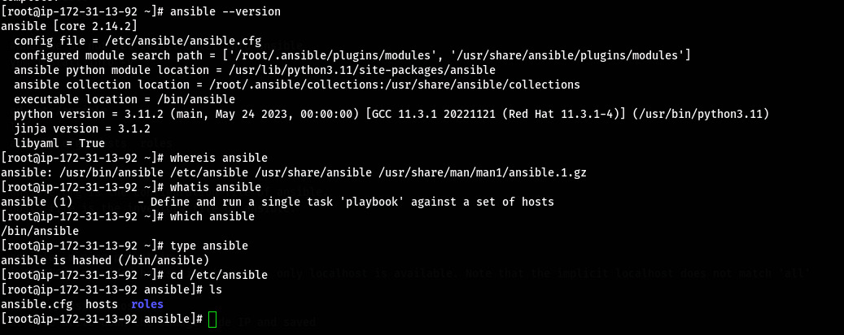
Check version: ansible –version
Also check the ansible location inventory file and configure file

Slide 8
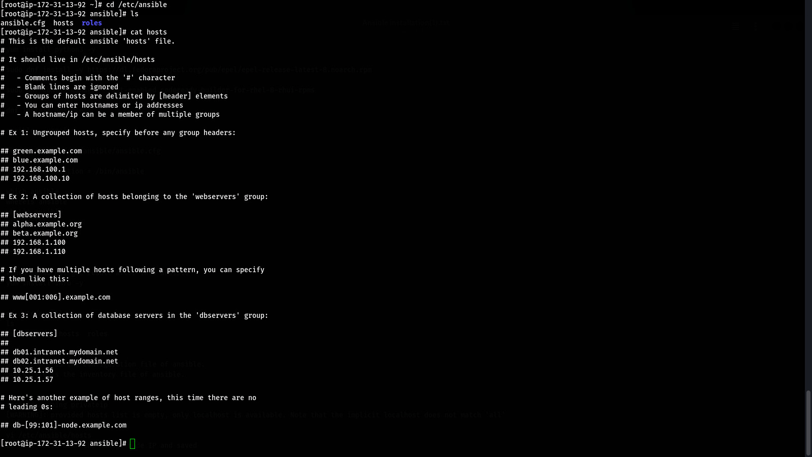
Check the content of hosts

Slide 9
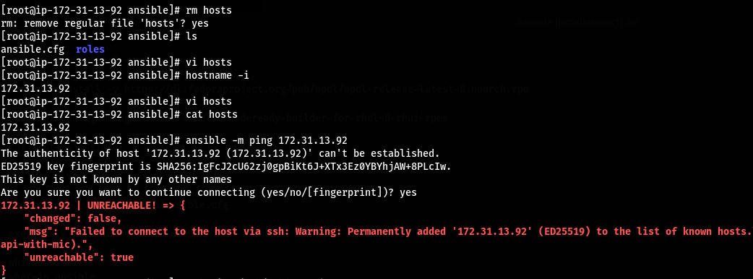
Delete the hosts and create new hostsfile and add the instance you to managed
Now use the ping module to check the following iup or server is working or not
Run : ansible –m ping ip_of_instance
Below we get error because we could not set the password on instance
Firstly setr the instance password then ping

Slide 10
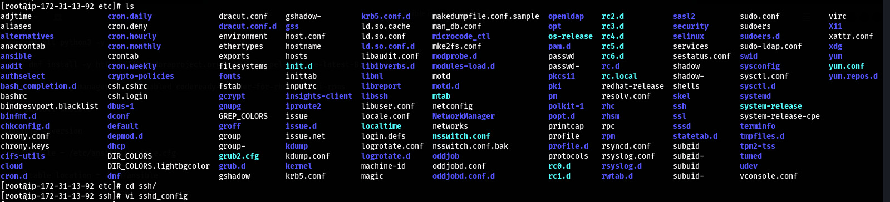
Go to location /etc/shh
Then open sshd_config

Slide 11

We find the password authentication decomment and save it

Slide 12
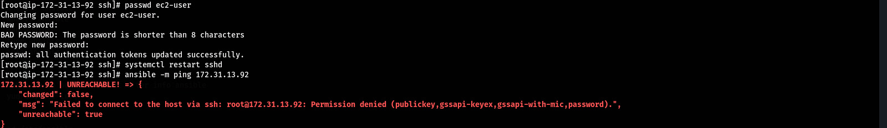
Set password
Run : passwd user_name
After the setting password is done ping the ip and we get an error because we does not give the user int ping module

Slide 13
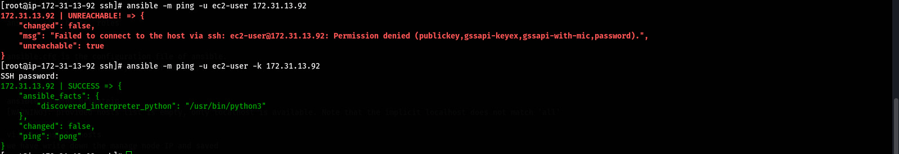
Giving the user authentication
Run : ansible –m ping –u user_name ip
We get error because we can’t give password authentication
Run: ansible –m ping –u user_name –k ip
Now
We success to ping the other instance using ping module

Slide 14
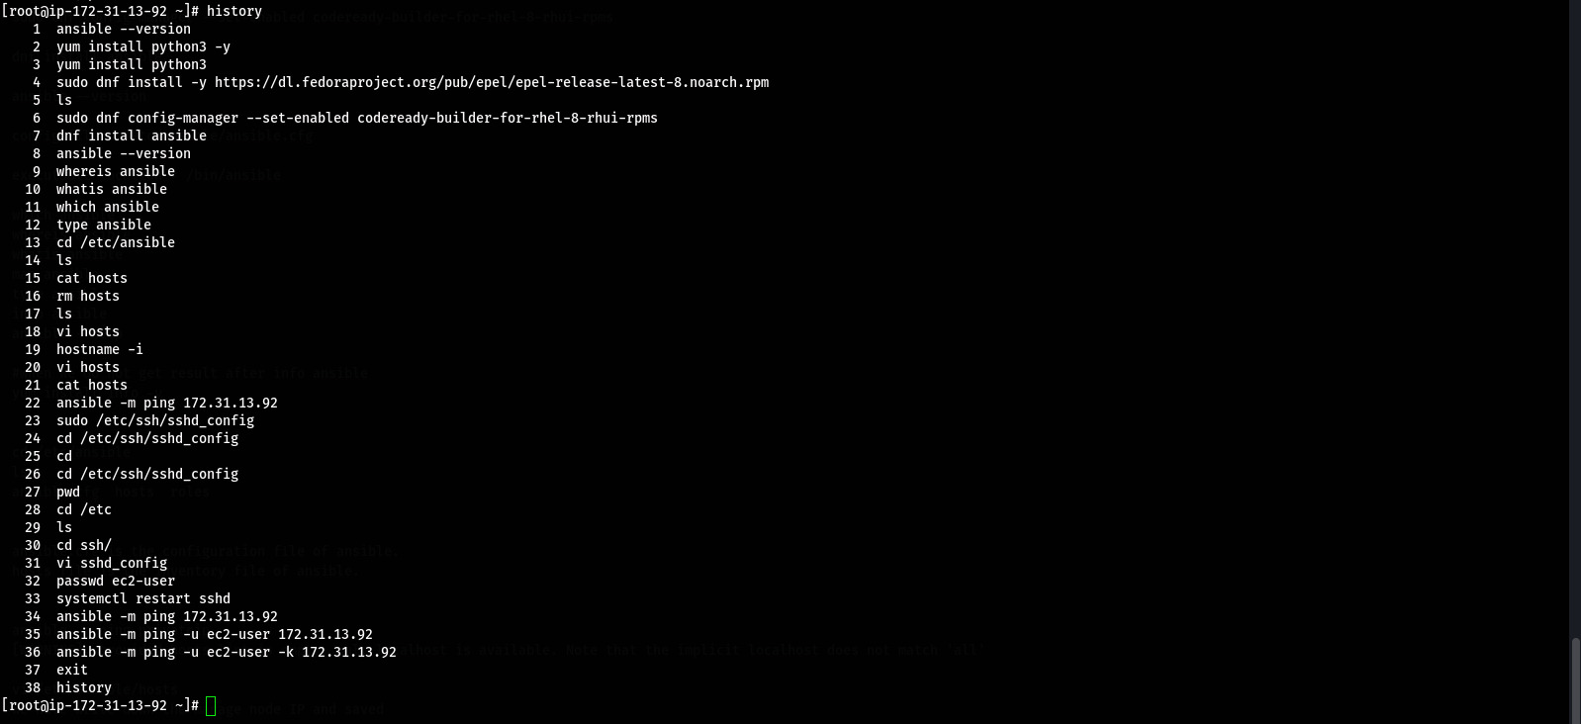
Command we use

Slide 15
THANK
YOU

