Slide 1

A
PRESENTATION ON
ANSIBLE
“group” MODULE
BY
RINKU SHARMA
TO
ASHISH MITTAL SIR

Slide 2
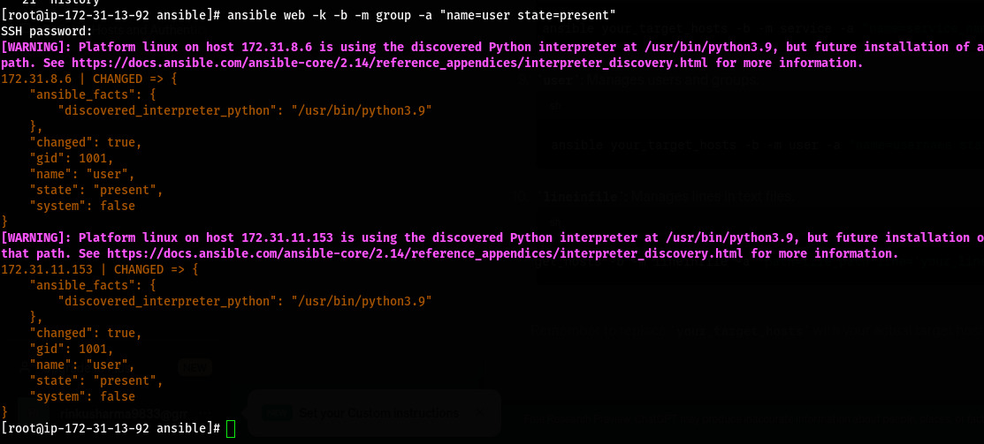

Slide 3
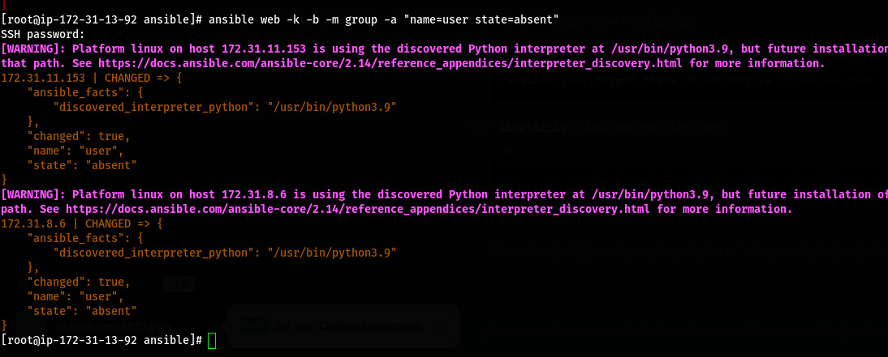

Slide 4
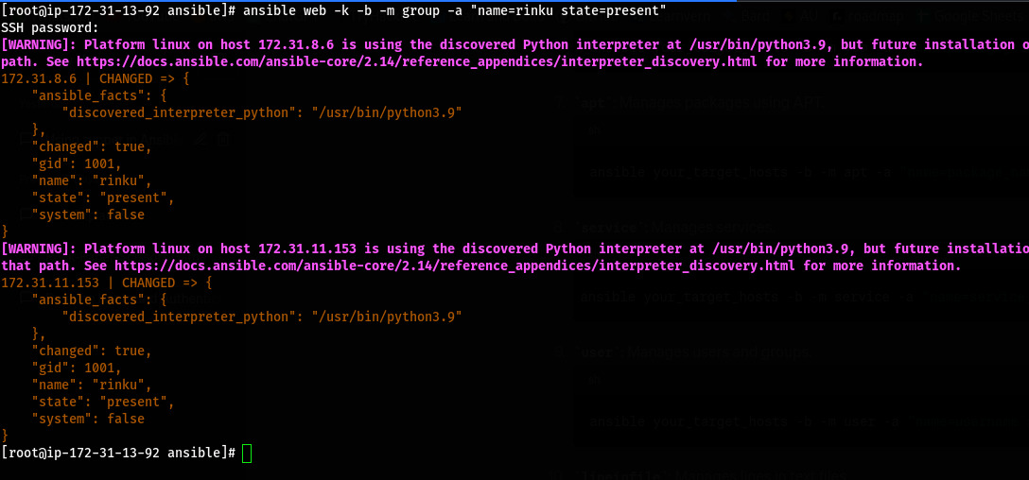

Slide 5
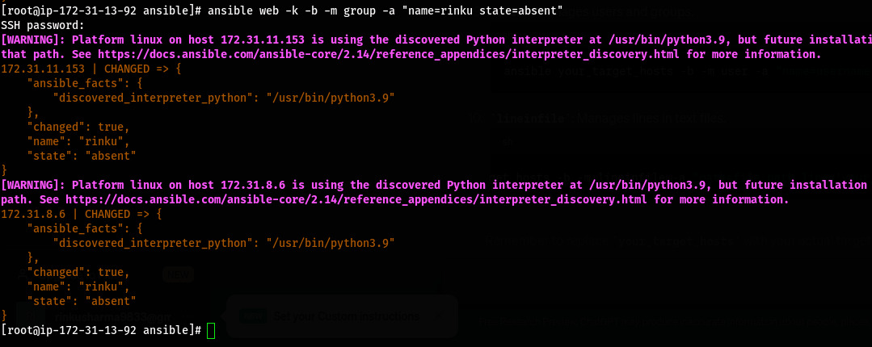

Slide 6
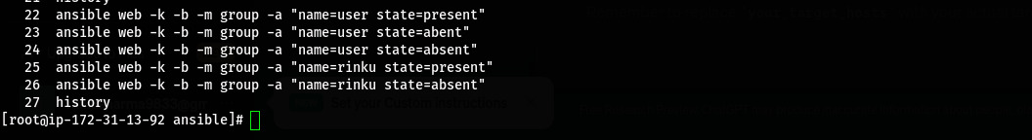

Slide 7
THANK
YOU

