Slide 1
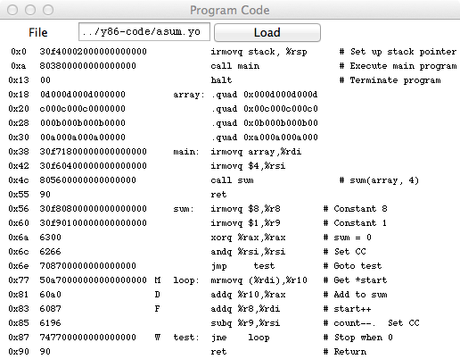
Control
Assembly
code
Object code
Currently executing instructions

