Slide 1
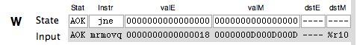
Current state
Register inputs

