Slide 1
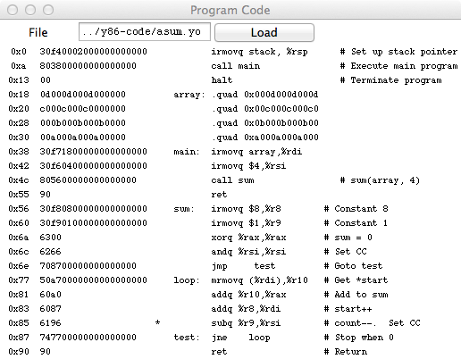
Control
Assembly
Code
Object code
Currently executing instruction

