Slide 1
Teaching an old dog new tricks: modernizing gsDesign
August 22, 2019
Keaven M. Anderson
R in PhRMA,Cambride, MA

Slide 2
Abstract/Overview
The gsDesign package for group sequential design is widely used with >30k downloads.
The package was originally written in 2007 with substantial documentation and Runit testing created before 2010.
A Shiny interface was created to make the package more approachable in about 2015.
Recent efforts have focused on updating package to use Roxygen2, pkgdown, covr/covrpage and testthat as well as changing vignettes from Sweave to R Markdown.
The learning curve for this modernization will be discussed as well as usage in a regulated environment.

Slide 3
Acknowledgements
Metrum Research Group
Devin Pastoor (presenting at 2pm)
Harsh Baid
Jonathon Sidi
Shiny interface: John Lueders
Revolution Computing (now part of Microsoft) – 2008-09
William Constantine (code review and adds)
Rich Calaway (documentation updates)
Merck
Yilong Zhang (Regulatory R preparations)
Many other gsDesign users
Testers of gsDesign vs other group sequential software
Scott Emerson
Gernot Wassmer
Vlad Dragalin

Slide 4
Shiny user interface at https://gsdesign.shinyapps.io/prod/
Exposes primary uses of design of clinical trials
Often easier to use than wading through help files
Generates code
Easy to document/save/reproduce designs
Biggest current shortfall: updating designs at time of analysis (2019 challenge!)

Slide 5
Help file conversion: .rd to Roxygen2
Original help files written prior to Roxygen2, R Markdown
Metrum: hard work + automation
I am very happy I didn’t have to do it!
sinew package
https://metrumresearchgroup.github.io/sinew/
“Sinew is a R package that generates a roxygen2 skeleton populated with information scraped from the function script”
“automate nearly all of the manual tasks needed to document functions”
Result enables construction of webpages using pkgdown
https://pkgdown.r-lib.org/articles/pkgdown.html
“The goal of pkgdown is to make it easy for package developers to make elegant and useful package websites”

Slide 6
iopages: Documentation website built by pkgdown
Documentation now available through browser: https://keaven.github.io/gsDesign/
Help files organized by topic area
Navigation through help information vastly improved
Vignettes:
Updates in progress
Test coverage using covrpage (in vignettes)
Badging
Builds (Travis-CI, Appveyor)

Slide 7
Unit testing/coverage
Conversion from RUnit to testthat
Use of covrpage to document coverage
803 tests
Inputs
Stress tests
Overall coverage low
Group sequential bounds and crossing probabilities are key calculations
Testing many known published results
Testing vs. expected results for other cases
Little unit testing coverage for time-to-event sample size
However, nSurvival() and nSurv() programmed independently; results have also been checked vs independently programmed SAS macro
Recent addition
Sequential p-values – coverage > 90%

Slide 8
github continuous integration
https://github.com/keaven/gsDesign
v 3.0-5 is latest release
Minor update from CRAN 3.0-4 release
Sequential p-values
Spending time vs information time
Major update in terms of continuous integration
Build checking
Travis-CI (most OS)
Appveyor (Windows)

Slide 9
“Regulatory R”
Secure environment
Controlled software access
All users on a project are using a common software environment
Controlled data access
General system components
Linux
RStudio
Pro
Package Manager
Connect
Key requirements
Reproducibility
Reliability
Trusted packages
Output validation
Enable innovation!

Slide 10
“Regulatory R”: Package libraries under consideration
Low risk
R Foundation, tidy
Intermediate risk
gsDesign may fall here?
Extra validation may be required for output
Open risk
For primarily for non-regulatory use
enables access to a controlled CRAN library for innovation
Used under exception for regulatory purposes?

Slide 11
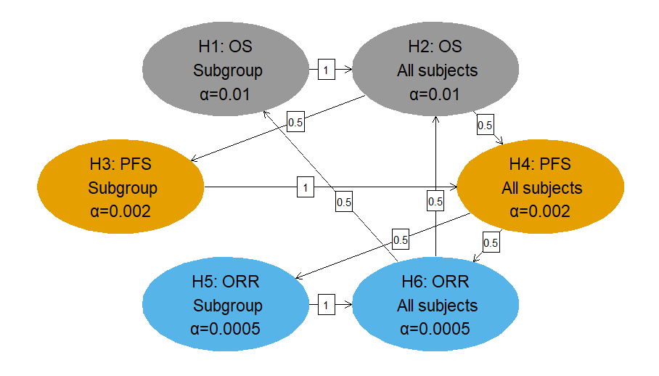
Example gsDesign use: group sequential design with graphical multiplicity methods

Slide 12
Group sequential design with graphical multiplicity methods Need for automated evaluation in pre-written R Markdown doc
User input
Specify group sequential designs (gsDesign)
Specify multiplicity graph (gMCP)
Input interim or final results
Could be simple outputs from SAS or compute tests in R
Initial evaluation
Compute sequential p-value for each hypothesis (gsDesign)
Plug sequential p-values into graph (gMCP)
Report out rejected hypotheses (gMCP)
Confirmation of hypothesis rejection
Report out sequence of rejections (gMCP)
Report max alpha allocated to each hypothesis (gMCP)
Compute group sequential bounds for max allocated alpha for each hypothesis (gsDesign)
Confirm hypotheses rejected and not rejected vs results
Produce summary table of conclusions for Data Monitoring Committee (R Markdown)

Slide 13
Group sequential design with graphical multiplicity methods Regulatory R needs
Base R
tidy R
gsDesign
gMCP

Slide 14
Summary
gsDesign can enable innovation in clinical trial design and analysis
Value in having a ‘regulatory ready’ version of package
Depending on requirements, this can be a non-trivial investment!

Slide 15
Thank you
Questions?

