Slide 1
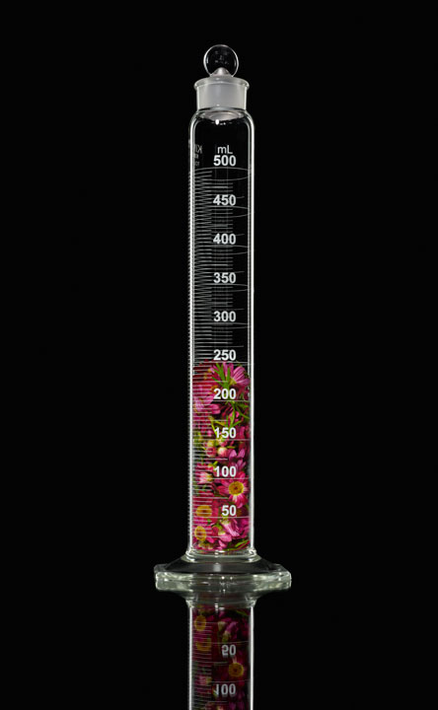

Democratizing NLP search through I2E and R Shiny
Abhik Seal PhD
Senior Data Scientist (Cheminformatics and NLP)
Data Science and Informatics
AbbVie Inc. North Chicago ,IL
8/23/19
Harvard University

Slide 2
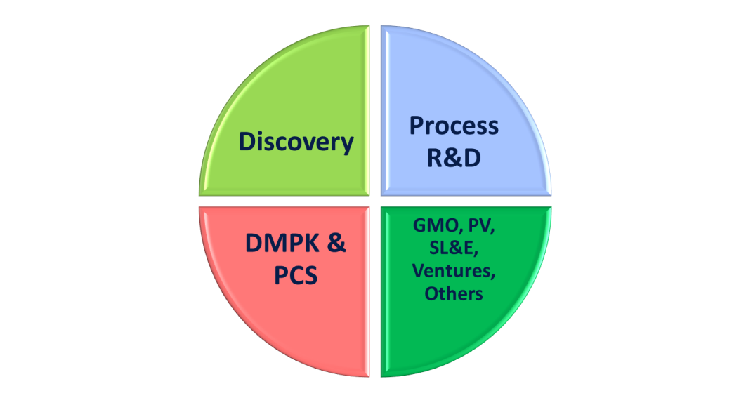
Who Am I
Education
(2011-2016)
Indiana University ( PhD in Cheminformatics )
AbbVie (2016)
60% of the work I do is with R
Machine Learning
Caret,MxNet,h2o,
Viz
visJs,ggplot2,gplots
Text
Mining
Text2vec,udpipe,
tm
Cheminformatics
Fingerprints
Fragments
Jaccard (tanimoto)
Natural Language Processing
Word2vec
Ngram
Dice , TF-IDF
Web
Shiny,
Rapache ,plumber
Twitter : @abhik1368
Email: abhik.seal@abbvie.com

Slide 3
Acknowledgements
AbbVie Information Research Group
Rishi Gupta
Ravishankar Kondin
Sabrina Wollenhaupt
Brian Martin
Philip Hajduk
Linguamatics I2E
Constantinos Katevatis
Marco Vicente
Clinical Pharmacology and Pharmacometrics AbbVie
Dwaipayan Mukherjee PhD
rinpharma Organizing Committee
Developers Shiny,Reticulate,data.table,Profvis,
Rconnect Enterprise.

Slide 4
Outline
Background
Introducing I2E
Pharmacokinetics and Pharmacodynamics Text Mining Case Study
Developing R shiny web Portal

Slide 5








Questions we need to get answered in Drug Discovery
What are the protein targets involved?
Which companies are patenting what technology?
What are the safety risks of drugs similar to mine?
How people are comparing my product with others?
What common factors are shared by patients requiring rehospitlization?
Idea
Basic
Research
Clinical Trials
Phase 1
Phase 2
Phase 3
Regulatory
Approval
Patient Care

Slide 6
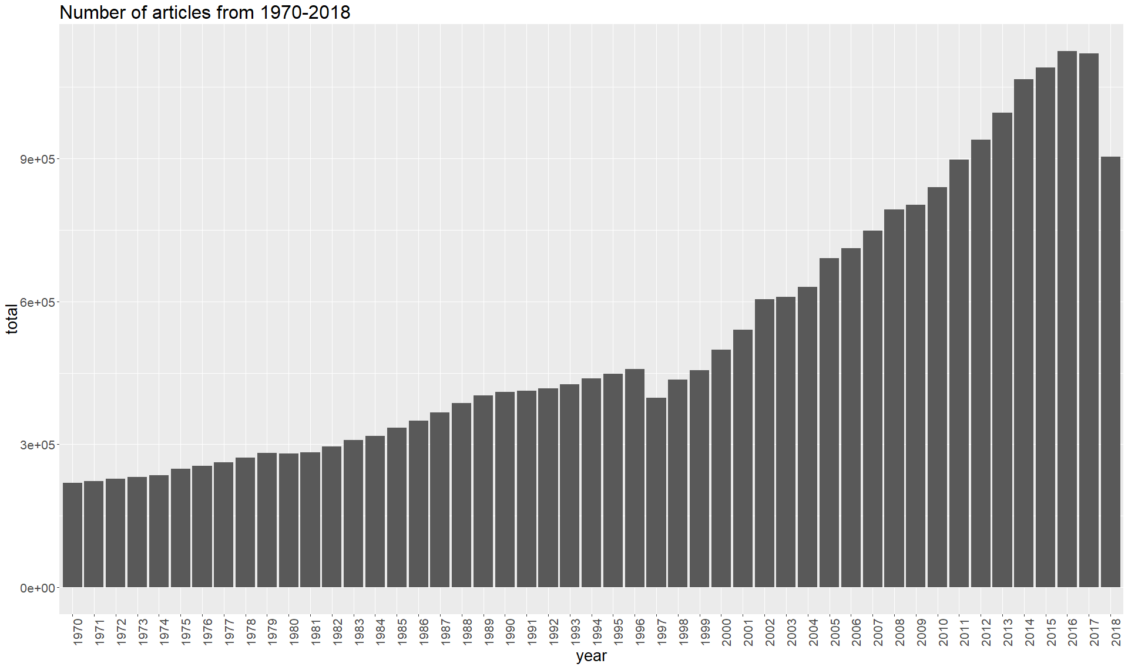
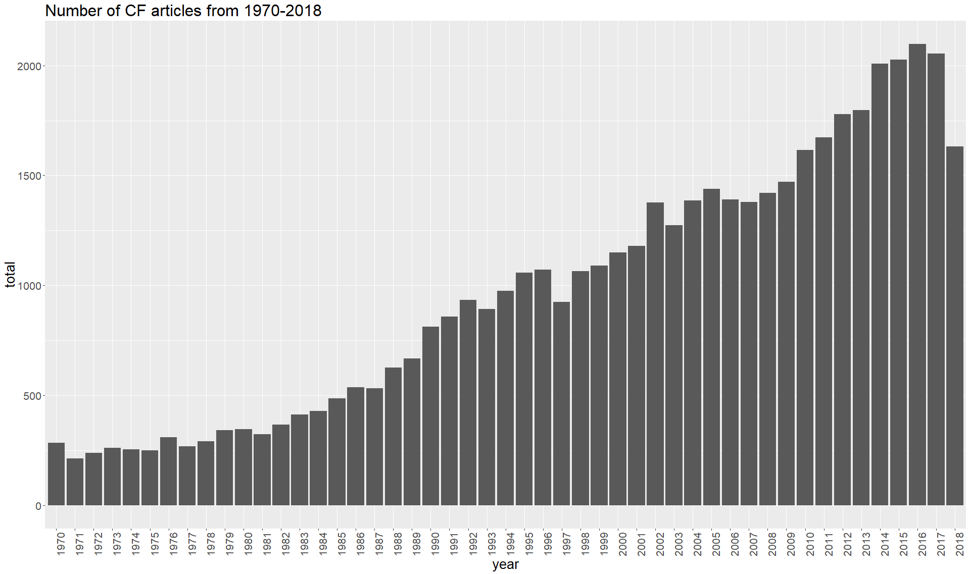
Most of these answers are available in text documents.
Every Increasing amount of text data …

Slide 7
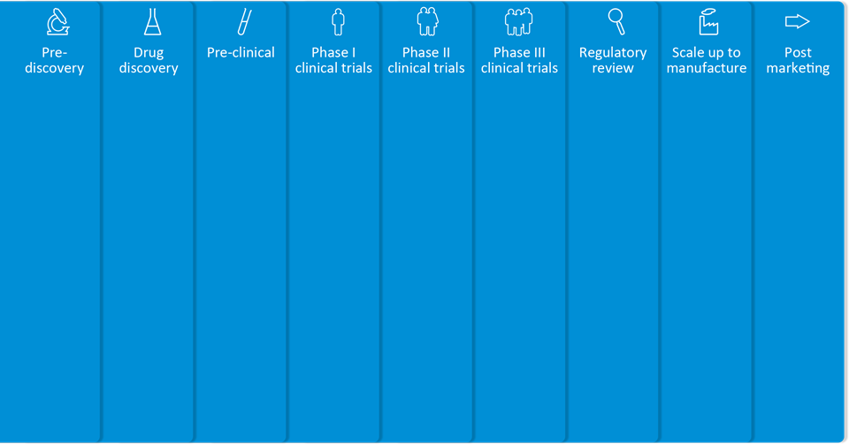
Advanced text analytics delivers value
From bench to bedside, NLP transforms text for decision support
Gene-disease mapping
Precision Medicine Research
HEOR
Target ID/selection
Trial site selection and study design
Regulatory MDM,
IDMP
Pharmacovigilance
Toxicity analysis and prediction
Safety
Competitive intelligence
Mutation/expression analysis
SAR
Real World Evidence
Biomarker discovery
Comparative Effectiveness
Drug repurposing
KOL identification
Voice of the Customer analysis
Patent analysis
Opportunity scouting
Social media analysis
Notes:
This slide gives you a flavour of all the different areas where our customers have utilised Linguamatics NLP to get better value from unstructured text, from early on in drug discovery looking for gene-disease mappings, target selection, biomarker discovery, or for safety aspects (both clinical & preclinical) right through to post-market activities such as pharmacovigilance, or competitive intelligence.

Slide 8
Challenges in Unstructured Data
Different word, same meaning
cyclosporine
ciclosporin
Neoral
Sandimmune
Different expression, same meaning
Non-smoker
Does not smoke
Does not drink or smoke
Denies tobacco use
NLP
Different grammar, same meaning
5mg/kg of cyclosporine per day
5mg/kg per diem of cyclosporine
cyclosporine 5mg/kg per day
Same word, different context
Diagnosed with diabetes
Family history of diabetes
No family history of diabetes

Slide 9

Ontologies
Sentence2vec
Word2vec
Name Entity Recognition

Slide 10
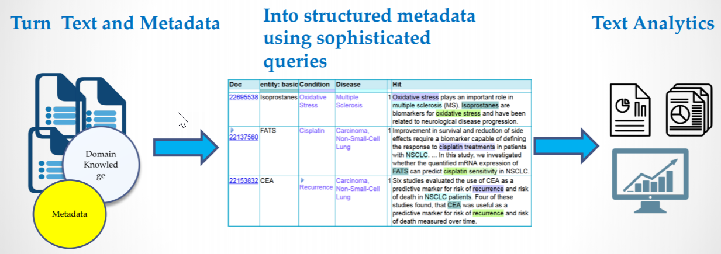
Linguamatics I2E Transforms Text into Actionable Insights

Slide 11
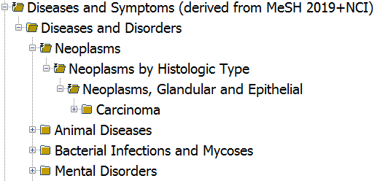
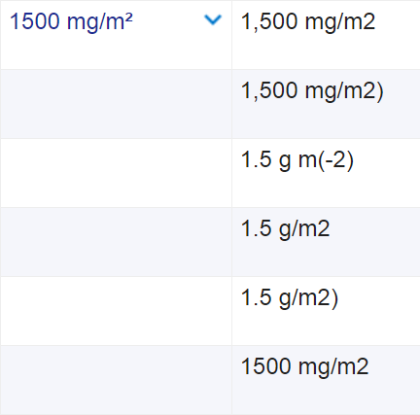
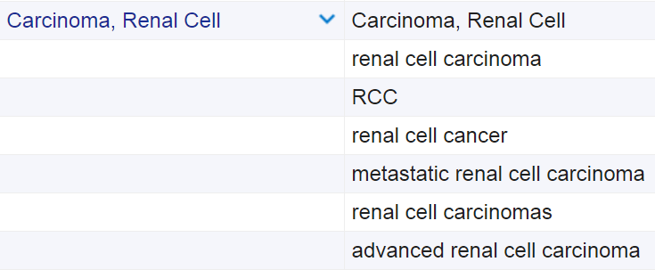
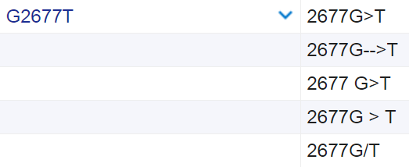
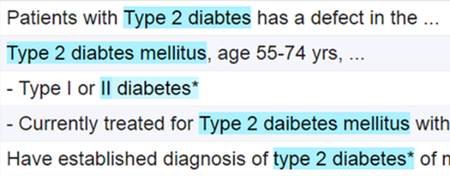
Normalization
Ontologies → language
Pattern ontologies → date, emails, TNM, etc. → measurements → mutations
Spelling correction, accents, OCR errors, etc.
Conjunctions

Slide 12
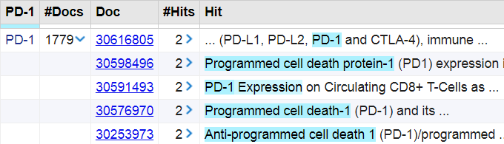

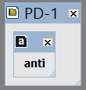
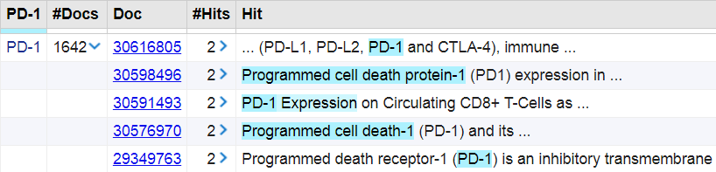
Negating (removing) terms
Removing unwanted context
Querying for PD-1 occurrences can bring back mentions of antibodies
Can be removed by negating prefix ‘anti’

Slide 13
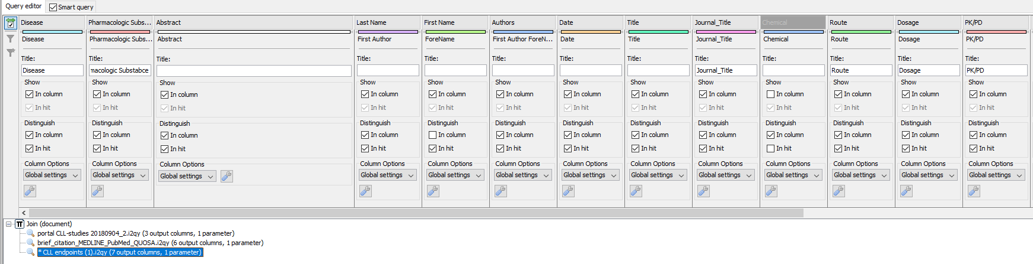
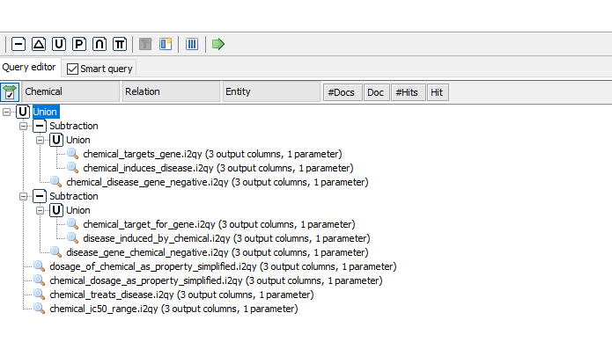
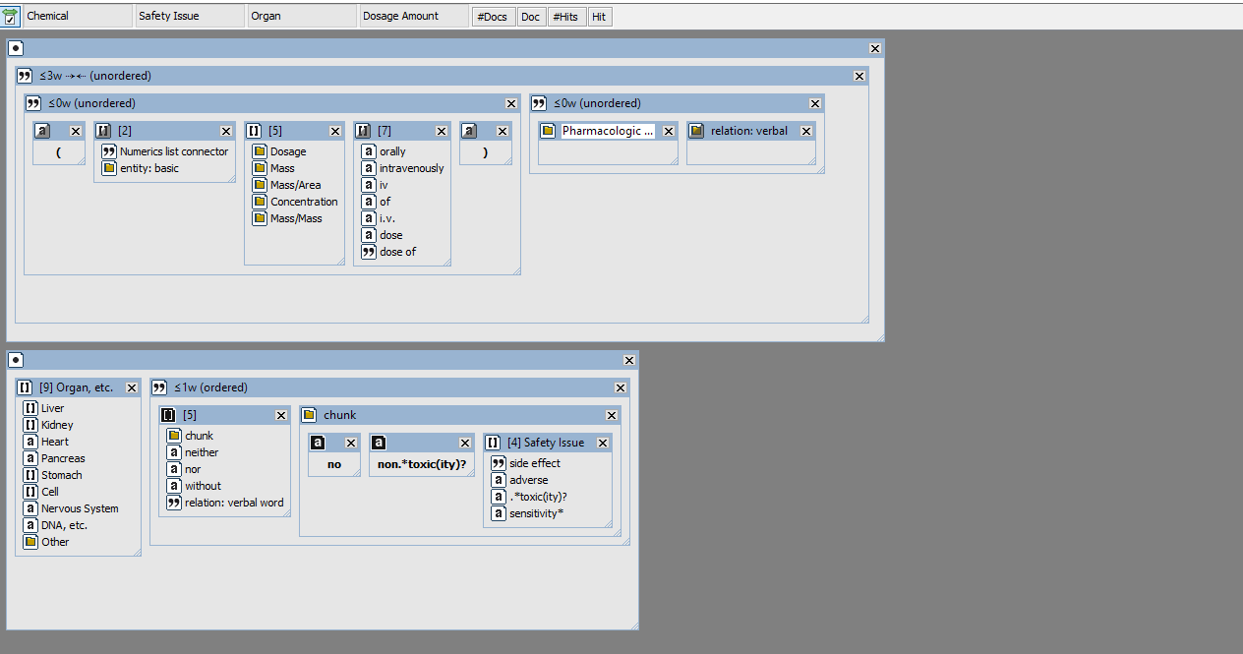
I2E Interface

Slide 14
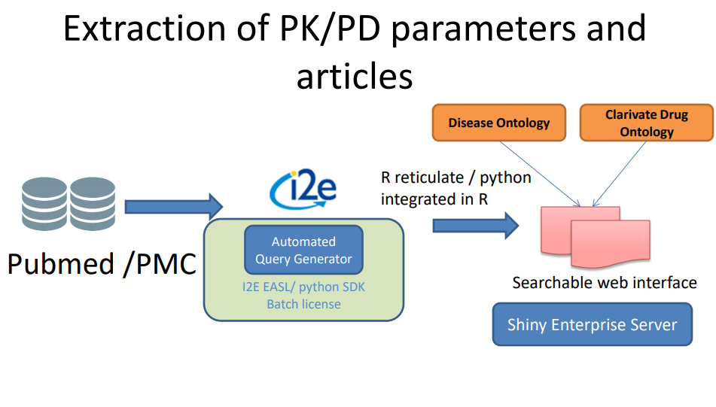
Technology and Current Workflow
Calling Python Objects in R
Formatting data
Yaml package

Slide 15
PharMine
Pk/PD Mine
Search through Pharmacokinetic and Pharmacodynamic Data from pubmed
GenoMine
Explore Gene Disease relationships from Pubmed
PPI-Mine
Explore Disease Protein Protein Interactions from Pubmed.
Marker Mine
Tox-Mine
Explore Disease BioMarkers associated with Diseases pubmed.
Search using chemical names and Tox related data from Pubmed and indentify tox organs and doses
Pharmine : AbbVie pharmaceutical text mining platform

Slide 16
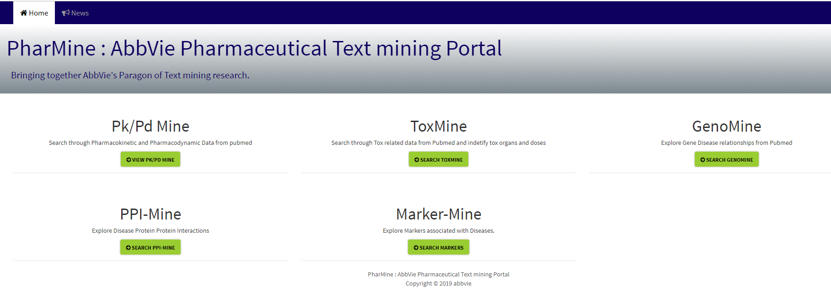
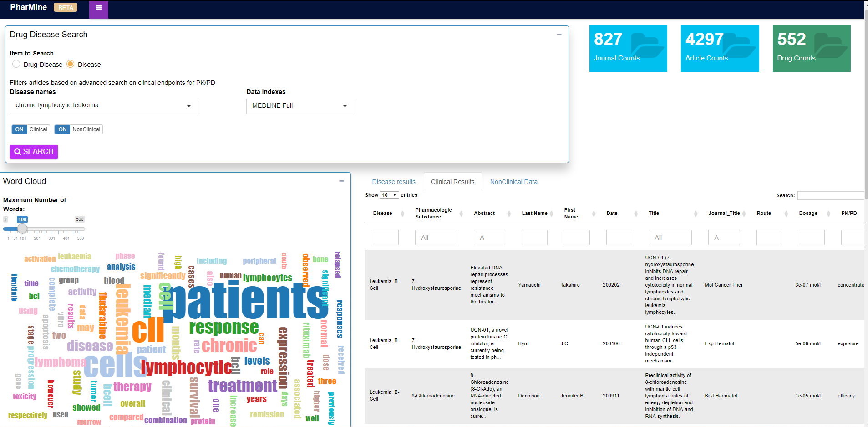
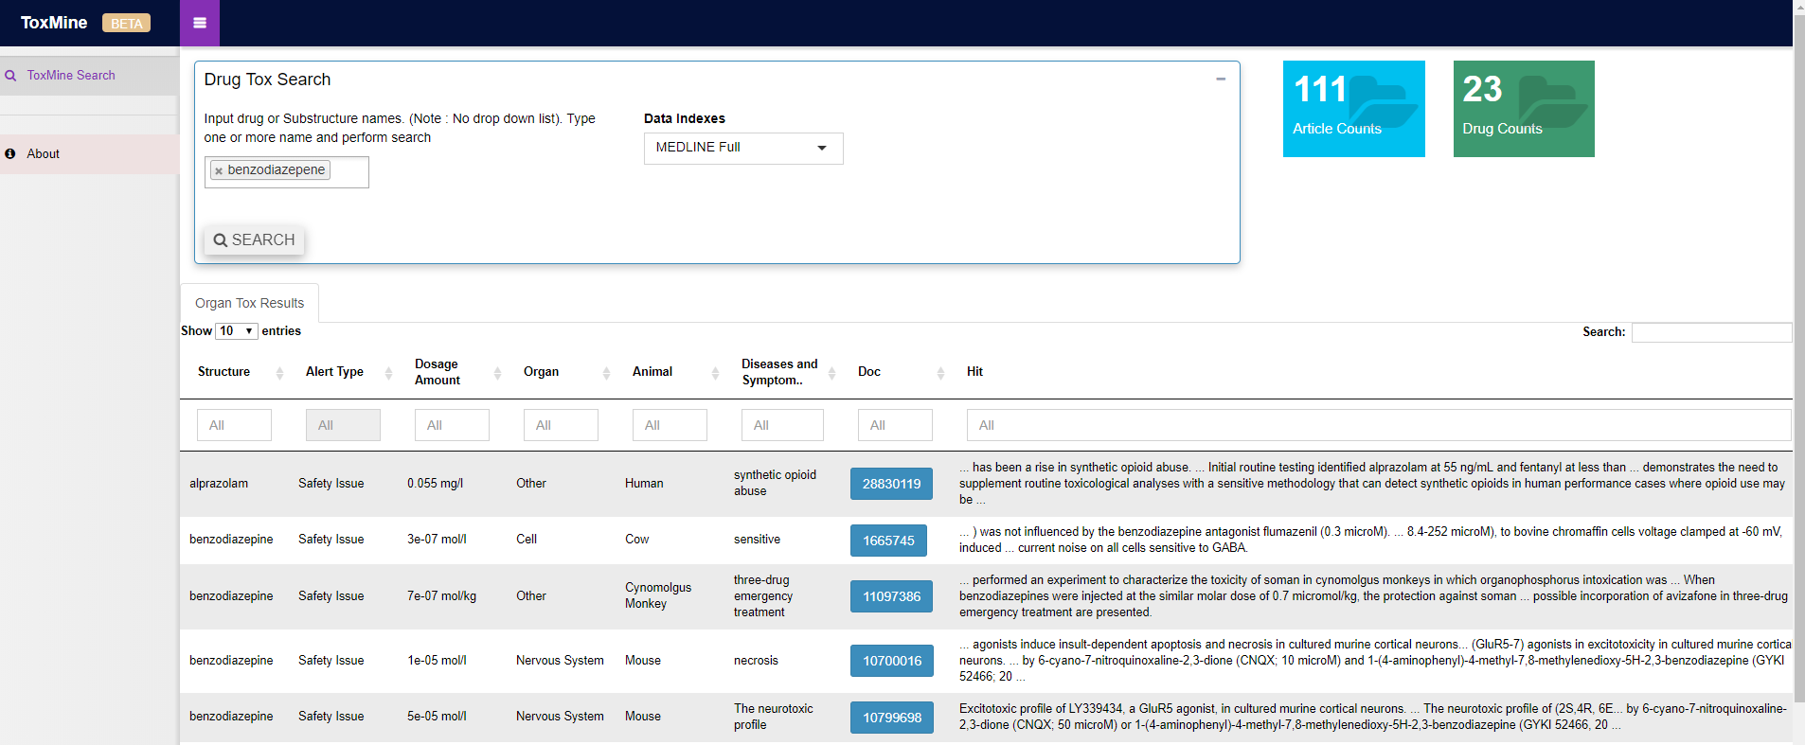
Interface

Slide 17
Pharmacokinetic and Pharmacodynamic Case Study Use Case

Slide 18
Semiautomatic Extraction of PK/PD parameters using I2E
Relevant parameters like pharmacokinetic/- dynamic (PK/PD) values are cumbersome to retrieve by classic search methods in abstract databases
Curated drug databases can offer structured and high quality information on selected drugs but need to consider multiple databases.

Slide 19
Pk-PD USE CASE
Disease background search
Parameter search
Disease overview
Clinical endpoints
Existing therapies
Known mechanisms
Biomarkers
Look for a particular parameter value
Data supporting the estimation of parameter value
One platform designed for the end-user
Model search
Data search
Existing mathematical models for same or similar disease
Clinical data
Animal data
Cell-level data
Proteomics data
Genotype data
“Slide courtesy: Dwaipayan Mukherjee, CPPM”.

Slide 20
Extraction of PK/PD parameters
Potential Applications:
Identification of set of terms for extracting PK/PD parameters using drug and disease names.
Searching for all drugs / pharmacological substances for a particular disease.
Entities to be extracted:
Administration and route (Dosing)
Subject demographics
Pharmacokinetic parameters
Pharmacodynamics
Race
Subject type
Relapse/Refractory/Remission/Survival

Slide 21
Current State and New Web Based Platform
Pros | Cons
Wider search Already indexed articles and book chapters Proprietary relevance matching Fine-tuned results based on functional need Mining relevant parameters and presenting them Full text mining solution a possibility | Huge quantity of results Requires careful sorting and selection Processing time higher due to indexing on the go for full text Requires testing and stability assessments
“Slide Courtesy: Dwaipayan Mukherjee, CPPM”.

Slide 22
Translating Pros and Cons to Requirements
Extract data (entities) using web based application than using Google or other approaches
All publications with basic information
Clinical data
Pre-Clinical data
Allow searching for various combinations of Drugs, Disease and Targets
Provide smart search and charting capabilities
Extend the platform to capture other unstructured data

Slide 23
Pk/PD Mine Search Platform
Drug and/or disease name search
Separate tabs for clinical and pre-clinical data
Word cloud (helps in filtering results)
Tabulated list of relevant parameters (saving scientists time
“Slide Courtesy: Dwaipayan Mukherjee, CPPM”.
Complete web based tool with additional full text mining features would save scientists significant time in performing literature review

Slide 24
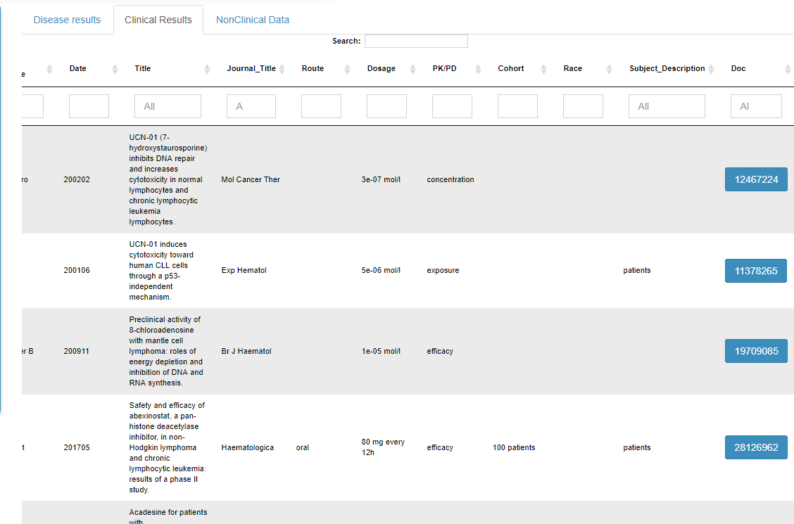
Snapshot of Results
Dose
Cohort
Race
Route
Pk/Pd

Slide 25
Are we done? challenges still exist…
•“Rifampin significantly (P<.0001) increased the systemic and oral clearance of midazolam from 0.44+/− 0.2 L. h/kg and 1.56 +/− 0.8 L x h/kg to 0.96 +/− 0.3 L x h/kg and 34.4 +/− 21.2 L x h/kg, respectively.”
•Concomitant administration of chlorthalidone appears to have little if any effect on the pharmacokinetics of atenolol during treatment for 7 days. The atenolol elimination half-lives were 6.7 +/- 1.1 and 6.3 +/- 0.9 h, respectively, with and without chlorthalidone.

Slide 26
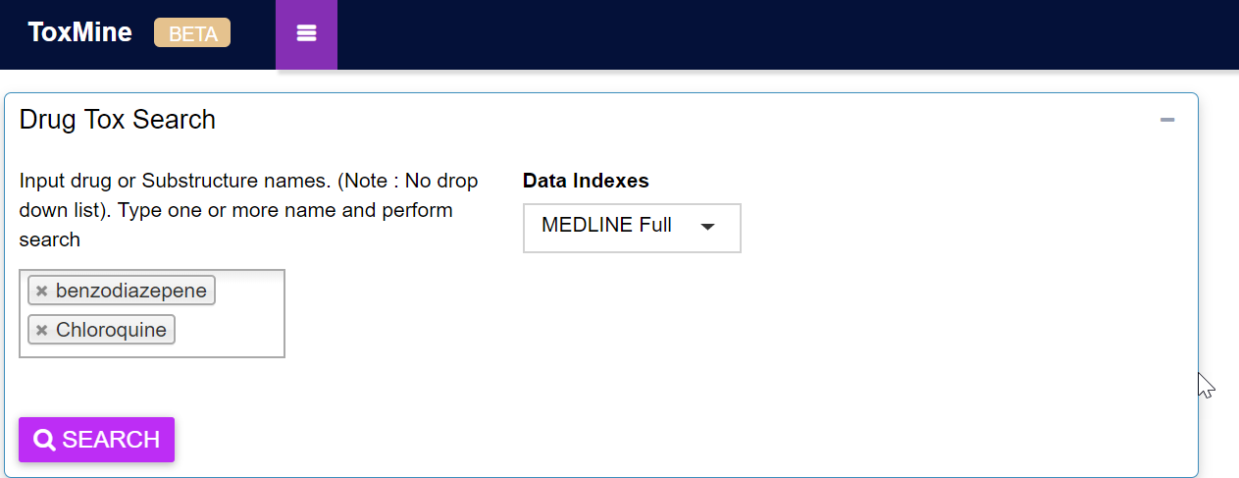
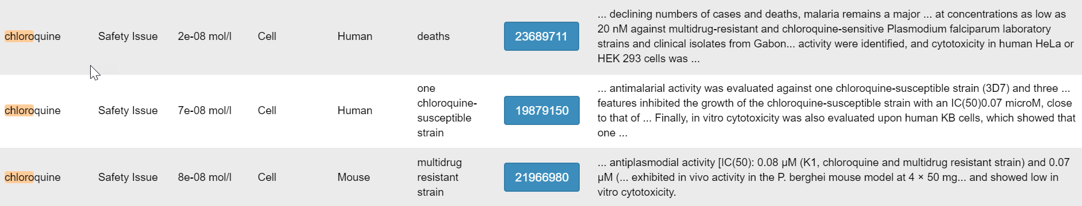
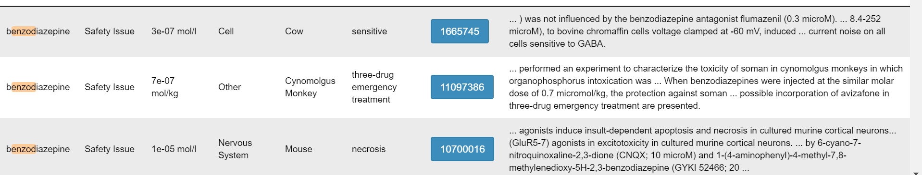
Tox-Mine Search
ChEBI and NCI compound Ontology
Dosage
Organ System
Species
Tox Type

Slide 27
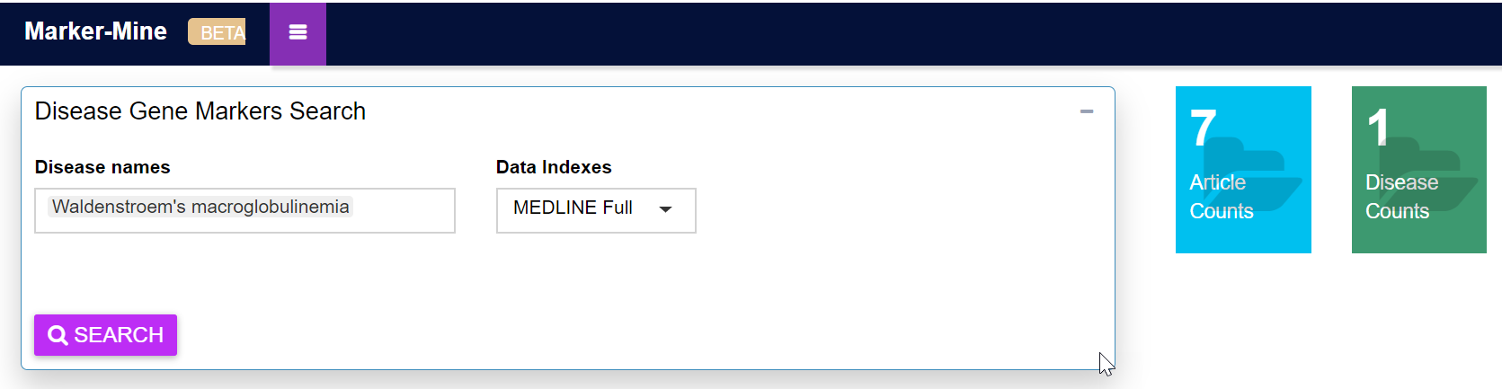
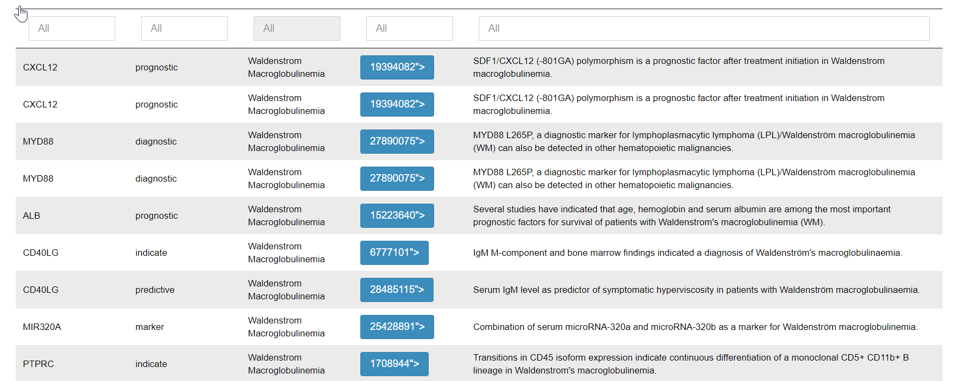
Marker-Mine Search

Slide 28
Summary
Working to continuously improve the platform
scientific improvement with query optimization
infrastructure improvements with on the fly visualizations .
Language based SDKs (Python) help to automate the queries and also can be leverage to develop custom portals .
Future Work
Mining Full text Articles
Lot of anomalies exist in the creating queries for full text specifically for Pk/Pd articles.

Slide 29
Questions ?
Abhik.seal@abbvie.com

Slide 31
Backups

Slide 32
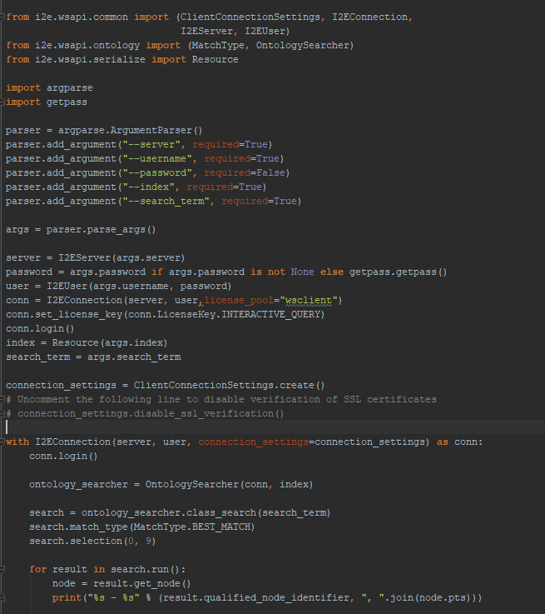
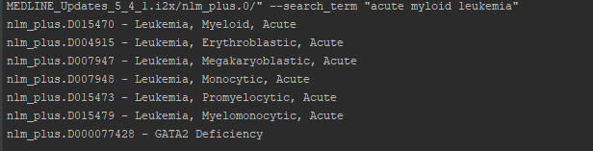
Cool Features of Python SDK
Automatically generate new queries for a given search like disease names, drug names etc.
Configure, launch, monitor , make an index ,run a query, delete query.
Spelling correction for diseases

Slide 33
Libraries from I2E
import yaml import requests from i2e.wsapi.common import I2EConnection, I2EServer, I2EUser from i2e.wsapi.common import RequestMaker, RequestConfiguration from i2e.wsapi.task import QueryConfiguration, TaskLauncher from i2e.wsapi.serialize import Resource import time import codecs import argparse import i2e.easl import sys ##################################################### username = XXXXXX
password = XXXXXX host = "https://www.i2eondemand.com/i2e/abbvie/" server = I2EServer(host) print (server) user = I2EUser(username, password) conn = I2EConnection(server, user,license_pool="wsclient") conn.set_license_key(conn.LicenseKey.INTERACTIVE_QUERY) conn.login() ###################################################### def get_chemlist(outfile,dname): multi_query = i2e.easl.parser.parse("Multi_Query_Disease_Drugs_nonclinical.i2qy") temp_query = i2e.easl.query.Query() temp_document = temp_query.root url_link1 = '/api;server=MEDLINE;type=class/virtuals/MEDLINE_Updates_5_4_0.i2x/nlm_plus.0/?search=' + dname print url_link1 response1 = requests.get(host + url_link1, auth=(username, password)) if response1.status_code == 200: for handle in response1.json()['handles'][0:1]: id2= handle.split('nlm_plus.0/')[1:2] dis_id = id2[0].encode('ascii', 'ignore').replace('/', '') dis_id = 'nlm_plus.' + dis_id print (dis_id)
Import WSAPI Lib
User information and connection
Load Query
Connect to api and print disease id

